Slide 1
LANDSCAPE DYNAMICS FROM LiDAR: features, metrics and processes
Helena Mitasova, Michael Starek, Eric Hardin
North Carolina State University, Raleigh, NC, USA
see video of a related keynote :
http://proceedings.esri.com/library/userconf/geomorphometry11/index.html
GRASS GIS

Slide 2
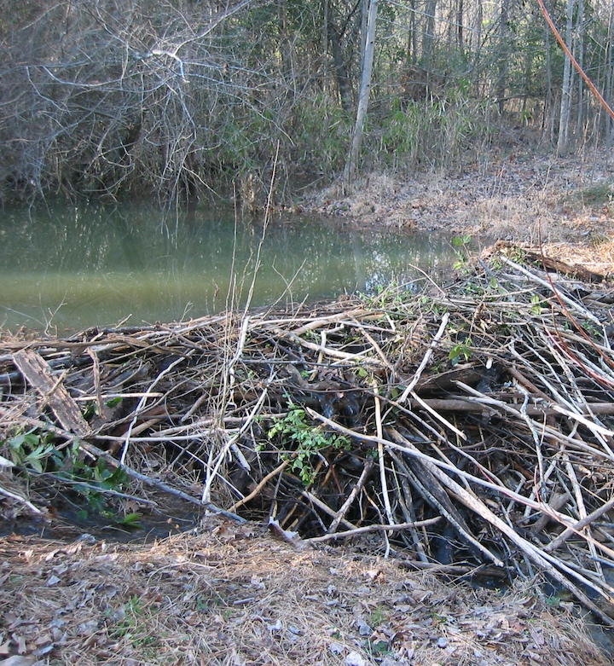
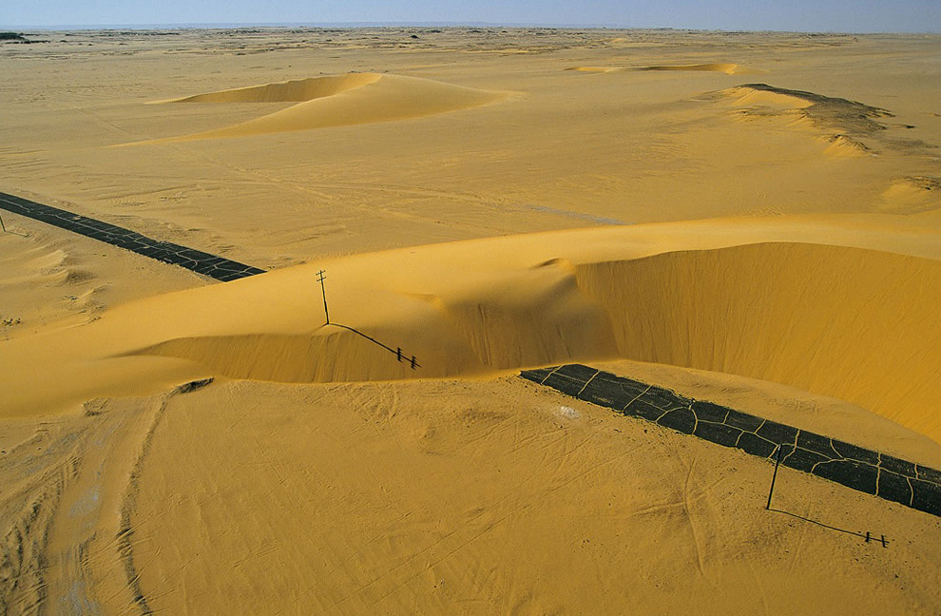
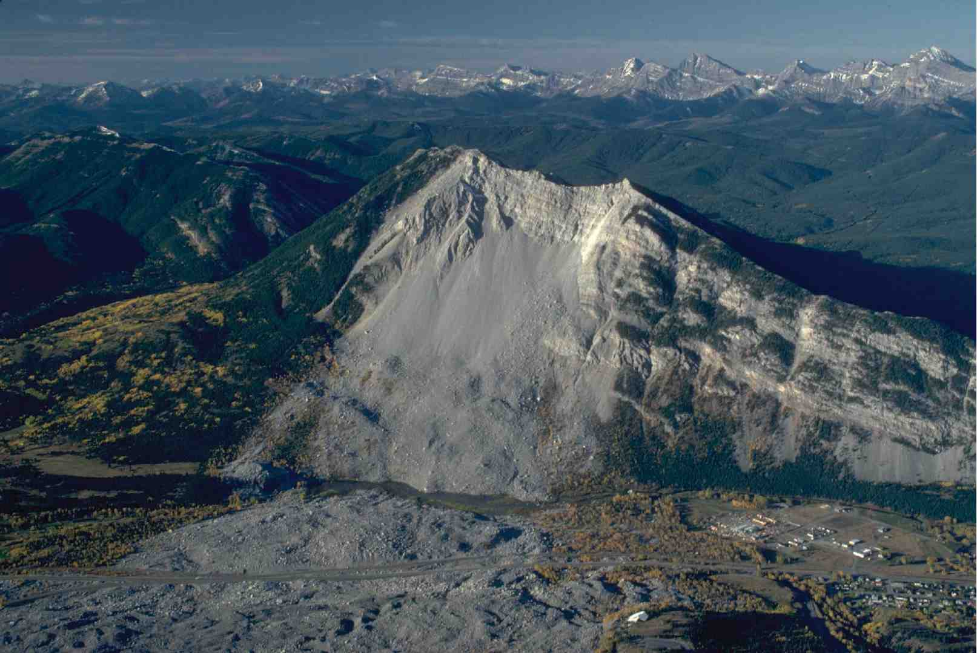
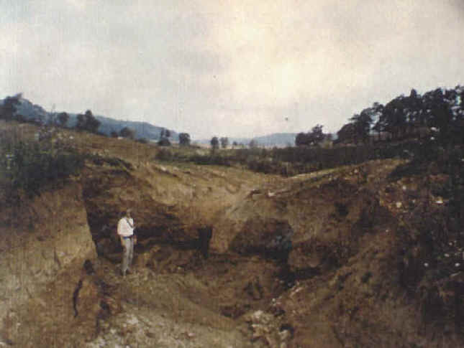
Landscape Dynamics
water, wind, gravitation, plants, animals and humans continuously change landscape surface
ocean: breach of barrier island
after hurricane Irene
animal: beaver dam
wind: migrating dunes in Egypt
gravitation: landslide
humans: dune removal
water: gully erosion at Hohenfels
mil. installation

Slide 3
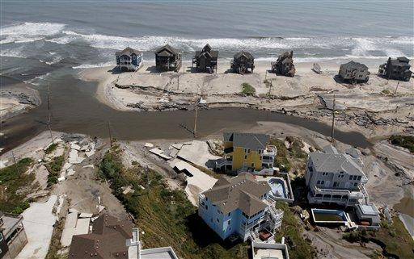
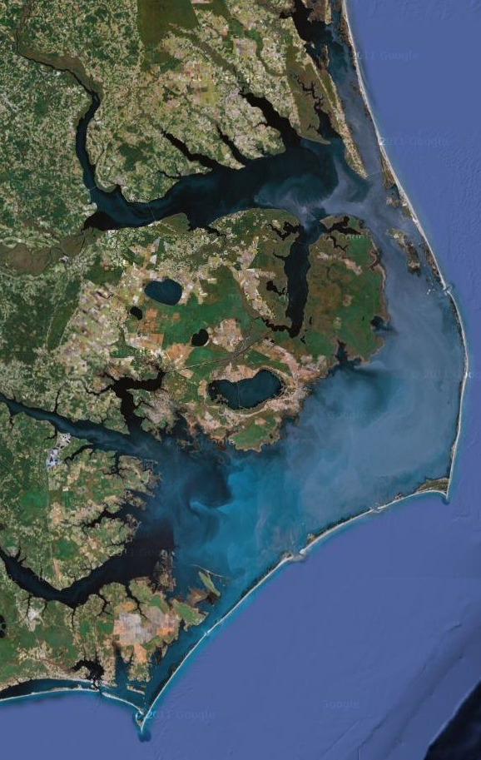
Landscape Dynamics
Land surface processes are poorly understood
our predictive capabilities are limited
decisions are often based on insufficient or obsolete information
applications that require up to date 3D terrain information and understanding of terrain change: line of sight, mobility, land management, …
Motivation for better data and better tools to extract relevant information
Modern technologies for 3D data collection: 3D laser scanning of Earth surface
50km
The most severe
Hurricane Irene damage
predicted and actual

Slide 4
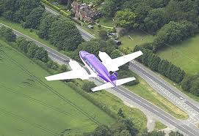
Lidar: time series and spatial scales
Repeated lidar surveys:
from static topography to dynamic landscapes
impacts of terrain change on processes
Lidar spans a range of spatial resolutions:
satellite lidar 50-100m
regional airborne lidar 0.3 – 1.0m
terrestrial lidar field surveys 0.01 - 0.10m
indoor 3D scanners 0.001-0.0001m
3D point clouds can also be acquired using digital photogrammetry
and 3D vision technology
Notes:
Repeated lidar surveys that generate a time series of point cloud data provide an opportunity to transition from traditional, static representations of topography to terrain abstraction as a 3D dynamic layer. A framework for landscape evolution analysis has been proposed using a terrain dynamics metrics that captures spatial and temporal variability of elevation surface. A raster based approach introduced the concepts of core and envelope surfaces, time of elevation min/max maps and per cell regression analysis of elevation change trends. Representation of terrain dynamics using a space-time trivariate function z=f(x,y,t) further extends this concept by using voxel models to extract evolution of contours as isosurfaces. For example, shoreline evolution is approximated by isosurfaces representing mean high water elevation and a vector of the fastest elevation change in space-time domain is mapped using spatio-temporal gradients.
Current 3D laser scanning technologies span a wide range of spatial scales, from regional airborne lidar mapping and terrestrial lidar field surveys to laboratory systems utilizing indoor 3D scanners. Several case studies are presented to illustrate the proposed terrain evolution analysis at different spatial and temporal scales: (a) study of a dynamic coastal region using multiyear airborne lidar surveys, where the change is driven by wind sand transport, wave induced beach erosion and human intervention such as beach nourishment and dune stabilization; (b) analysis of land surface elevation change due to soil erosion/deposition and vegetation growth using time series of terrestrial lidar scans of agricultural field; (c) investigation of terrain change impacts on water flow and erosion using flexible, 3D laboratory models that are modified by hand and the impact of changes is analyzed and projected back onto the model using a Tangible Geospatial Modeling System coupled with GRASS GIS.

Slide 5
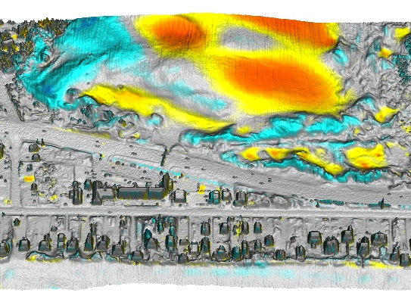
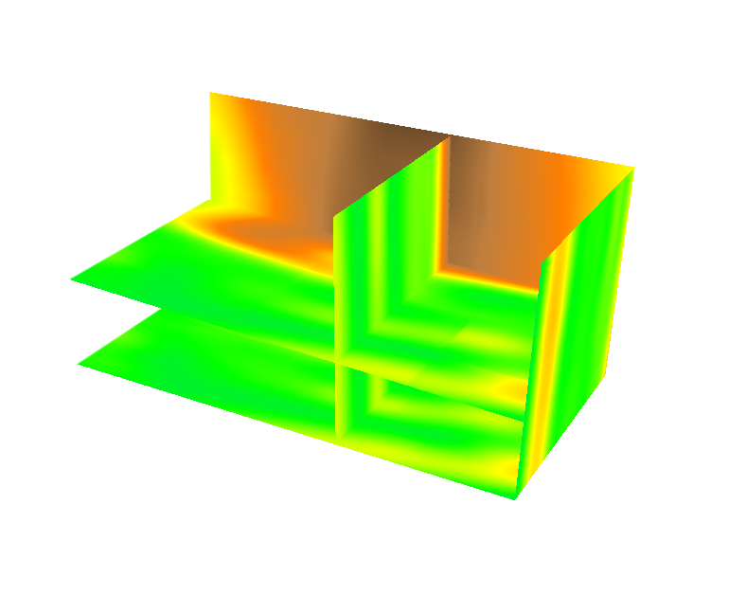
Multidimensional analysis
1D feature change: channels, shorelines
Feature extraction:
manual digitizing or image processing
least cost path
Feature change: tracing migration along transects
2D pattern of elevation change:
Difference of DEMs, volumes
Per cell statistics applied to DEM time series
3D space-time cube: z=f(x,y,t)
Notes:
cite work by others here! Add figure for all features – crests, peaks, shorelines

Slide 6
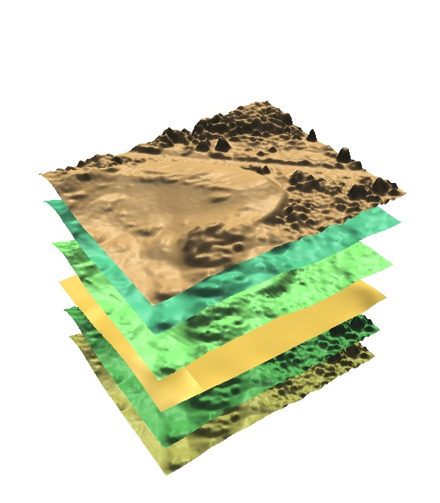
Raster-based analysis
Spatial pattern of elevation change
Per cell statistics:
value in the resulting map grid cell is a function of respective values in the time series
t₁
t₂
t₃
.
.
t_{n}
result
Nags Head

Slide 7
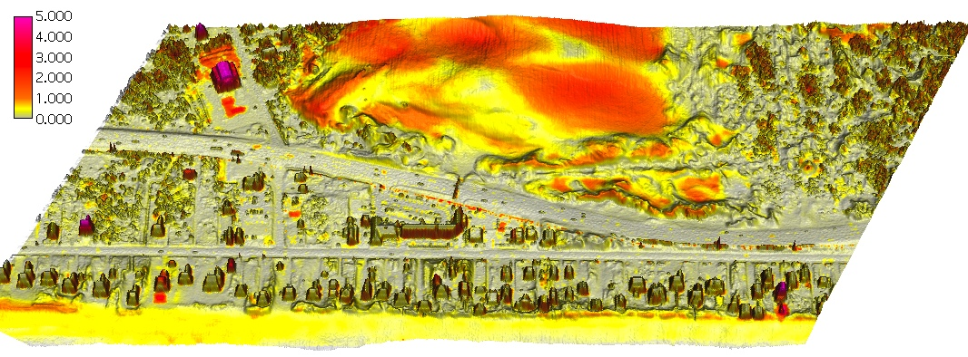
Core, envelope for a migrating dune
core, envelope, DEM
1999
2001
2004
2008
0 100m
Orthophoto and shoreline band
Elevation range: dz = z_{max} - z_{min}

Slide 8
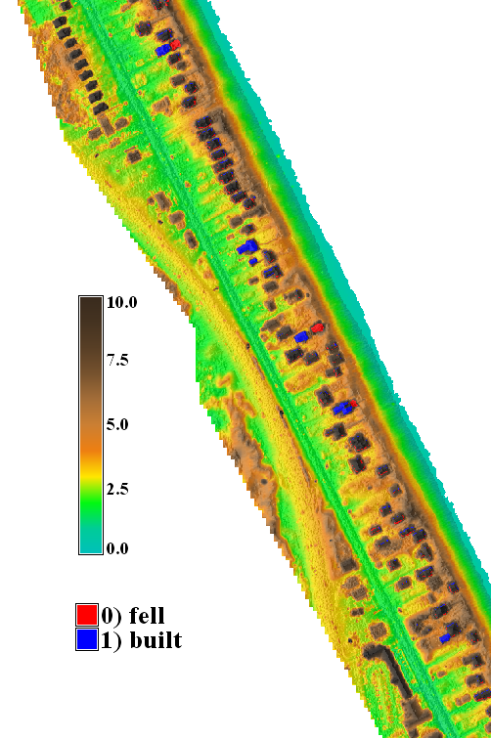
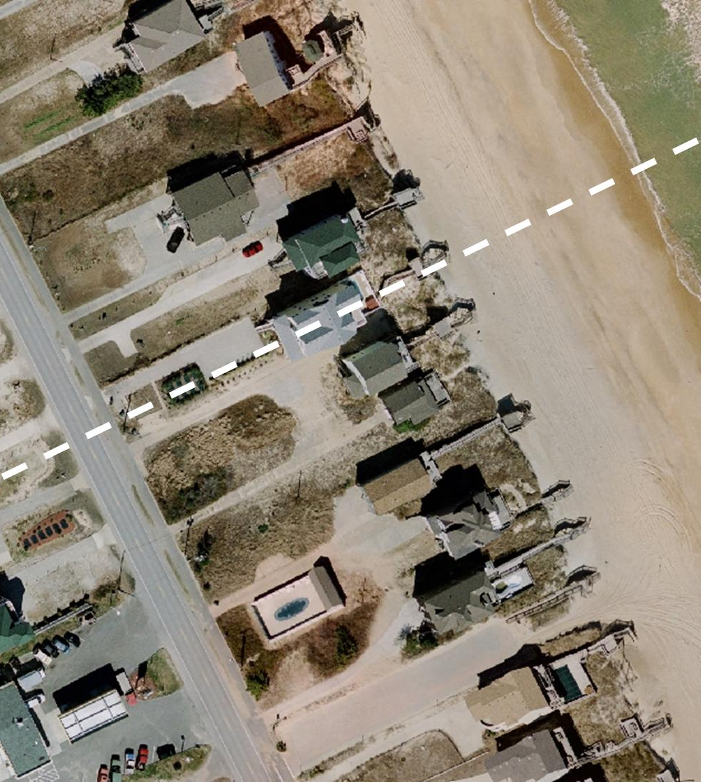
Discrete changes from core and envelope
10 year time series
Problem: find quickly new or lost homes from large series of DEMs
H1a: lost in 2004
H1b: rebuilt in 2005
H2: old, no change
H1
H2
H5: new, built in 2007
H3a: lost in 2005
H3b: rebuilt 2007
H4a: lost in 1997
H4b: rebuilt 1998
H1ab
H2
m
envelope
core
Core surface: min elevation 1997-2008
Envelope: max elevation 1997-2008
Time is determined by automated
query of DEM time series at identified
new or lost home centroids
200m
lost
built

Slide 9
Terrain evolution in space-time cube
How does evolution pattern change with elevation?
What is the direction of fastest elevation change?
Time series of (x,y,z) point clouds interpolated to voxel model
(x,y,z)
t_{n}
…
Time
[year]
(x,y,z)
t₂
(x,y,z)
t₁
Y[m]
reorder
as
(x,y,t,z)
interpolate
z=f(x,y,t)
X[m]
15
7
0 m
space-time cube
Notes:
9
9
Figure 3: Representation of terrain evolution using trivariate space-time function: merged time series of point clouds is interpolated into space-time voxel model (Mitasova et al., 2011).
*Reviewer asks for a more thorough explanation of how 3D information fits into the 4d cube (3D shape)? The reviewer seems confused here as it is not a 4D cube but a 3D cube for elevation values at space time. Perhaps this figure can be modified to show that at a specific time constat for a lidar-survey you get back out your DEM for that survey. Note also this figure was used in your geomorph paper.

Slide 10
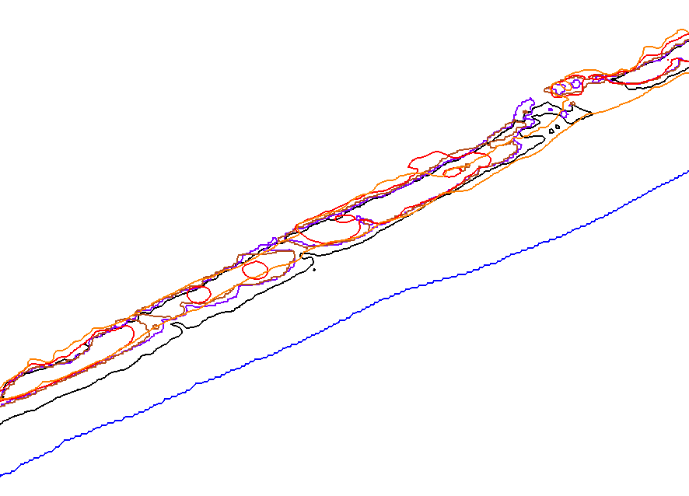
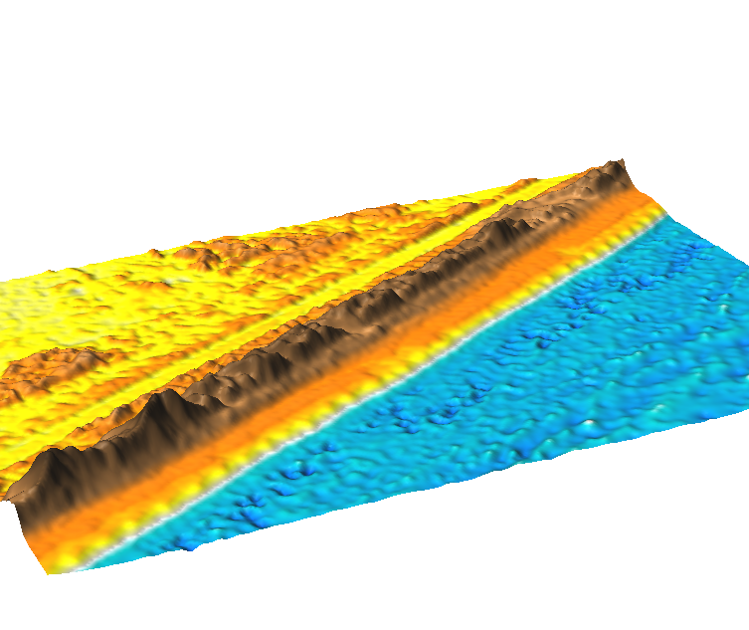
Contour evolution with overwash
Oregon inlet
DEM [year]
2005
2003
1997
2005
2003
2001
1999
1997
contours
z = 4.5m
600m
200m
2005 shoreline
Standard contour representation
Notes:
10
10
I need to find a more attractive area to show this - it can be skipped

Slide 11
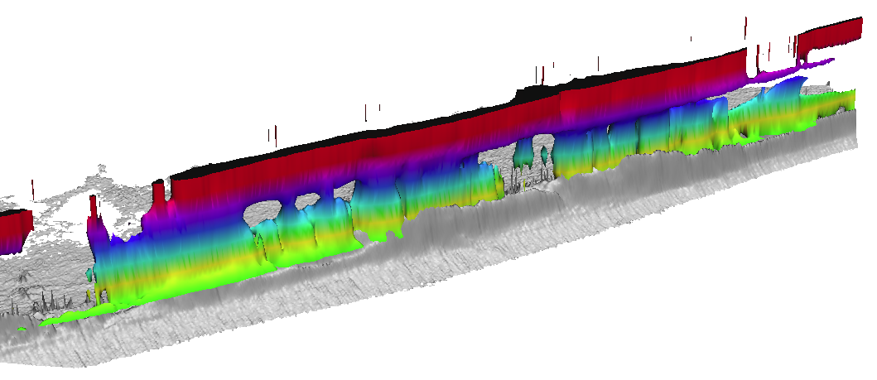
Contour evolution with overwash
DEM [year]
2005
2003
1997
2005
2003
2001
1999
1997
contours
z = 4.5m
200m
2005 shoreline
Time
[year]
2007
2005
2003
2001
1999
1997
Time
[year]
beach
N
Y[m]
Isosurface z = 4.5m
X[m]
4.5m contour evolution extracted as isosurface from STC
Notes:
11
11
I need to find a more attractive area to show this - it can be skipped

Slide 12
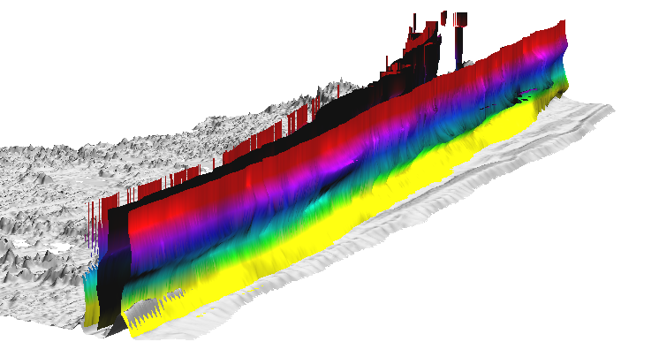
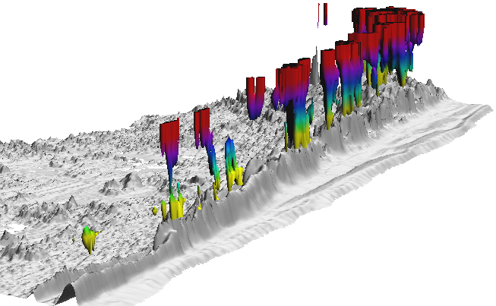
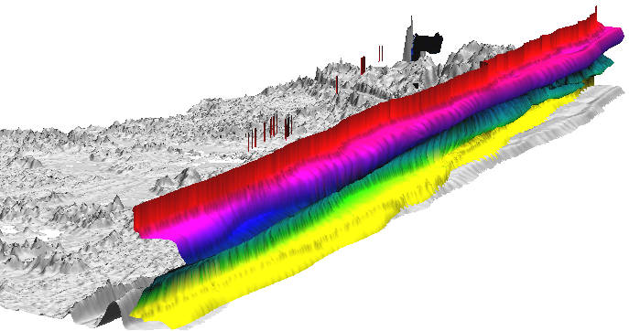
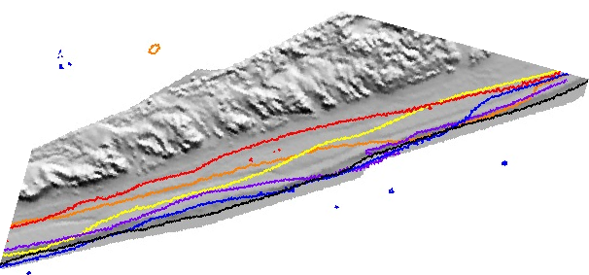
Dynamics at different elevations
0.7m shoreline, 1.5m upper beach, 7.5m dune ridge
stable dune peaks
2007
2005
2003
2001
1999
1997
z=1.5m
z=0.7m
z=7.5m
sand disposal
200m
Time
[year]
X[m]
Y[m]
Notes:
12
12
I need to find a more attractive area to show this - it can be skipped

Slide 13
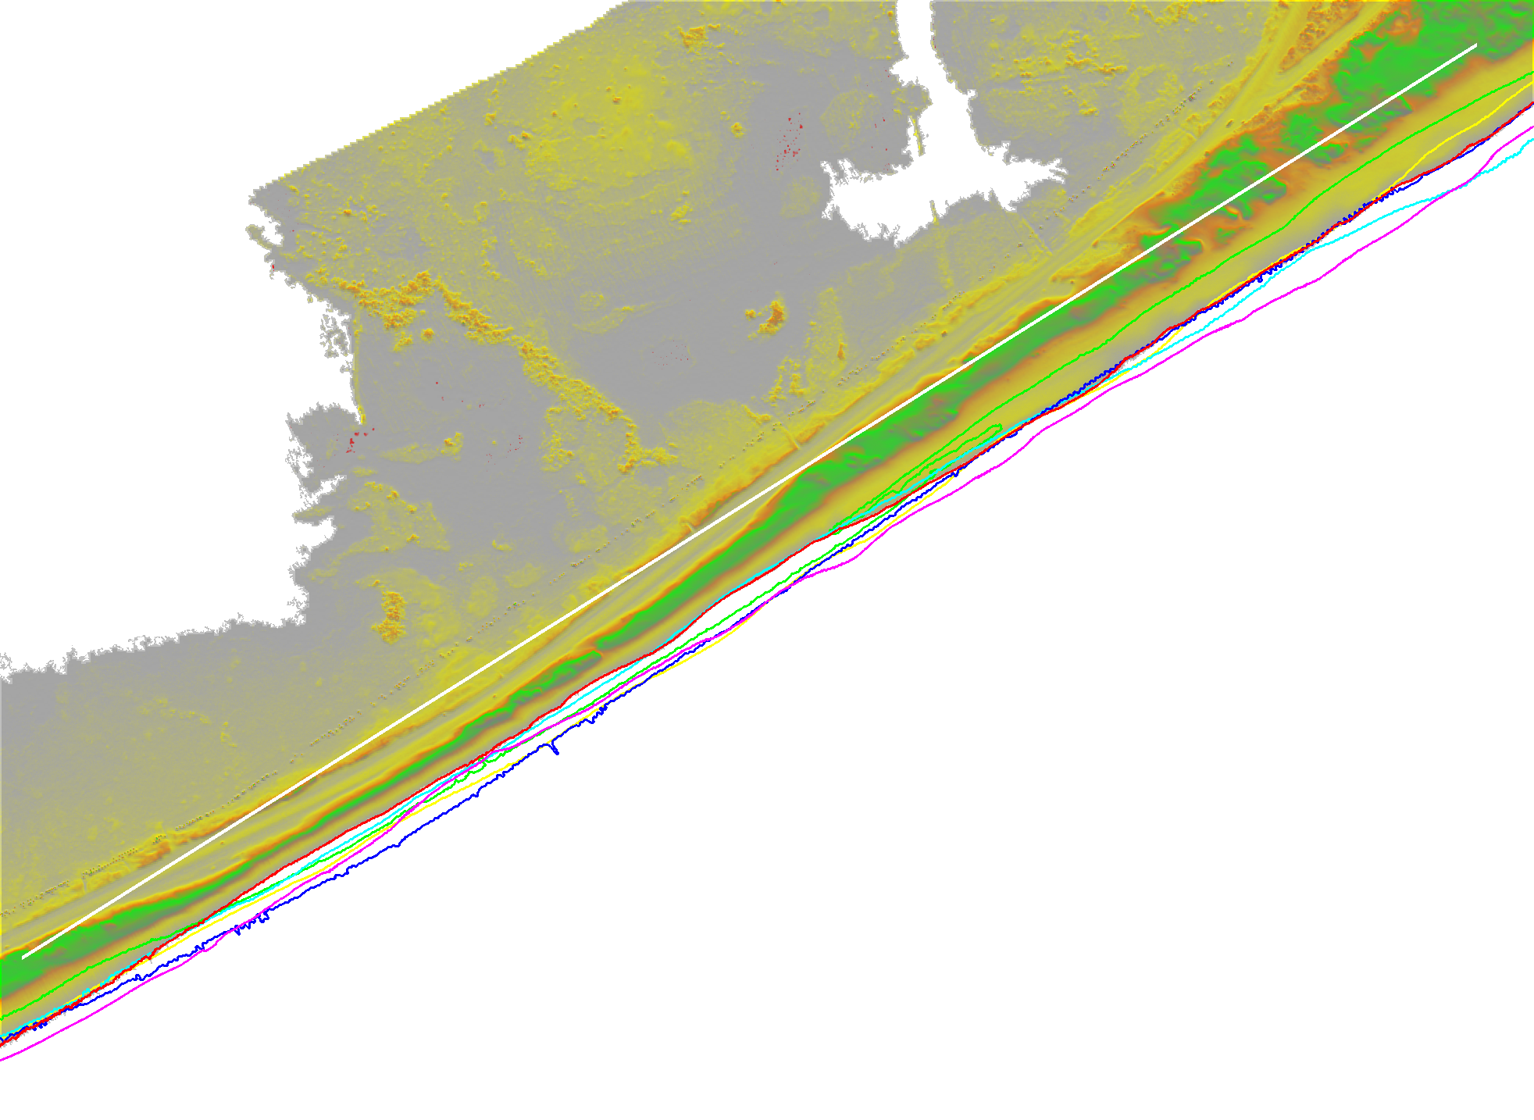
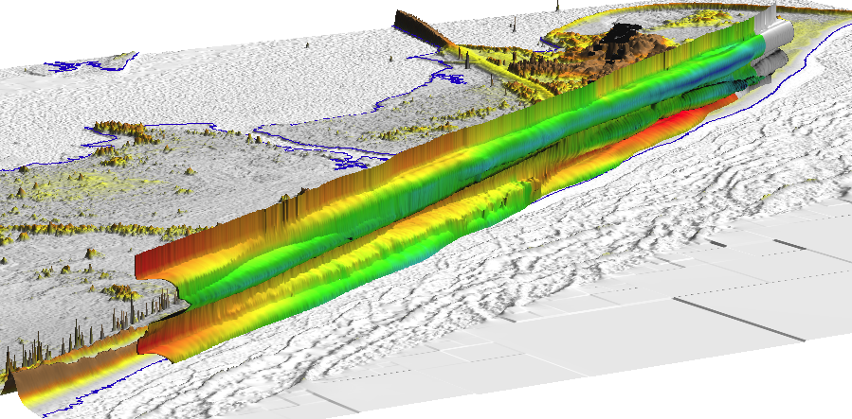
Distance from baseline
1997
1999
2001
2003
2005
2008
300m
2008
2005
2003
2001
1999
1997
Distance
75
90
105
120
135
150 m
Time
[year]
Y[m]
Notes:
13
13
I need to find a more attractive area to show this - it can be skipped

Slide 14
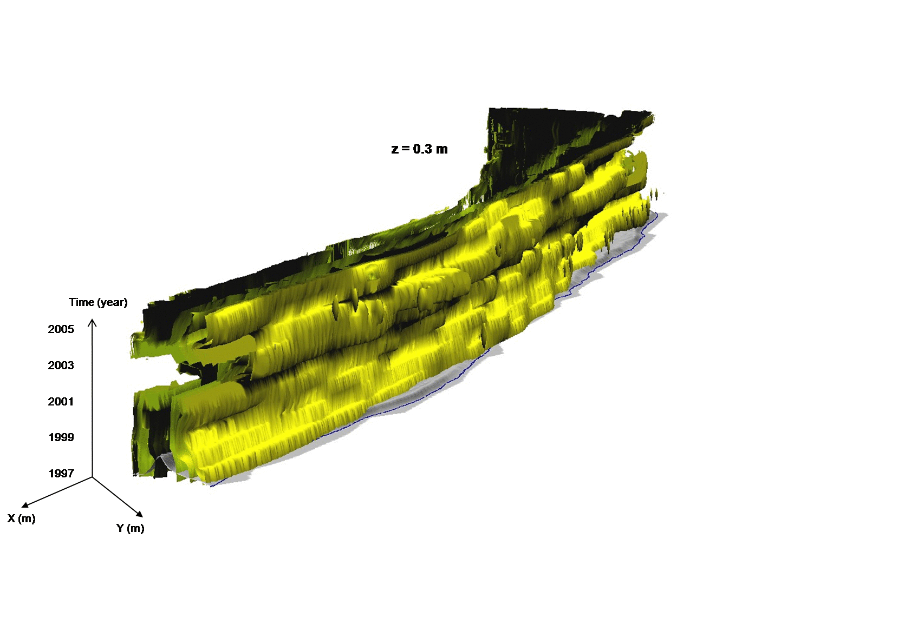
Series of contours in space-time cube
browsing through evolution of contours
0.5,1., 1.5, 2., 2.5, 3., 3.5, 4., 5., 6., 7., 8., 9.m
Notes:
14
14
I need to find a more attractive area to show this - it can be skipped

Slide 15
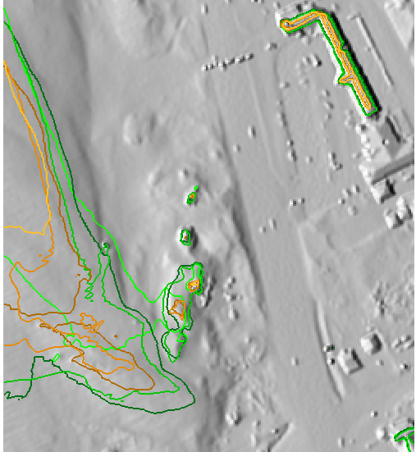
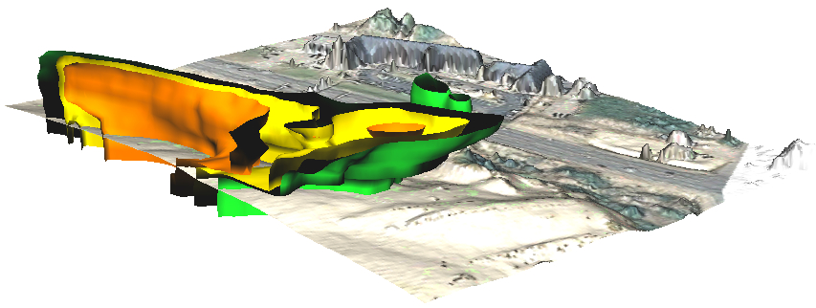
Contour evolution as isosurface
10m and 12m elevation contours for 3 years
Isosurface representation of 10, 11 and 12m elevation contours for time series
Elevation: 10 11 12 m
2008
2005
2001
1999
10 | 12 | z[m]
~~ | ~~ | 2008
~~ | ~~ | 2005
~~ | ~~ | 1999
Time
Y
X
0 100m
Notes:
15
15
I need to find a more attractive area to show this - it can be skipped

Slide 16
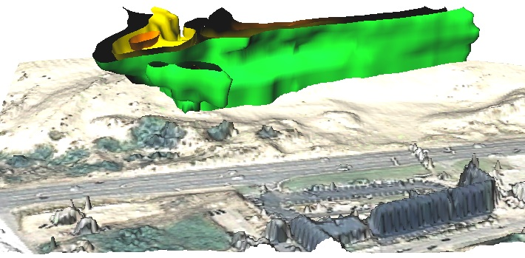
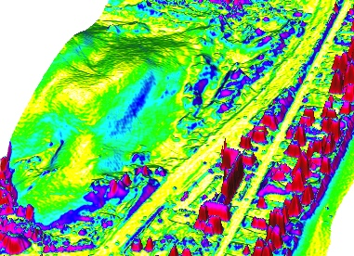
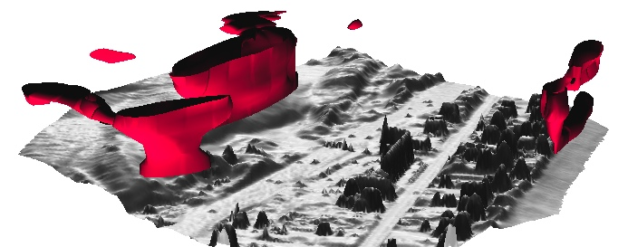
Ongoing work: Exploring space-time gradient
migrating
Time
migrating slip face (slope > 15deg location in 2008
2008
2005
2001
1999
Y
stable
X
Elevations: 10 11 12 m
ST gradient=1.6
evolving slipfaces
new slip face
expanding
slip face
space-time gradient -> show spatial and temporal component
Notes:
16
16
16

Slide 17
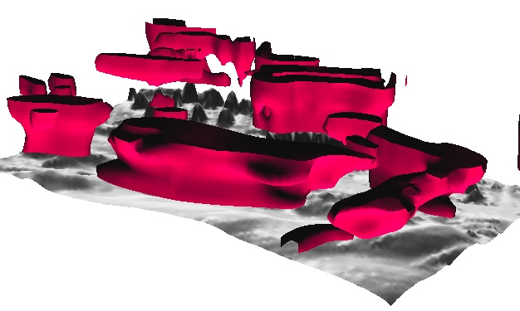
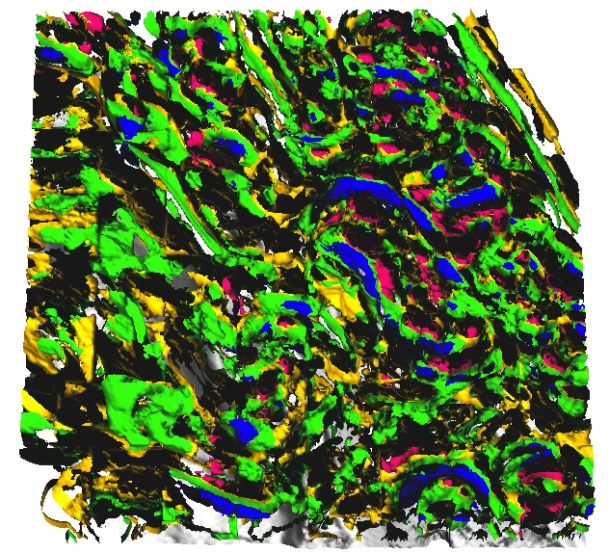
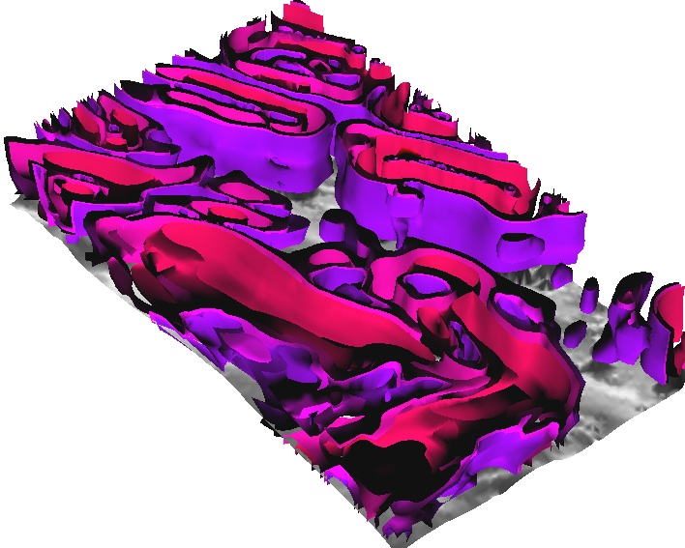
Ongoing work : Exploring space-time gradient
View from West
Time
2008
2005
2001
1999
Y
X
ST gradient – 1.4
evolving slipfaces
Elevations: 10 11 12 m
Curvature
in gradient direction:
-5, -0.5, +0.5, +5
ST gradient isosurfaces
– 1.2, 1.3, 1.4
Rate of elevation change in ST gradient direction
Notes:
17
17
17

Slide 18
Bank erosion monitoring with terrestrial lidar
Michael J. Starek; Helena Mitasova; Karl W. Wegmann, Terrestrial Laser Scanning for Measuring Stream Bank Erosion within Legacy Sediments: Data Processing and Analysis Methods, AGU Fall meeting, Abstract EP41A-0581, Dec. 2011.

Slide 19
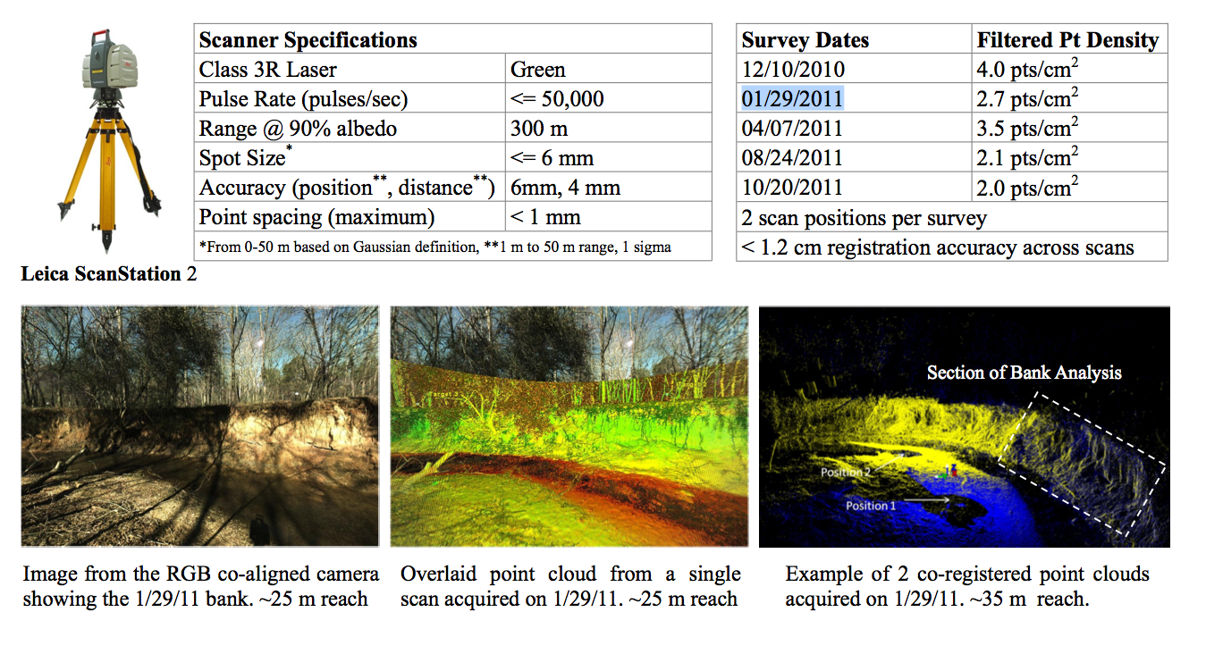
image from the poster

Slide 20
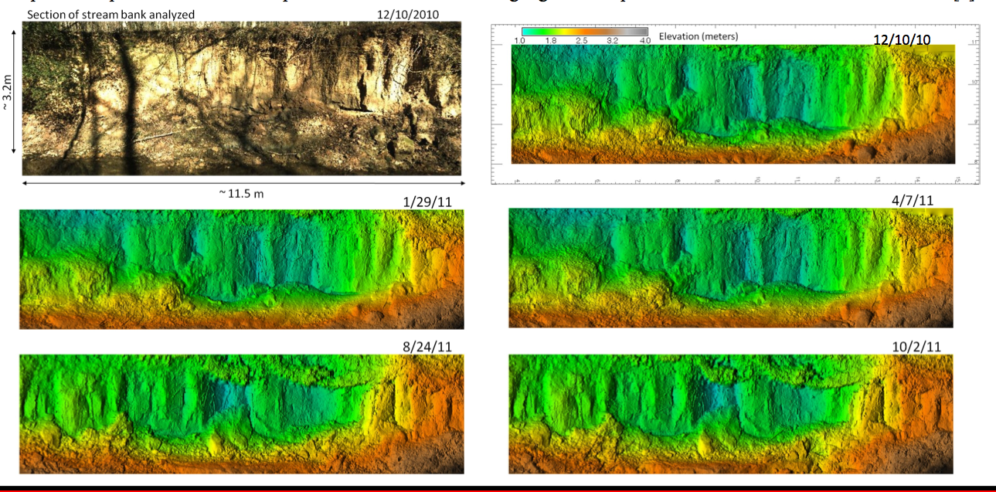
Series of vertical stream bank DEMs:
“elevation” is distance from base plane

Slide 21
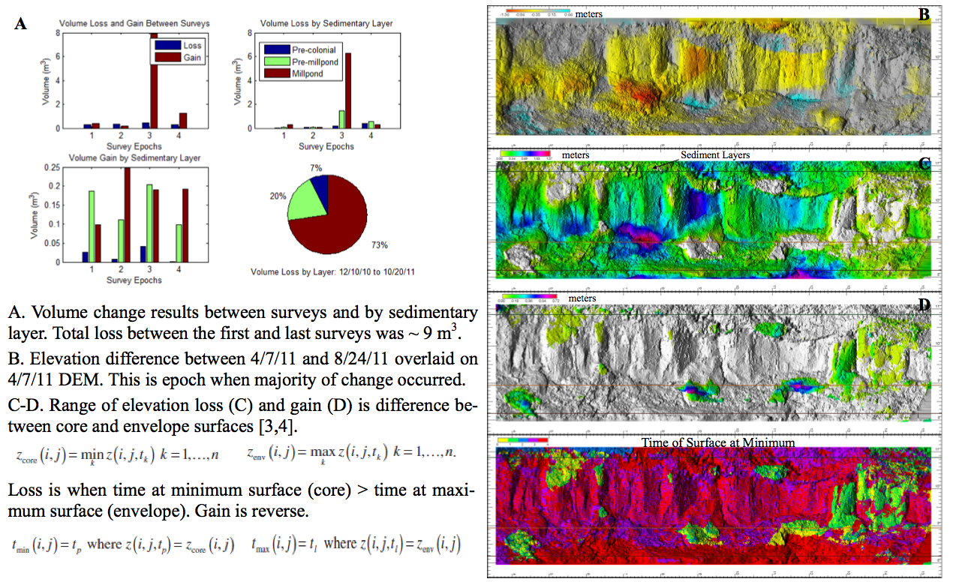

Slide 22
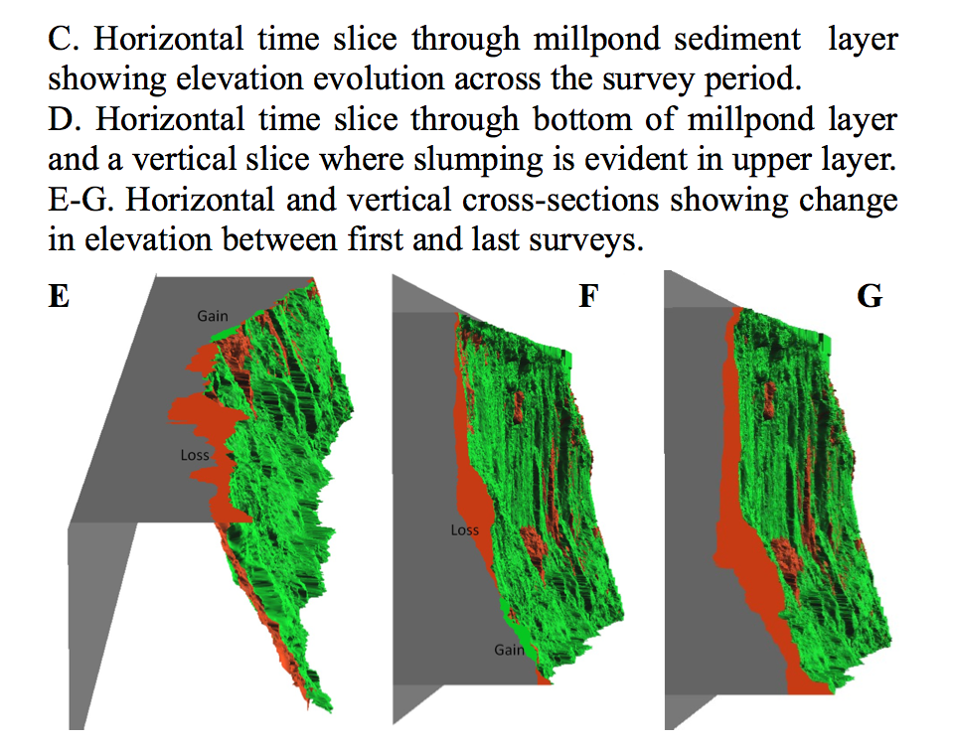
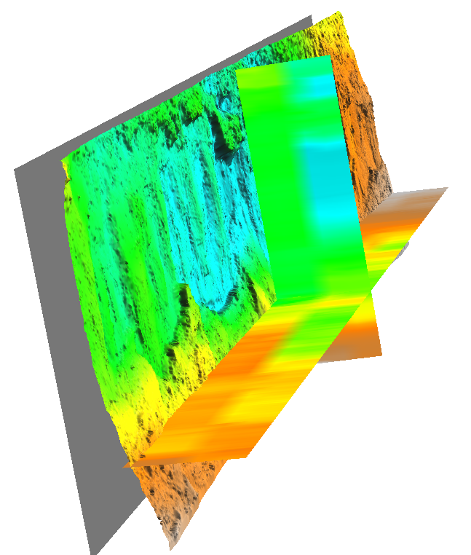
evolution of “elevation”
(distance from a base plane)
storm event
time

Slide 23
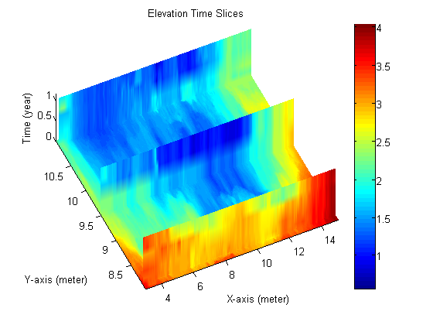
Michael Starek

Slide 24
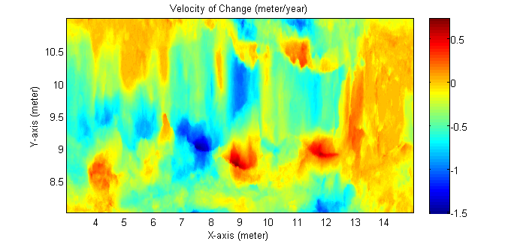
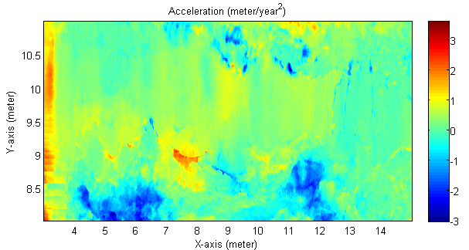
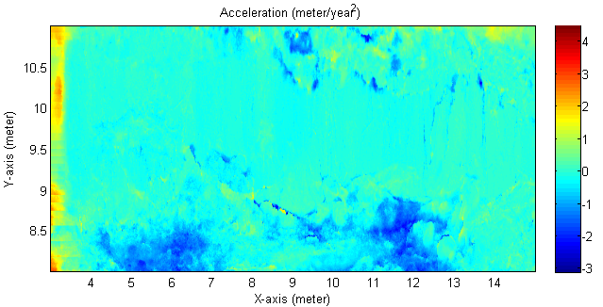
Rate of change computed using a linear fit.
Acceleration computed using a 2nd order polynomial fit to each grid cell of the 3D elevation voxel model. Unit of time was measured in years based on temporal span from first survey. By taking the 2nd derivative of the fitted polynomial, the acceleration for each grid location was computed.
Another acceleration plot, but in this example, the velocity (rate of change) for a given grid cell was computed between each successive survey epoch. A linear fit of velocity as a function of time was then used to compute acceleration. There are some similar patterns between the two difference acceleration plots but also noticeable differences.
Michael Starek
Notes:
blue(negative) is loss? we need map of coefficient of determination (r2) for this to see where the linear fit applies

Slide 25
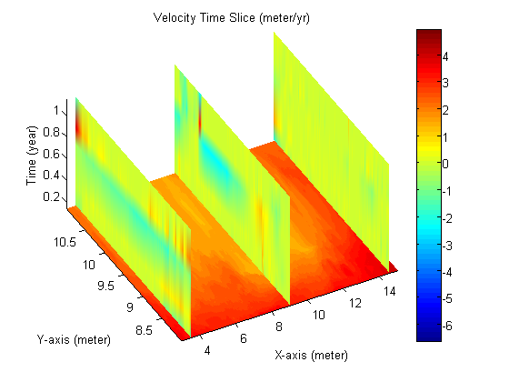
Michael Starek

Slide 26
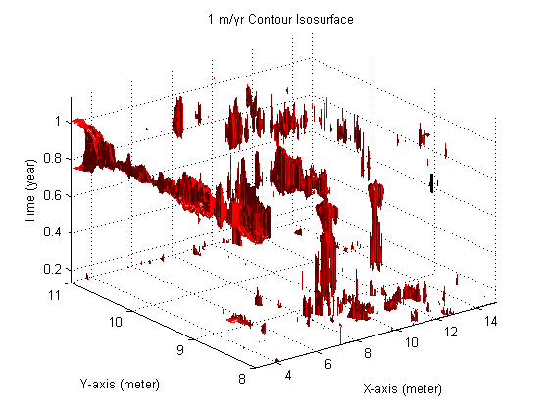
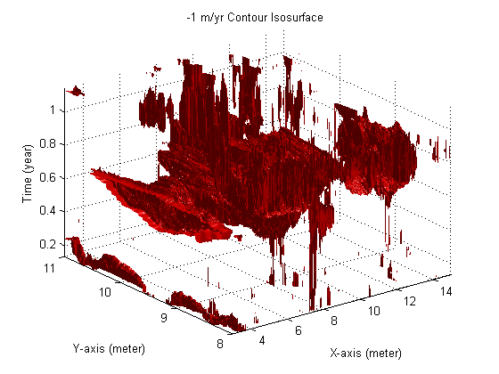
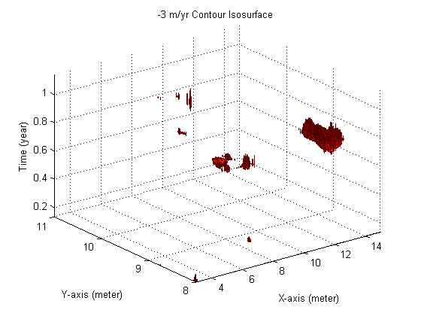
Michael Starek

Slide 27
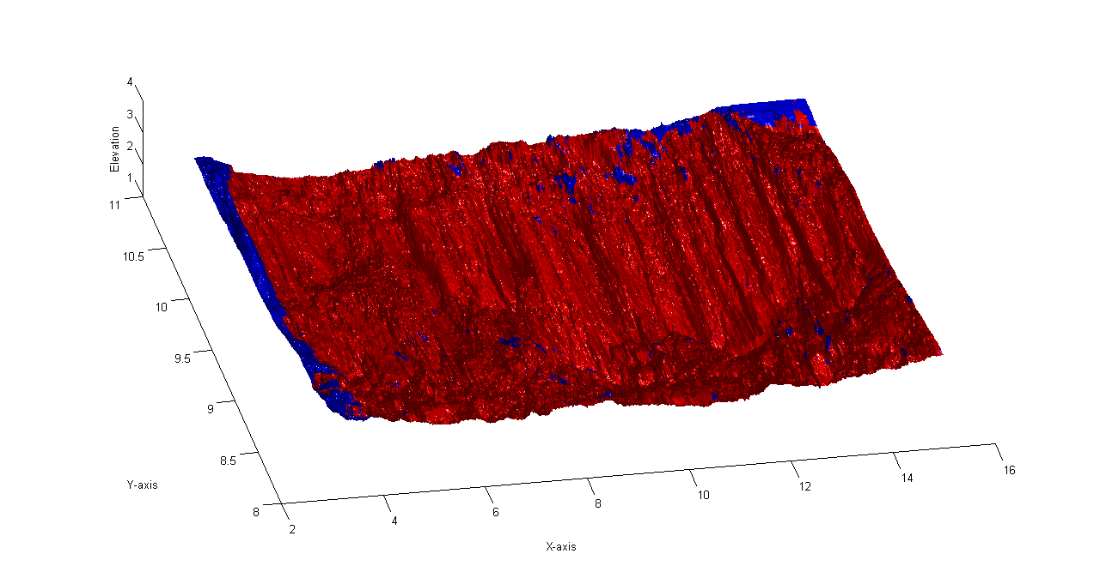
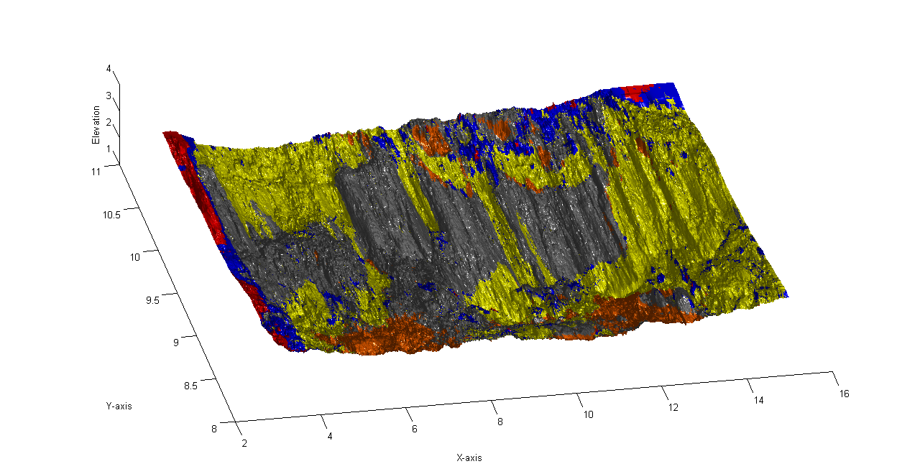
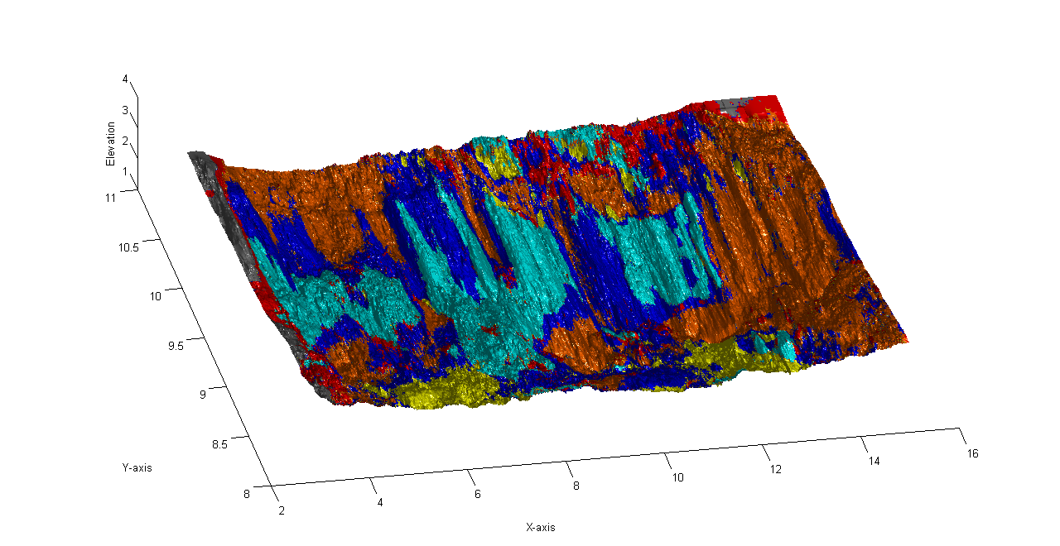
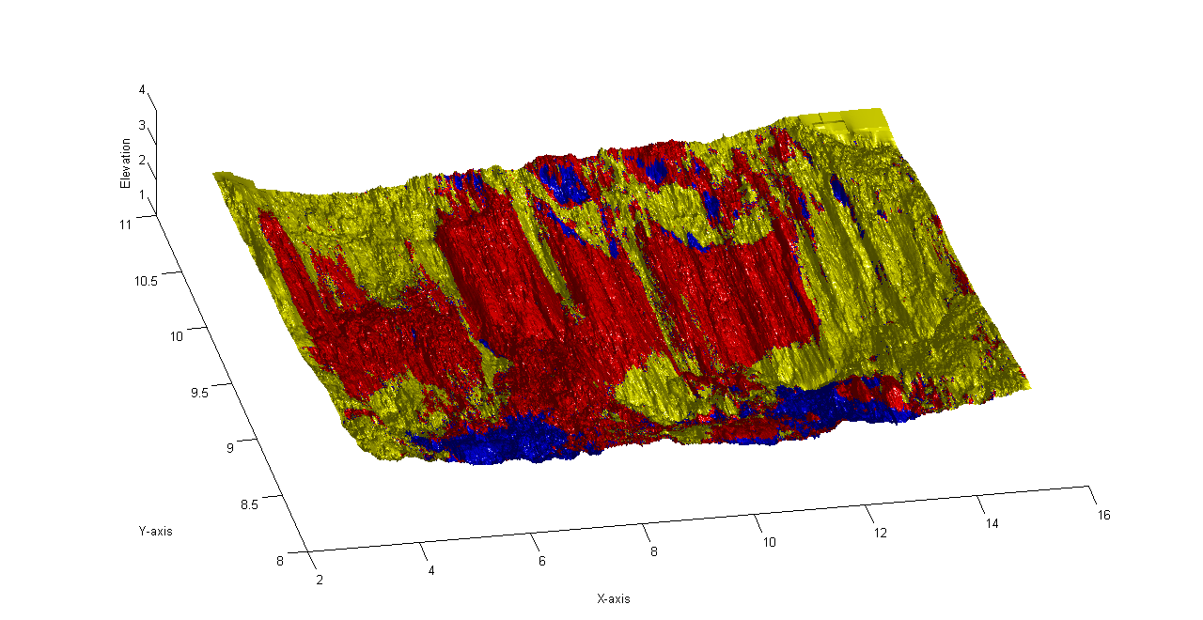
Cluster Analysis: k = 2, 3,5,6 Clustered based on velocity and acceleration
Cluster Centroids: (velocity, acceleration)
-0.3001 -0.1960
-0.3361 0.9257
Michael Starek

Slide 28
Current status/accomplishments
Computation of STC voxel models:
- integration of lidar point clouds generated at different times by different technologies
- multivariate RST interpolation from subset of point cloud series to voxel model
Extraction and visual analysis of topologies of elevation change for varied types of dynamic landscapes
– space-time elevation isosurfaces for migrating dunes, shorelines, and for eroding stream banks, identification of distinct topological features associated with feature evolution/behavior
- voxel models for attributes such as time or distance from baseline visualized as isosurface color map to facilitate interpretation of space-time isosurfaces
Space-time gradients
derived simultaneously with interpolation from point cloud using RST derivatives
derived using per-cell regression (see eroding bank)
Products – new knowledge
knowledge: events versus continuous change, anomalies in evolution
methodology for creating STC representation of terrain dynamics
methodology for analysis of gradients: spatial patterns of rate of change and acceleration
classification/clustering based on velocity and acceleration
Ft. Bragg workshop L3 contractors – experience with lidar but not time series (see more on next slide)
Ultimate benefits to TEC
- understanding of changing landscape, identification of anomalies in landscape change
- from static pattern recognition to dynamic process recognition
tech transfer through Geospatial analytics / Geospatial intelligence programs as BS, MS and PhD projects for students coming from the Army (Ft. Bragg, special forces, geospatial intelligence contractors)
- implementation in open source geospatial software
Similar research
(see proposal, let me know if more references are needed)
traditional approach: feature extraction and quantification of change in features (e.g. shoreline erosion)
lidar: elevation change as difference of DEMs (spatial pattern of erosion and deposition between two snapshots)
space-time cube used mostly for Socio-Economic data (lines, points)
analogy in behavior recognition based on human movement geometry

Slide 29
Plan, issues/obstacles
optimization of voxel model computation from point clouds (multivariate splines and geostatistical methods with optimized parameters)
start exploring gradient trajectories
interpretation of space-time gradients and curvatures and their directional components (temporal and spatial)
continue investigating link between processes and geometry derived from the voxel model by comparing the STC geometry derived from deterministic simulations with STC geometry from real-world data
add different type of landscape change (we have wind and waves for coastal, gravitation for stream bank, we need to add water flow)
obstacles – massive data sets, errors and artifacts in data
Technology transfer, extension service
results of this project are incorporated in the educational material and student projects on an ongoing basis
one day workshop on Lidar at Ft. Bragg by NCSU faculty in March 2012.
Geospatial Analytics program selected as one of 12 from 70 submissions for Faculty excellence program with new funding for 3 tenure / tenure-track faculty positions: see more here
http://provost.ncsu.edu/special-initiatives/chancellors-faculty-excellence/selected-clusters.php#ga
from the proposal, text related to DoD: This program will develop a relationship with the DoD to establish NC State as one of the few institutions that offer undergraduate and graduate training in Geospatial Intelligence. Our current Professional Science Masters program will be expanded through the addition of a partnership with Fayetteville State University (FSU) and Fort Bragg.

