Slide 1
Bank erosion monitoring with terrestrial lidar
Michael J. Starek; Helena Mitasova; Karl W. Wegmann, Terrestrial Laser Scanning for Measuring Stream Bank Erosion within Legacy Sediments: Data Processing and Analysis Methods, AGU Fall meeting, Abstract EP41A-0581, Dec. 2011 and figures for a submission to GRSL.

Slide 2
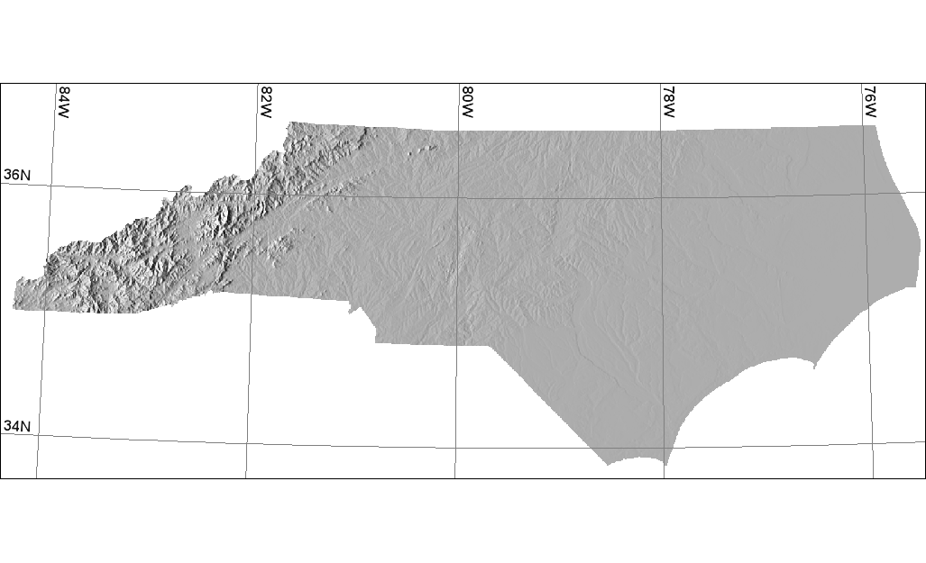
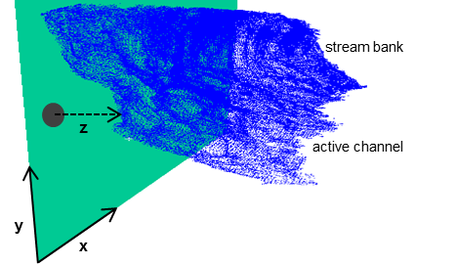
Tennessee
North Carolina
South Carolina
0 200km
N
Atlantic Ocean
Fig 1 Study site

Slide 4
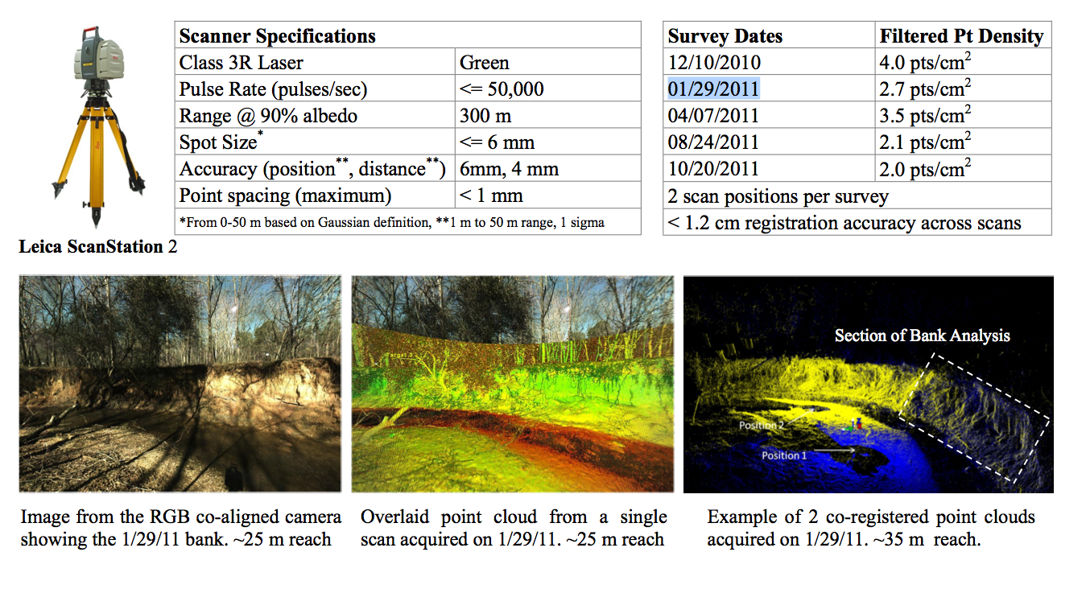
image from the poster

Slide 5
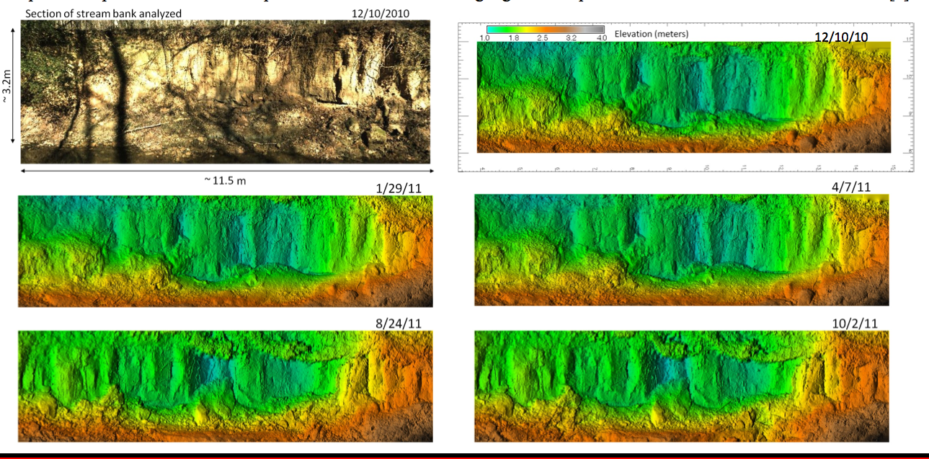
Series of vertical stream bank DEMs:
“elevation” is distance from base plane

Slide 6
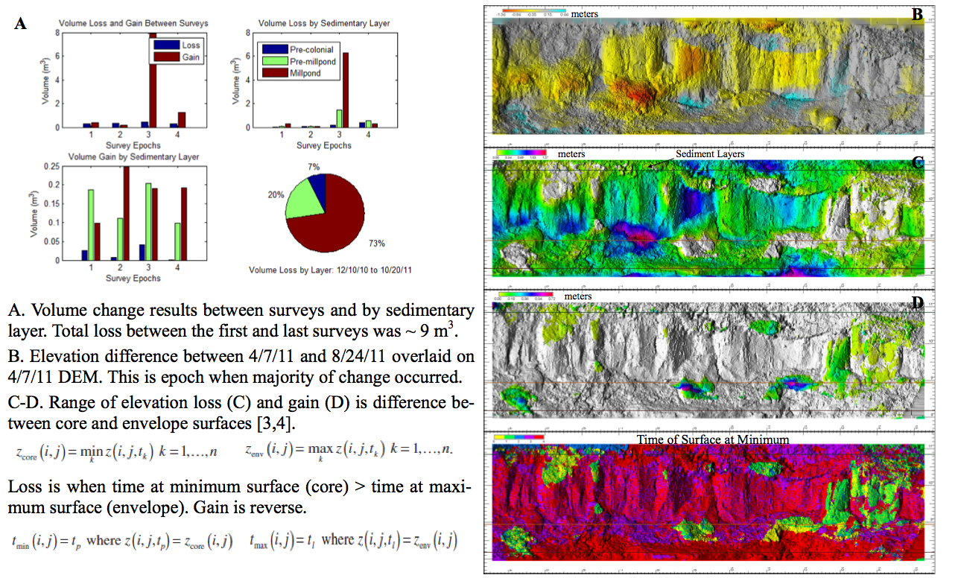

Slide 7
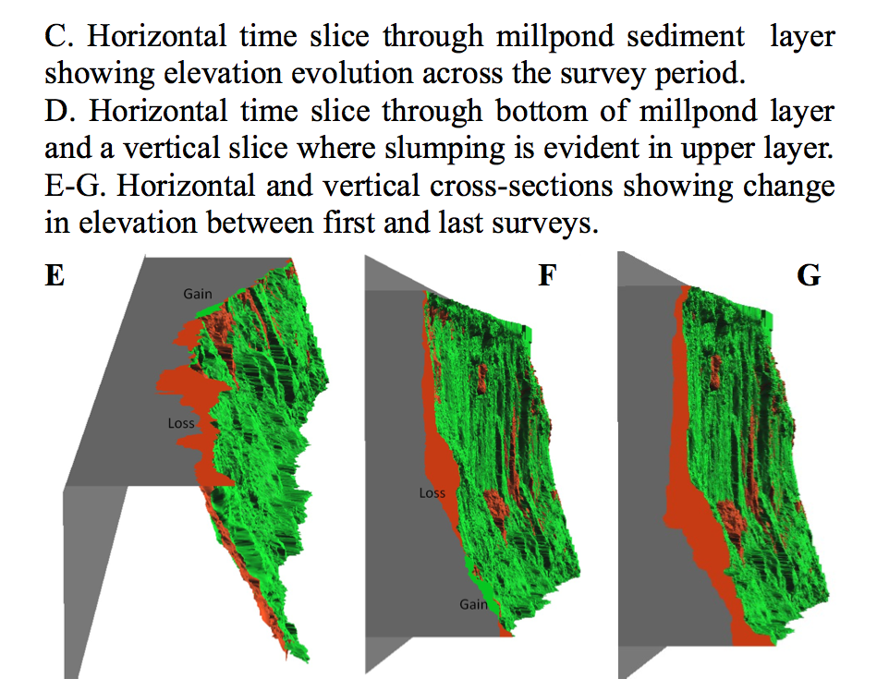
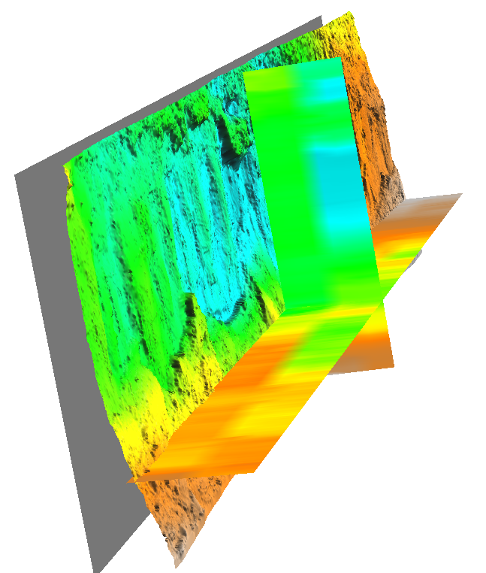
evolution of “elevation”
(distance from a base plane)
storm event
time

Slide 8
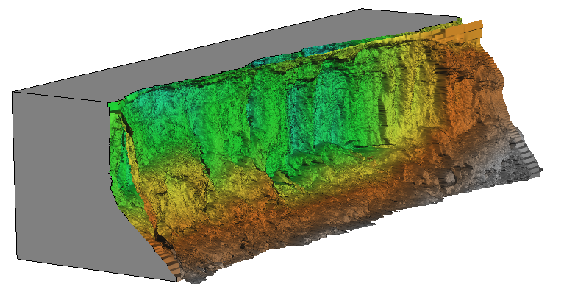
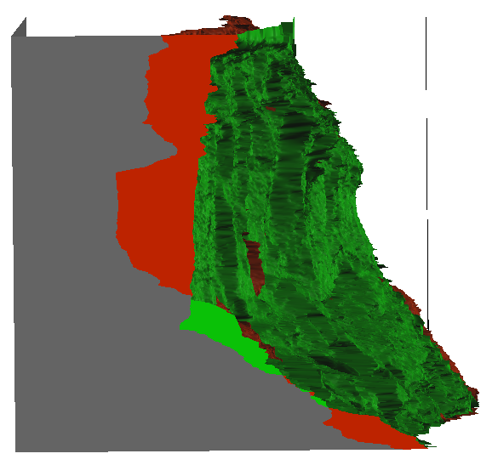
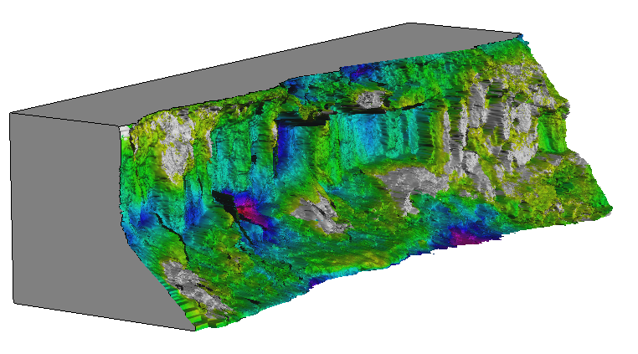
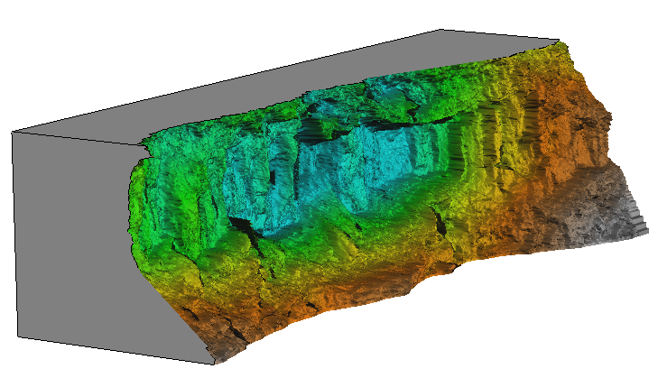
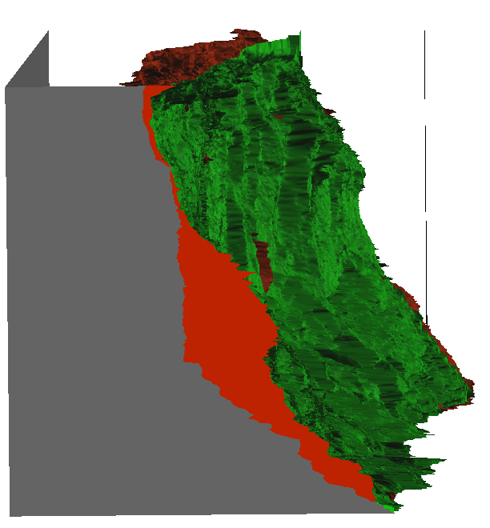
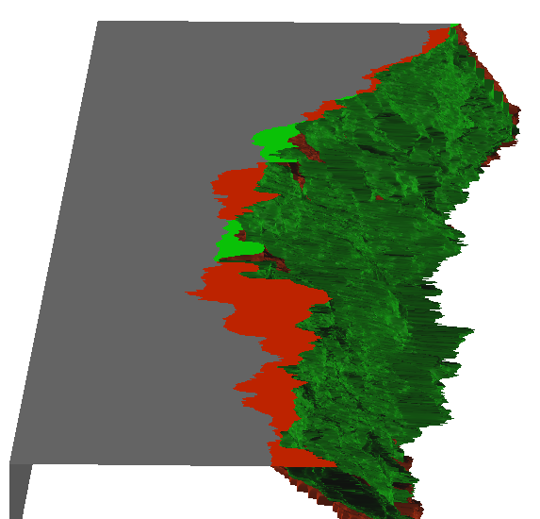
First and last scan analysis
but the Loss color map draped over last scan
is derived from range derived from entire series

Slide 9
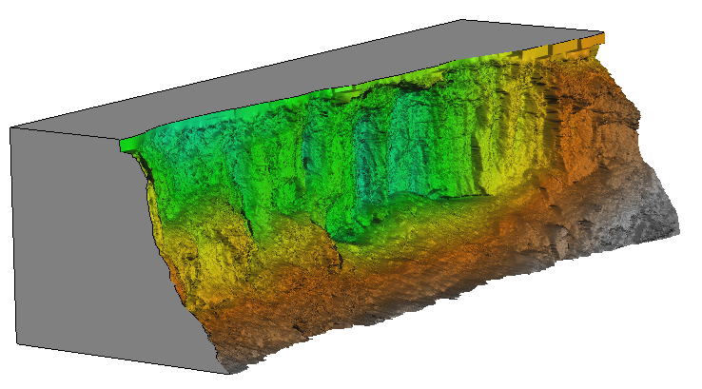
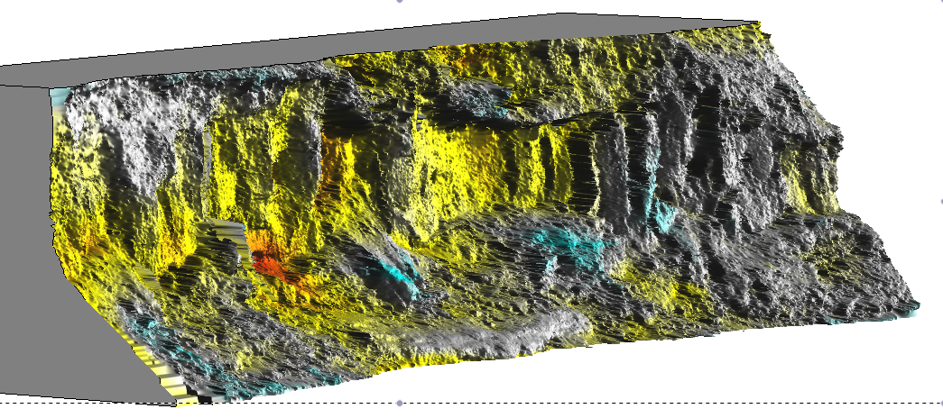
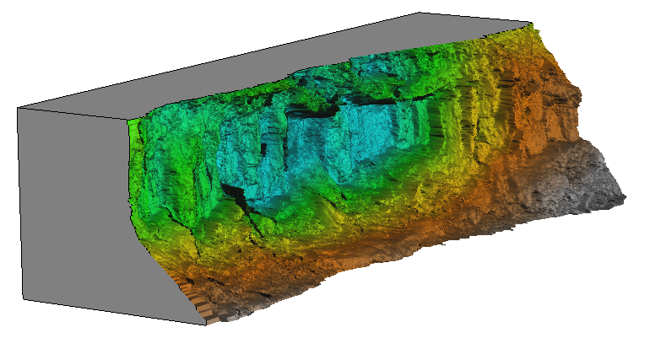
Two scans when most of the change have been observed over 137 days
- april-august 2011 – was there a single event or several storms?
(others were 45,67,56 days)

Slide 10
Two scans when most of the change have been observed over 137 days
- april-august 2011 – was there a single event or several storms?
(others were 45,67,56 days)

Slide 11
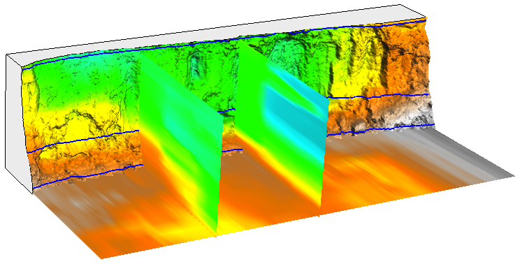
L1
L2
L3
0 epochs 8
distance from base plane [m]

Slide 12
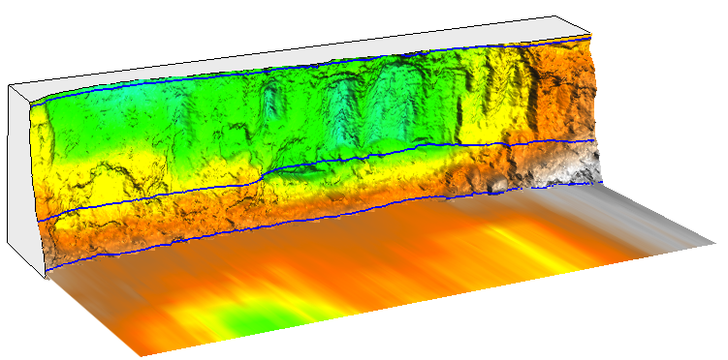
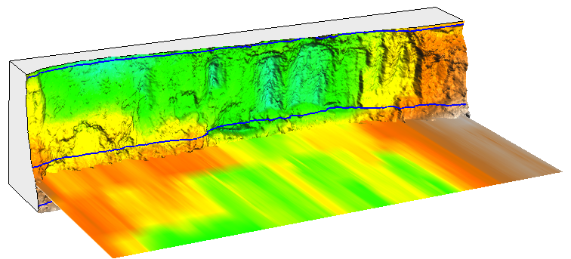
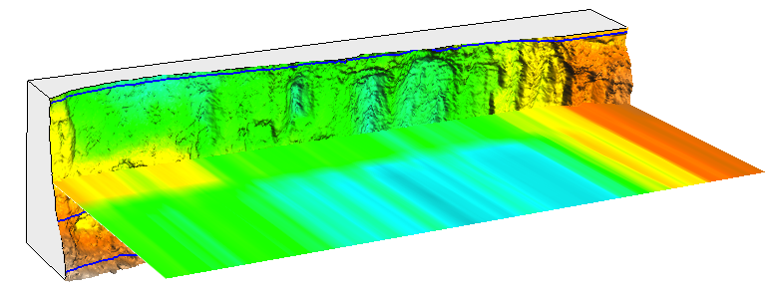
Fig. 6 STC crossections
L1
L2
L3
1 epochs 8
distance from base plane [m]

Slide 13
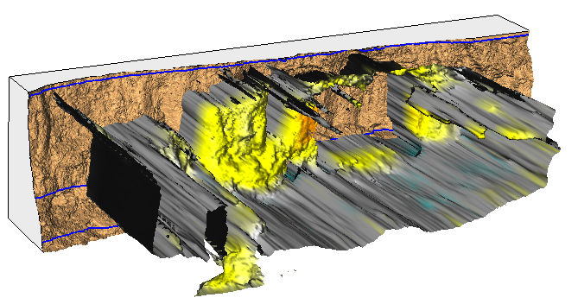
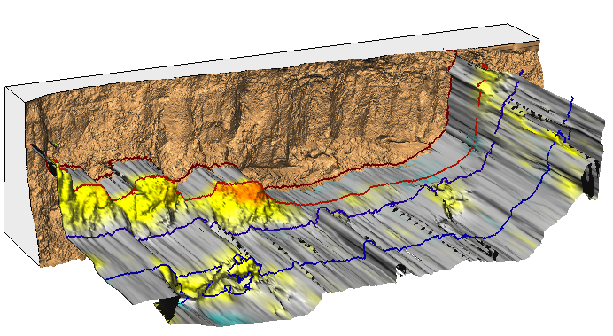
Fig 7 STC isosurface – show contours > isosurface with draped change and lines for year
epochs
distance difference [m]

Slide 14
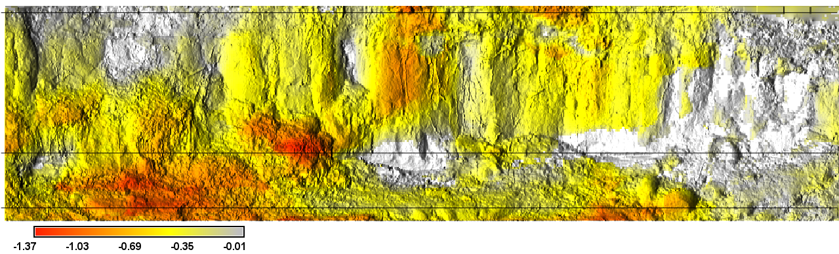
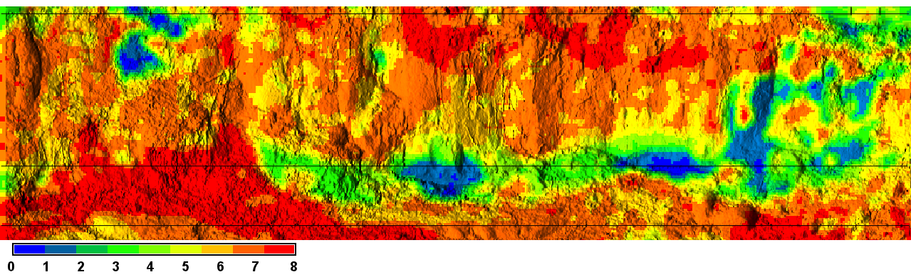
Fig. 5
m
epoch

Slide 15
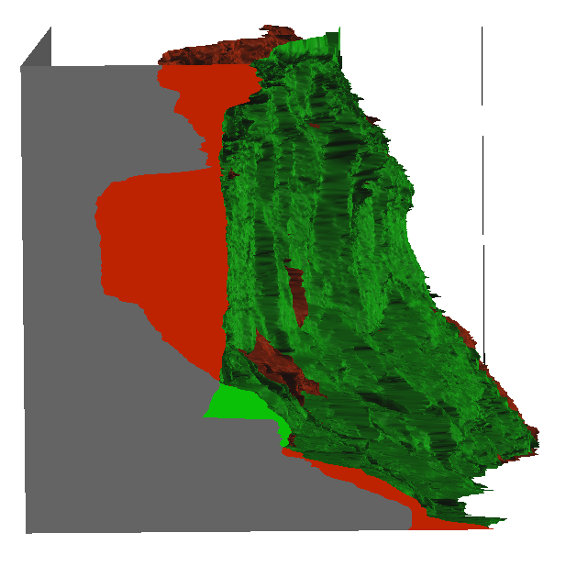
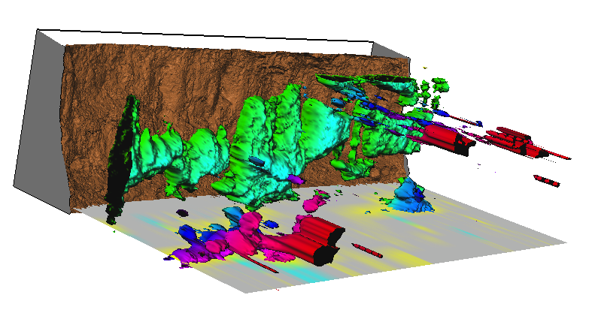
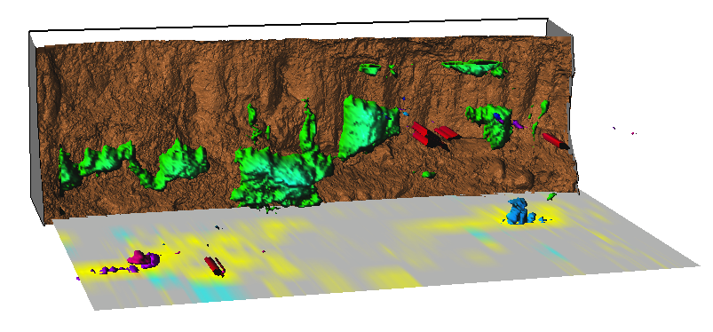
Fig 8 STC change isosurface

Slide 16
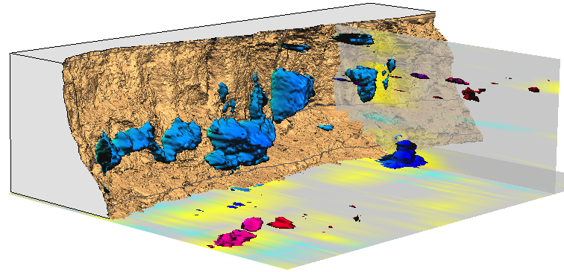
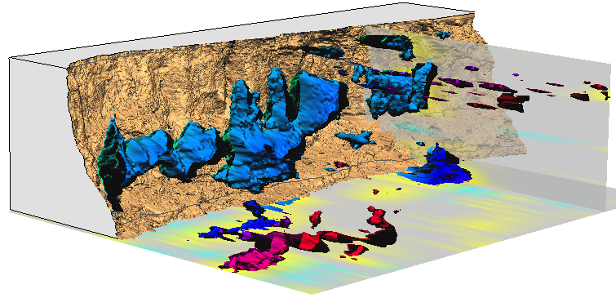
Fig 8 STC change isosurface

Slide 17
Fig 8 STC change isosurface
epochs
distance difference [m]

Slide 18
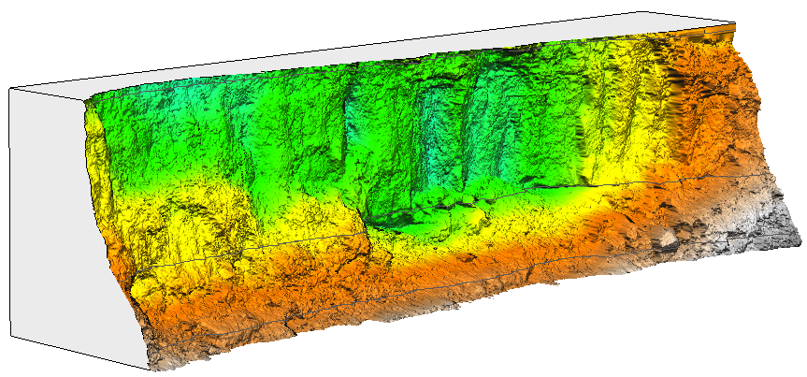
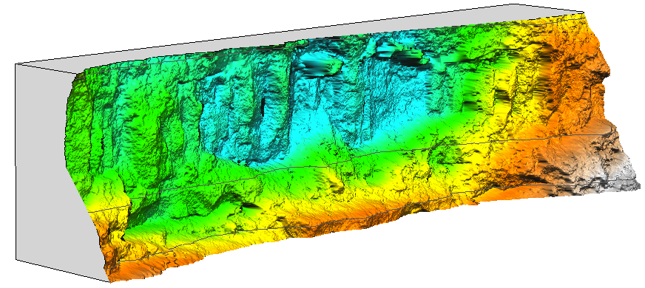
Fig 8 STC change isosurface
12/10/2010
06/27/2012
distance from base plane [m]

