Slide 1
Open Source Geospatial Research and Education Laboratory
Helena Mitasova,
Anna Petrasova, Vaclav Petras, Brendan Harmon
North Carolina State University, Raleigh, NC, USA
GRASS GIS
Notes:
Over the past decade free and open source software (FOSS) has moved into mainstreem and its growth includes a wide range of geospatial software tools. The presentation will briefly describe the principles of FOSS and provide an overview of major FOSS projects that support management, processing, analysis, visualization and on-line distribution of georeferenced data. Interoperability between the different tools enabled by the FOSS concept will be highlighted using examples of applications that combine software developed by several projects, such as GRASS, Mapserver, GDAL, PROJ, R-stats, PostGIS, paraview and others. Special focus will be given to the recent new developments in Geographic Resources Analysis Support System (GRASS, http://grass.itc.it). Since its original design as a land management tool for military installationsthe system has evolved into one of the most comprehensive, general purpose GIS and support for environmental modeling has been an integral part of its development. Overview of the GRASS6 capabilities relevant to environmental modeling will be provided, including tools for working with 2D and 3D raster data, the completely redesigned topological 2D/3D vector engine, vector network analysis and SQL-based attribute management. Various graphical user interfaces, such as QGIS and JAVAGRASS, that are being used with GRASS will be introduced and enhancements to 3D dynamic visualization will be presented. Environmental modeling will be illustrated by examples in the area of coastal management and sediment pollution control using the latest lidar data and new or updated GRASS6 modules. The talk will conclude with discussion of visions for the future of FOSS geospatial modeling.

Slide 2
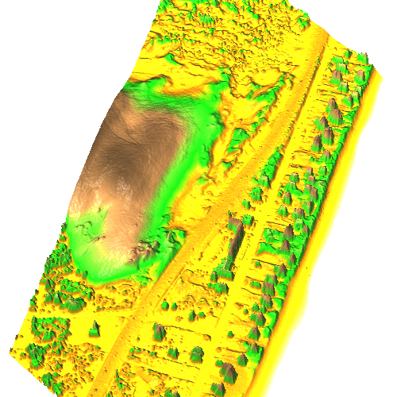
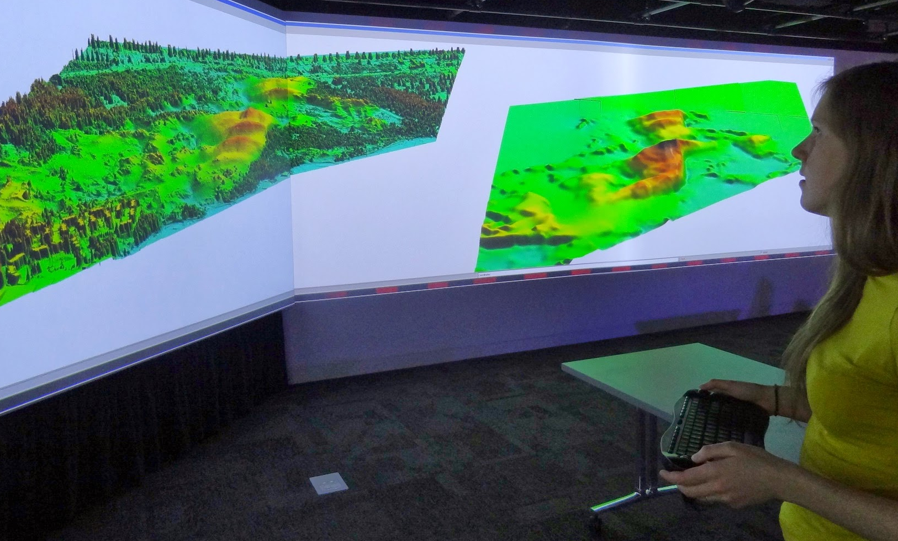
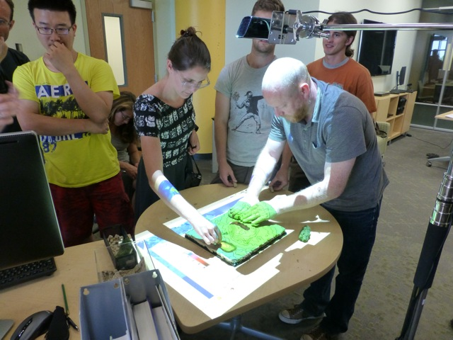
Geospatial Analytics of Landscape Dynamics
processing and integration of 2D and 3D data (lidar, imagery) to capture landscape dynamics
development of open source GIS-based toolboxes to map, analyze and model 3D landscape dynamics and its processes
development of visualization and tangible modeling environments to support planning and decision making
Helena Mitasova, MEAS and Center for Geospatial Analytics, OSGeo Laboratory

Slide 3
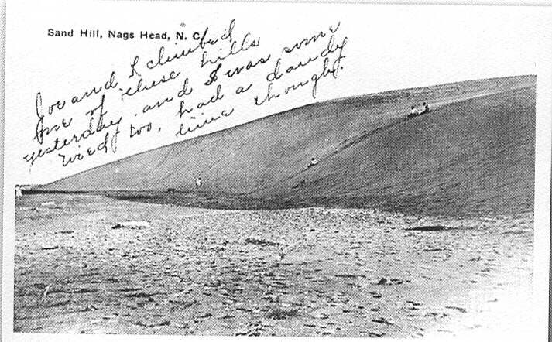
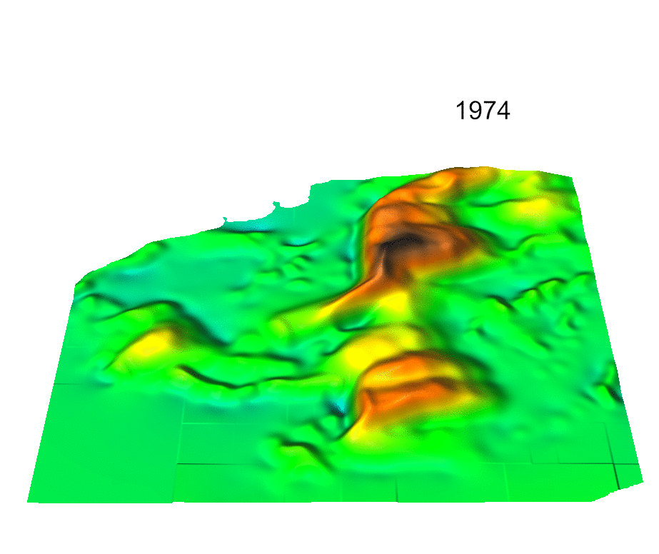
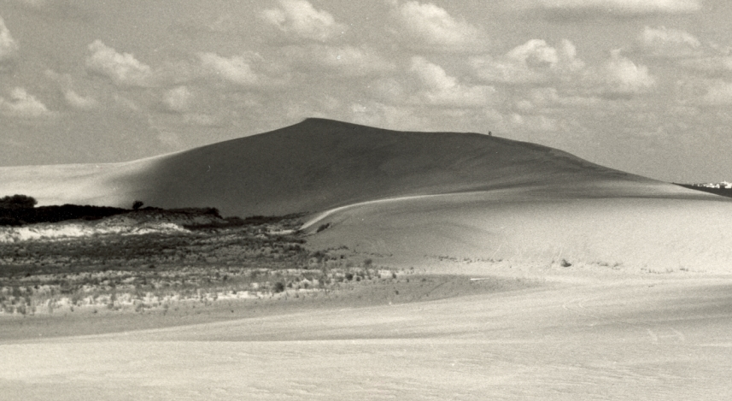
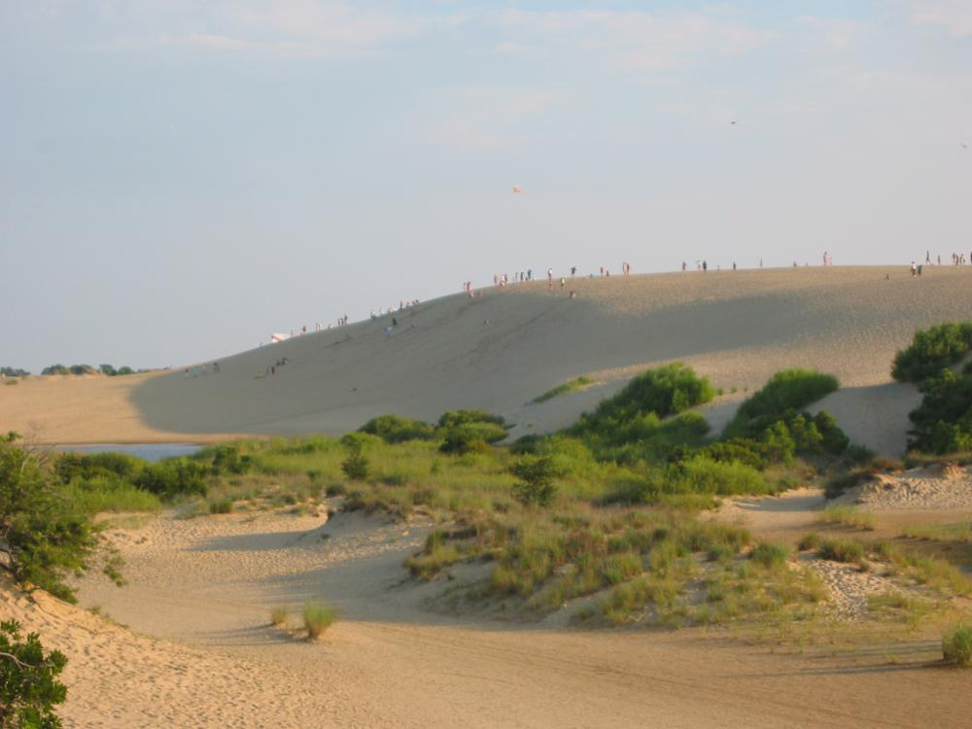
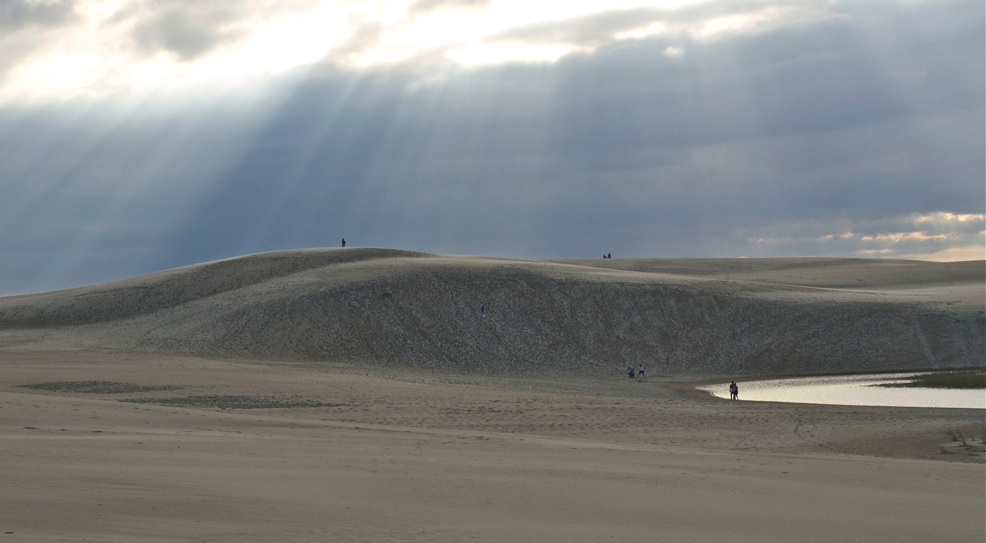
Jockey’s Ridge dune 1974-2008
1917 20m ?
1953 42m
2008: 21 m
2012 ??m
19m

Slide 4
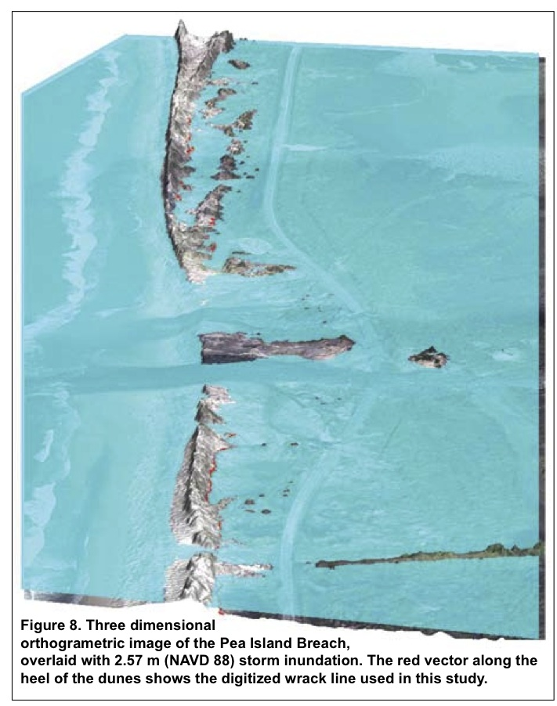
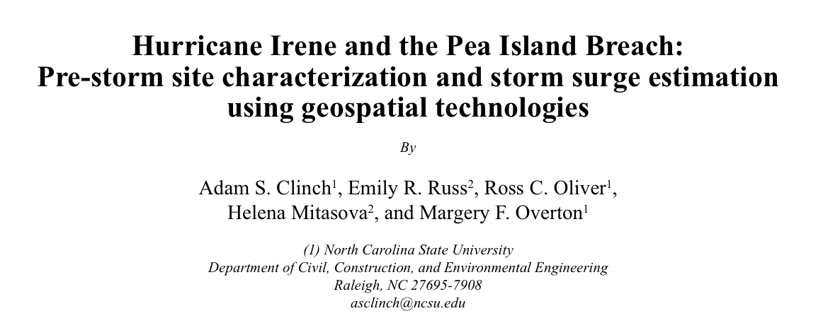
Coastal Flooding
Several team projects lead to a published paper
300m
published in Shore & Beach 80(2) spring 2012

Slide 5
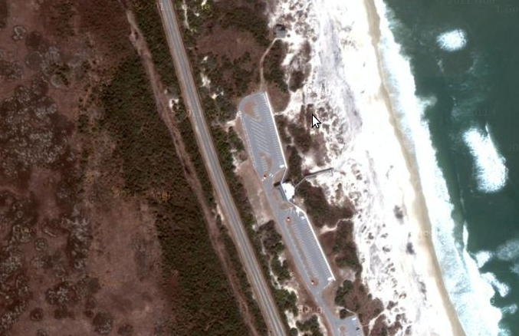
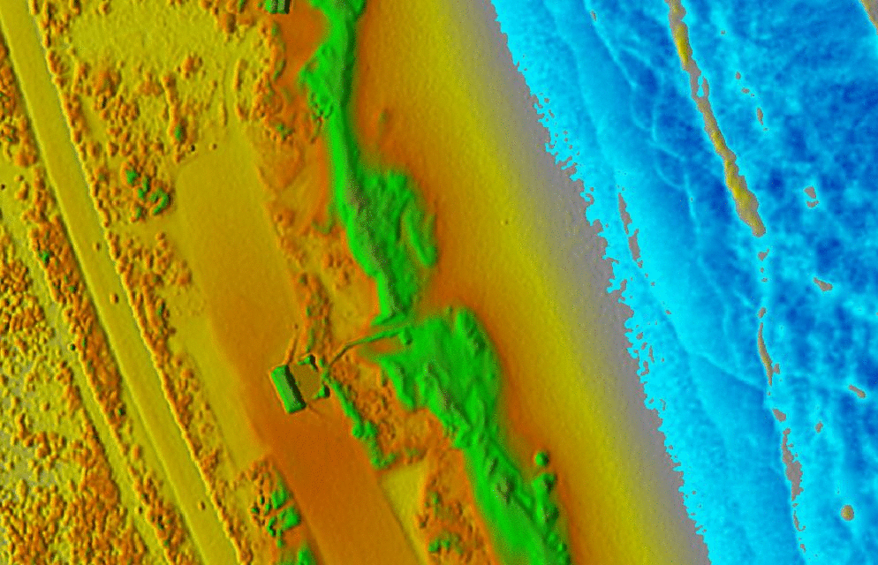
Coastal vulnerability
Identifying coastal
vulnerability from high resolution, lidar-based terrain models:
Degraded beach access
with low elevation

Slide 6
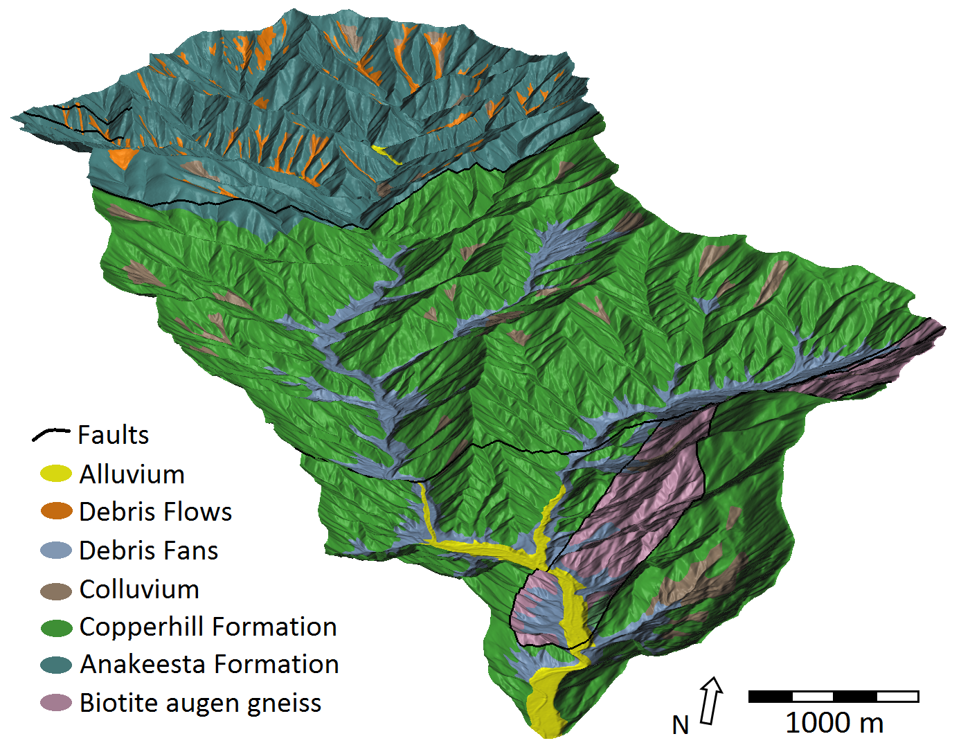
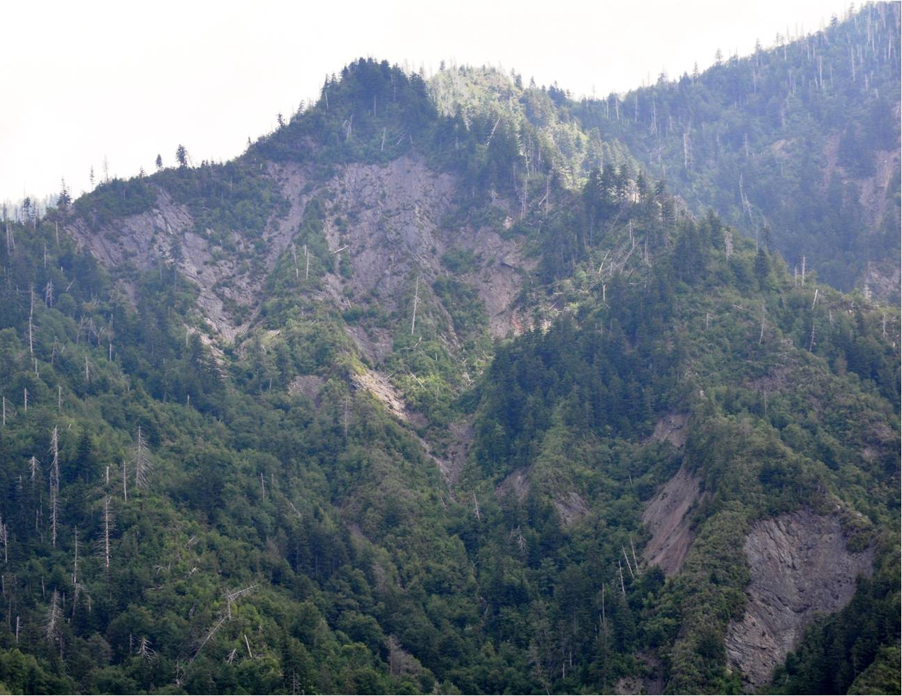
Lidar mapping in Smokies
Bare ground surface with geology
Notes:
6

Slide 7
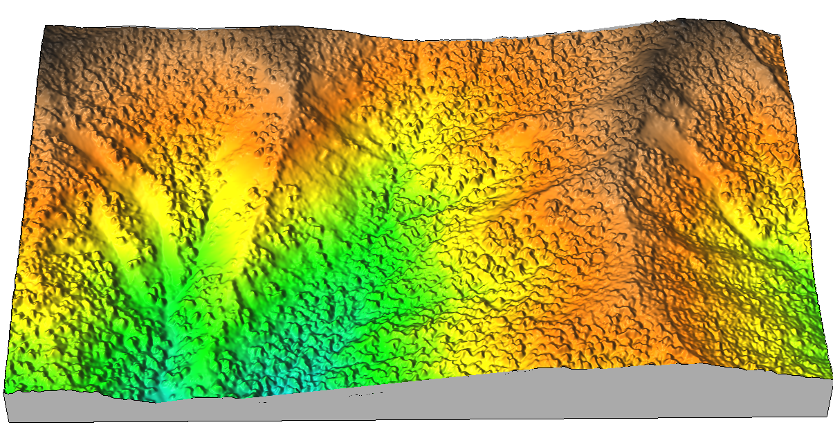
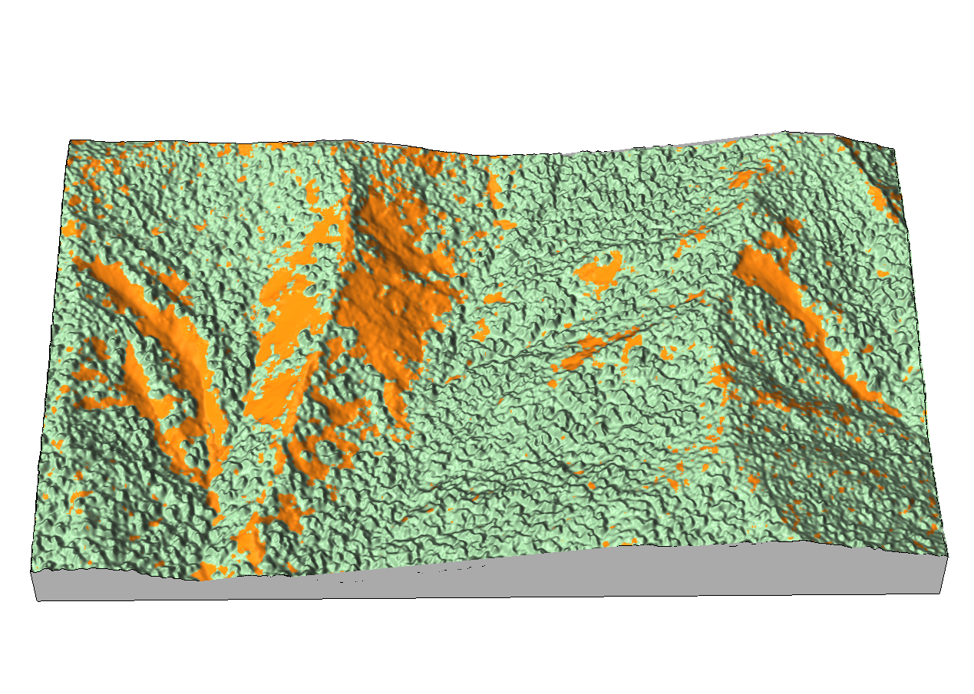
Landslides and surface flow
GIS-based mapping of landslides from airborne imagery and lidar,
flow tracing on landslides: impact on streams
m
1700
1500
1300
N
N
potential recent debris flow
0 400m

Slide 8
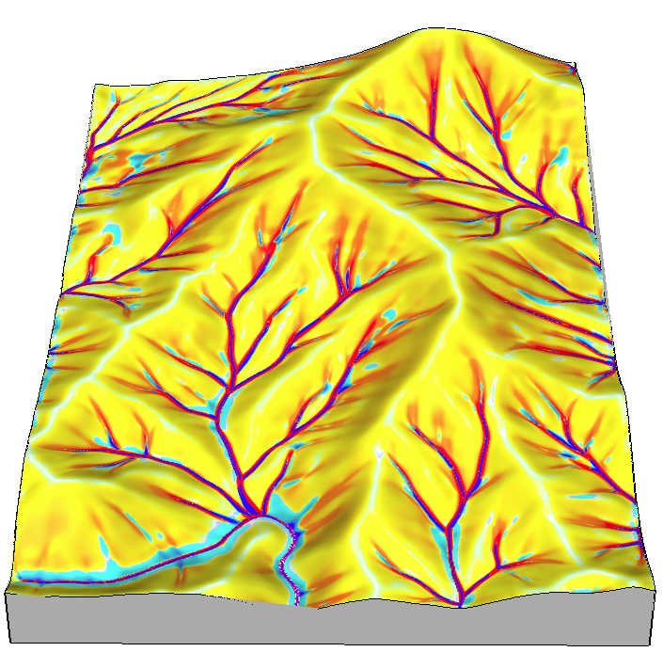
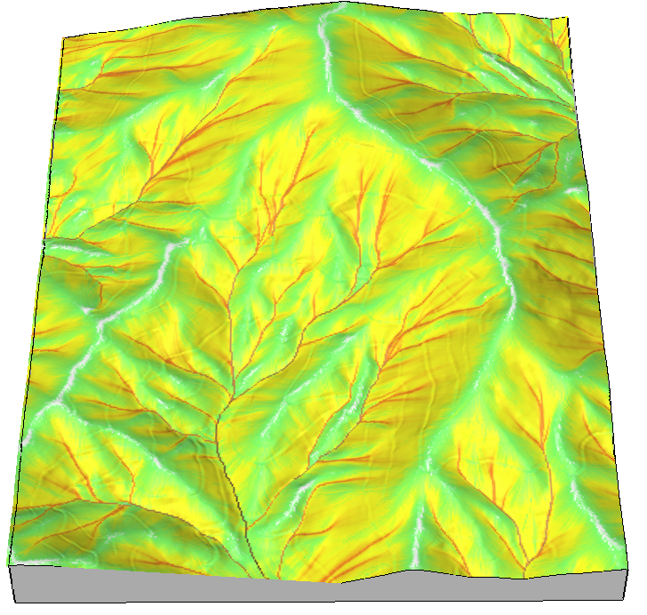
Sediment transport rate and net erosion/deposition rates
Appalachian Mountains, NC
15
10
5
0
Erosion
Deposition
500 m

Slide 9
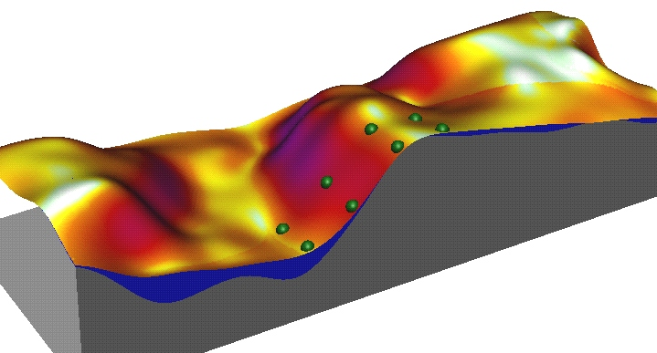
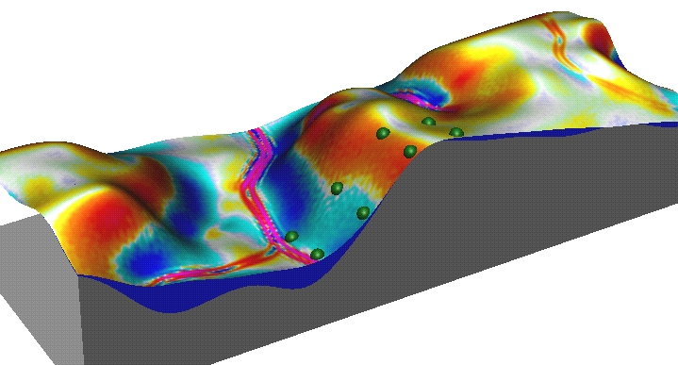
ESTCP demonstration project
Replacement of USLE by an erosion/deposition model with
the same rainfall, land cover and soil parameters as USLE
but generalized for complex topography.
It predicts locations of erosion and deposition and potential
for erosion by concentrated water flow (e.g. gullies, shallow streams).
Modeled soil erosion:
GIS-based USLE
Modeled erosion and deposition:
GIS-based USPED
t ha⁻¹ yr⁻¹
0
6
12
18
t ha⁻¹ yr⁻¹
6
0
-6
Deposition
Erosion

Slide 10
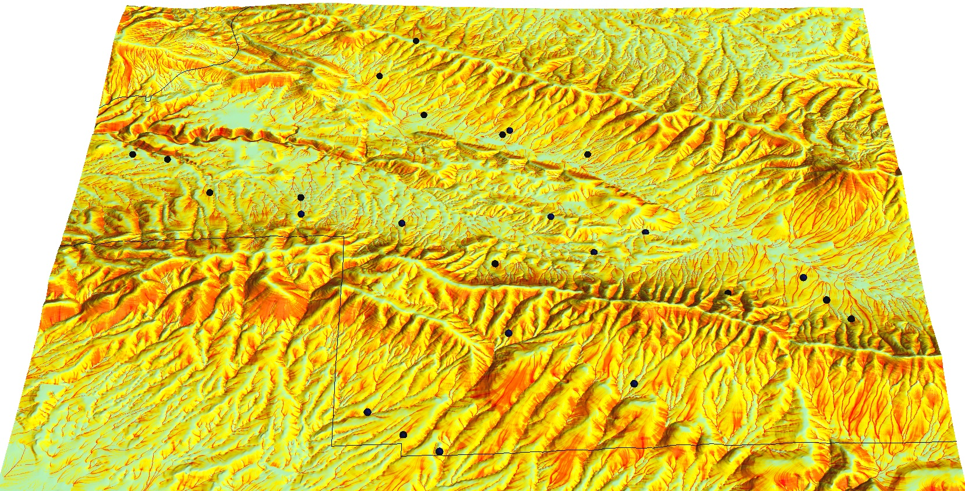
ESTCP demonstration project
Five test installations including Ft. Hood and Yakima.

Slide 11
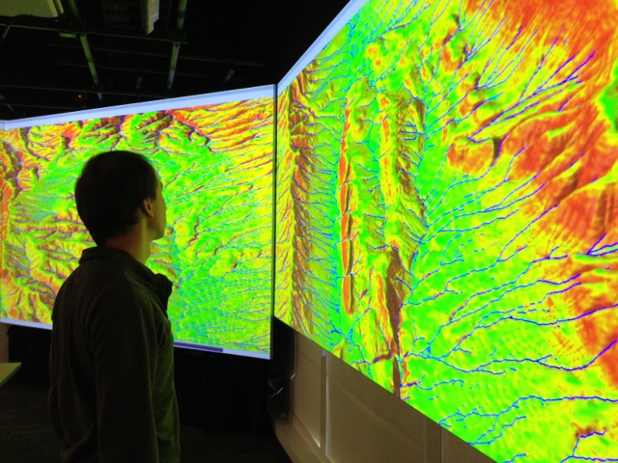
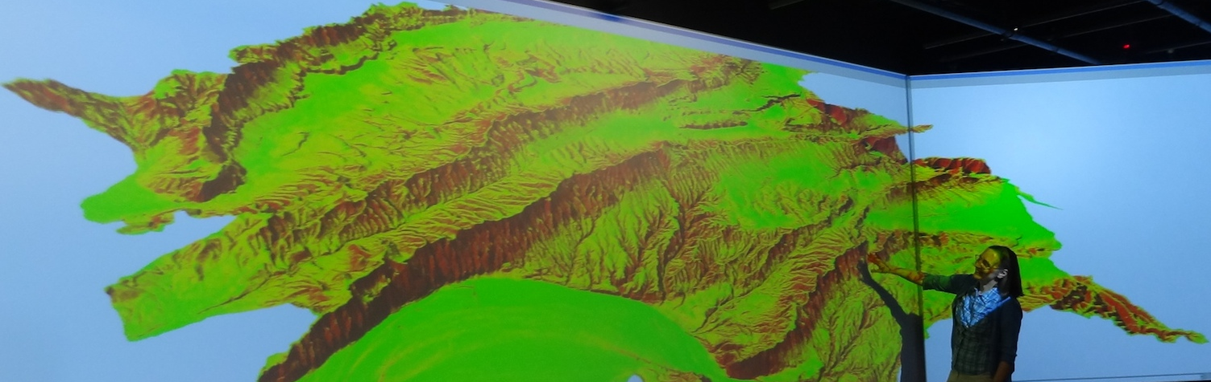
Interactive Visualization

Slide 12
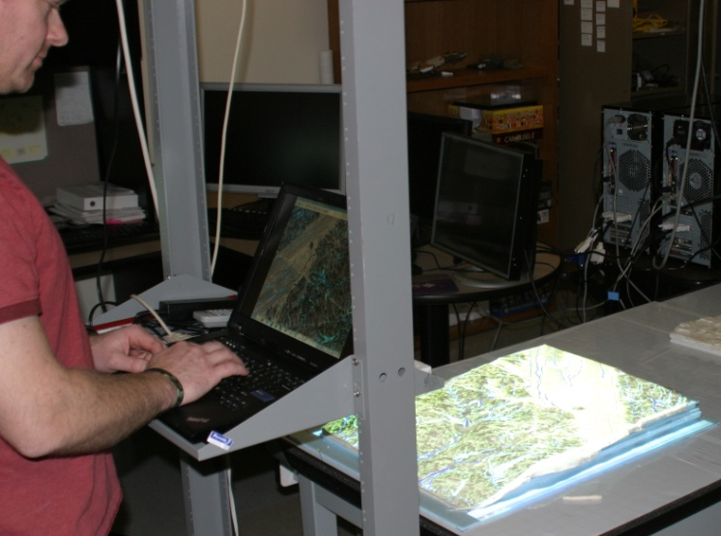
Runoff and Erosion modeling at Ft. Bragg
Brent D. Fogleman
Notes:
Now we can conduct analysis.
Analysis can include any operation that a GIS can conduct on a LIDAR DEM.
Processes that can be modeled include surface runoff, soil erosion and deposition, and solar irradiation.

Slide 13
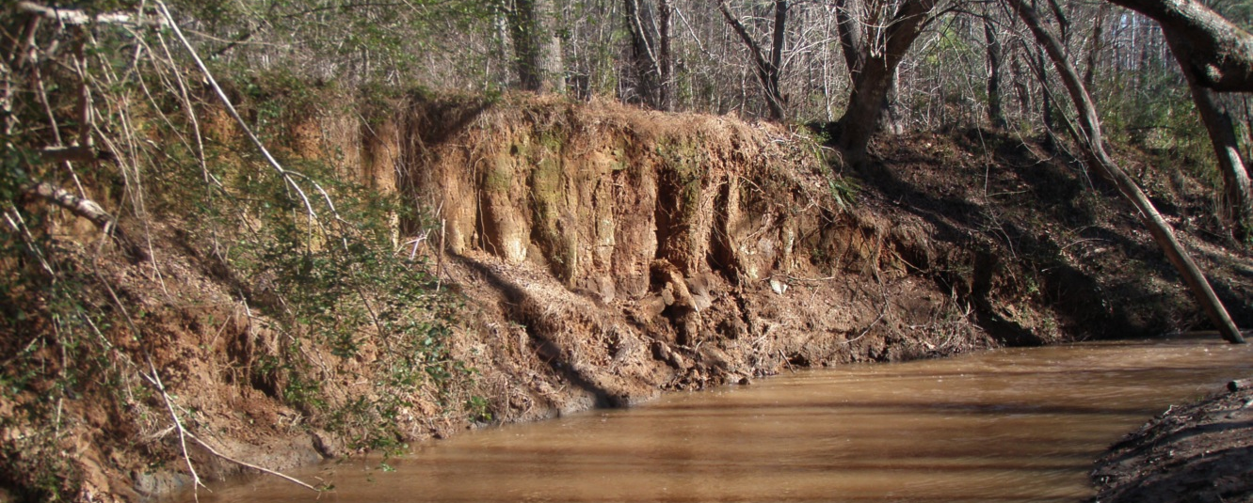
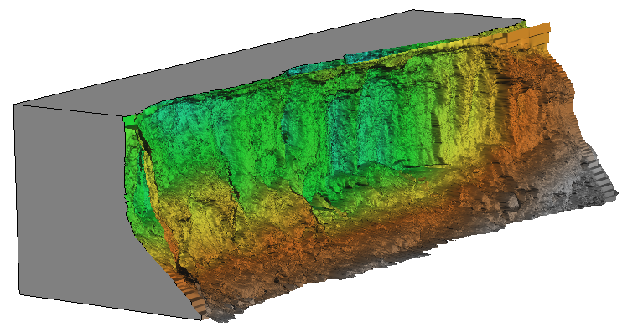
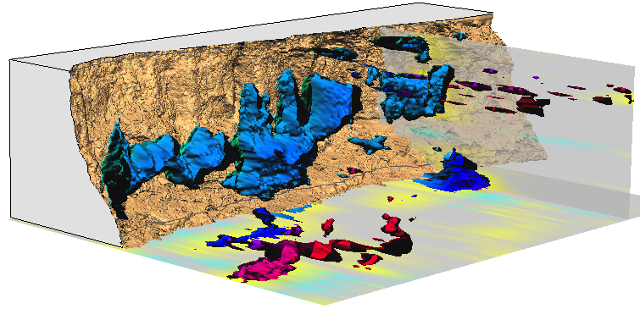
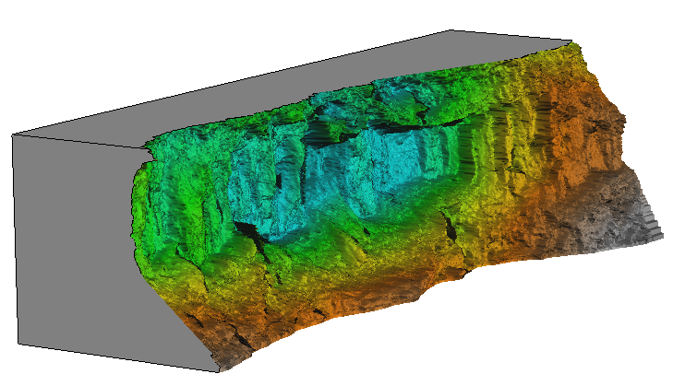
Monitoring eroding stream bank
Where and when was the change between two surveys greater
than 0.5m and what was its pattern?
Isosurfaces of change > 0.5 m
First and last scan of 9 total
5m
epochs
distance difference [m]
Dr. M. Starek, N. Lyons, K. Cepero, Dr. Wegmann
legacy sediment from old millpond, in farmland turned to state park
monitoring by Leica Scan terrestrial scanner – 8 epochs 2010 – 2012, 1cm res DEM
distance to base plane [m]

Slide 14
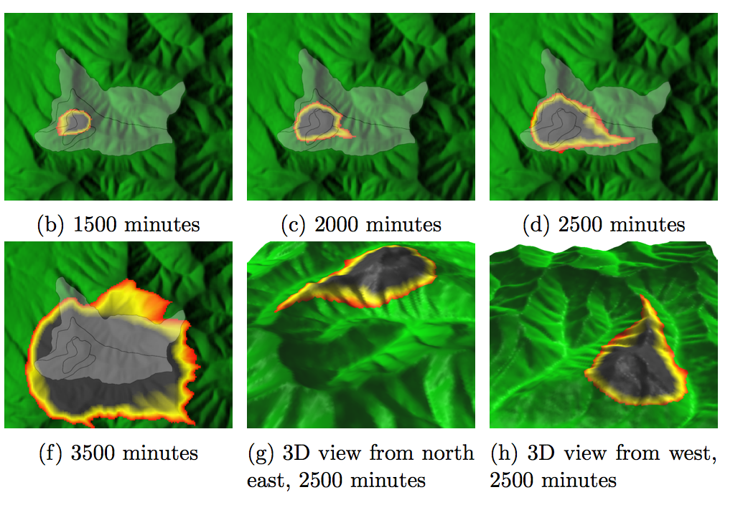
Project: Fire modeling in GRASS
Enhance wildfire modeling in GRASS to support time series input and dynamic visualization: r.fire.spread python module
Simulation of past fire in Shenandoah National Park

Slide 15
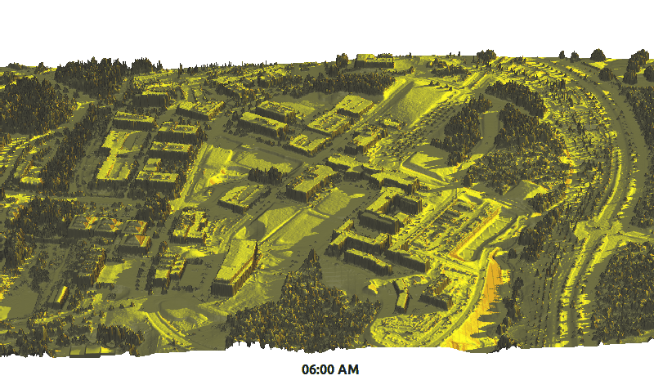
Insolation and cast shadows
Computes amount of solar radiation at any point each 30 minutes

Slide 16
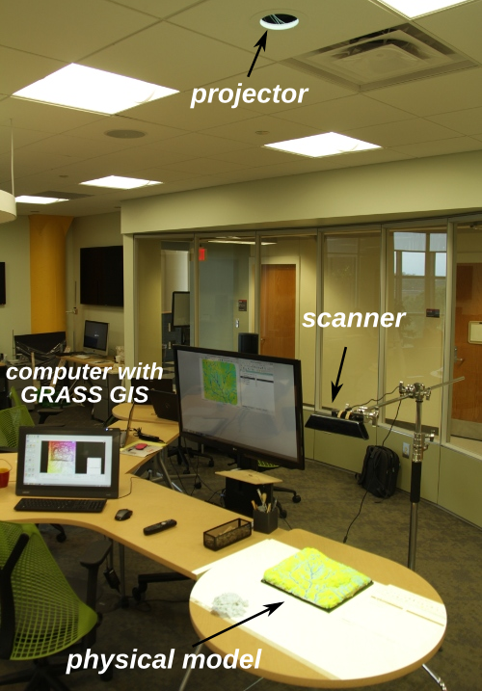
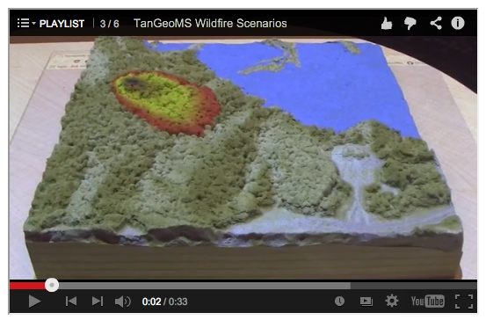
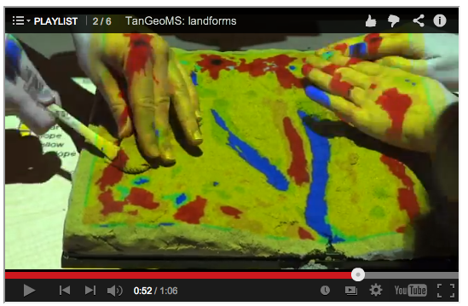
TanGeoMS
Tangible GIS interface
Landscape model is modified by hand and the response is projected on the model surface.
Kinect + projector + 3D model coupled in near real-time with GRASS GIS
Motivation for development of GIS-based simulation tools:
runoff, flooding, erosion, solar radiation, fire spread, dam breach, avalanches and others
see videos at: http://geospatial.ncsu.edu/osgeorel/tangeoms.html

Slide 17
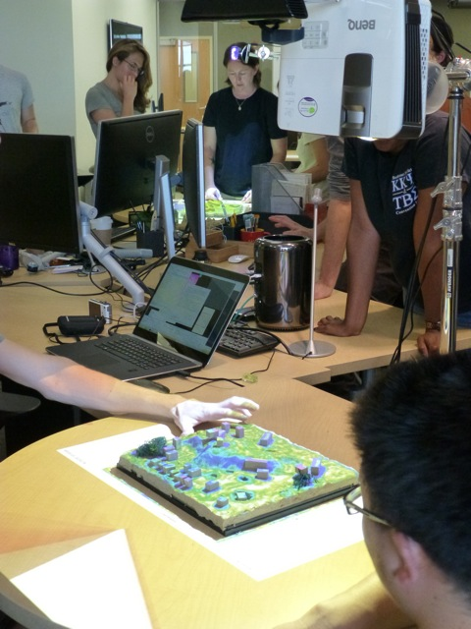
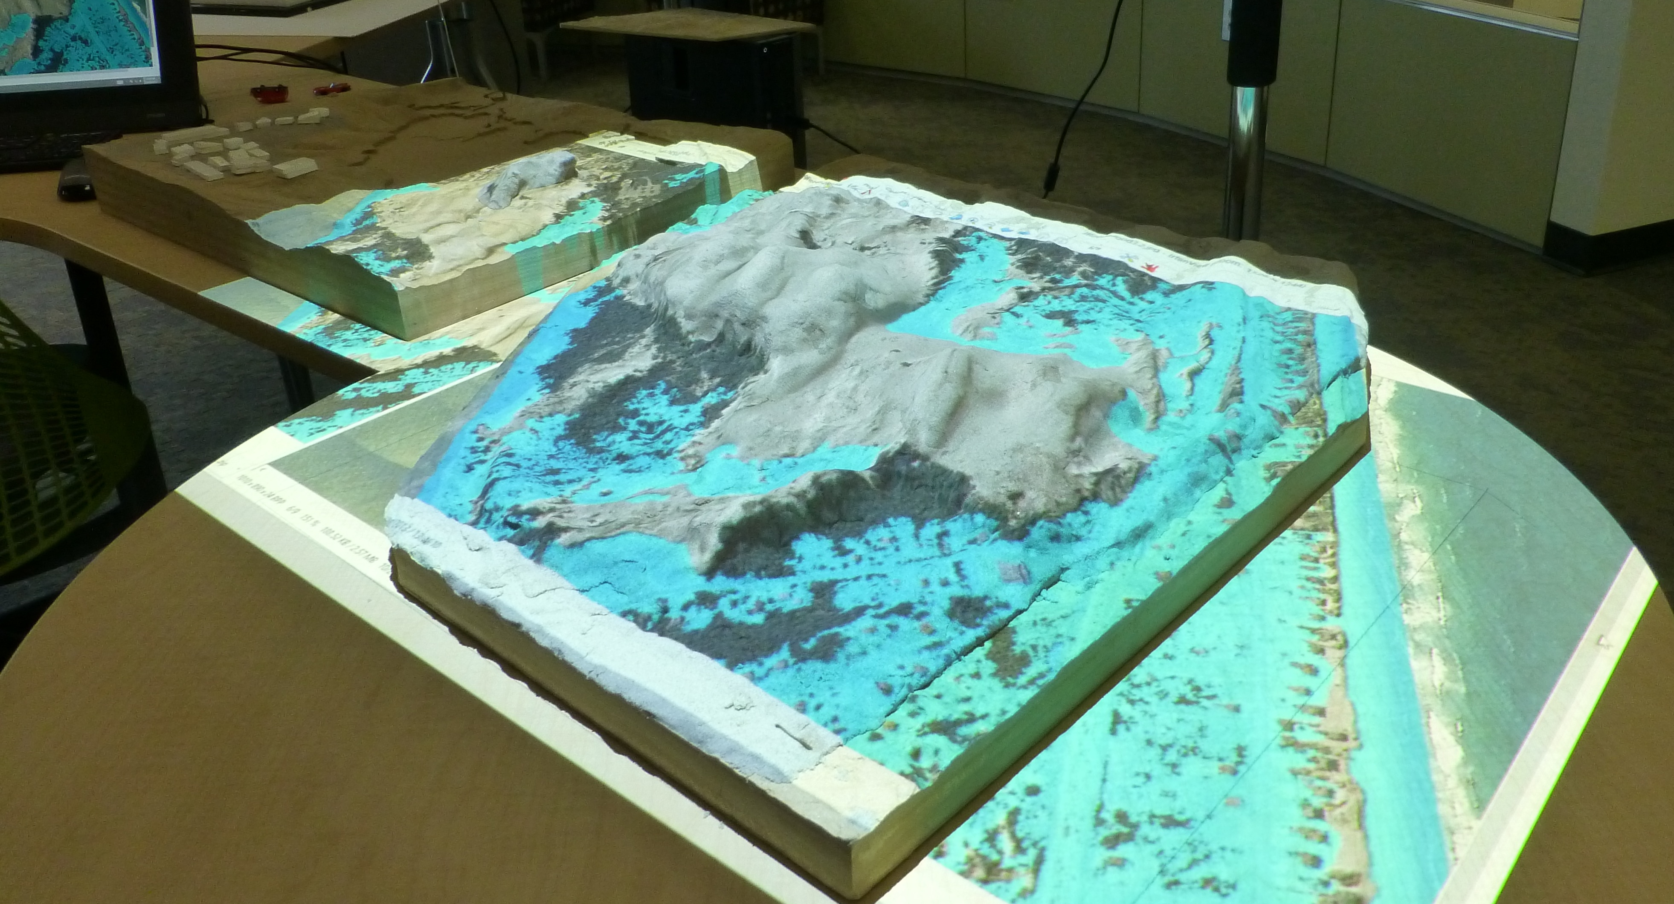
TanGeoMS

Slide 18
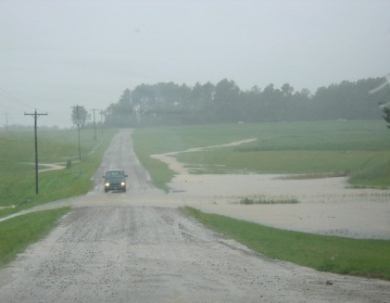
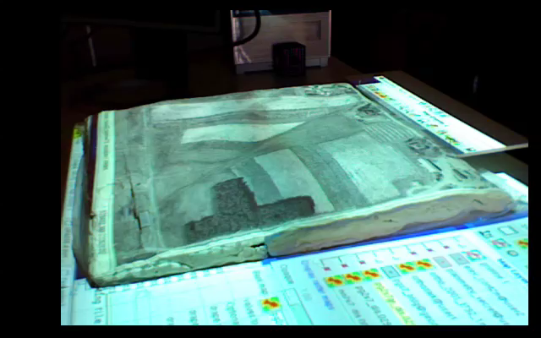
Tangible Geospatial Modeling System
http://www4.ncsu.edu/~hmitasowrriwork/tangis/tg1bak2_ed4_1min640.mov
N
2009 version
with laser scanner
Notes:
18

