Slide 1
Building open source geospatial education at research universities
Helena Mitasova, Makiko Shukunobe
North Carolina State University, Raleigh, NC, USA
Martin Landa, Anna Kratochvilova
Czech technical University, Prague, CR
and contributions by NCSU students
GRASS GIS
Notes:
Over the past decade free and open source software (FOSS) has moved into mainstreem and its growth includes a wide range of geospatial software tools. The presentation will briefly describe the principles of FOSS and provide an overview of major FOSS projects that support management, processing, analysis, visualization and on-line distribution of georeferenced data. Interoperability between the different tools enabled by the FOSS concept will be highlighted using examples of applications that combine software developed by several projects, such as GRASS, Mapserver, GDAL, PROJ, R-stats, PostGIS, paraview and others. Special focus will be given to the recent new developments in Geographic Resources Analysis Support System (GRASS, http://grass.itc.it). Since its original design as a land management tool for military installationsthe system has evolved into one of the most comprehensive, general purpose GIS and support for environmental modeling has been an integral part of its development. Overview of the GRASS6 capabilities relevant to environmental modeling will be provided, including tools for working with 2D and 3D raster data, the completely redesigned topological 2D/3D vector engine, vector network analysis and SQL-based attribute management. Various graphical user interfaces, such as QGIS and JAVAGRASS, that are being used with GRASS will be introduced and enhancements to 3D dynamic visualization will be presented. Environmental modeling will be illustrated by examples in the area of coastal management and sediment pollution control using the latest lidar data and new or updated GRASS6 modules. The talk will conclude with discussion of visions for the future of FOSS geospatial modeling.

Slide 2
Motivation
GIS teaching at universities: prevailing proprietary software
Science and engineering programs need more flexibility and portability
Organizations with limited resources need GIS capabilities
Gov. agencies and industry need open source software to design custom solutions

Slide 3
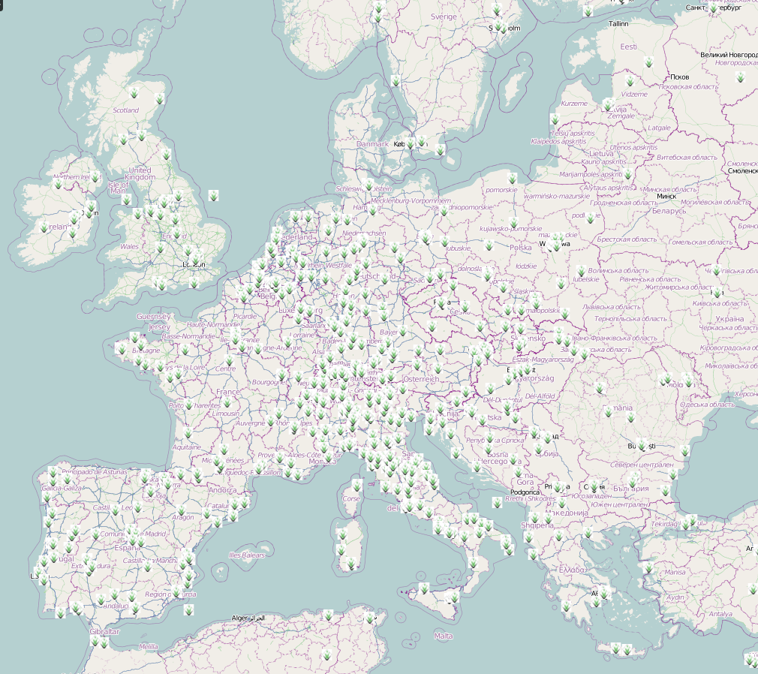
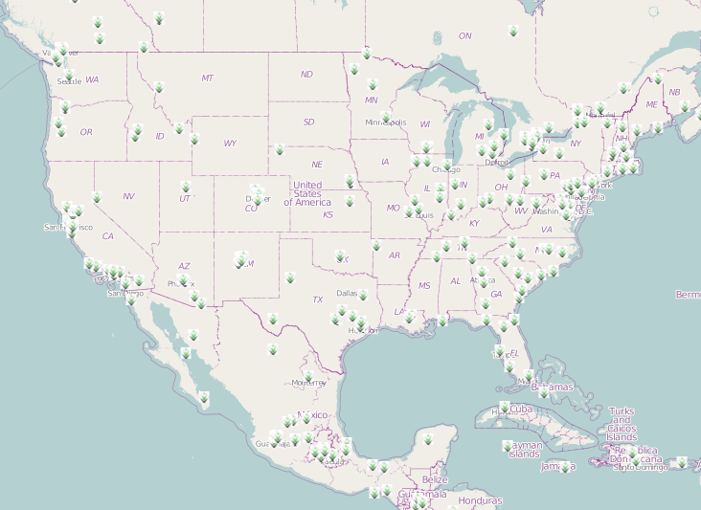
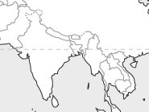
What works
Research
open source GIS: used in research labs worldwide, represented at
FOSS4G Academic Sessions
Journal special issues: TGIS, AG, IJGI
Symposia and local conferences
Sessions at major meetings: AGU, AAG
Education
Short courses and workshops
Summer schools
OSGeo Live DVD
Sample Conferences
in 2012

Slide 4
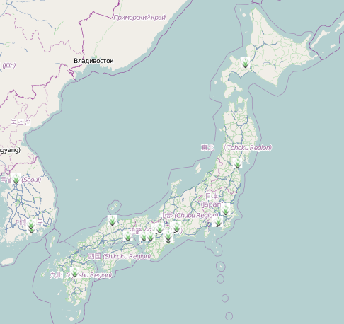
What needs more effort
Full courses
in spite of excellent examples present here, only fraction of GIST programs has well established set of full courses that incorporate open source software development and applications
sample university programs with open source GIS
Repositories
ELOGeo: Conferences (16 - 2012), Education (16 - 2011), Learning (23-2012), Use cases (8)
OSGeo Edu repository, svn

Slide 5
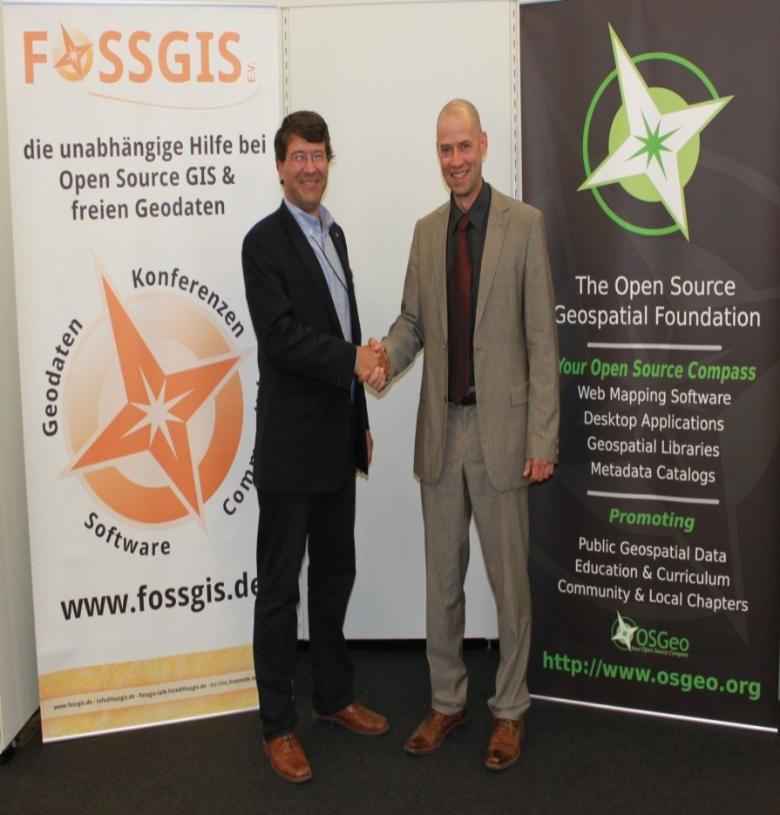
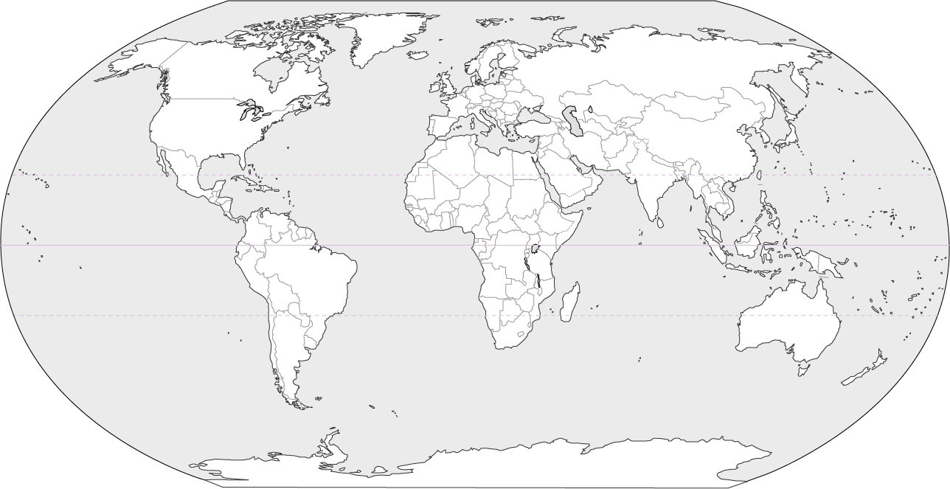
What may help
Global network of Open Source Geospatial Research and Education Laboratories:
ICA-OSGeo MOU: build teaching and research infrastructure worldwide
open network: please join!
current laboratories, more announced
University of Pretoria, South Africa
University of Nottingham, UK
University of Girona, Spain
Federal University of Paraná, Brazil
UNottingham Malaysia Campus, Malaysia
NCSU, USA
thanks to Suchith Anand at Nottingham University: organizers of FOSS4G2013

Slide 6
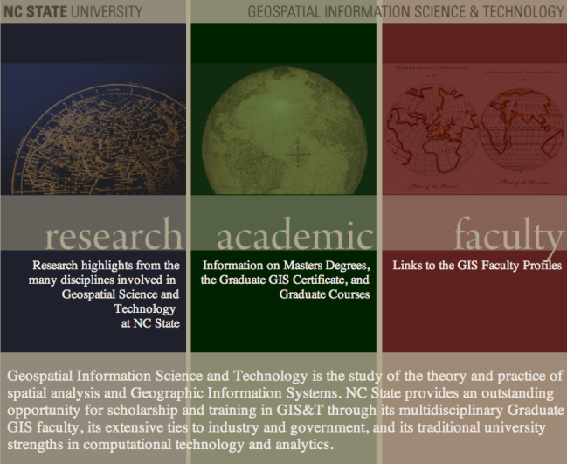
Open Source Geospatial at NCSU
NCSU Open Source Initiative
supported by RedHat: the largest open source software company
Certificate and MS program in GIST
interdisciplinary: no geography dept.
FOSS4G integrated into courses along with proprietary software
core GRASS-based course, elective courses: python, PostGIS and WebGIS applications: OpenGeo stack

Slide 7
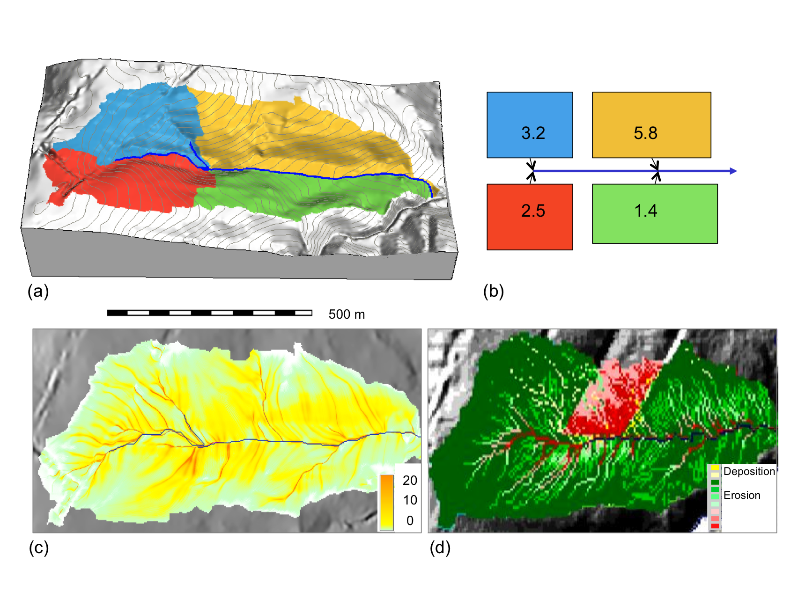
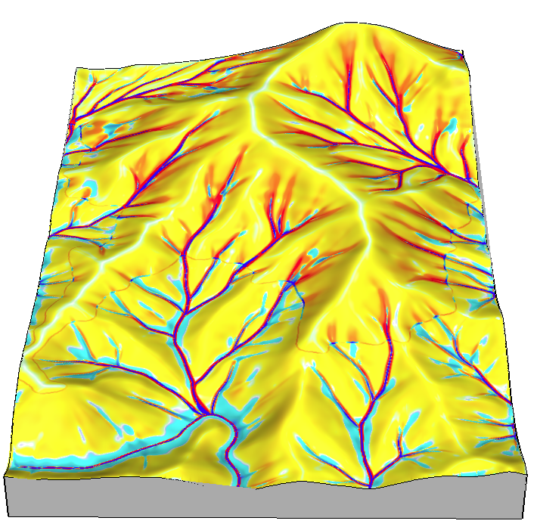
Course: Geospatial Modeling
Lectures:
fundamentals and methods
software independent
Weekly Assignments:
GRASS GIS + ArcGIS
“flipped approach”: given workflow, explain methods and results
Independent project:
thesis-based or selected topic
students chose software
combining is encouraged

Slide 8
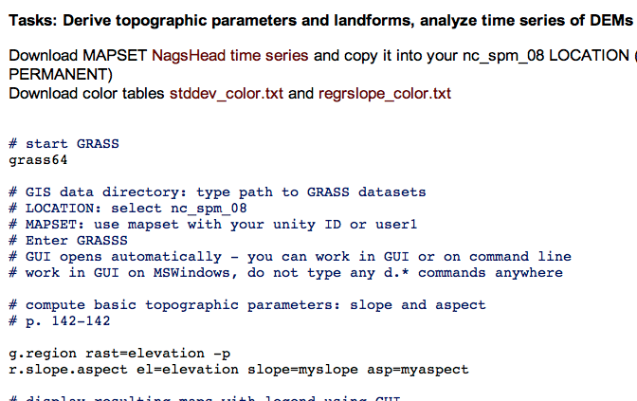
Internet-based section
Screen capture with audio:
lectures
interactive tools such as visualization
Assignments for GRASS, ArcGIS:
in plain html for easy updates
Course is free online
message board discussion, help
Google sites: post HW, get feedback
register to get credit
Most students: experienced ArcGIS users, with backgrounds in engineering, natural resources, earth sciences

Slide 9
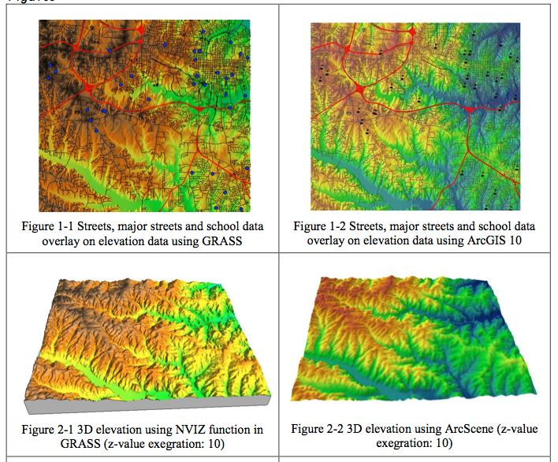
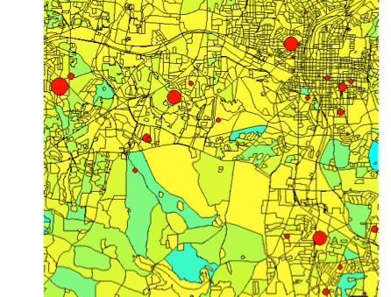
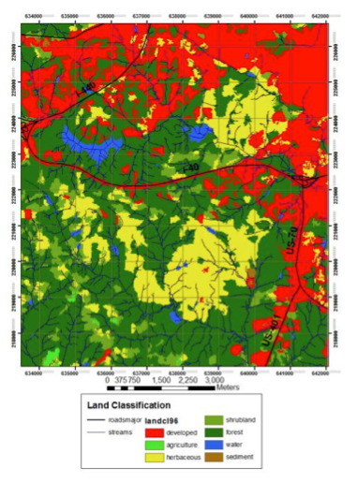
Assignment: Data Display
Display provided data in 2D and 3D to support spatial analysis
GRASS
ArcGIS
GRASS ArcGIS

Slide 10
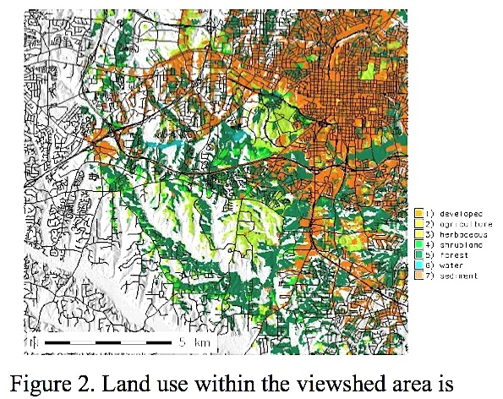
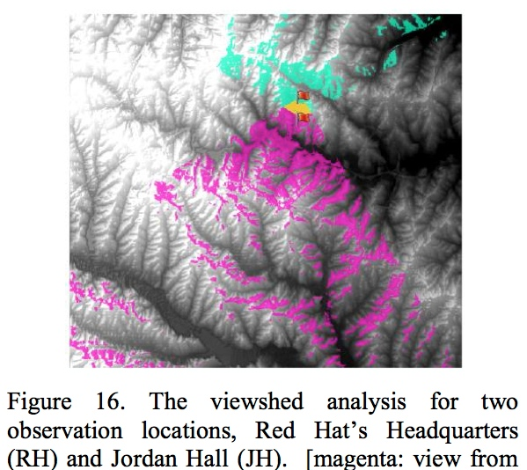
Assignment: Viewsheds
Analyse land cover composition visible from a given building in GRASS
Assess visibility between two buildings in ArcGIS
Do not compare software but explain concepts and interpret the results
GRASS ArcGIS

Slide 11
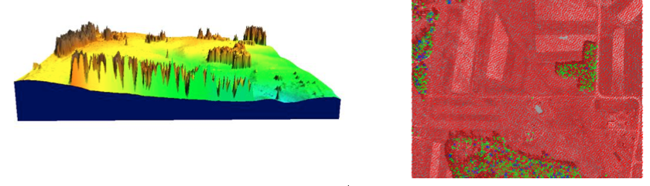
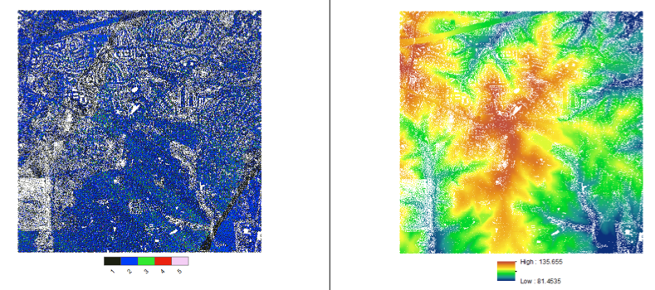
Assignment: Lidar
Compare DEM and DSM, analyze lidar point cloud properties
GRASS
ArcGIS

Slide 12
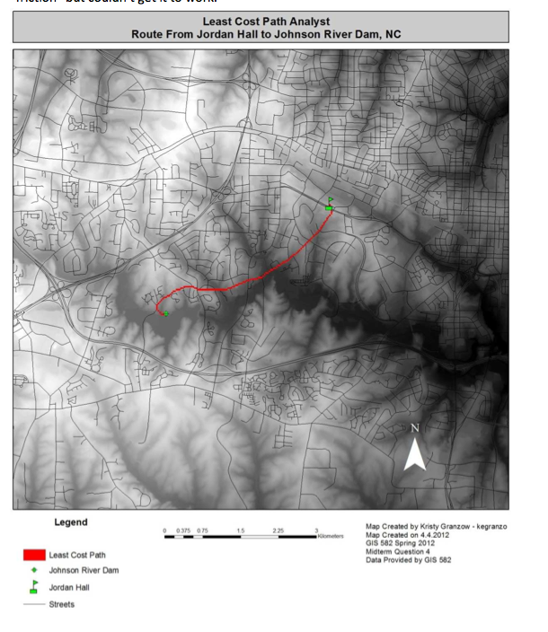
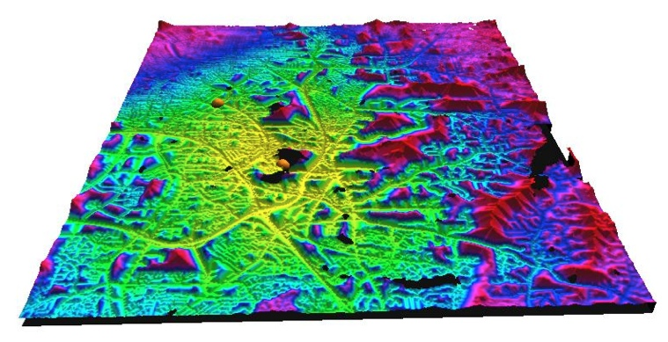
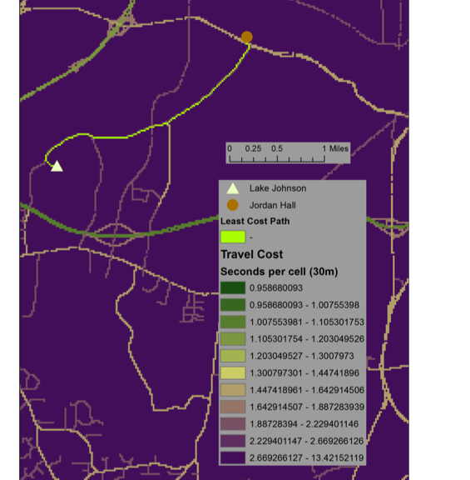
Midterm exam
Find least cost path between two given off-road locations using GRASS or ArcGIS. Examples of results visualization
GRASS

Slide 13
Independent Projects
Core of the course
Define problem, acquire data,
Develop workflow, produce and present results
Most students use ArcGIS but number of students who use GRASS for at least part of their project is increasing every semester
Example topics
Coastal dynamics
Solar irradiation and energy potential
Lidar data processing and Watershed analysis
Cost surfaces and least cost paths
Hazards mapping and response management
Process modeling
Utilities planning and assessment
Open source GIS development

Slide 14
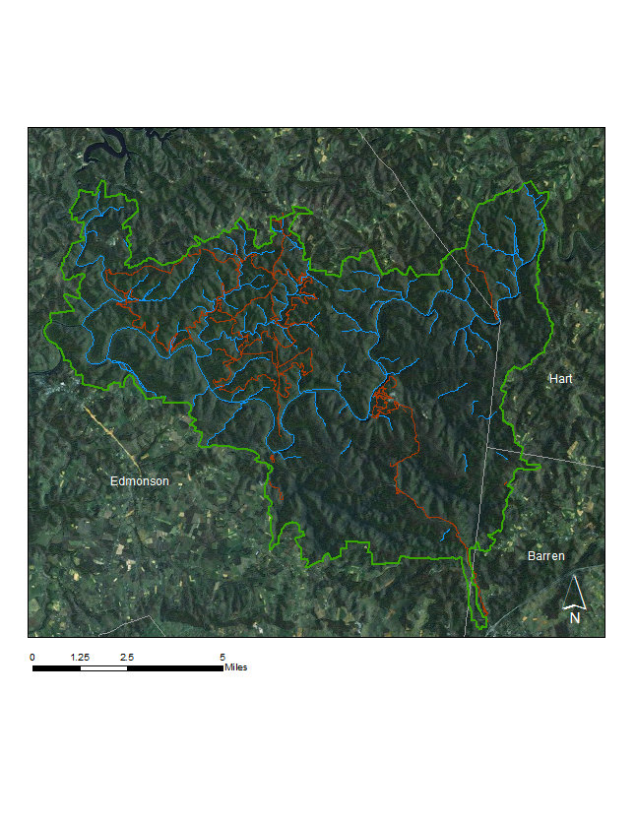
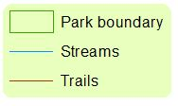
Project: Mammoth Cave National Park
Objective: Map karst landforms and canopy height from lidar data
Lidar mapping:
multiple return,
waveform data
Workflow:
point cloud
filter with
lasTools
analyze DEM,DSM with
GRASS
The longest cave network in the world:
350 miles surveyed
3D model by lidar on a robot
Student:
Makiko Shukunobe
Notes:
213.795 km²
[

Slide 15
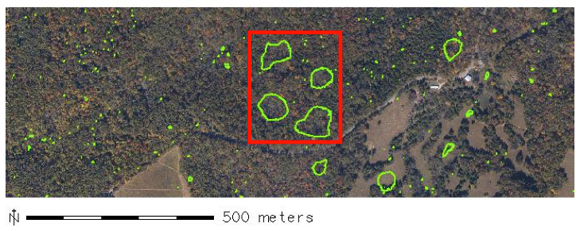
Project: Mammoth Cave National Park
Mammoth Cave national park lidar mapping: assessment of canopy height, analysis of karst landforms
Tree height [m]

Slide 16
Project: Mammoth Cave National Park
Bare earth surface reveals karst morphology
Tree height
volumes from NCAR data
Bare earth
(Spline)
(m)
1.5 km

Slide 17
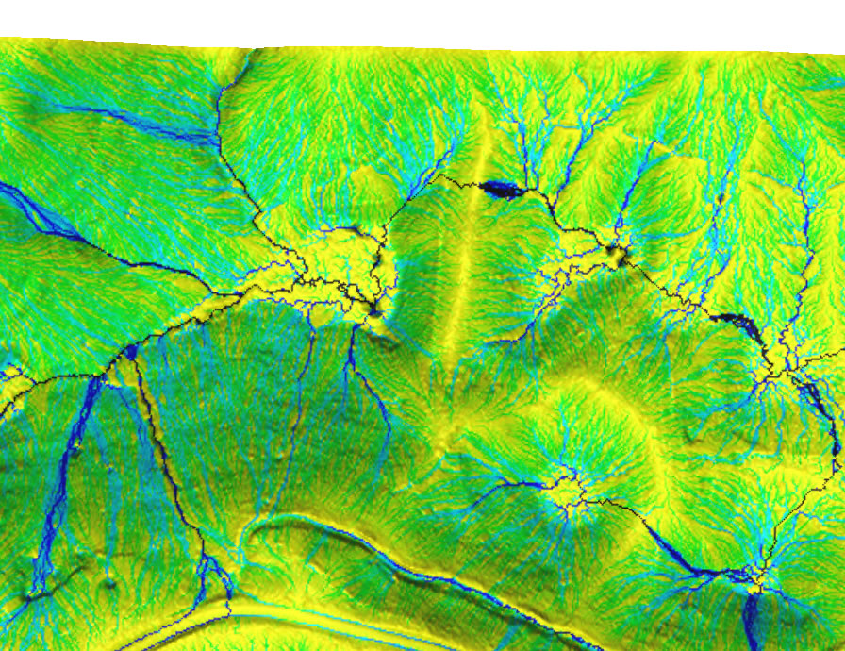
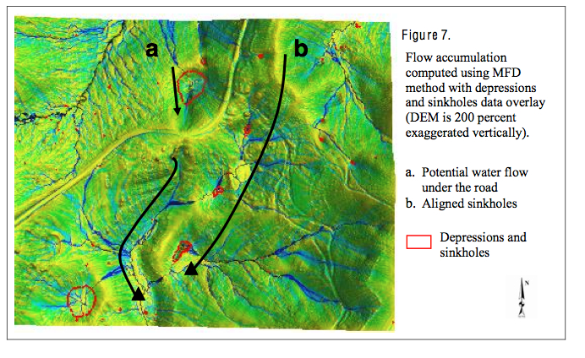
Project: Mammoth Cave National Park
More to do: waveform data, vegetation composition, archeological exploration
Results of each project provided to the park
Work continues in subsequent courses, potentially becomes a capstone project for the degree

Slide 18
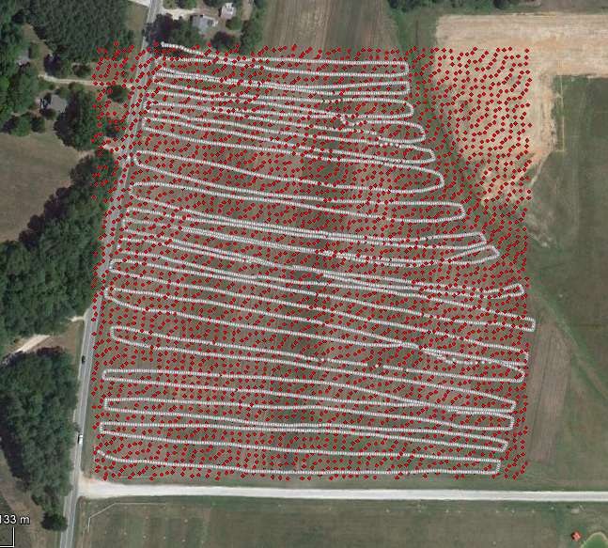
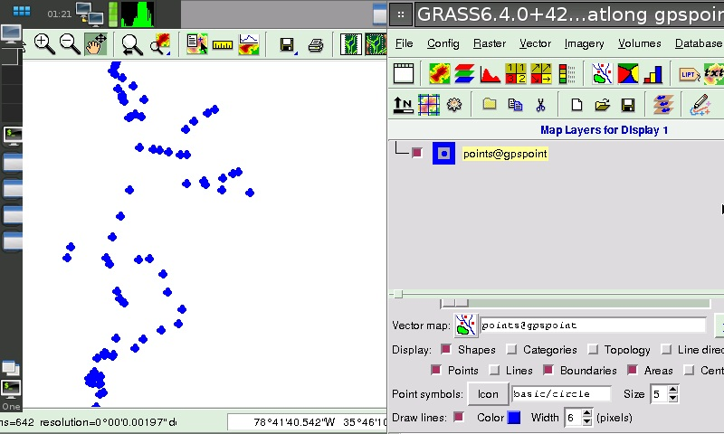
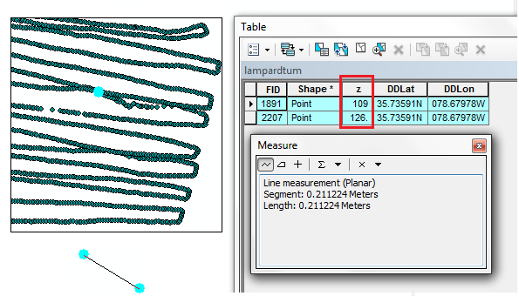
Project: DEM by mobile phone
Objective: Create Digital Elevation Model Using a Mobile Device and
compare it to lidar-based DEM
300m
Approach: GRASS on Debian phone
+ lidar points + phone GPS
In 2 hours 6000 points collected
In 21cm 17meter
elevation difference
Student: Ali Ihsan Durmaz

Slide 19
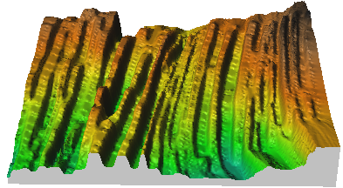
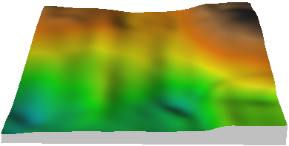
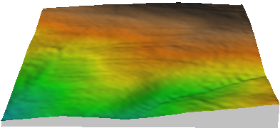
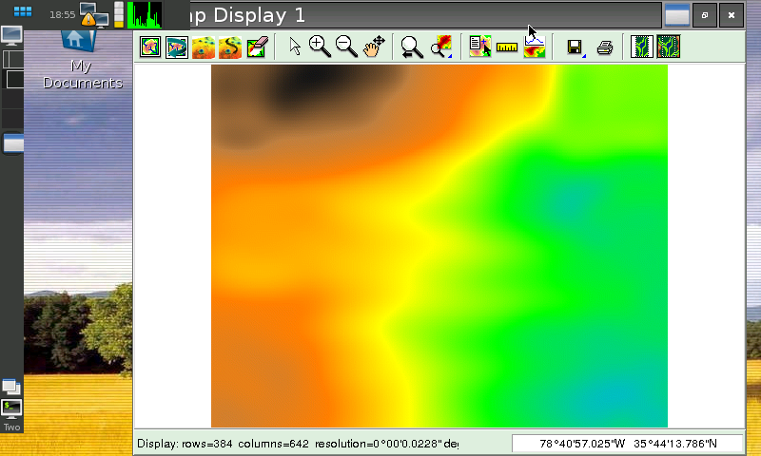
Project: DEM by mobile phone
Interpolated DEMs
96% area within 5m difference,
80% area within 3m difference
300m
smoothing spline lidar based DEM
interpolation by IDW – data captured while going in different directions are shifted
Screen view from
the mobile device
Student: Ali Ihsan Durmaz

Slide 20
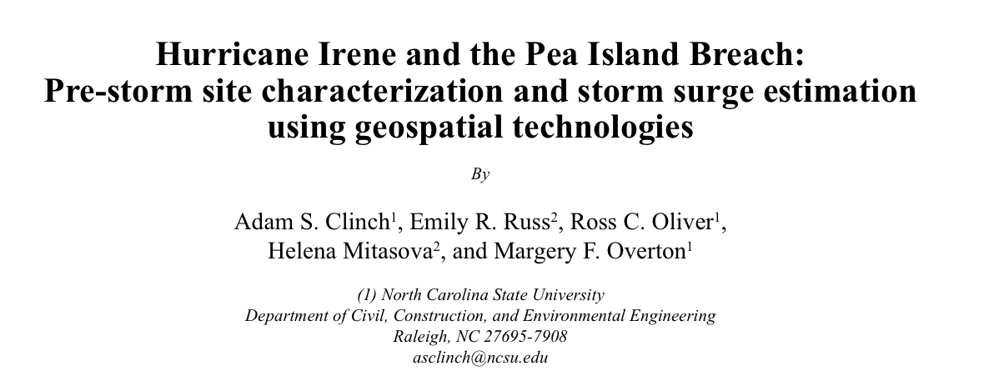
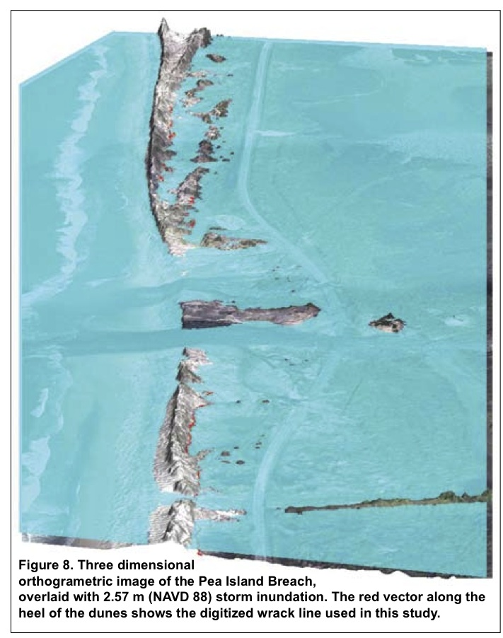
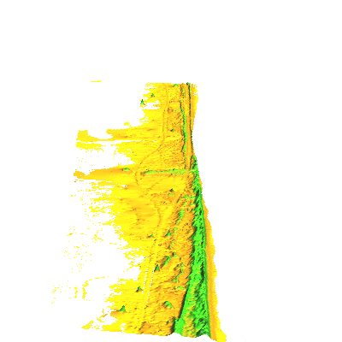
Project: Coastal Flooding
Several team projects lead to a published paper
published in Shore & Beach 80(2) spring 2012

Slide 21
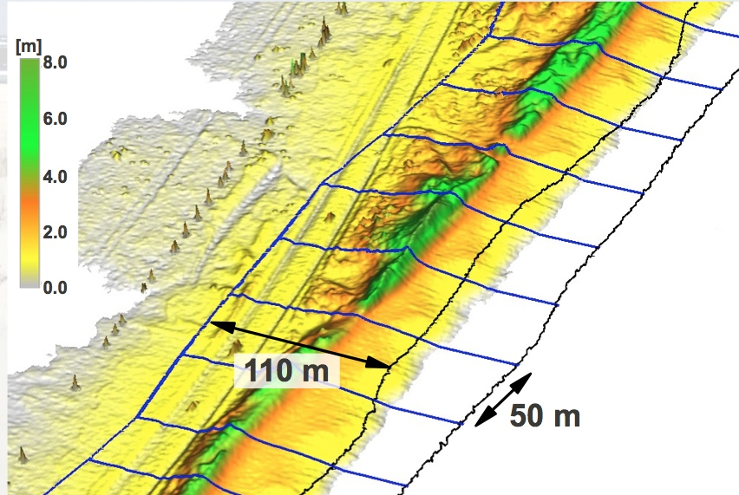
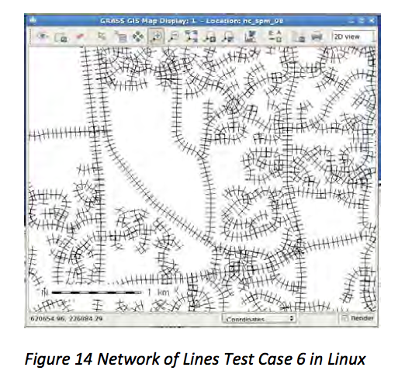
Student projects: development
Graduate students from industry bring their own expertise
Example: v.transects add-on generates transects and boxes for shoreline, channel or road crossections and volumes.
Independent module testing by a student with IT background, fixing bugs, modifications for portability
parameter verification test set
3 different data sets test sets
run original script in Linux
run fixed script in Linux and on Windows
Full report linked to man page
After testing and fixes submitted through SVN

Slide 22
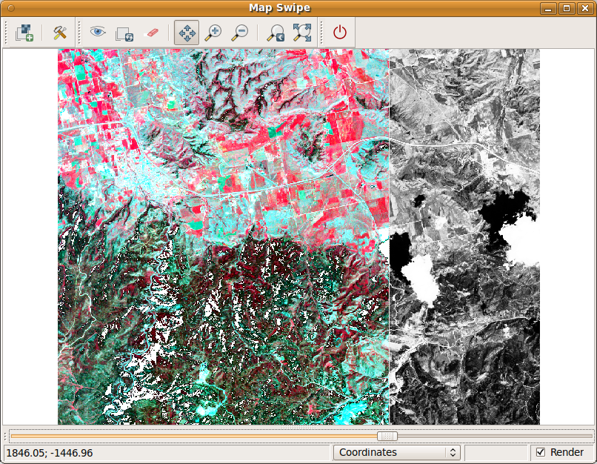
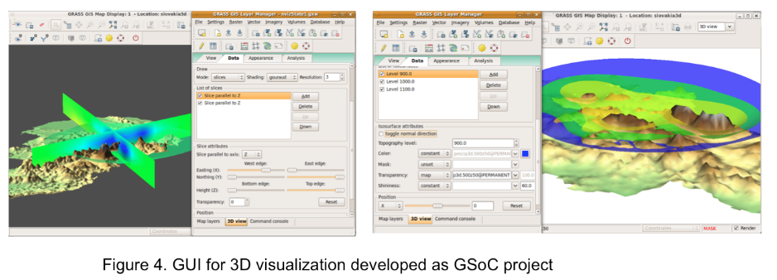
Beyond courses: Research and collaboration with CTU Prague
Google summer of code 2008, 2010, 2011:
GRASS GIS Development,
Visualization tools for time series and 3D
new interface: wxnviz
improved volumes in wxnviz
new tools: map swipe, animations
Research and development collaboration
CTU team - Martin and students: development of visualization tools
NCSU team: data collection, processing, applications

Slide 23
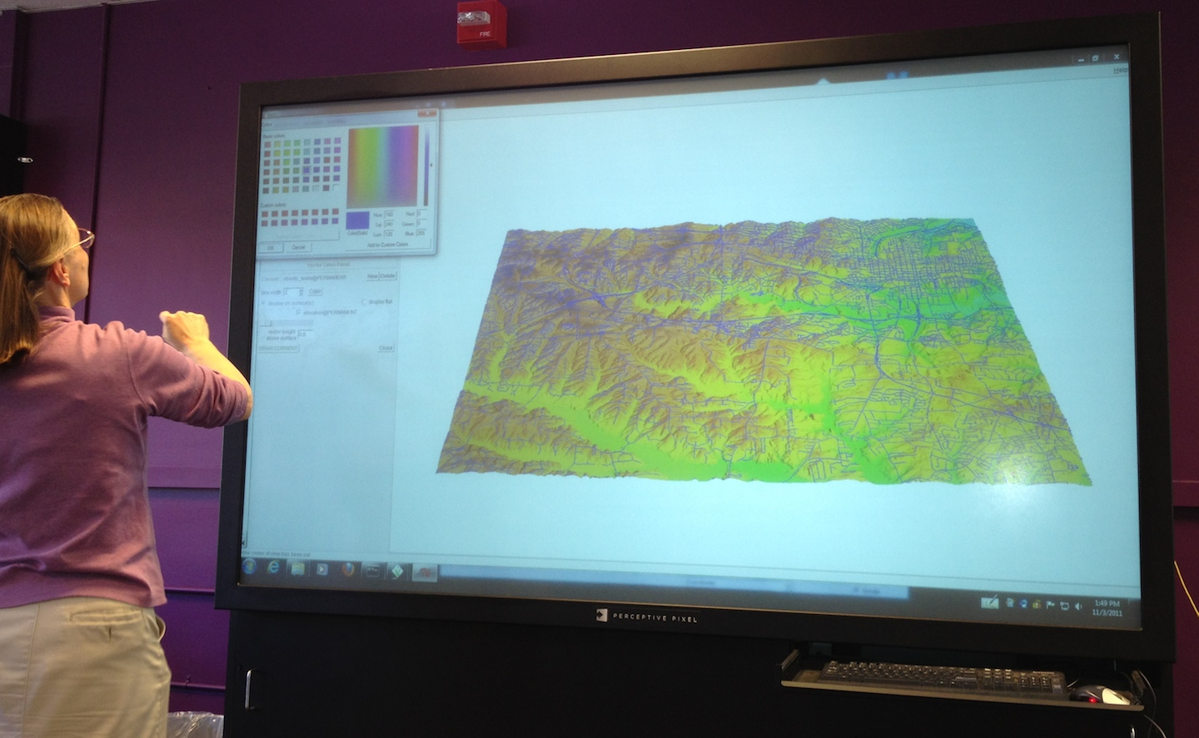
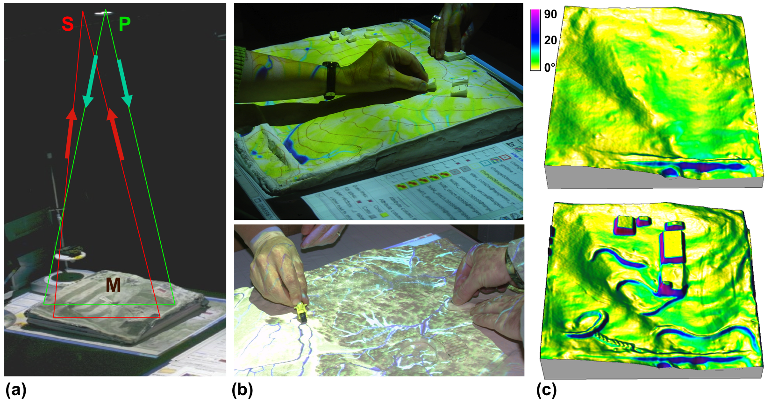
NCSU Research using GRASS
Lidar data time series analysis
Coastal terrain dynamics
Terrestrial lidar mapping
Tangible Geospatial Modeling System
Erosion modeling

Slide 24
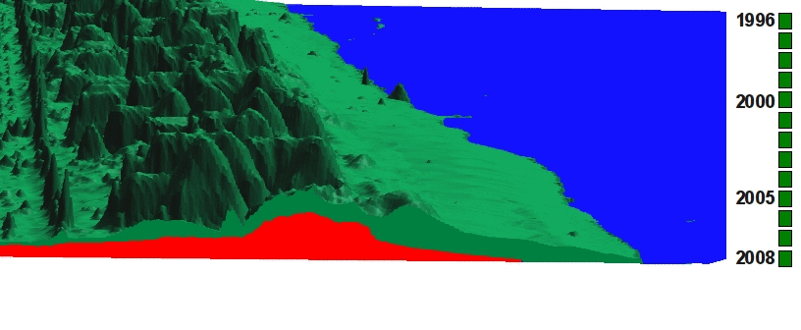
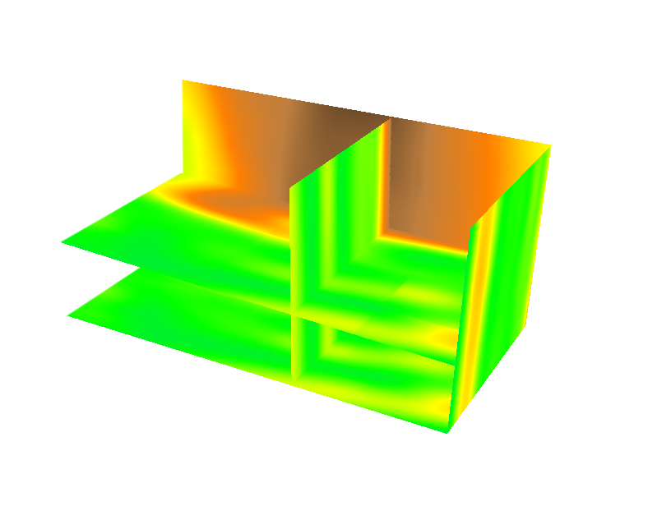
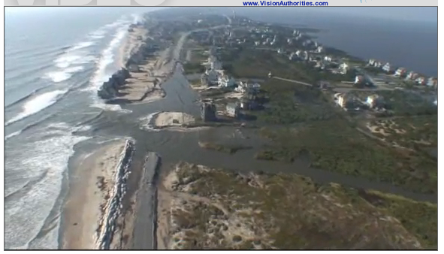
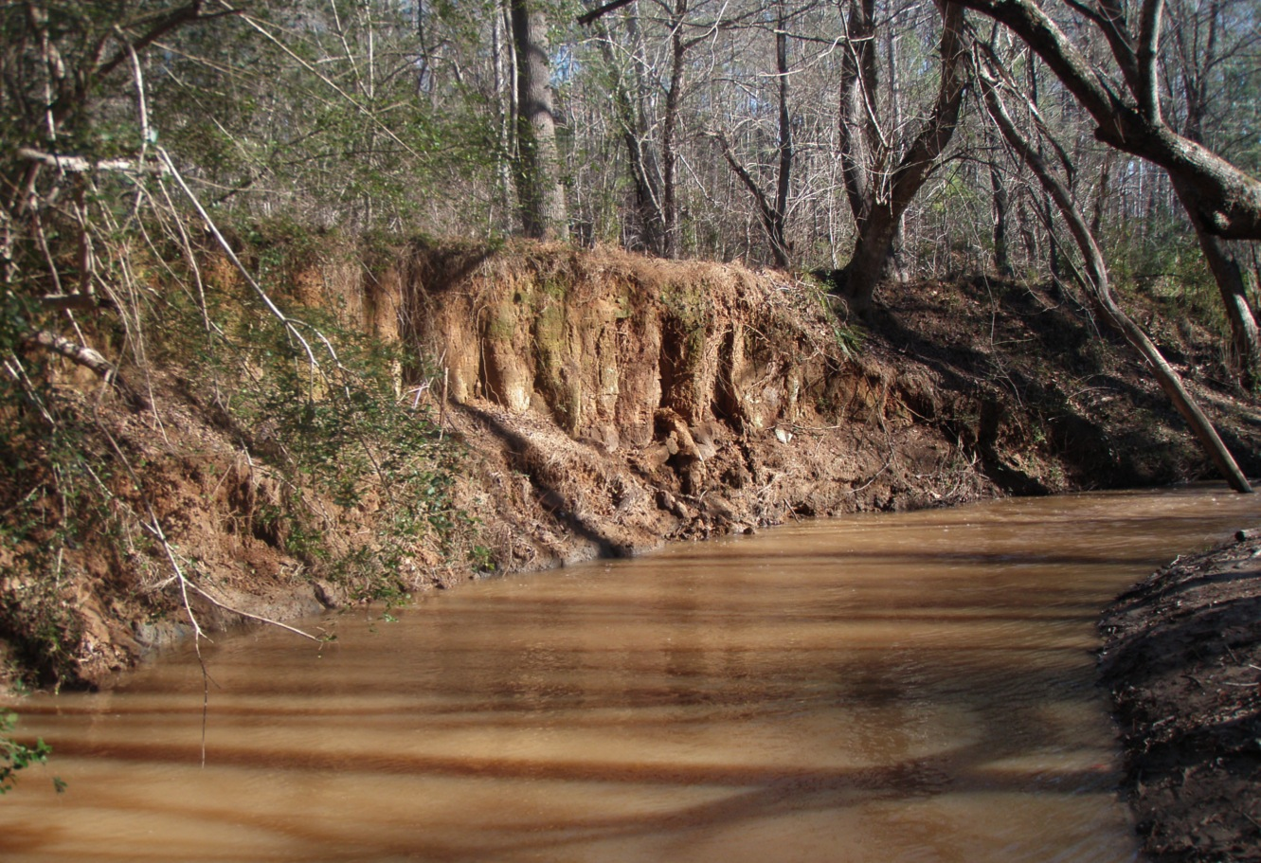
Lidar time series analysis
1D feature change:
shorelines, dune crests
tracing feature migration along transects
2D pattern of elevation change:
Difference of DEMs, volumes
Per cell statistics applied to DEM time series : core and envelope concept
3D space-time cube: z=f(x,y,t)
Applications:
Coastal terrain change
Eroding stream bank in Piedmont
coast photo
Notes:
cite work by others here! Add figure for all features – crests, peaks, shorelines

Slide 25
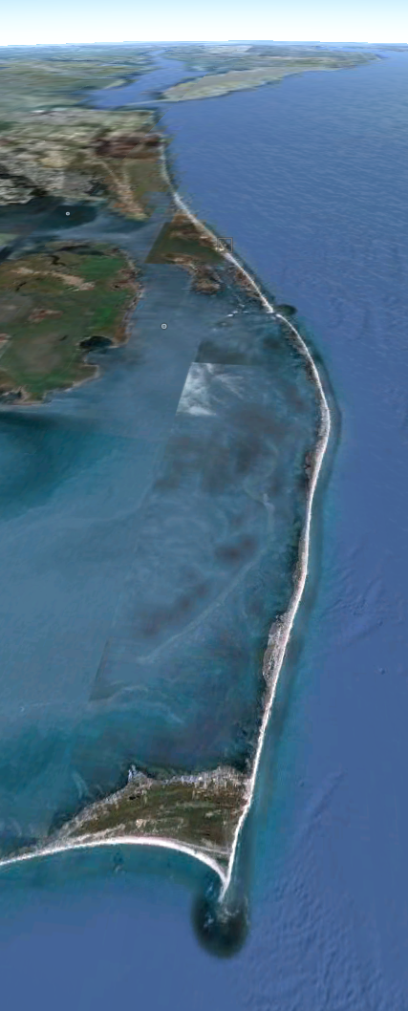
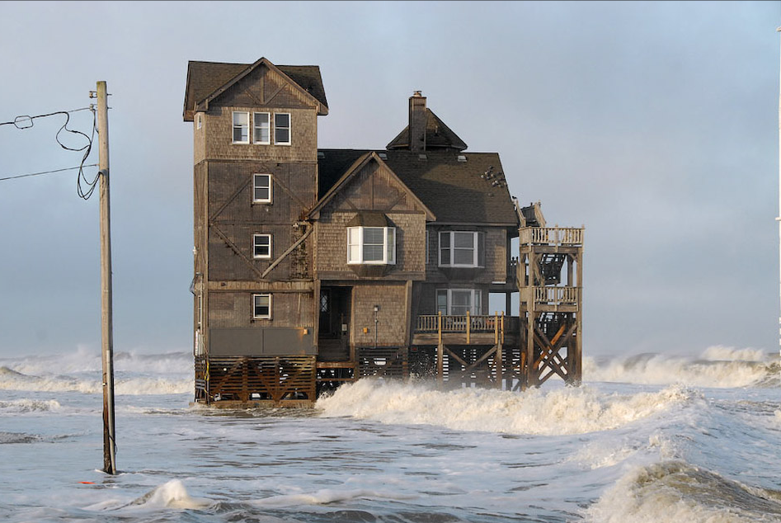
Coastal terrain dynamics
Barrier islands
Outer Banks
Atlantic Ocean
Nags Head
Jockey’s Ridge
Dynamic landscape:
sand redistributed
by wind, waves, storm surge
Vulnerable:
coastal erosion,
sea level rise, breach
Lidar mapping
1996 – 2011:
14 snapshots
Road mapping in 2012
Rodanthe
Cape Hatteras
0 10km
Notes:
The Outer Banks are historically known for their constant battering from intense storms and sea level rise which expose vulnerable areas such as the Isabel Breach south of Cape Hatteras created during Hurricane Isabel. These storms also destroy personal properties such as this picture of a porsche being submerged under sand and overwash. And with the steady increase of sea level, infrastructure that was once a safe distance away are merely feet away from the shoreline (for example the moving of the Cape Hatteras Lighthouse in 1999). This area is also well known for its high dunes that once permitted the Wright Brother’s to successfully take flight in 1903.

Slide 26
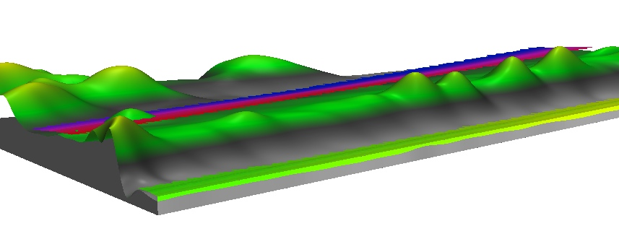
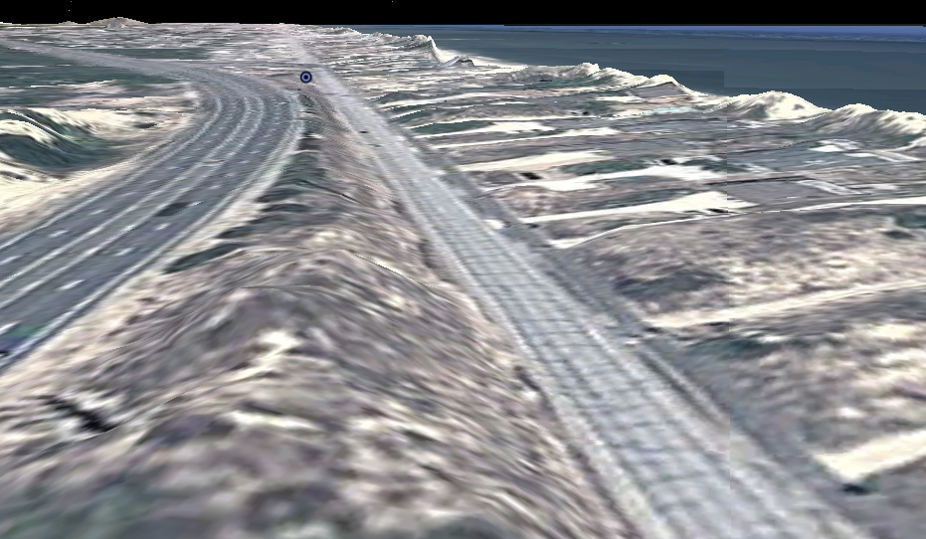
DEM processing
Point cloud (x,y,z) interpolated by smoothing spline to DEMs at 0.3-2m resolution
Vertical shifts assessment using
geodetic benchmarks 1 per 100m
RTK-GPS along road centerline
new terrestrial lidar road data
RTKGPS
2001 Lidar 0.2m lower
0 road centerline survey 2.4km
2001 1m res. DEM and 2012 0.1m res. road DEM

Slide 27
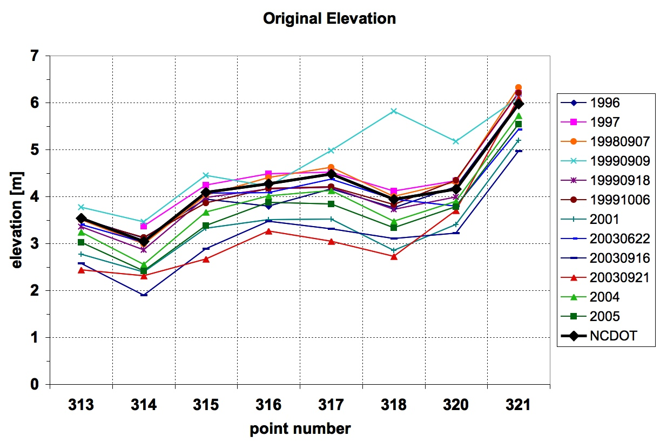
Corrected DEM series
Systematic error corrected, ocean masked out, DEMs ready for:
feature, volume, and difference analysis
core and envelope mapping,
new and destroyed buildings assessment
Space-Time Cube analysis of evolution
Nags Head
t₁
t₂
t₃
.
.
t_{n}
Atlantic Ocean
800m road section

Slide 28
Terrain evolution in space-time cube
How does evolution pattern change with elevation?
What is the direction of fastest elevation change?
Stack time series of DEMs or interpolate time series
of (x,y,z) point clouds to voxel model
(x,y,z)
t_{n}
…
Time
[year]
(x,y,z)
t₂
(x,y,z)
t₁
Y[m]
reorder
as
(x,y,t,z)
interpolate
z=f(x,y,t)
X[m]
15
7
0 m
space-time cube
Notes:
28
28
Figure 3: Representation of terrain evolution using trivariate space-time function: merged time series of point clouds is interpolated into space-time voxel model (Mitasova et al., 2011).
*Reviewer asks for a more thorough explanation of how 3D information fits into the 4d cube (3D shape)? The reviewer seems confused here as it is not a 4D cube but a 3D cube for elevation values at space time. Perhaps this figure can be modified to show that at a specific time constat for a lidar-survey you get back out your DEM for that survey. Note also this figure was used in your geomorph paper.

Slide 29
Jockey’s Ridge dune evolution
sand lost
sand
gained
stable
1949: 42 m
1974: 33 m
2008: 21 m
1930: 32 m ?
N
1917: 20 m ?
2008: 21 m 1950: 42 m 1917 20 m ?
High active dune: result of bad land management?
Landscape going back to its more stable form
Notes:
29

Slide 30
Jockey’s Ridge dune 1974-2008
19m
new 2d animation tool add-on, 3D surface animations done with m.nviz.image

Slide 31
Contour evolution
10m and 12m elevation contours for 3 years
10 | 12 | z[m]
~~ | ~~ | 2008
~~ | ~~ | 2005
~~ | ~~ | 1999
Notes:
31
31
I need to find a more attractive area to show this - it can be skipped

Slide 32
Contour evolution as isosurface
10m and 12m elevation contours for 3 years
Isosurface representation of 10, 11 and 12m elevation contours extracted from space-time voxel model
Elevation: 10 11 12 m
2008
2005
2001
1999
10 | 12 | z[m]
~~ | ~~ | 2008
~~ | ~~ | 2005
~~ | ~~ | 1999
Time
Y
X
0 100m
Notes:
32
32
I need to find a more attractive area to show this - it can be skipped

Slide 33
Evolution along contours
When and at which elevation
has the dune started to split into
parallel ridges? – at 17m in red year
Where and when did the elevation
rebound ?
2008
2005
2001
1999
1998
1995
1974
Time
[year]
15m
Y[m]
X[m]
23m
22m
17m
single crescentic dune transforming
into three parabolic dunes
creates conditions for interdune vegetation

Slide 34
Evolution along contours
When and at which elevation
has the dune started to split into
parallel ridges? – at 17m in red year
Where and when did the elevation
rebound ?
2008
2005
2001
1999
1998
1995
1974
Time
[year]
Y[m]
15m-26m
X[m]
23m
22m
17m

Slide 35
Shoreline evolution at Rodanthe
Standard contour and new STC representation
2011 breach
2011
2009
2008
2005
2004
2003
2003
2001
1999
200m
z=0.5m, colored by year
Notes:
35
35
I need to find a more attractive area to show this - it can be skipped

Slide 36
Shoreline evolution at Cape Fear
Image, 2D contours, animation, and shoreline in STC
2011
2009
2008
2005
2004
2003
2003
2001
1999
200m
evolution
of shoreline
Cape Hatteras 1997-2011

Slide 37
Monitoring eroding stream bank
Dr. Mike Starek, Nathan Lyons, Keren Cepero, Dr. Wegmann
legacy sediment from old millpond, in farmland turned to state park
monitoring by Leica Scan terrestrial scanner – 8 epochs 2010 – 2012
1cm res DEM

Slide 38
Total change from first and last DEMs
First and last scan analysis
distance to base plane [m]
Loss as change in distance to base plane [m]

Slide 39
Evolution of distance from base plane
pre-settlement pre-millpond millpond sediment
L1
L2
L3
1 epochs 8
distance from base plane [m]

Slide 40
Change greater than 0.5 m
Where and when was the change between two surveys greater
than 0.5m and what was its pattern?
epochs
distance difference [m]
massive fallout from milldam sediment layer in epoch 3 (April, after storms), stable after
smaller, more scattered loss at lower elevations – fluvial, deposited from fall-off
event based when conditions are right rather than continuous change – several surveys
with almost no change in spite of storms

Slide 41
Future of Open source GIS at NCSU
OSGeo Research and Development Laboratory network collaborations
Extending FOSS4G academy
continue incorporating open source geospatial into existing and new courses,
more focus on development skills
in-class and internet-based delivery
State of the art technology lab: combine proprietary and open source technology
Geospatial Analytics Program
3 new faculty positions
JB Hunt library
NC Nature Research Center

Slide 42
Conclusions: challenges
Rapidly changing technology and releases require continuous updates to educational material
Limited engagement of faculty in FOSS4G projects
Selecting the right software for the course or application is confusing for faculty newcomers
Data acquisition and integration still takes a lot of time: do we need OpenGeo on-line?

Slide 43
Conclusions: ideas for future
OSGeo educator wiki page: pool of faculty who could serve on student BS, MS, PhD committees or as advisors (similar to OSGeo advocate wiki)
OSGeo graduate student wiki: student exchange, Research Assistant positions
Community sprints: participate, organize, send students (CTU Prague GRASS code sprints)
Google Summer of Code: co-mentor students
OSGeo REL network
Seek funding for FOSS4G academic infrastructure –
Phill Davis FOSS4G academy and MOOC presentation

