Slide 1
Building open source geospatial education at research universities
Helena Mitasova
North Carolina State University, Raleigh, NC, USA
with contributions by NCSU GIST students
GRASS GIS
Notes:
Over the past decade free and open source software (FOSS) has moved into mainstreem and its growth includes a wide range of geospatial software tools. The presentation will briefly describe the principles of FOSS and provide an overview of major FOSS projects that support management, processing, analysis, visualization and on-line distribution of georeferenced data. Interoperability between the different tools enabled by the FOSS concept will be highlighted using examples of applications that combine software developed by several projects, such as GRASS, Mapserver, GDAL, PROJ, R-stats, PostGIS, paraview and others. Special focus will be given to the recent new developments in Geographic Resources Analysis Support System (GRASS, http://grass.itc.it). Since its original design as a land management tool for military installationsthe system has evolved into one of the most comprehensive, general purpose GIS and support for environmental modeling has been an integral part of its development. Overview of the GRASS6 capabilities relevant to environmental modeling will be provided, including tools for working with 2D and 3D raster data, the completely redesigned topological 2D/3D vector engine, vector network analysis and SQL-based attribute management. Various graphical user interfaces, such as QGIS and JAVAGRASS, that are being used with GRASS will be introduced and enhancements to 3D dynamic visualization will be presented. Environmental modeling will be illustrated by examples in the area of coastal management and sediment pollution control using the latest lidar data and new or updated GRASS6 modules. The talk will conclude with discussion of visions for the future of FOSS geospatial modeling.

Slide 2
Motivation
GIS teaching at universities: prevailing proprietary software
Science and engineering programs need more flexibility and portability
Organizations with limited resources need GIS capabilities, agencies and industry benefit from open source software to design custom solutions
Growing need for graduates with diverse skills and familiarity with open source GIS

Slide 3
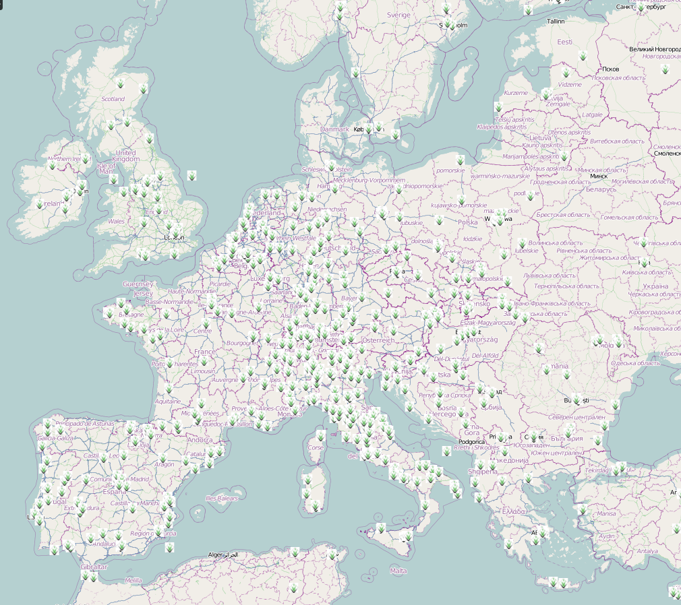
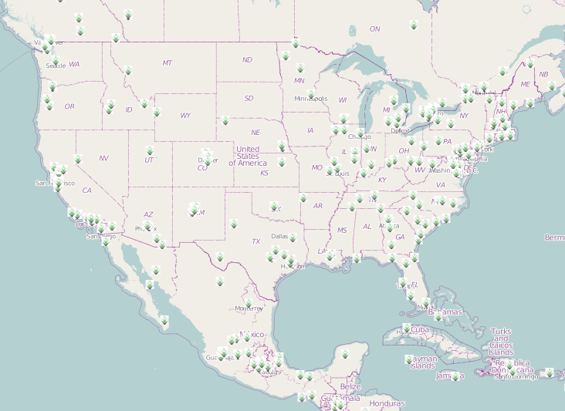
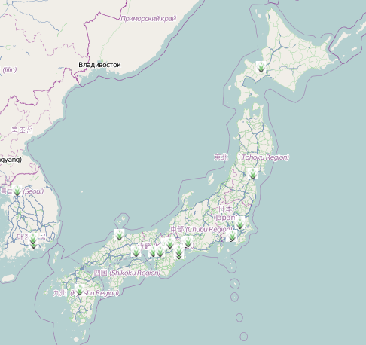
Established academic activities
sample university programs with open source GIS
Research
FOSS4G is used in research labs worldwide:
Academic Sessions at FOSS4G conference, and meetings: AGU, AAG, NC GIS
Education
Short courses and workshops
Full courses at select universities
Repositories
ELOGeo: Conferences (17), Education (16), Learning (26), Use cases (9)
OSGeo Edu repository, svn

Slide 4
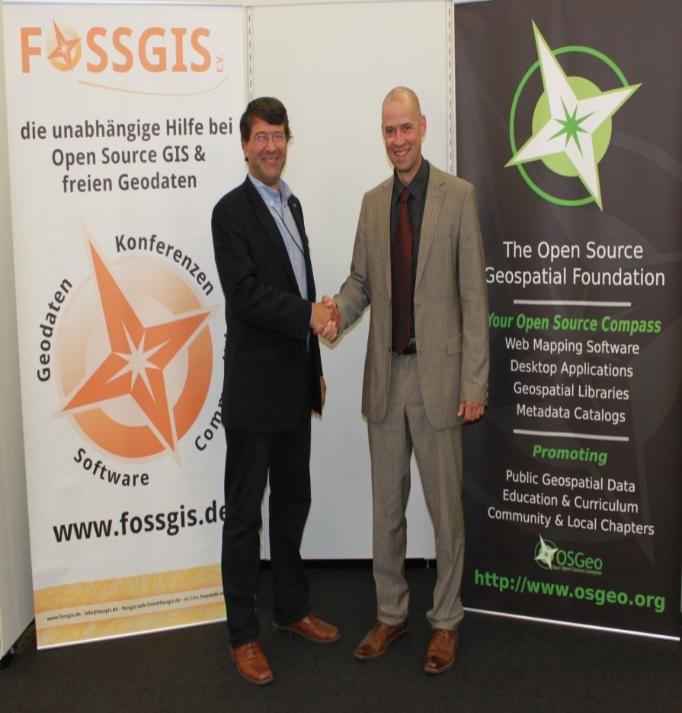
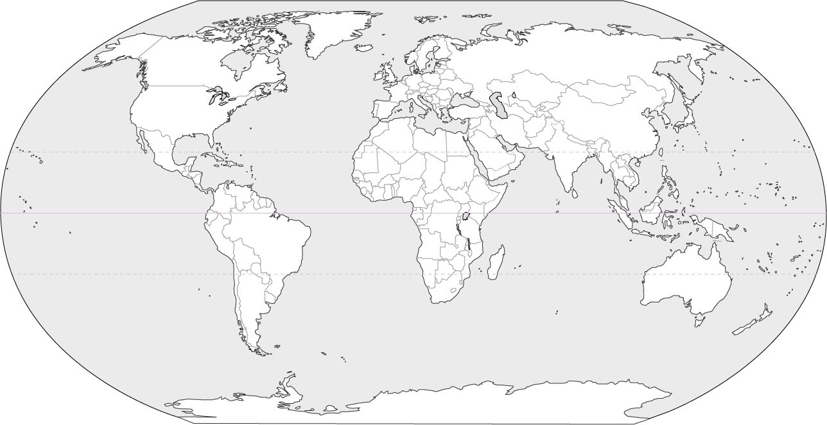
New Initiative: OSGeo REL network
Global network of Open Source Geospatial Research and Education Laboratories:
ICA-OSGeo MOU: build teaching and research infrastructure worldwide
open network
6 founding laboratories, including NCSU
growing fast: currently 19 labs globally
http://wiki.osgeo.org/wiki/Edu_current_initiatives
thanks to Suchith Anand, Nottingham University: organizers of FOSS4G2013

Slide 5
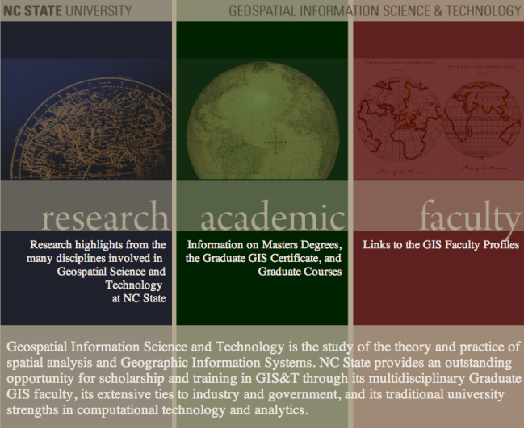
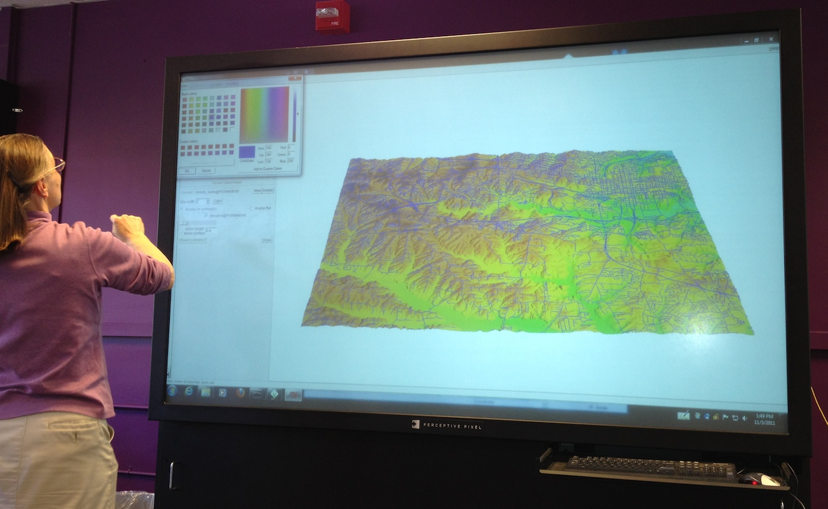
Open Source Geospatial at NCSU
Grad Certificate and MS in GIST
Discipline-based PhD with GIST focus
interdisciplinary: no Geography dept.
FOSS4G integrated into courses along with proprietary software
core GRASS-based course, elective courses: python, PostGIS and WebGIS applications: OpenGeo stack

Slide 6
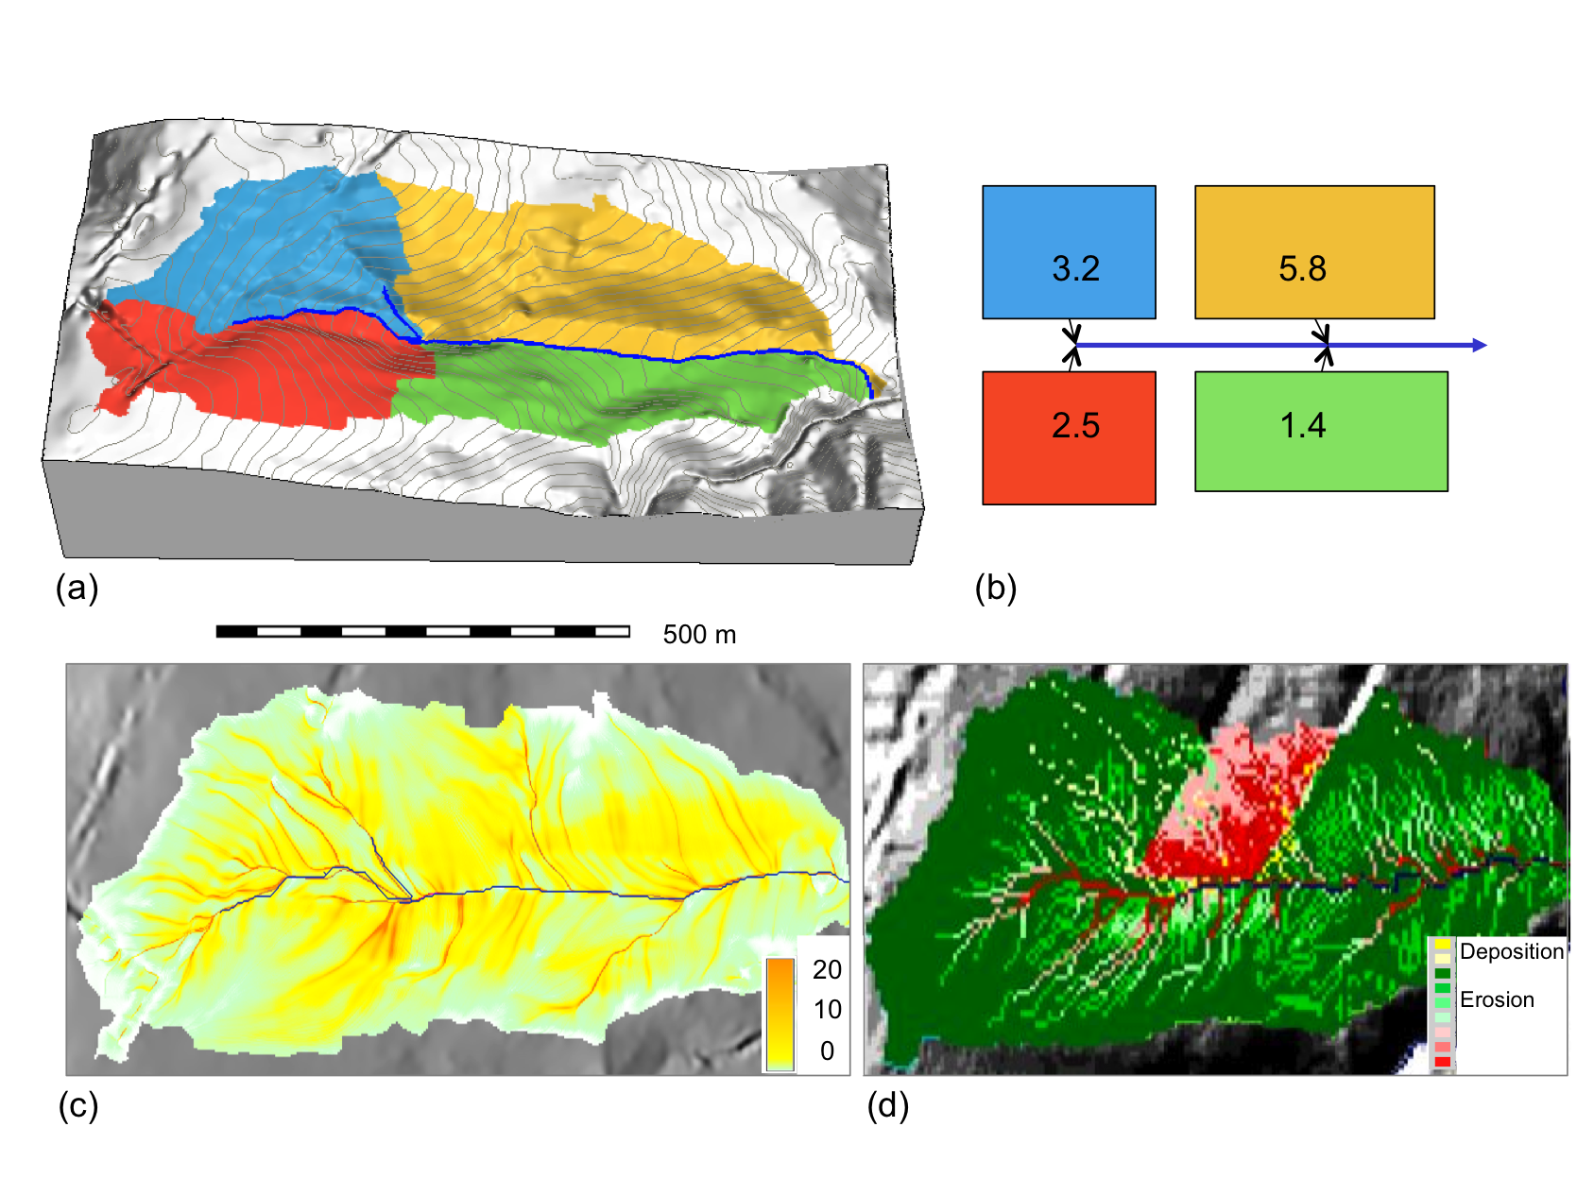
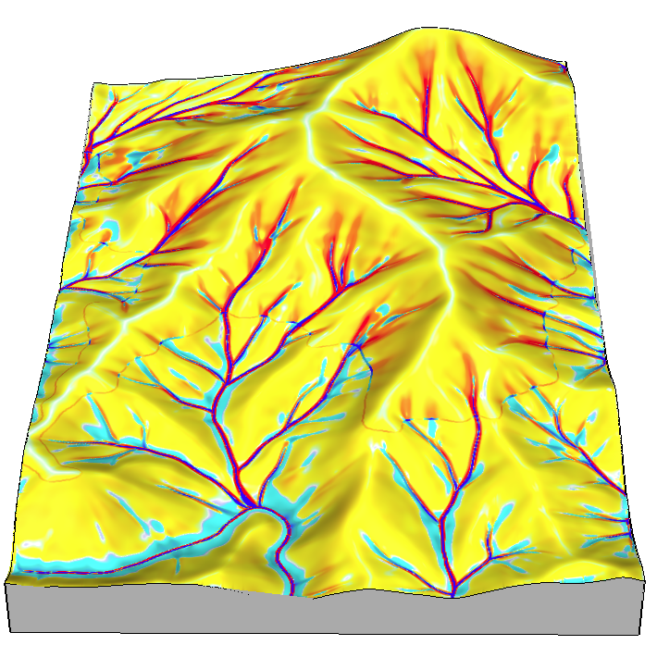
Course: Geospatial Modeling
Lectures:
fundamentals and methods
software independent
Weekly Assignments:
GRASS GIS + ArcGIS
“flipped approach”: given workflow, explain methods and results
Independent project:
thesis-based or selected topic
students chose software
combining is encouraged
erosion
depos
500m

Slide 7
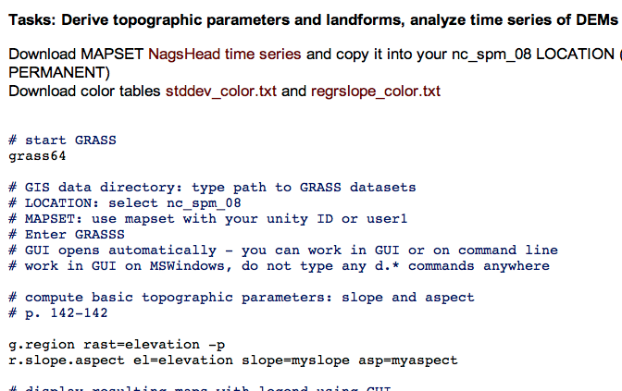
On-line section
Screen capture with audio:
lectures
interactive tools such as visualization
Assignments for GRASS, ArcGIS:
in plain html for easy updates
Course is free online
message board discussion, help
Google sites: post HW, get feedback
register to get credit
Most students: experienced ArcGIS users, with backgrounds in engineering, natural resources, earth sciences

Slide 8
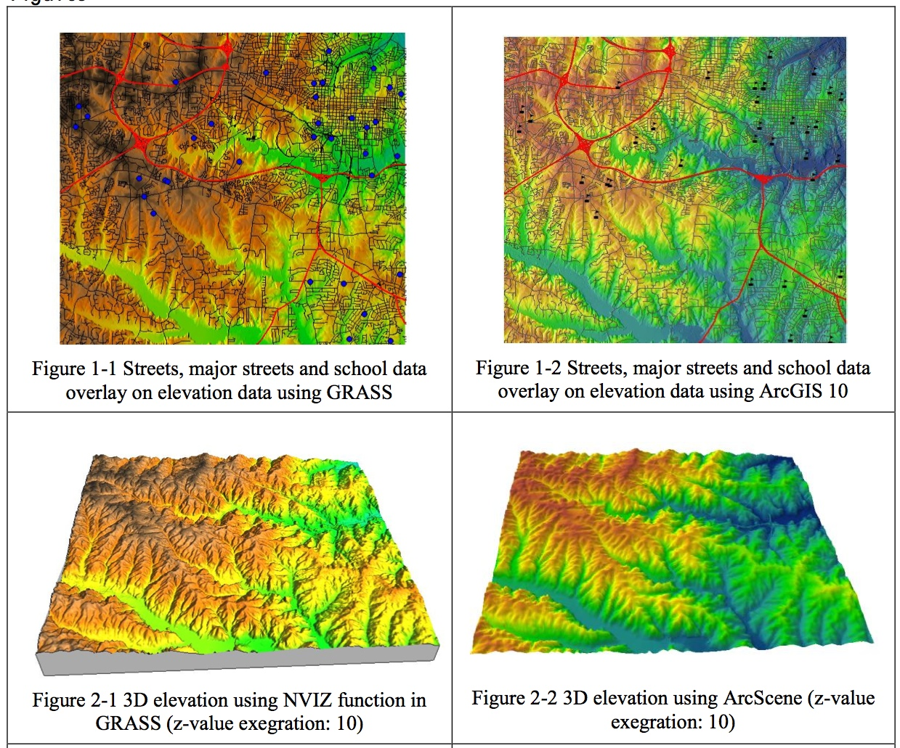
Assignment: Getting started
Display provided
SW Wake county data in 2D and 3D
GRASS ArcGIS
Makiko Shukunobe, spring 2012

Slide 9
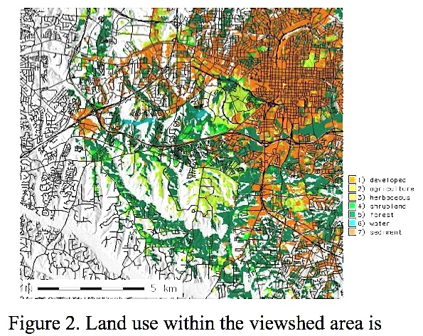
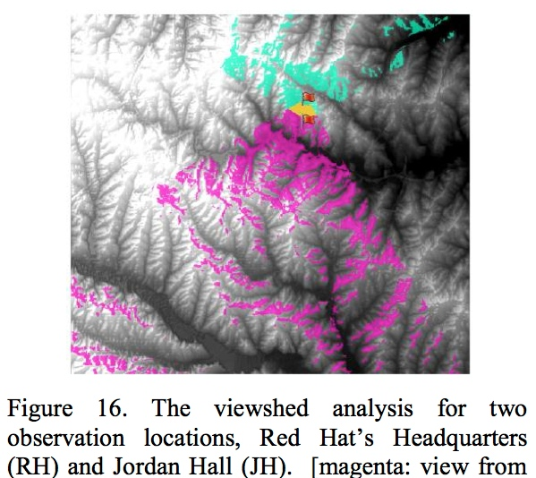
Assignment: Viewsheds
Analyse land cover composition visible from a given building in GRASS
Assess visibility between two buildings in ArcGIS
Do not compare software but explain concepts and interpret the results
GRASS ArcGIS
Makiko Shukunobe, spring 2012

Slide 10
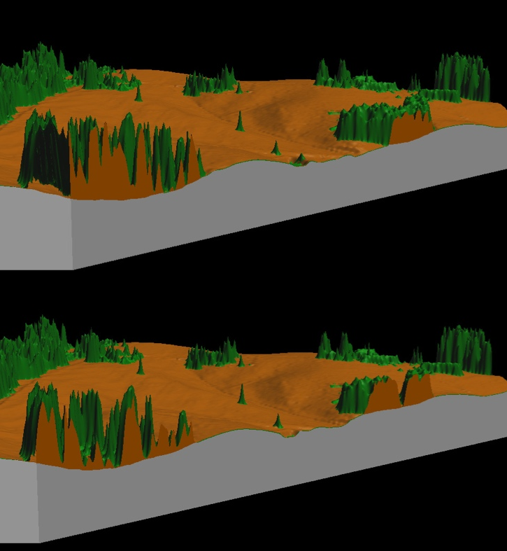
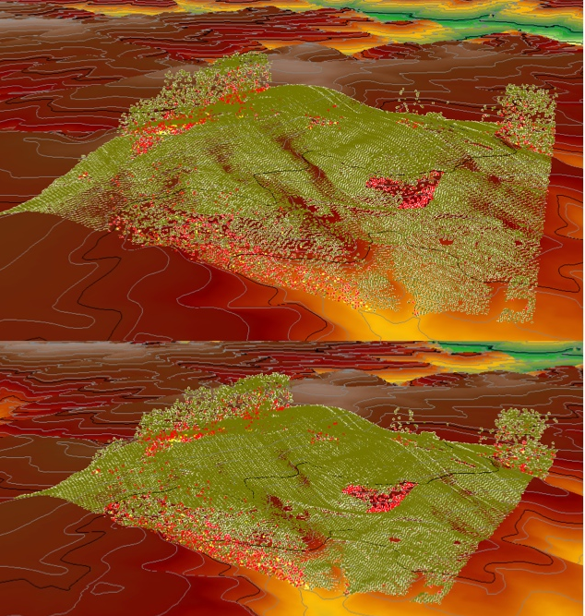
Assignment: Lidar
Compare DEM and DSM, analyze lidar point cloud properties
GRASS ArcGIS
Mathew J Pare, fall 2012

Slide 11
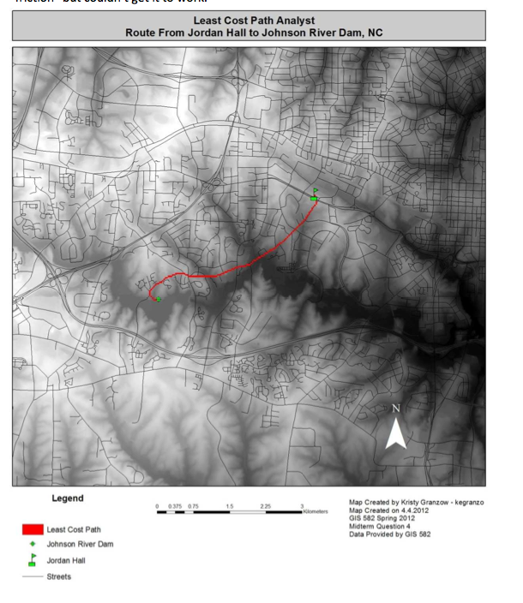
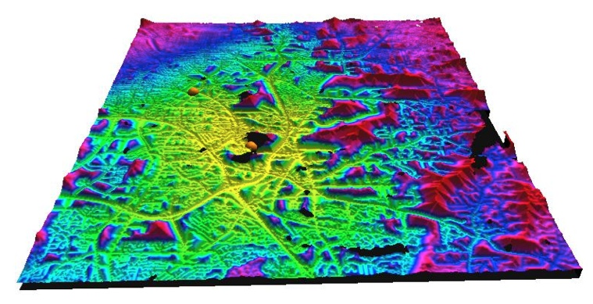
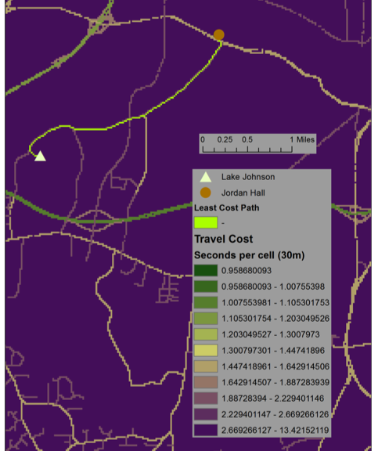
Midterm exam
Find least cost path between two off-road locations using GRASS or ArcGIS.
ARC GRASS
Granzow, Shortley, Terblanche, Shukunobe, Spore

Slide 12
Independent Projects
Core of the course
Define problem, acquire data,
Develop workflow, produce and present results
Most students use ArcGIS but number of students who use GRASS for at least part of their project is increasing every semester
Example topics
Coastal dynamics
Solar irradiation and energy potential
Lidar data processing and Watershed analysis
Cost surfaces and least cost paths
Hazards mapping and response management
Process modeling
Utilities planning and assessment
Open source GIS development

Slide 13
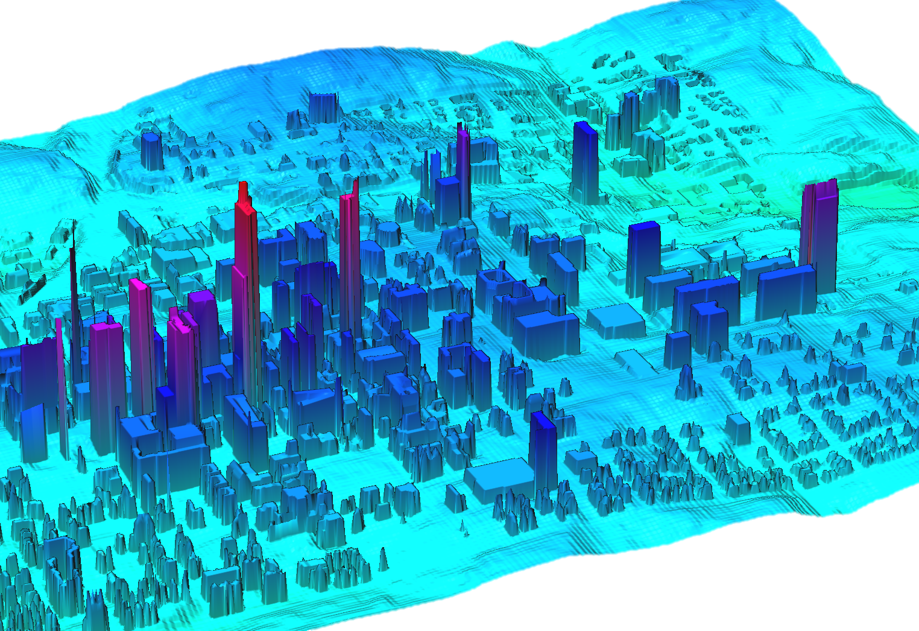
Project: Impact of building shadows
input: 10ft resolution downtown Raleigh DTM derived from 3D city model mapped annually by Pictometry
analysis: custom tools, ArcGIS and GRASS
Justin Greco, City of Raleigh

Slide 14
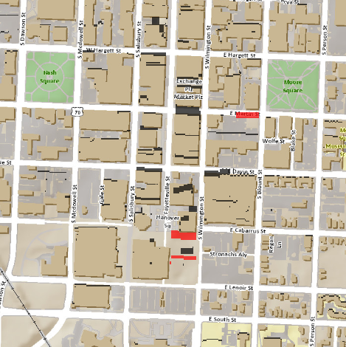
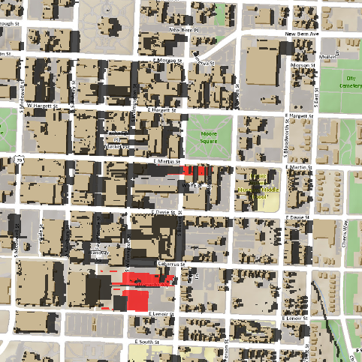
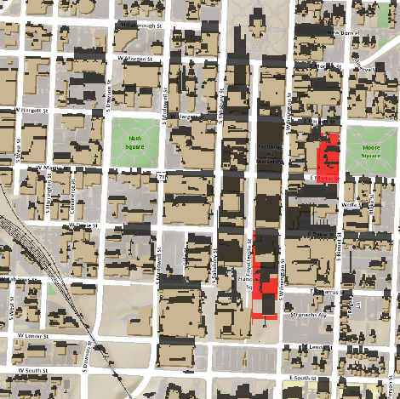
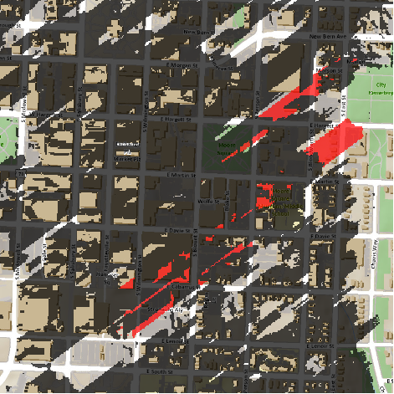
Project: Impact of building shadows
Summer solstice:
noon 4pm
Winter solstice:
noon 4pm
Spatial extent of cast shadows in summer and winter for the
current (grey) and planned (red) buildings
Justin Greco, City of Raleigh

Slide 15
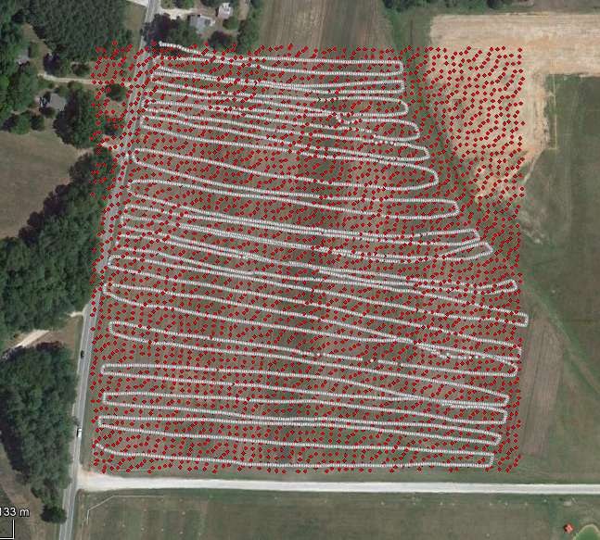
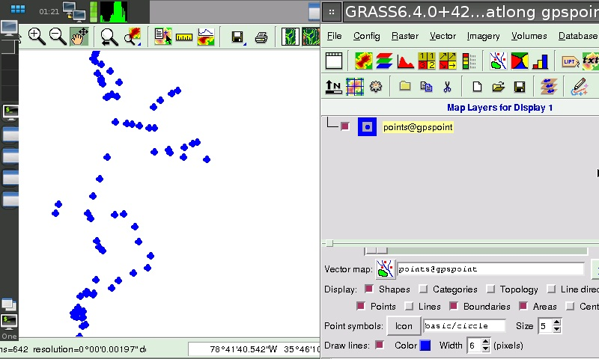
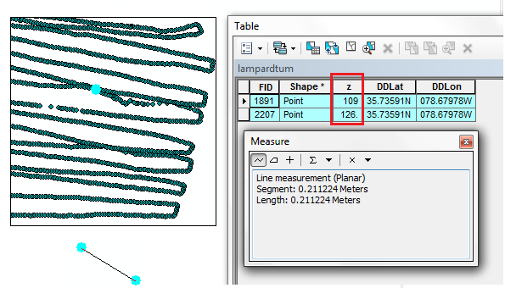
Project: DEM by mobile phone
Objective: Create Digital Elevation Model Using a Mobile Device and
compare it to lidar-based DEM
300m
Approach: GRASS on Debian phone
+ lidar points + phone GPS
In 2 hours 6000 points collected
In 21cm 17meter
elevation difference
Student: Ali Ihsan Durmaz

Slide 16
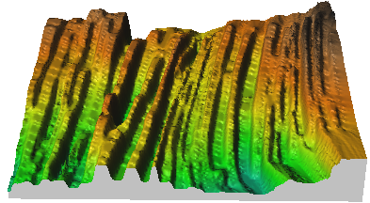
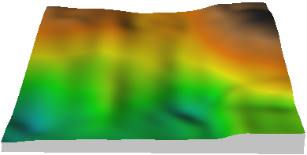
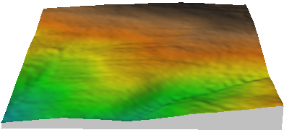
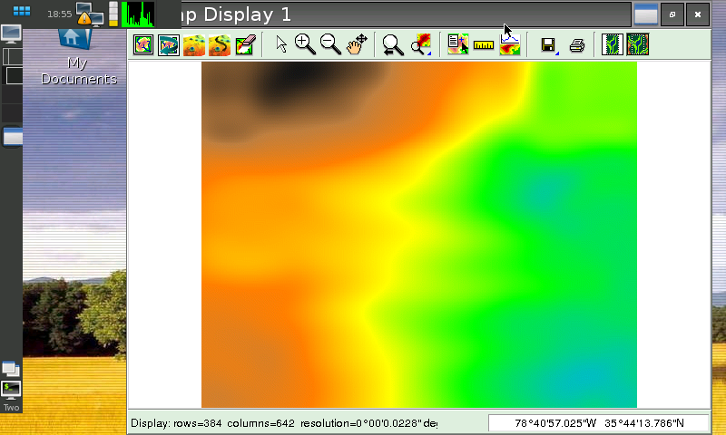
Project: DEM by mobile phone
Interpolated DEMs
96% area within 5m difference,
80% area within 3m difference
300m
smoothing spline lidar based DEM
interpolation by IDW – data captured while going in different directions are shifted
Screen view from
the mobile device
Student: Ali Ihsan Durmaz

Slide 17
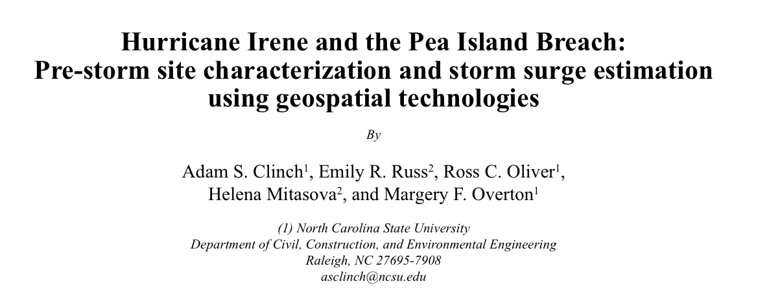
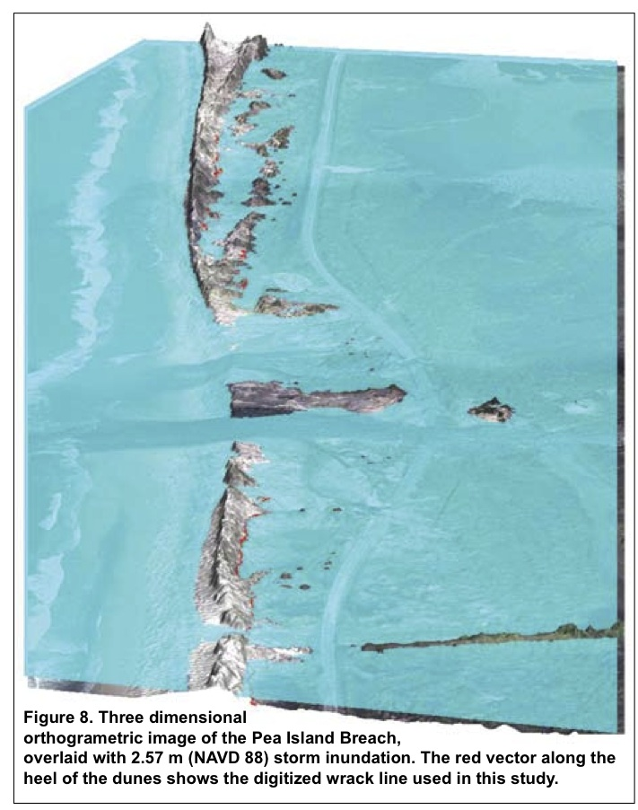
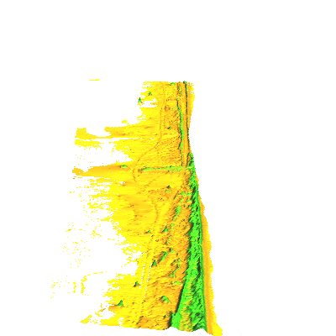
Project: Coastal Flooding
Several team projects lead to a published paper
published in Shore & Beach 80(2) spring 2012
300m
2011 1999

Slide 18
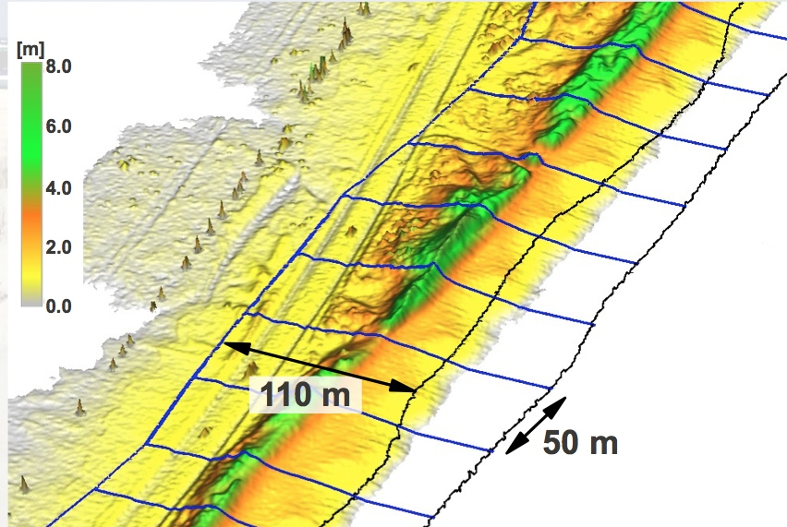
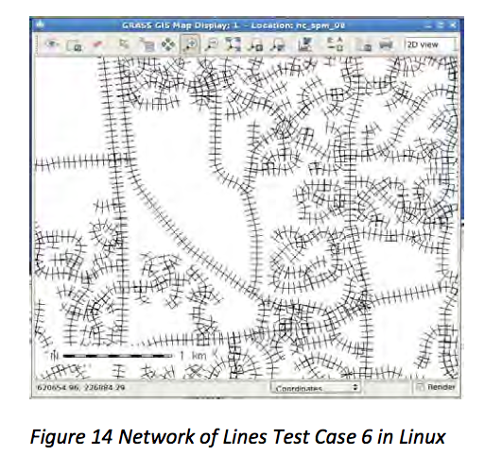
Project: add-on development
Graduate students from industry bring their own expertise
Example: v.transects add-on generates transects and boxes for shoreline, channel or road crossections and volumes.
Independent module testing by a student with IT background, fixing bugs, modifications for portability
parameter verification test set
3 different data sets test sets
run original script in Linux
run fixed script in Linux and on Windows
Full report linked to man page
After testing and fixes submitted through SVN
Students: John Lloyd, Eric Hardin

Slide 19
GE-GRASS user interface
Class project in Geospatial Modeling and Analysis
Rate of change in elevation for Jockey’s Ridge, Nags Head, NC
Steve Ansari
steve.ansari@noaa.gov

Slide 20
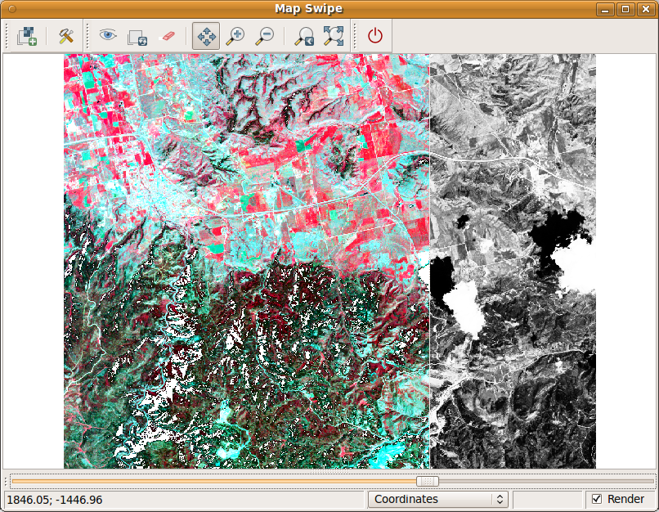
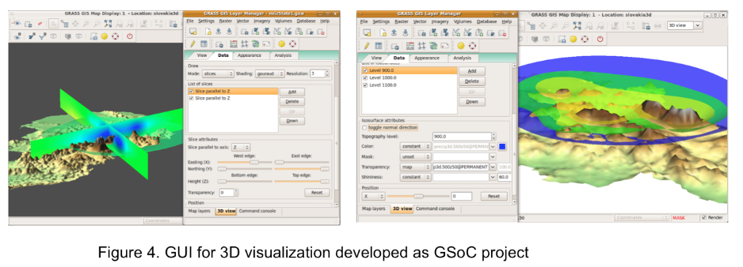
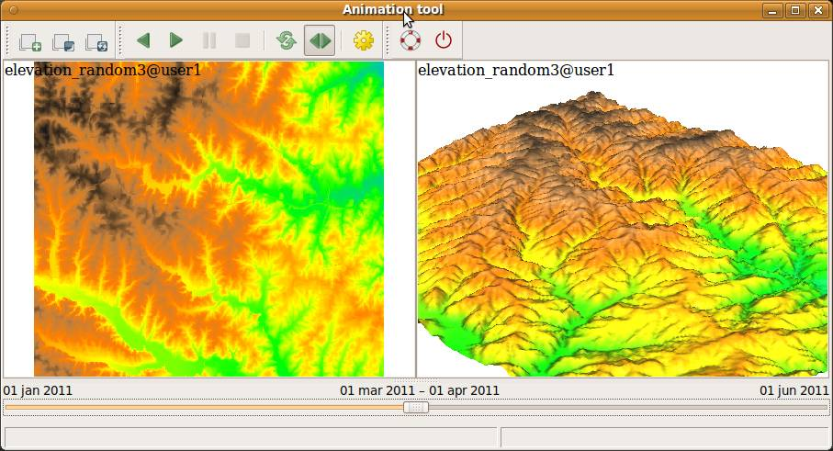
OSGeo REL with CTU Prague
Google summer of code 2008, 2010, 2011
Grad. student committee member
GRASS GIS Development,
Visualization tools for time series and 3D
wxnviz, map swipe, 2D/3D animations
CTU: development of visualization tools
Martin Landa, Anna Kratochvilova, Vaclav Petras
NCSU: data collection, processing, applications, Eric Hardin, Katie Weaver, Emily Russ, Nathan Lyons, Keren Cepero

Slide 21
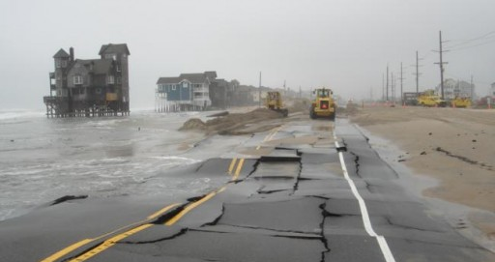
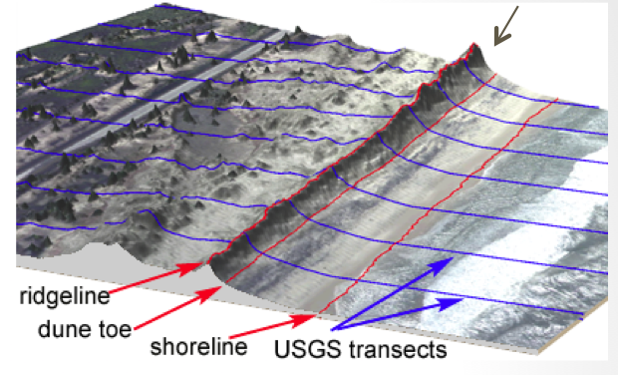
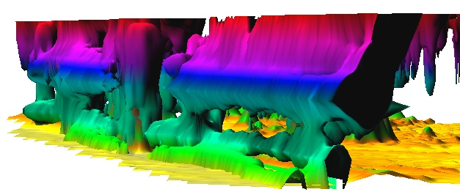
Coastal dynamics toolbox for GRASS
Volume Surfaces Lines Points
Processing lidar time series: point clouds to consistent DEMs
Feature extraction: shoreline, dune ridge,
Transect-based analysis: feature migration, volume change mapping
Raster-based analysis: core, envelope, rate of change
Derived metrics: storm vulnerability
Inundation analysis: flooding extent
Space-Time voxel model
Notes:
Over the past decade free and open source software (FOSS) has moved into mainstreem and its growth includes a wide range of geospatial software tools. The presentation will briefly describe the principles of FOSS and provide an overview of major FOSS projects that support management, processing, analysis, visualization and on-line distribution of georeferenced data. Interoperability between the different tools enabled by the FOSS concept will be highlighted using examples of applications that combine software developed by several projects, such as GRASS, Mapserver, GDAL, PROJ, R-stats, PostGIS, paraview and others. Special focus will be given to the recent new developments in Geographic Resources Analysis Support System (GRASS, http://grass.itc.it). Since its original design as a land management tool for military installationsthe system has evolved into one of the most comprehensive, general purpose GIS and support for environmental modeling has been an integral part of its development. Overview of the GRASS6 capabilities relevant to environmental modeling will be provided, including tools for working with 2D and 3D raster data, the completely redesigned topological 2D/3D vector engine, vector network analysis and SQL-based attribute management. Various graphical user interfaces, such as QGIS and JAVAGRASS, that are being used with GRASS will be introduced and enhancements to 3D dynamic visualization will be presented. Environmental modeling will be illustrated by examples in the area of coastal management and sediment pollution control using the latest lidar data and new or updated GRASS6 modules. The talk will conclude with discussion of visions for the future of FOSS geospatial modeling.

Slide 22
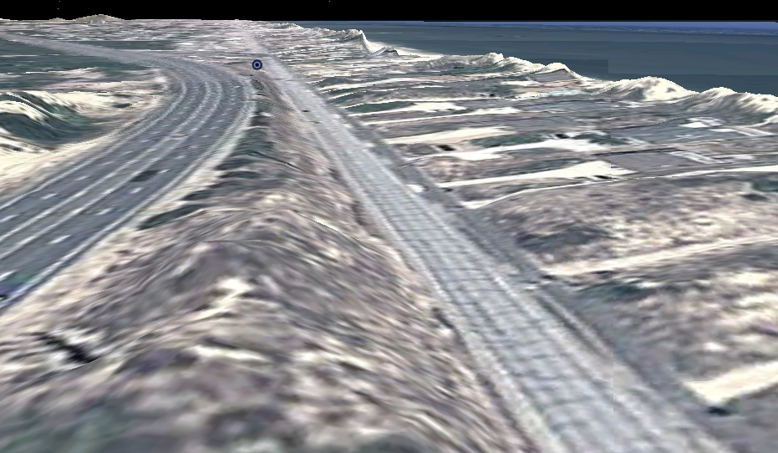
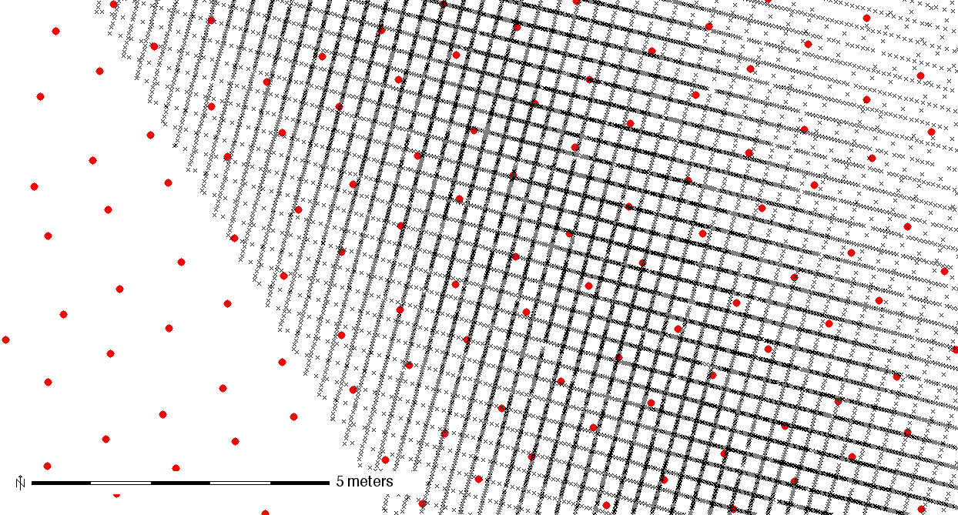
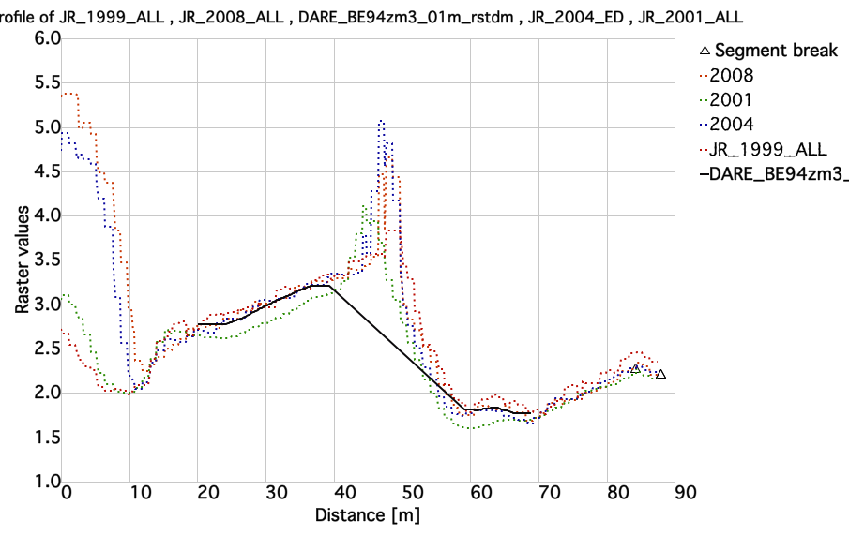
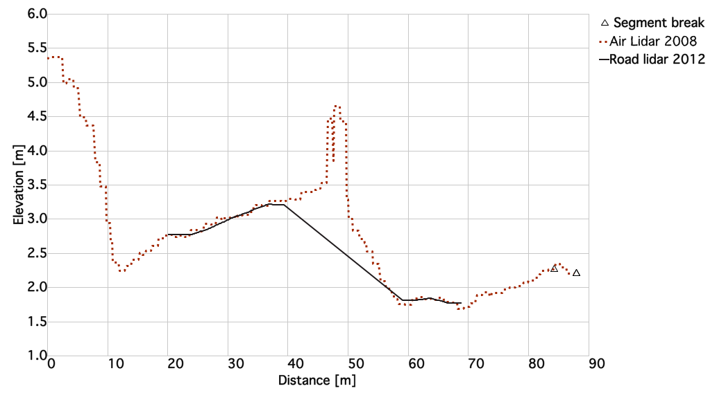
Road lidar data: 2012
New mobile terrestrial lidar road survey for all NC coastal counties
scan lines: 15-20cm
masked 10cm resolution DEMs
captures road profile
I-158 NC-12
airborne + terrestrial
20m
10m
2001 1m res. DEM, 2012 0.1m res. road DEM
Thanks to Doug Newcomb and Hope Morgan for sharing the data
Notes:
Road lidar 15cm profiles, sub 1cm along profile

Slide 23
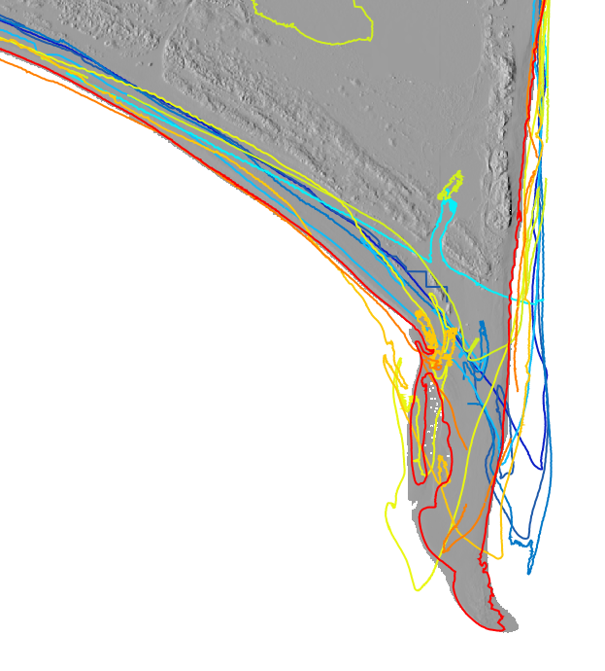
Shoreline evolution: contours
Cape Hatteras dynamics: shorelines 1997 - 2011
2011
2009
2008
2005
2004
2003
2001
1999
1997
shorelines extracted as
0.5m elevation contours
from lidar-based DEMs
200m

Slide 24
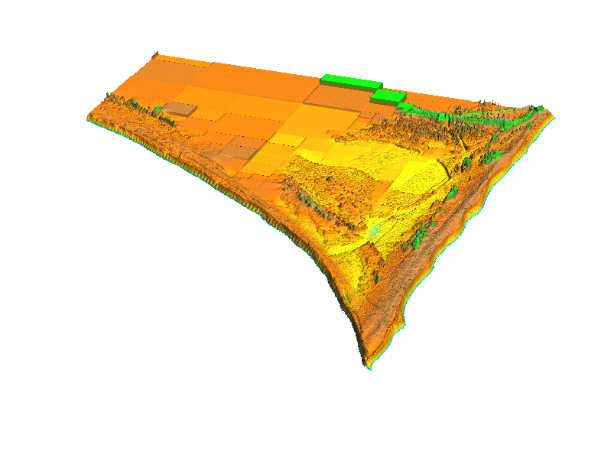
Shoreline evolution: animation
Cape Hatteras dynamics: DEM series animation 1997 - 2011
2011
2009
2008
2005
2004
2003
2001
1999
1997
200m
Cape Hatteras 1997-2011

Slide 25
Shoreline evolution from voxel model
Cape Hatteras: shoreline evolution as 0.5m isosurface
2011
2009
2008
2005
2004
2003
2003
2001
1999
time[yr]
DEMs are stacked
into voxel model
200m
Cape Hatteras 1997-2011

Slide 26
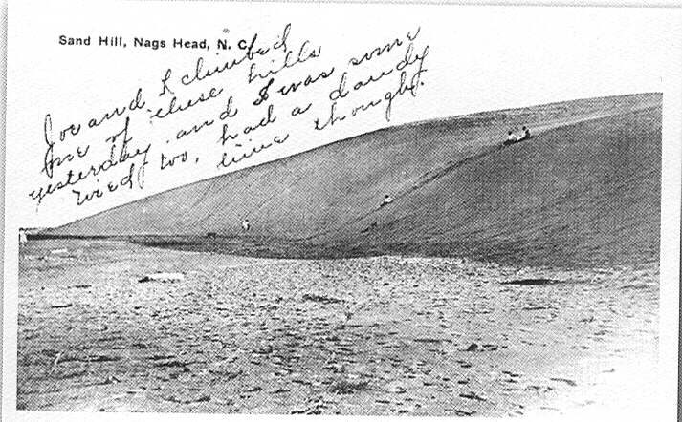
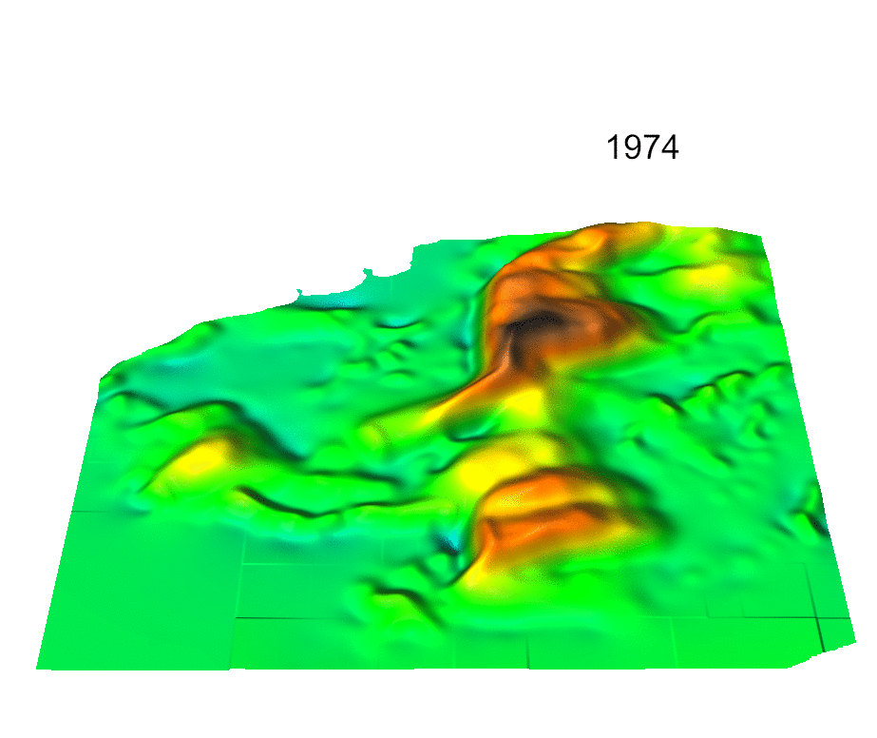
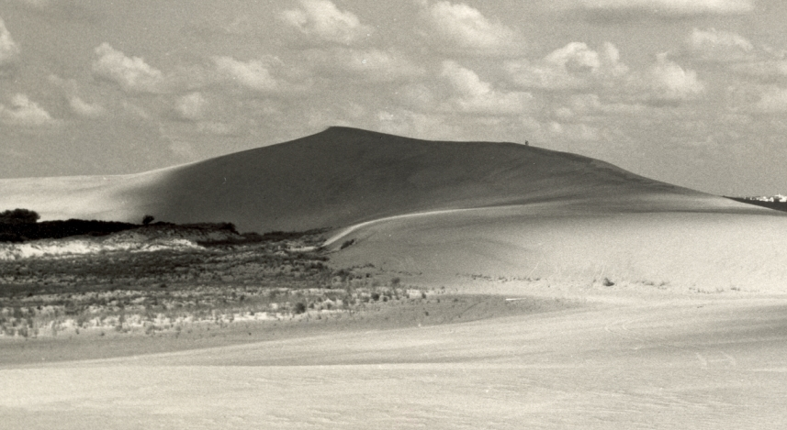
Jockey’s Ridge dune 1974-2008
1917 20m ?
1953 42m
2008: 21 m
2012 ??m
19m

Slide 27
Evolution along contours
When and at which elevation
has the dune started to split into
parallel ridges?
Where and when did
the elevation rebound ?
15m
2008
2001
1998
1974
Time
[year]
Y[m]
17m
X[m]
23m
22m

Slide 28
Monitoring eroding stream bank
Where and when was the change between two surveys greater
than 0.5m and what was its pattern?
Isosurfaces of change > 0.5 m
First and last scan of 9 total
5m
epochs
distance difference [m]
Dr. M. Starek, N. Lyons, K. Cepero, Dr. Wegmann
legacy sediment from old millpond, in farmland turned to state park
monitoring by Leica Scan terrestrial scanner – 8 epochs 2010 – 2012, 1cm res DEM
distance to base plane [m]

Slide 29
Tangible Geospatial Modeling System
Collaborative environment for exploration of terrain change
impacts on landscape processes: 2009 setup
S: 3D laser scanner
P: projectors
M: flexible clay model
coupled with GRASS GIS
S P1 P2
M
N
0 400m
Notes:
29
29

Slide 30
Tangible Geospatial Modeling System
Notes:
30
30

Slide 31
Tangible Geospatial Modeling System
Notes:
31
31

Slide 32
Future of Open source GIS at NCSU
OSGeo Research and Development Laboratory network collaborations
http://wiki.osgeo.org/wiki/Edu_current_initiatives
Extending FOSS4G academy
continue incorporating open source geospatial into existing and new courses,
more focus on software development skills
in-class and on-line delivery
State of the art technology lab: combine proprietary and open source technology
Geospatial Analytics Program
JB Hunt library
NC Nature Research Center

