Slide 1




Building open source geospatial education at research universities
Helena Mitasova
North Carolina State University, Raleigh, NC, USA
with contributions by NCSU GIST students
GRASS GIS
Notes:
Over the past decade free and open source software (FOSS) has moved into mainstreem and its growth includes a wide range of geospatial software tools. The presentation will briefly describe the principles of FOSS and provide an overview of major FOSS projects that support management, processing, analysis, visualization and on-line distribution of georeferenced data. Interoperability between the different tools enabled by the FOSS concept will be highlighted using examples of applications that combine software developed by several projects, such as GRASS, Mapserver, GDAL, PROJ, R-stats, PostGIS, paraview and others. Special focus will be given to the recent new developments in Geographic Resources Analysis Support System (GRASS, http://grass.itc.it). Since its original design as a land management tool for military installationsthe system has evolved into one of the most comprehensive, general purpose GIS and support for environmental modeling has been an integral part of its development. Overview of the GRASS6 capabilities relevant to environmental modeling will be provided, including tools for working with 2D and 3D raster data, the completely redesigned topological 2D/3D vector engine, vector network analysis and SQL-based attribute management. Various graphical user interfaces, such as QGIS and JAVAGRASS, that are being used with GRASS will be introduced and enhancements to 3D dynamic visualization will be presented. Environmental modeling will be illustrated by examples in the area of coastal management and sediment pollution control using the latest lidar data and new or updated GRASS6 modules. The talk will conclude with discussion of visions for the future of FOSS geospatial modeling.

Slide 2
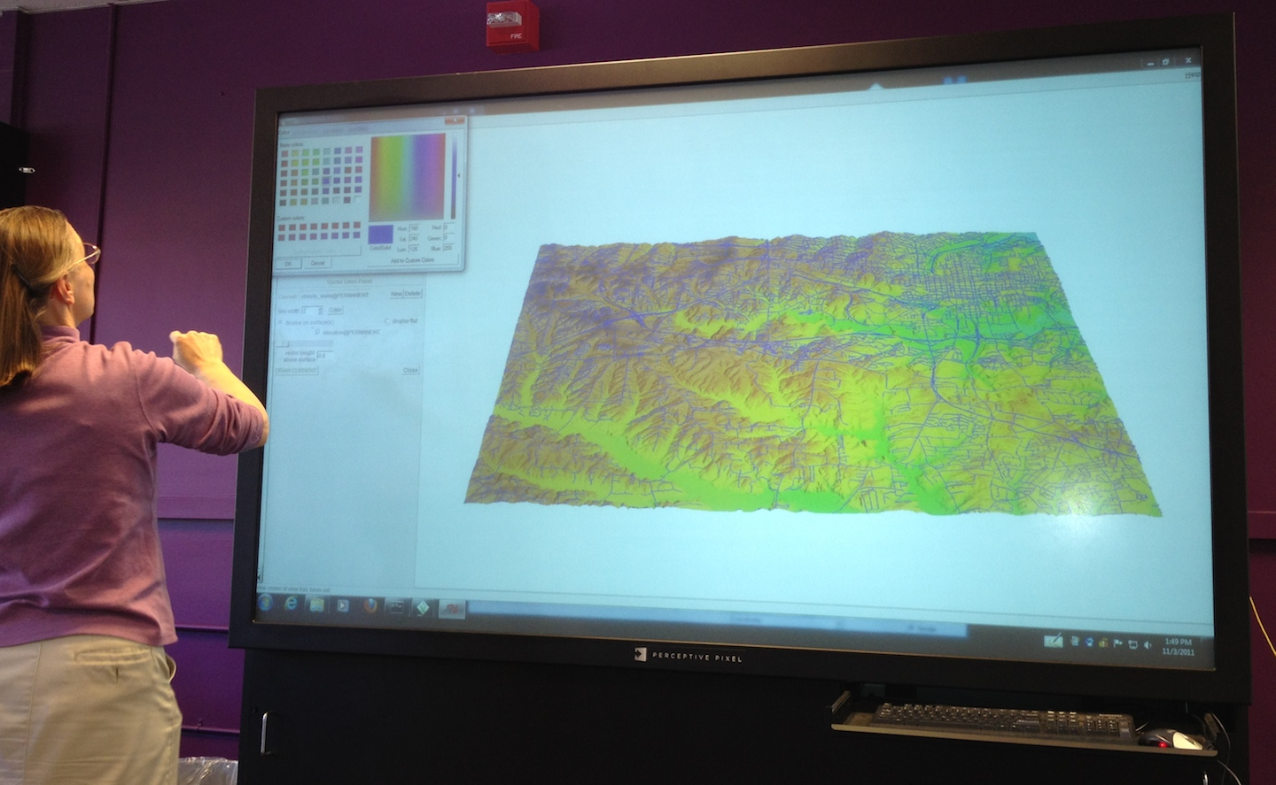
Working with Perceptive Pixel

Slide 3
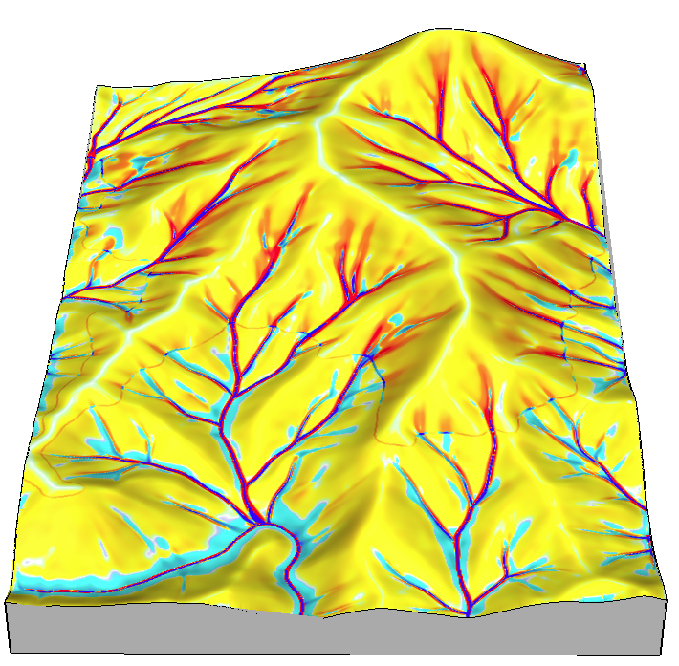
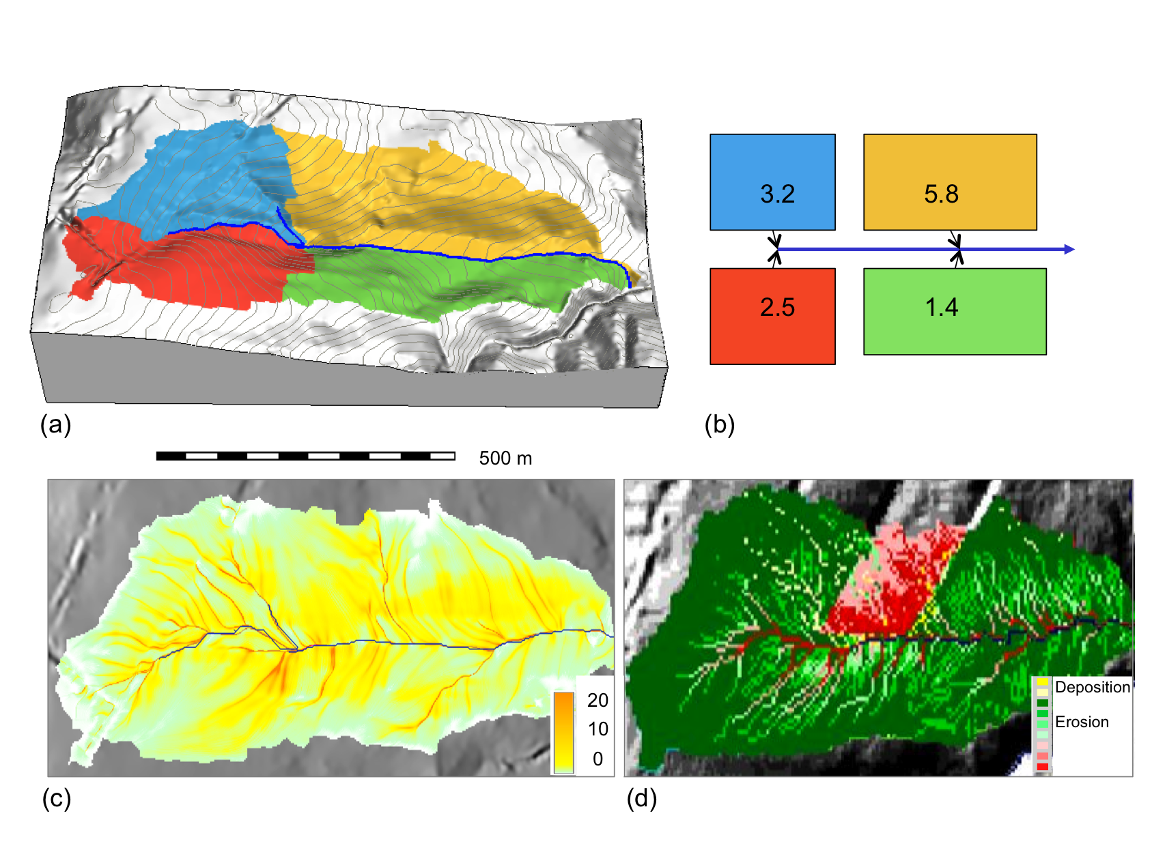


Course: Geospatial Modeling
erosion
depos
500m

Slide 4
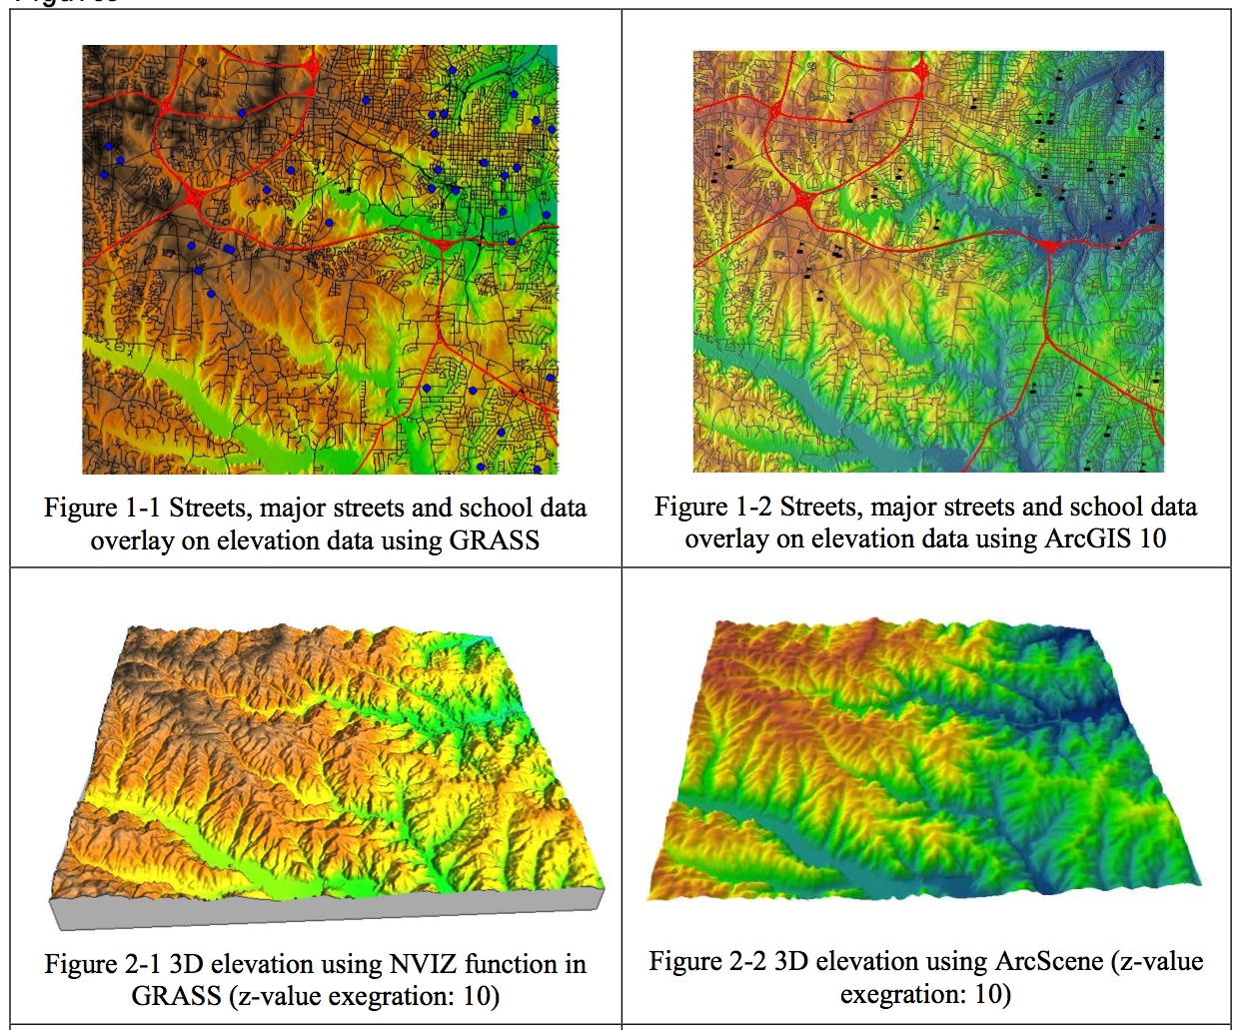
Assignment: Getting started
Display provided
SW Wake county data in 2D and 3D
GRASS ArcGIS
Makiko Shukunobe, spring 2012

Slide 5
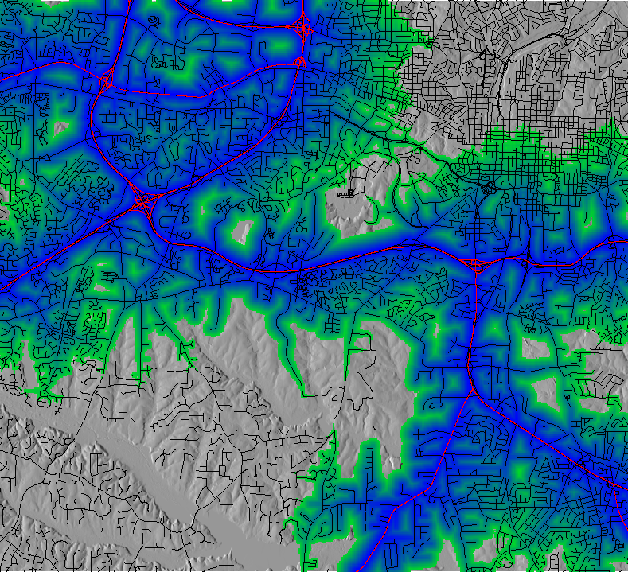
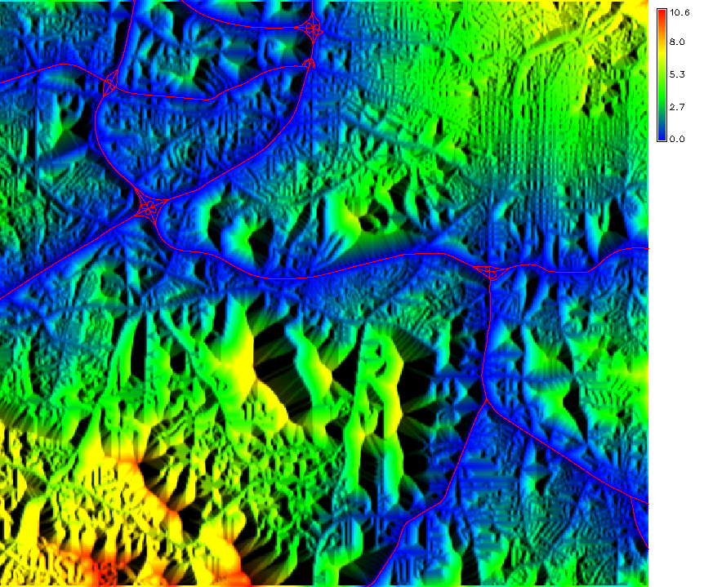
Cost surfaces: locations with given driving distance to highways

Slide 6
Cost surfaces: locations with given driving distance to highways

Slide 7
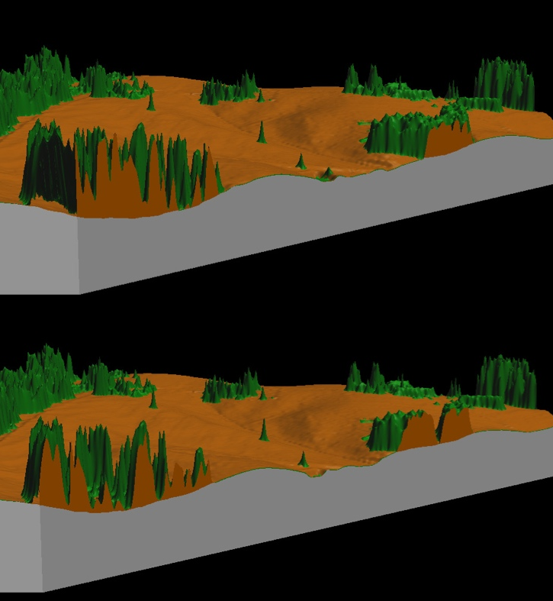
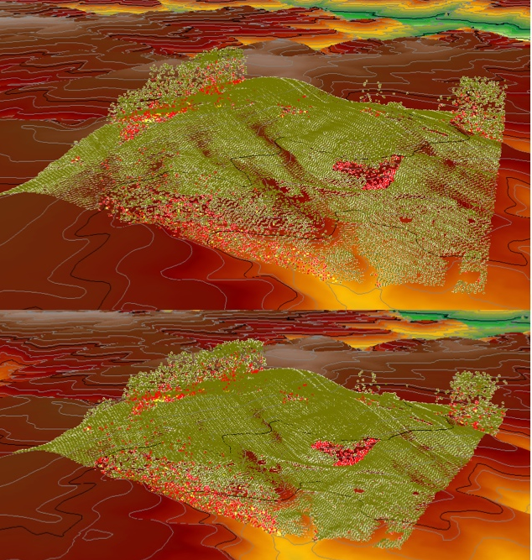
Assignment: Lidar
Compare DEM and DSM, analyze lidar point cloud properties
GRASS ArcGIS
Mathew J Pare, fall 2012

Slide 8
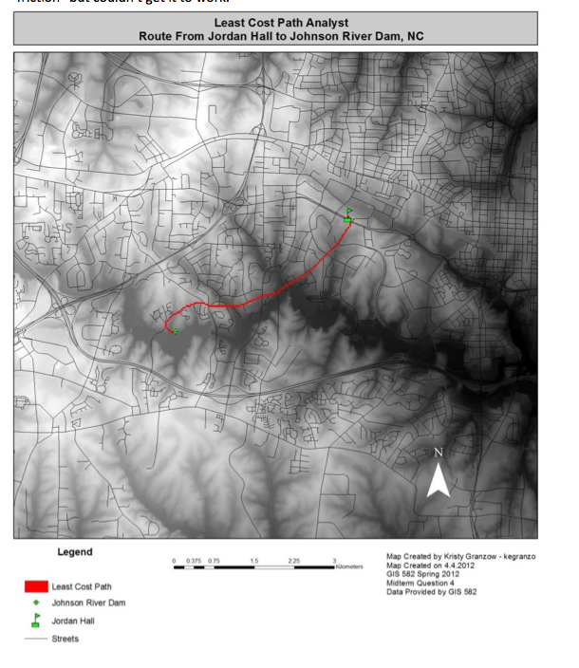
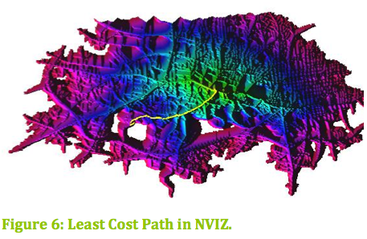
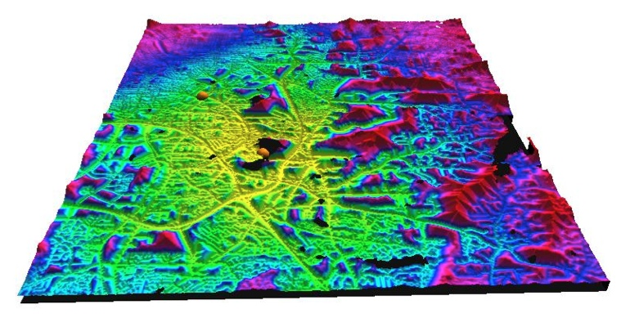
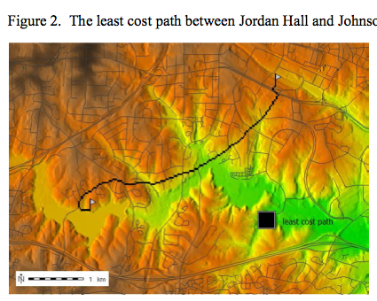
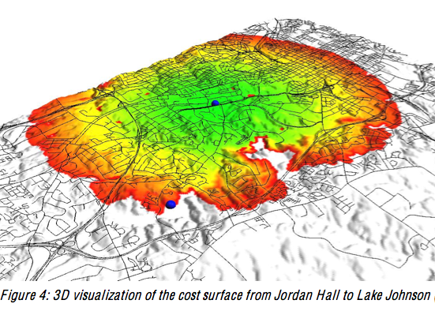
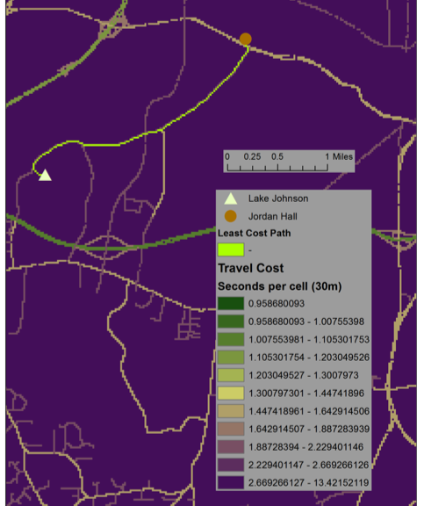
Midterm exam
Find least cost path between two off-road locations using GRASS or ArcGIS.
ARC GRASS
Granzow, Shortley, Terblanche, Shukunobe, Spore

Slide 9
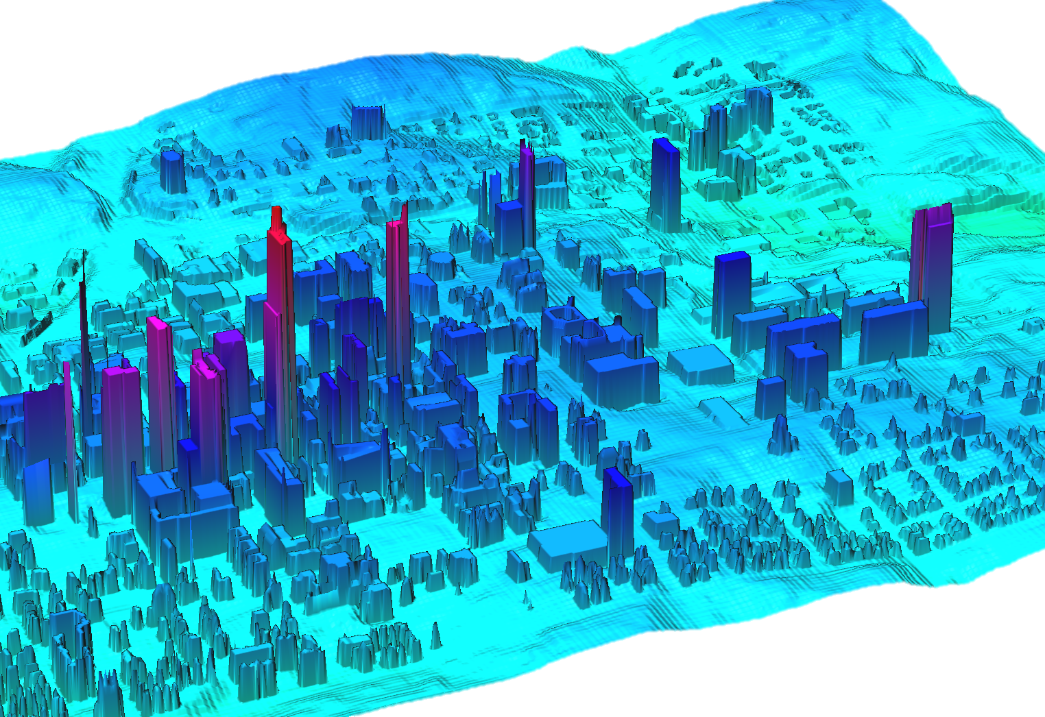
Project: Impact of building shadows
input: 10ft resolution downtown Raleigh DTM derived from 3D city model mapped annually by Pictometry
analysis: custom tools, ArcGIS and GRASS
Justin Greco, City of Raleigh

Slide 10
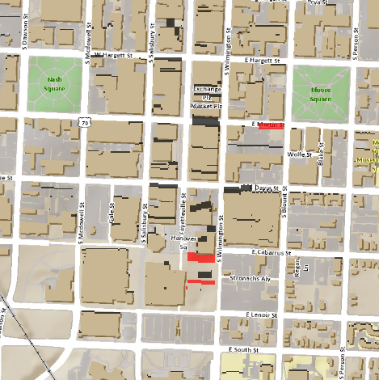
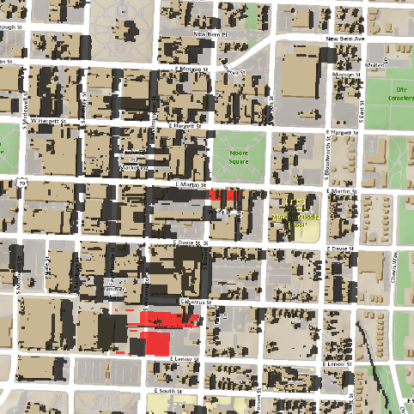
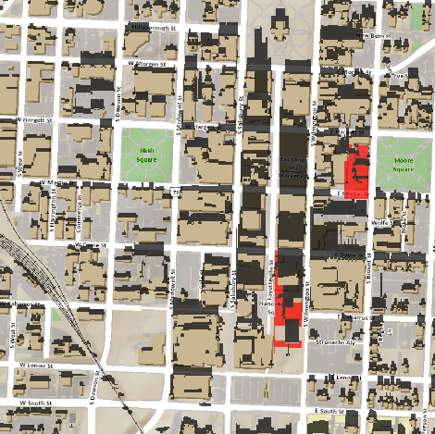
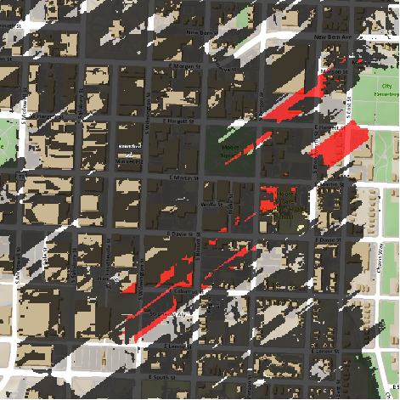
Project: Impact of building shadows
Summer solstice:
noon 4pm
Winter solstice:
noon 4pm
Spatial extent of cast shadows in summer and winter for the
current (grey) and planned (red) buildings
Justin Greco, City of Raleigh

Slide 11
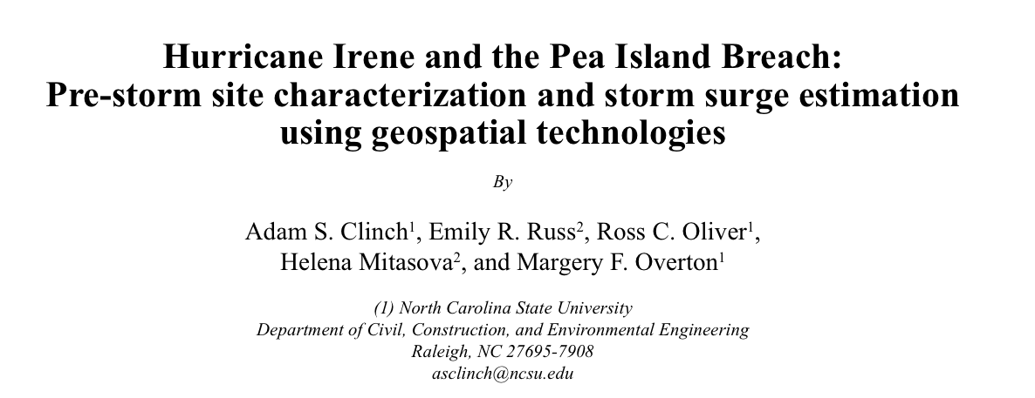
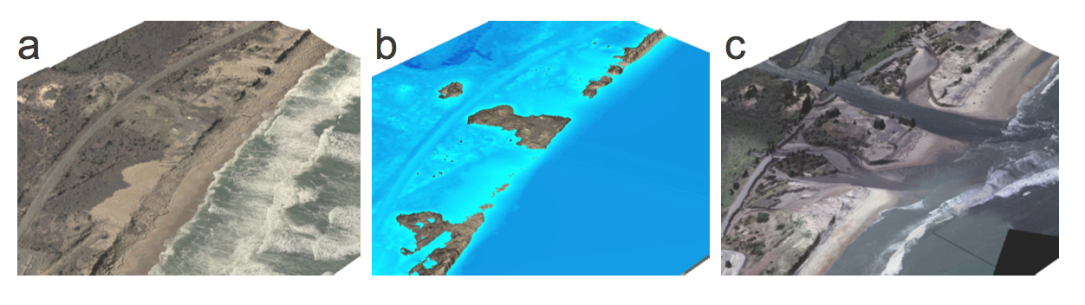
Project: Coastal Flooding
Several team projects lead to a published paper
published in Shore & Beach 80(2) spring 2012
300m

Slide 12
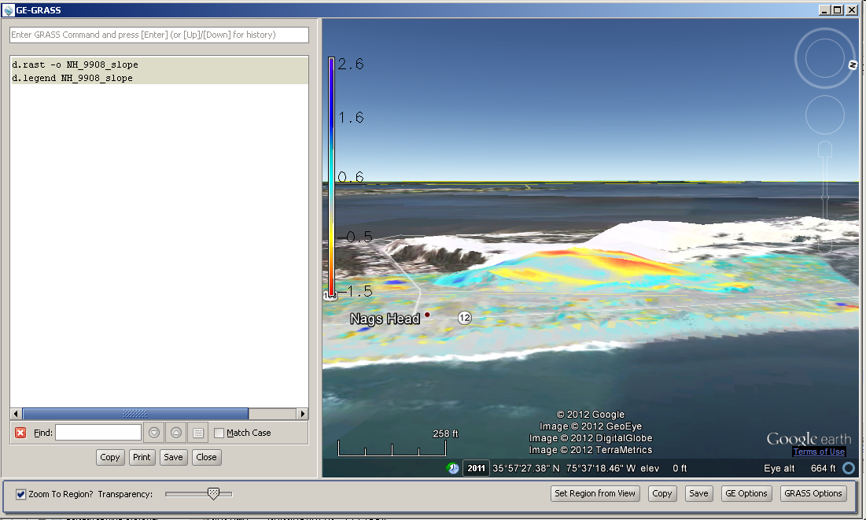
GE-GRASS user interface
Class project in Geospatial Modeling and Analysis
Rate of change in elevation for Jockey’s Ridge, Nags Head, NC
Steve Ansari
steve.ansari@noaa.gov

Slide 13
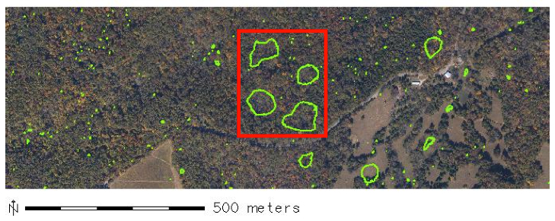
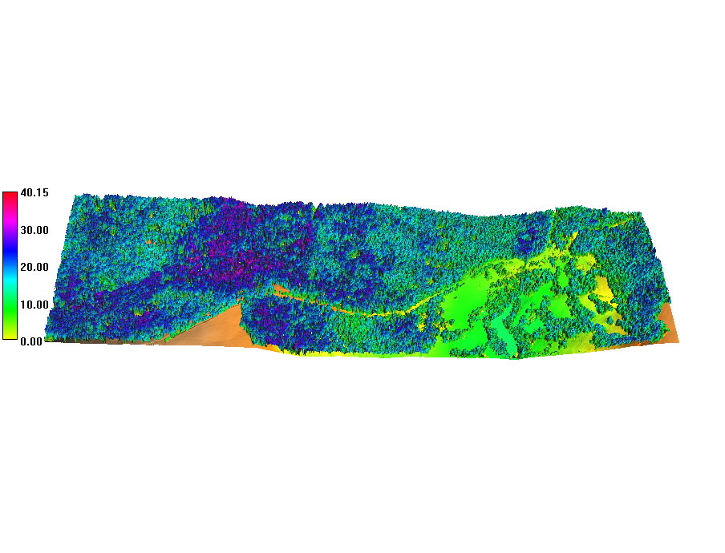

Project: Mammoth Cave National Park
Mammoth Cave national park lidar mapping: assessment of canopy height, analysis of karst landforms
Tree height [m]

Slide 14
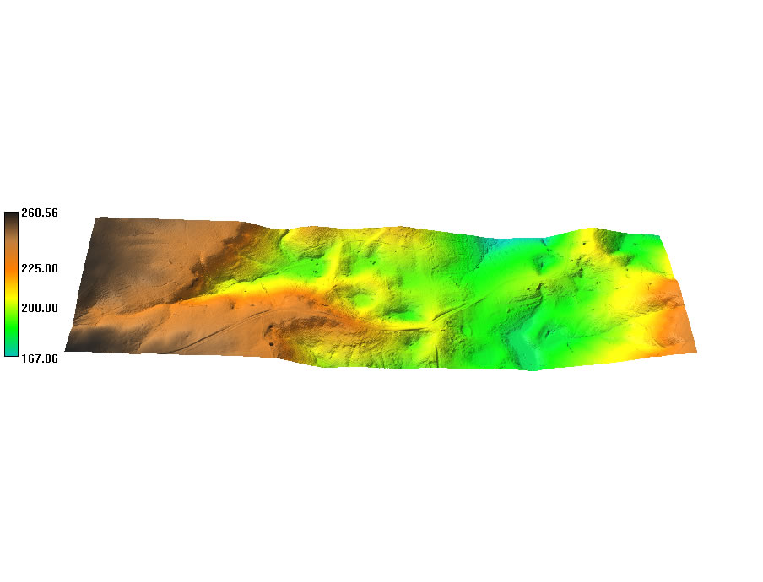
Project: Mammoth Cave National Park
Bare earth surface reveals karst morphology
Tree height
volumes from NCAR data
Bare earth
(Spline)
(m)
1.5 km

Slide 15
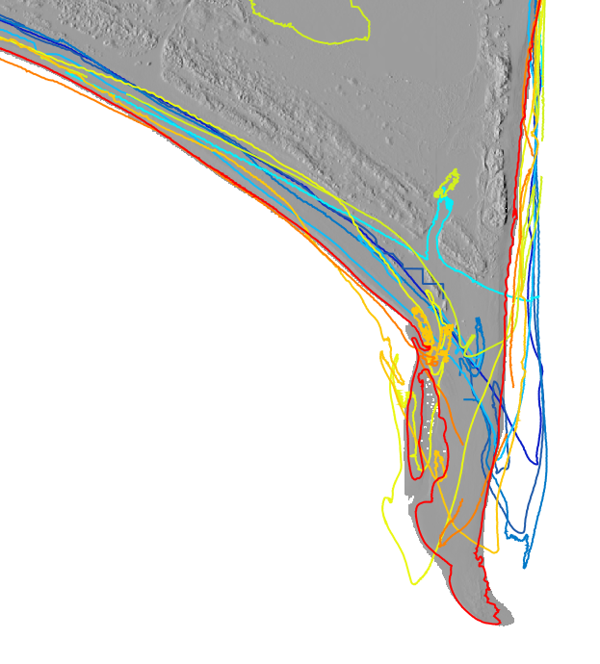
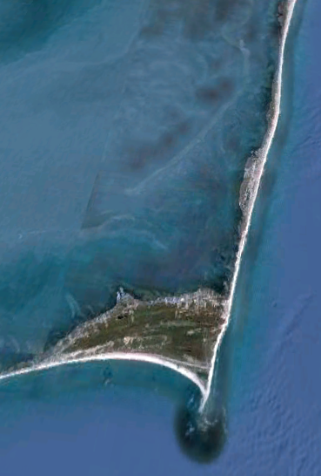

Shoreline evolution from voxel model
Cape Hatteras: shoreline evolution as 0.5m isosurface
2011
2009
2008
2005
2004
2003
2003
2001
1999
time[yr]
DEMs are stacked
into voxel model
200m
Cape Hatteras 1997-2011

Slide 16
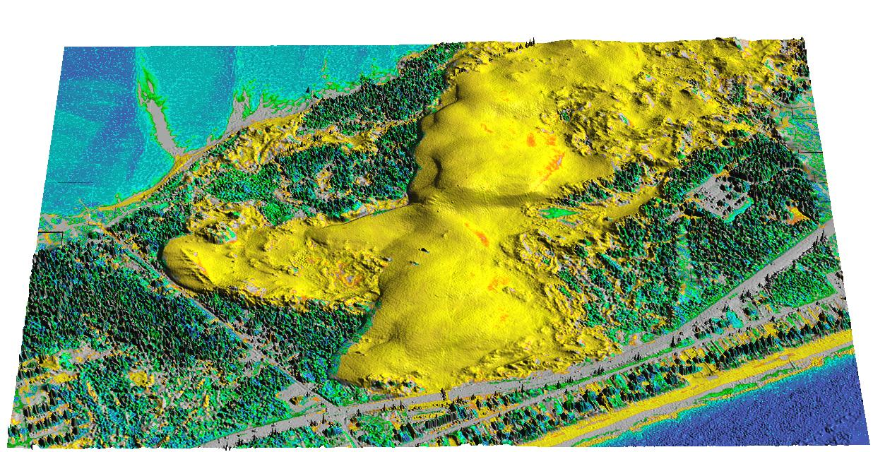
Jockey’s Ridge dune 1999
19m

Slide 17
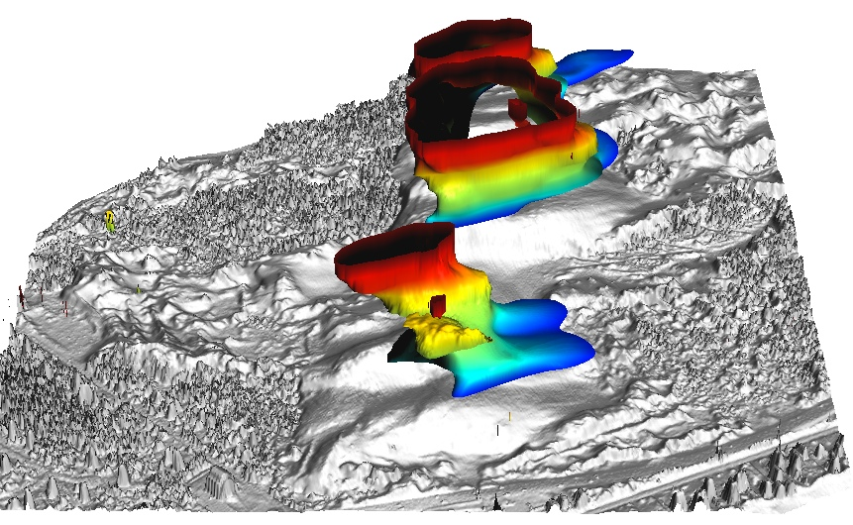
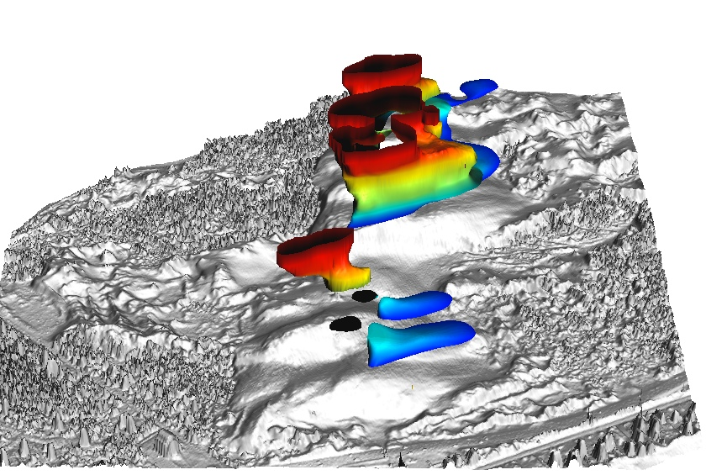
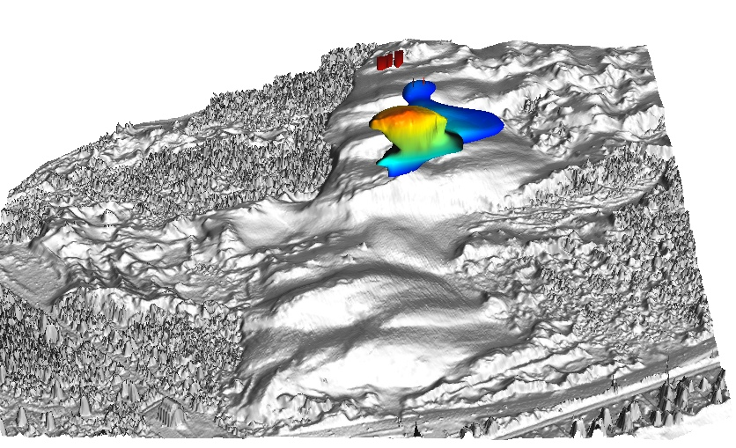
Evolution along contours
When and at which elevation
has the dune started to split into
parallel ridges?
Where and when did
the elevation rebound ?
15m
2008
2001
1998
1974
Time
[year]
Y[m]
17m
X[m]
23m
22m

Slide 18
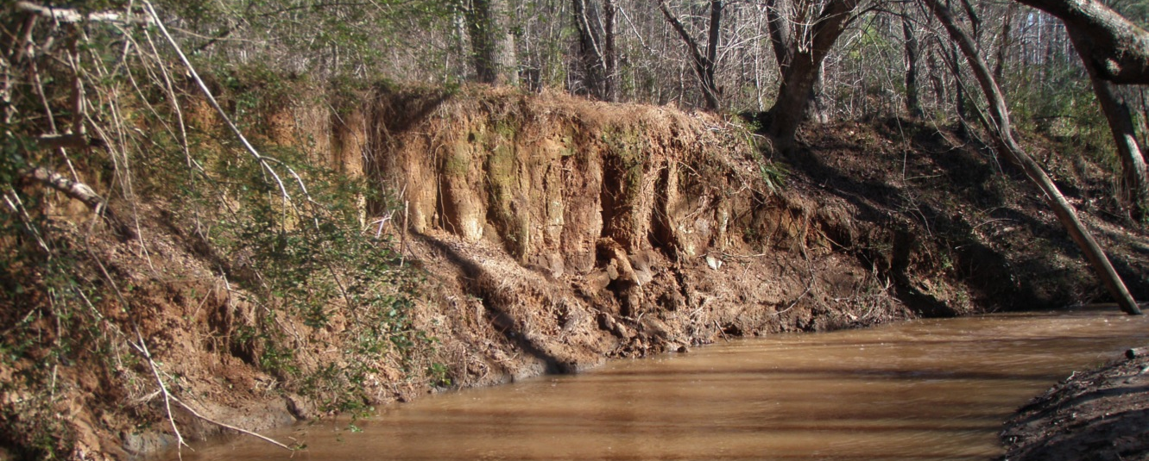
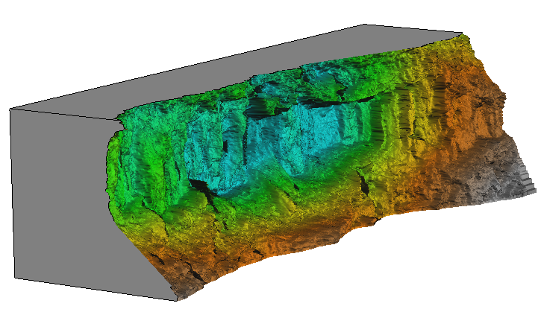
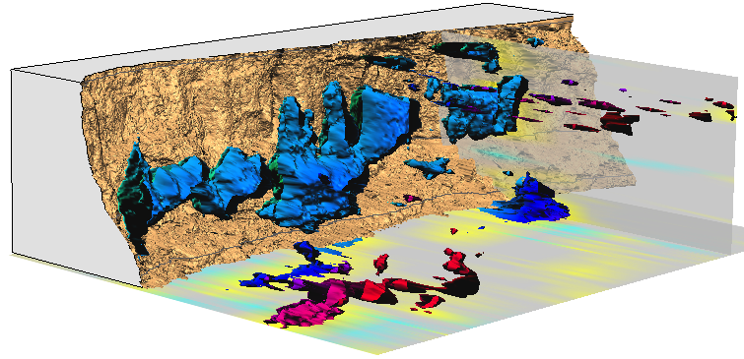


Monitoring eroding stream bank
Where and when was the change between two surveys greater
than 0.5m and what was its pattern?
Isosurfaces of change > 0.5 m
First and last scan of 9 total
0 5m
Time [epoch #] 1 3 5
Dr. M. Starek, N. Lyons, K. Cepero, Dr. Wegmann
legacy sediment from old millpond, in farmland turned to state park
monitoring by Leica Scan terrestrial scanner – 8 epochs 2010 – 2012, 1cm res DEM
distance to base plane [m]

