Slide 1
Geospatial modeling for sustainable land management: surface runoff and erosion/deposition
Helena Mitasova
North Carolina State University
GRASS GIS
Notes:
1
Over the past decade free and open source software (FOSS) has moved into mainstreem and its growth includes a wide range of geospatial software tools. The presentation will briefly describe the principles of FOSS and provide an overview of major FOSS projects that support management, processing, analysis, visualization and on-line distribution of georeferenced data. Interoperability between the different tools enabled by the FOSS concept will be highlighted using examples of applications that combine software developed by several projects, such as GRASS, Mapserver, GDAL, PROJ, R-stats, PostGIS, paraview and others. Special focus will be given to the recent new developments in Geographic Resources Analysis Support System (GRASS, http://grass.itc.it). Since its original design as a land management tool for military installationsthe system has evolved into one of the most comprehensive, general purpose GIS and support for environmental modeling has been an integral part of its development. Overview of the GRASS6 capabilities relevant to environmental modeling will be provided, including tools for working with 2D and 3D raster data, the completely redesigned topological 2D/3D vector engine, vector network analysis and SQL-based attribute management. Various graphical user interfaces, such as QGIS and JAVAGRASS, that are being used with GRASS will be introduced and enhancements to 3D dynamic visualization will be presented. Environmental modeling will be illustrated by examples in the area of coastal management and sediment pollution control using the latest lidar data and new or updated GRASS6 modules. The talk will conclude with discussion of visions for the future of FOSS geospatial modeling.

Slide 2
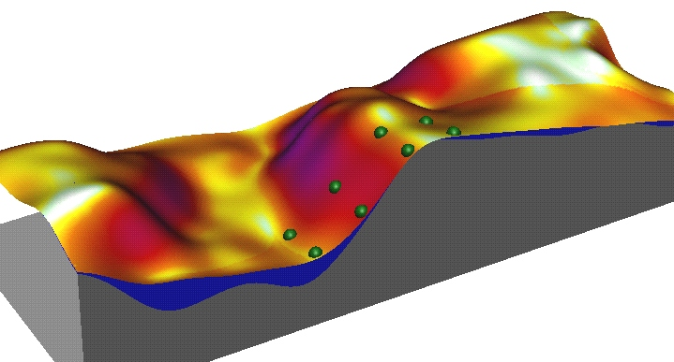
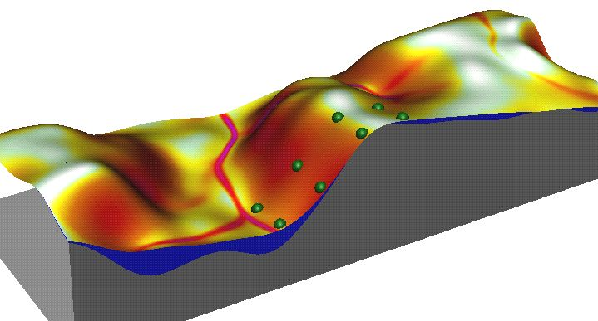
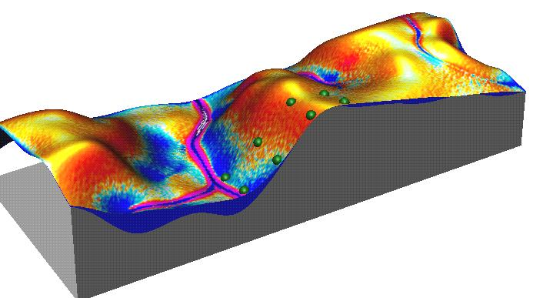
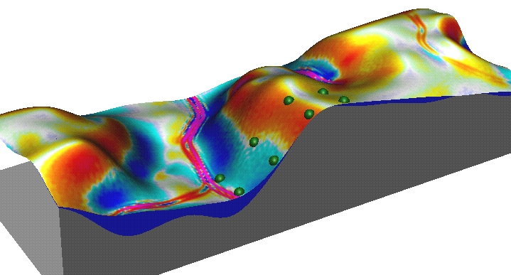
Geospatial erosion modeling
erosion only: USLE2D USLE/RUSLE3D
A=RKLSCP
slope length
A=RKLSCP
upslope area
erosion
deposition
erosion/deposition: USPED physics-based SIMWE

Slide 3
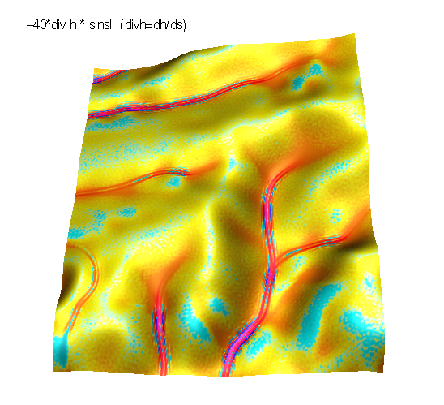
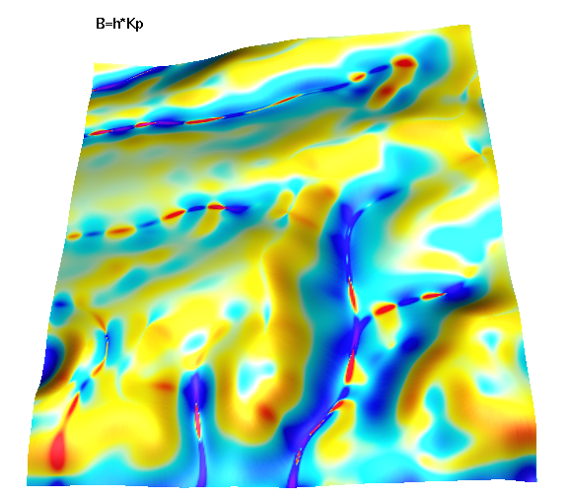
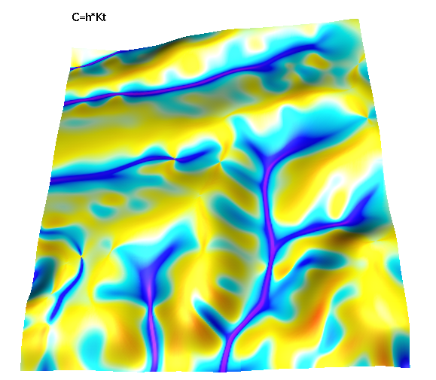
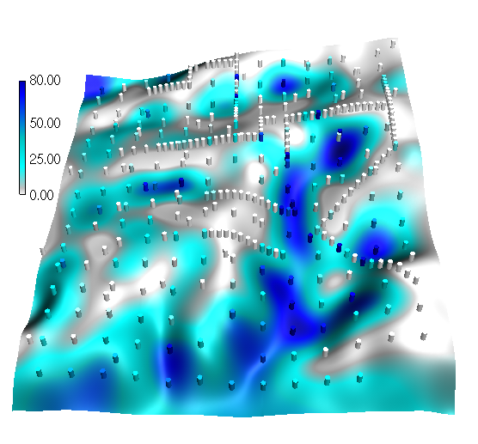
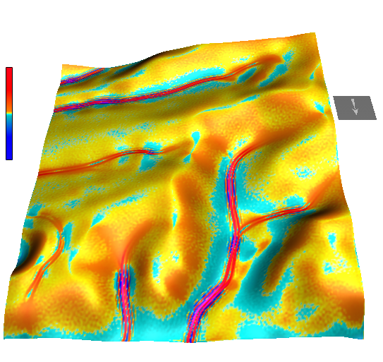
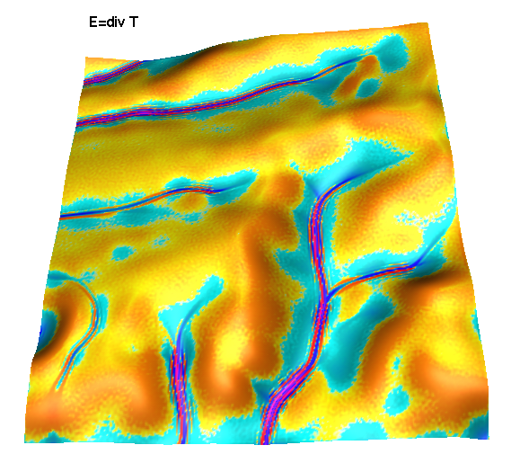
(a) (b) (c)
+ +
erosion deposition
(d) (e) (f)
300m

Slide 4
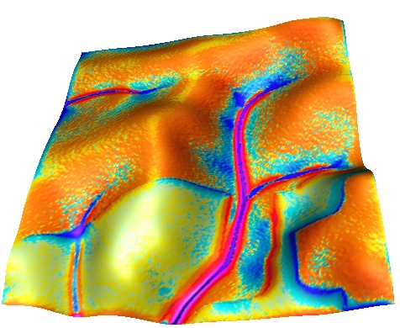
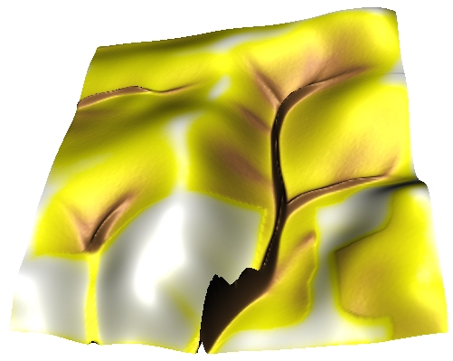
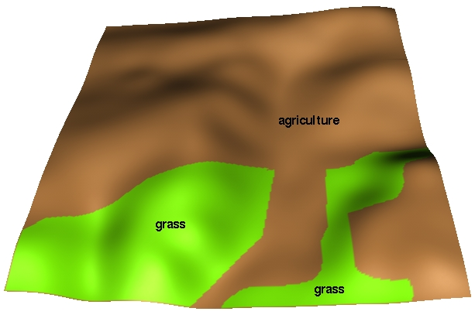
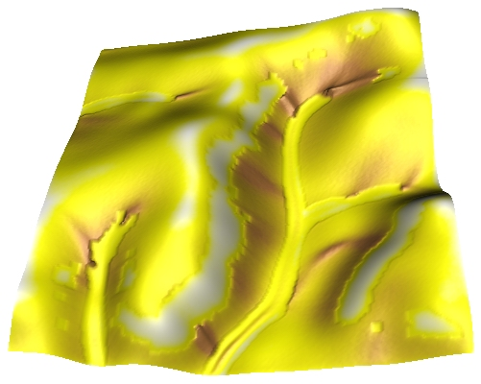
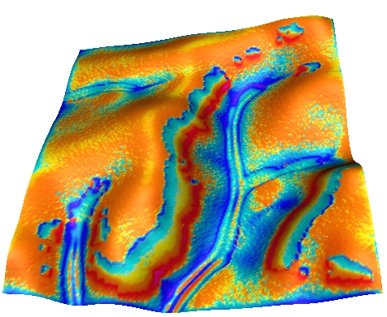
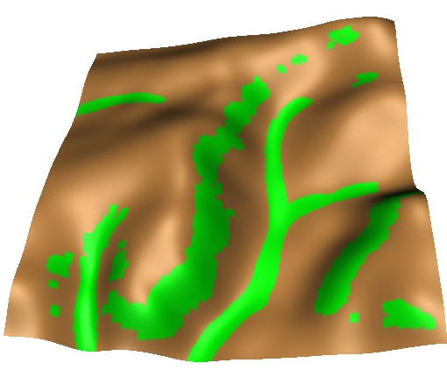
Impact of change in land use pattern
Original LU sediment flow net erosion/deposition
Optimized LU

Slide 5
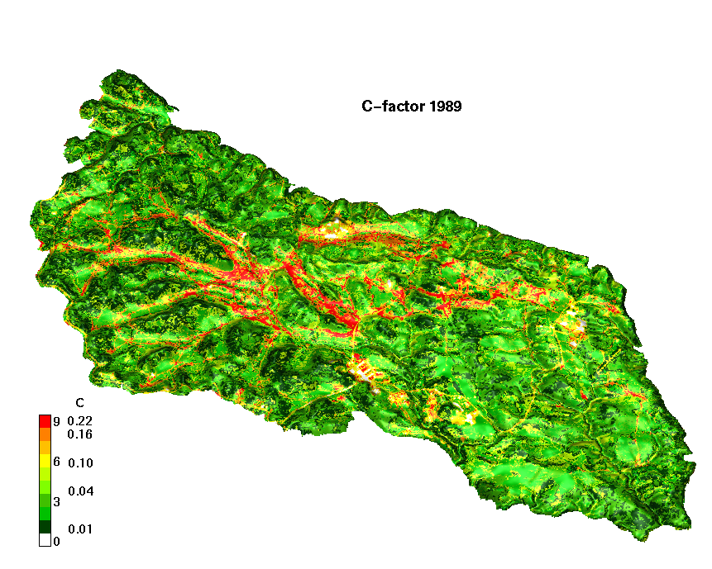
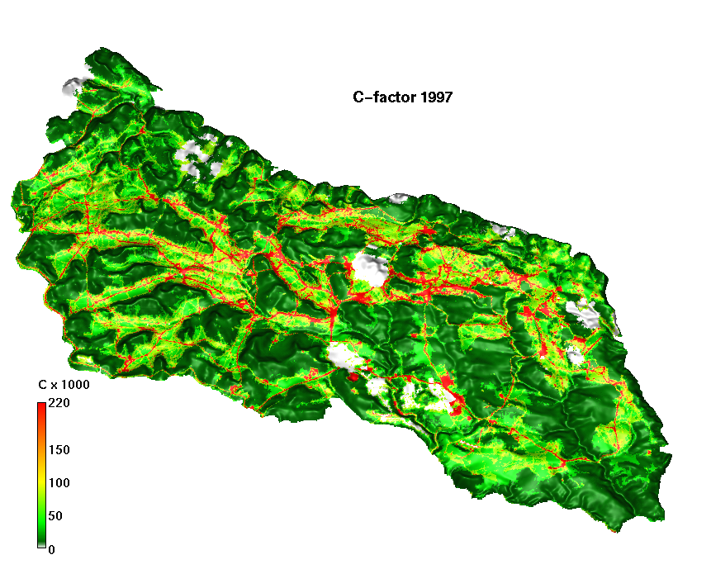
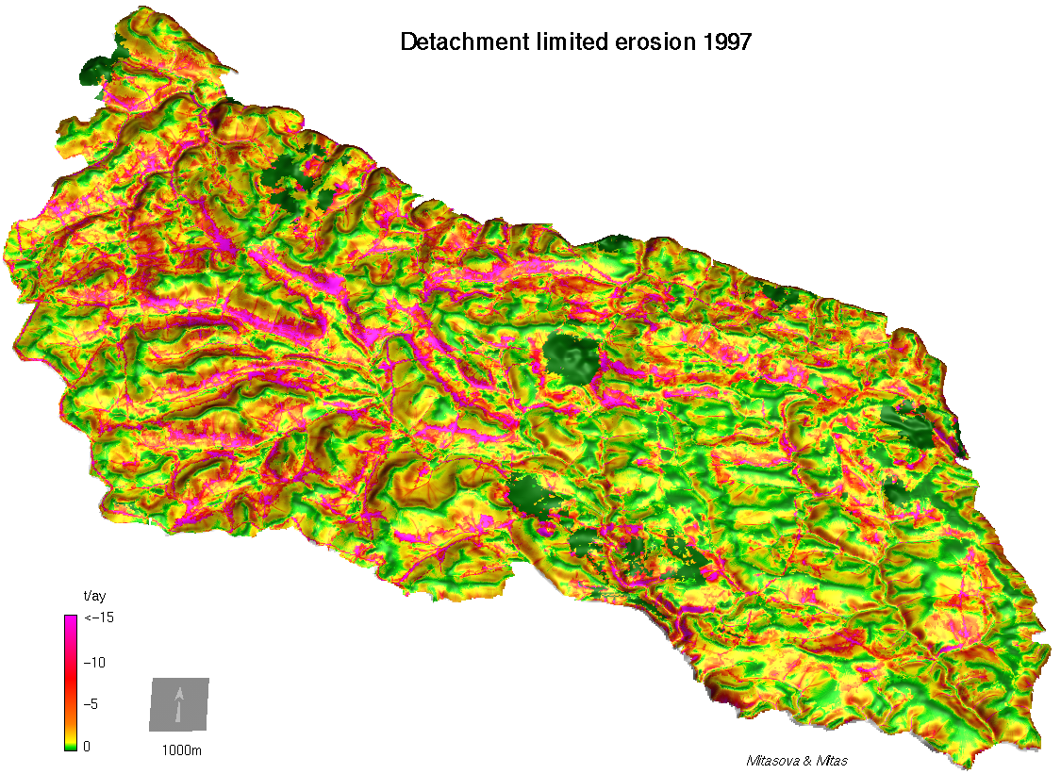
Mapping high risk areas – installation scale
Hohenfels,
Germany
Notes:
5

Slide 6
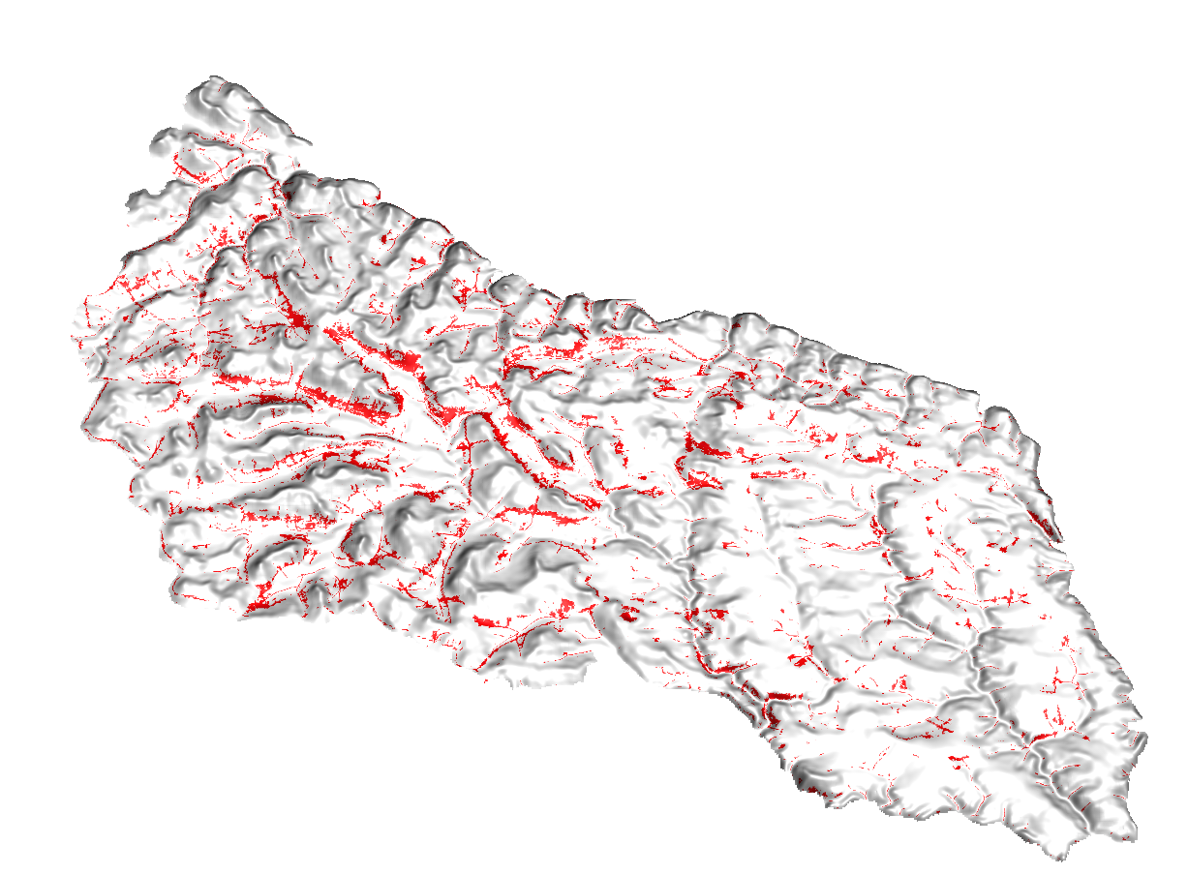
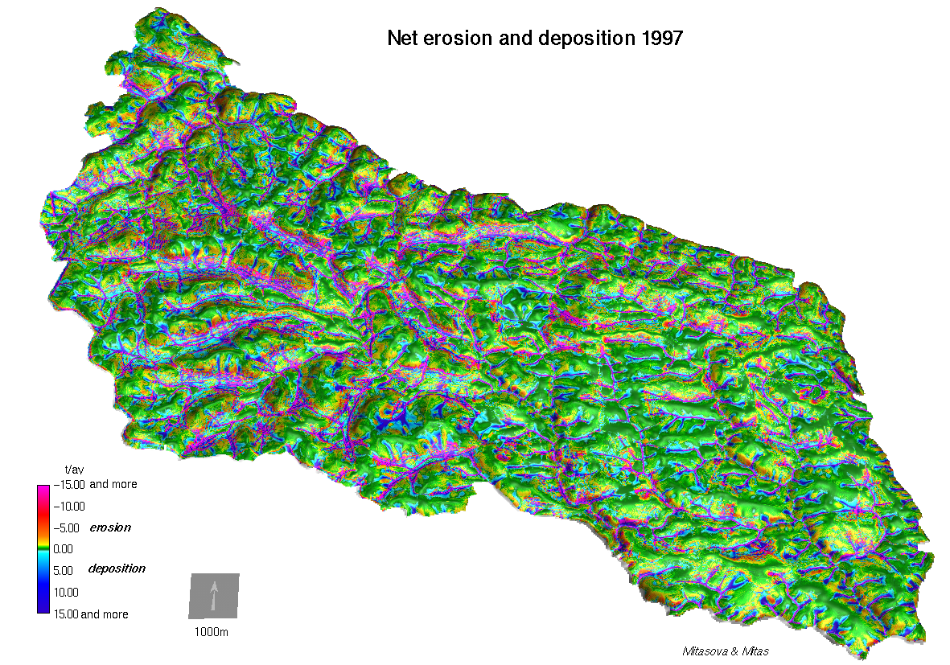
Mapping high risk areas – installation scale
Hohenfels, Germany
Notes:
6

Slide 7
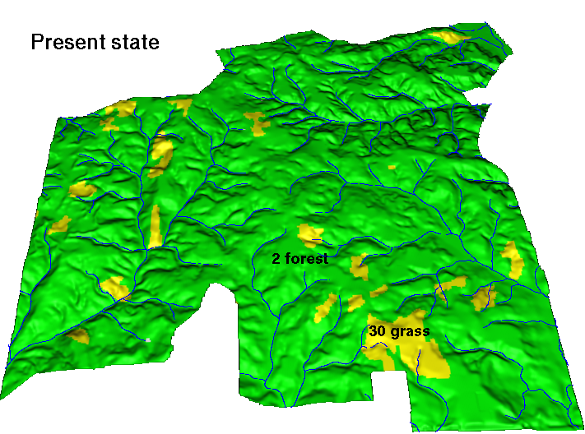
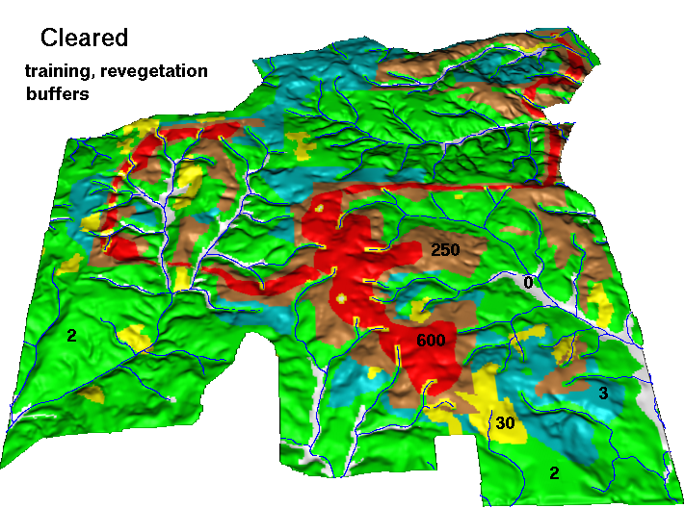
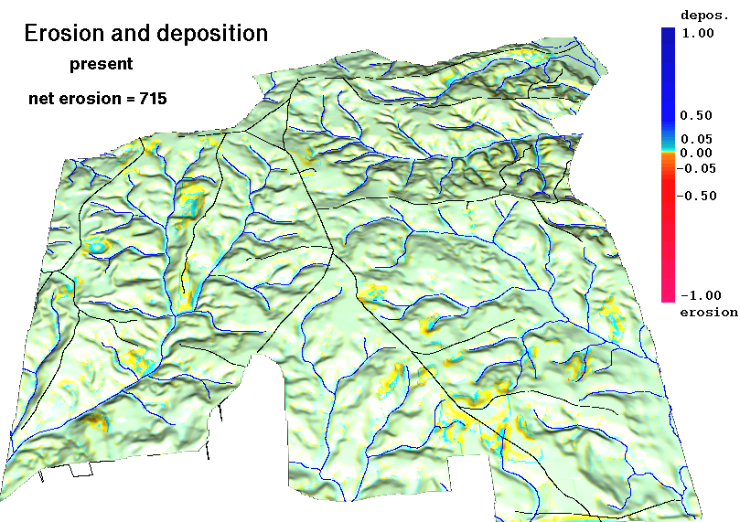
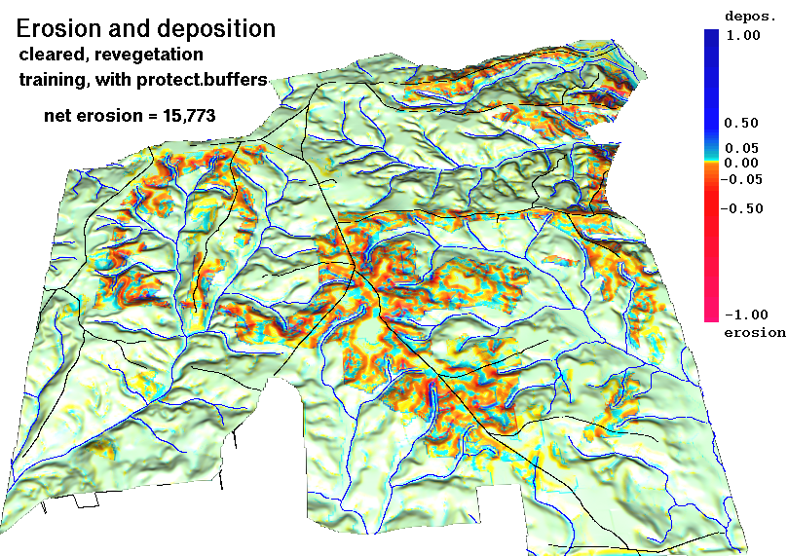
Impact of land use change – installation scale
Camp Shelby extension
Notes:
7

Slide 8
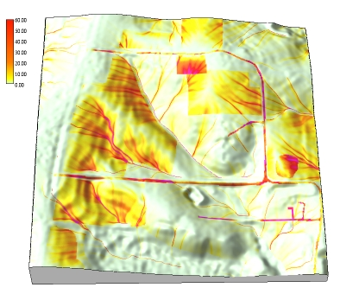
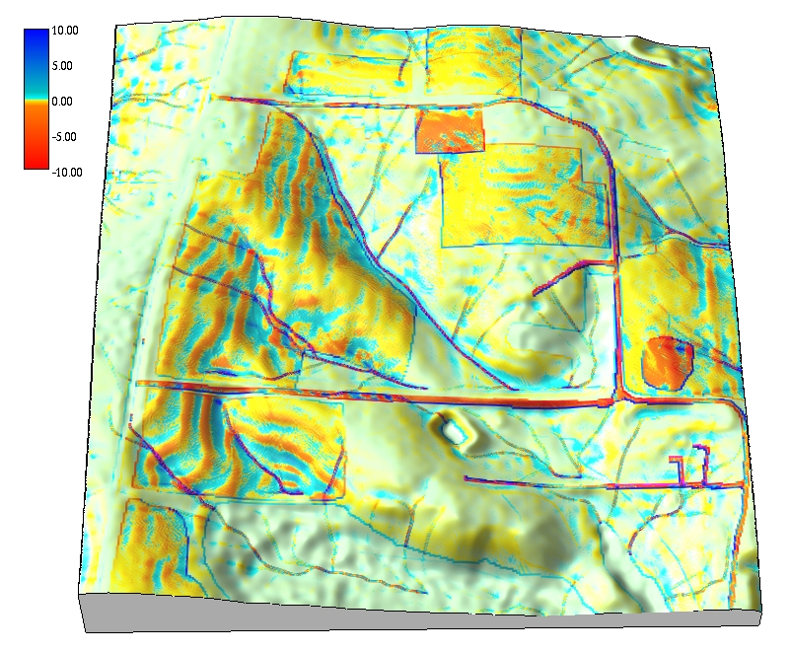
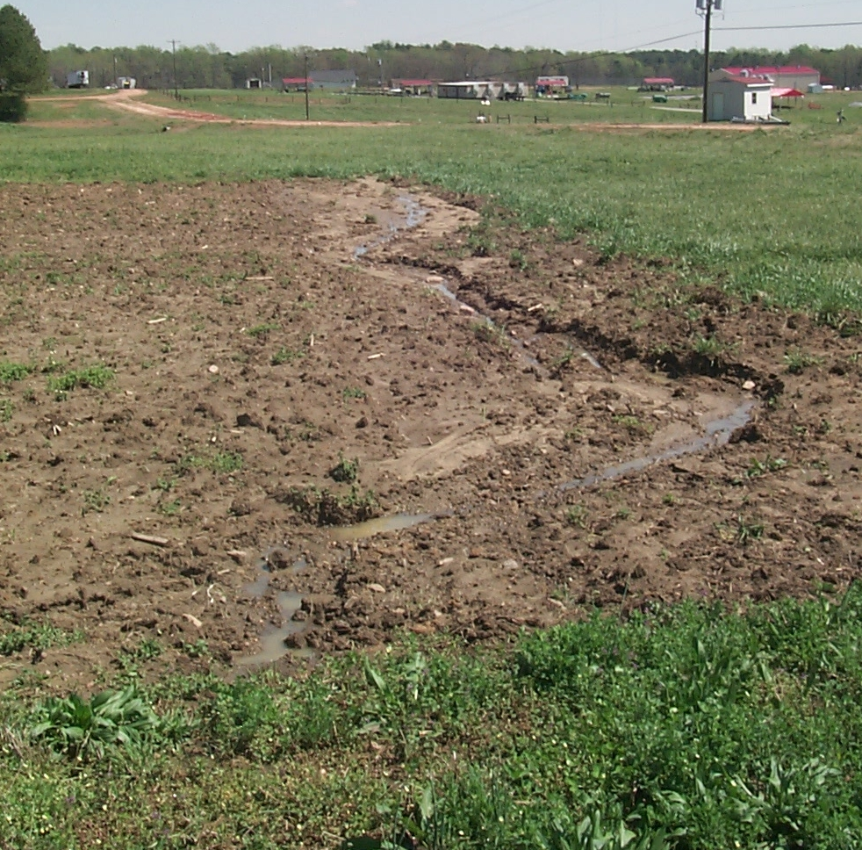
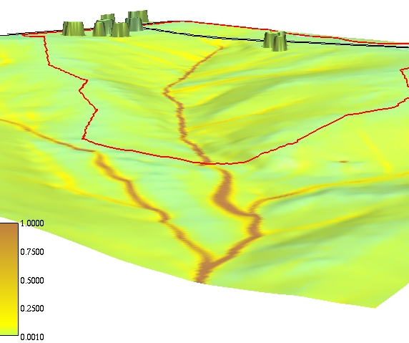
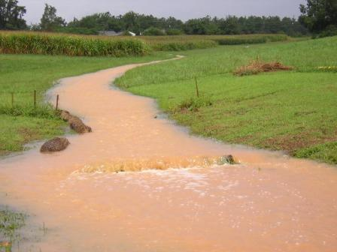
Sediment transport modeling
High resolution
DEM, soils and
land cover data:
process-based
simulations
soil detachment
sediment flow
net erosion and
deposition
GRASS GIS Open Source Geospatial Foundation
Notes:
8

Slide 9
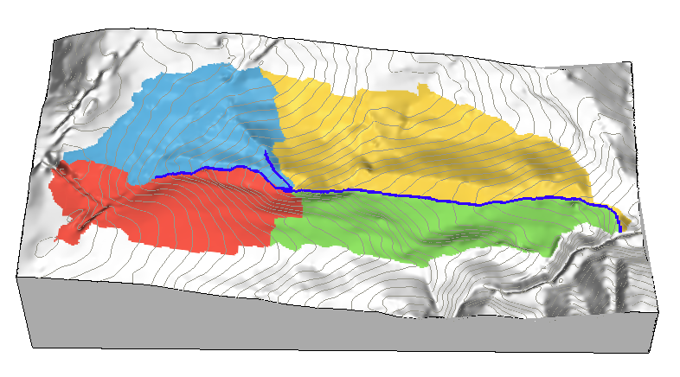
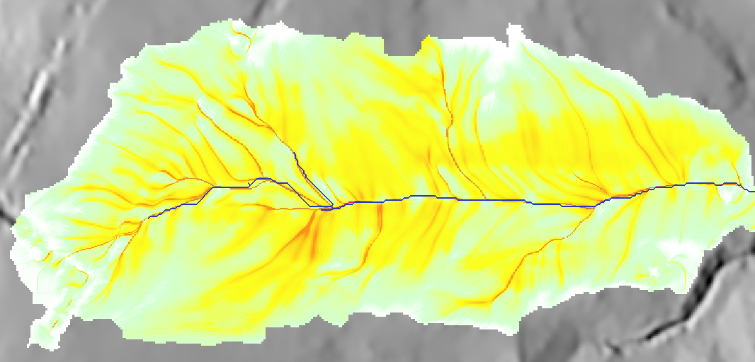
3.2 5.8
2.5 1.4
(a) (b)
500m
20
10
0
deposition
erosion
(c) (d)
Notes:
Intro - this has been already covered

Slide 10
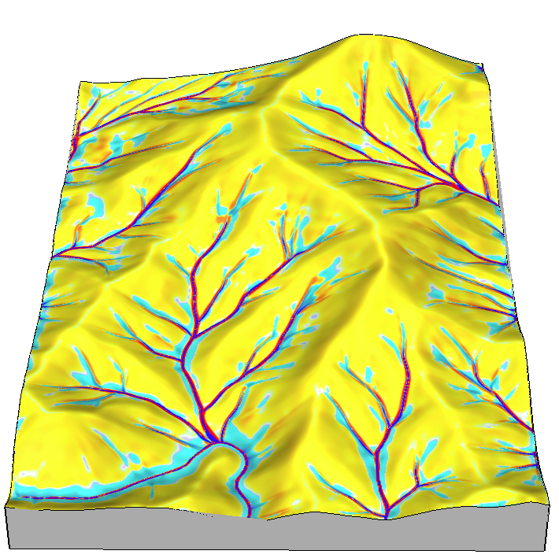
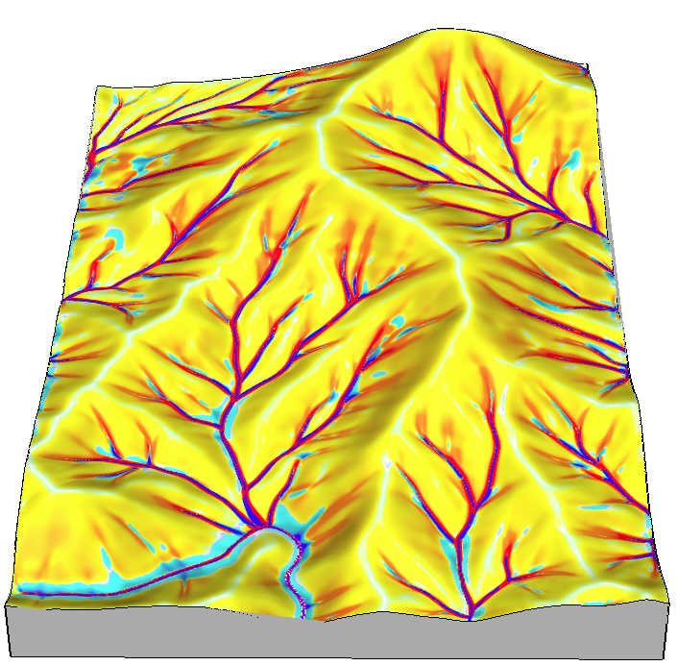
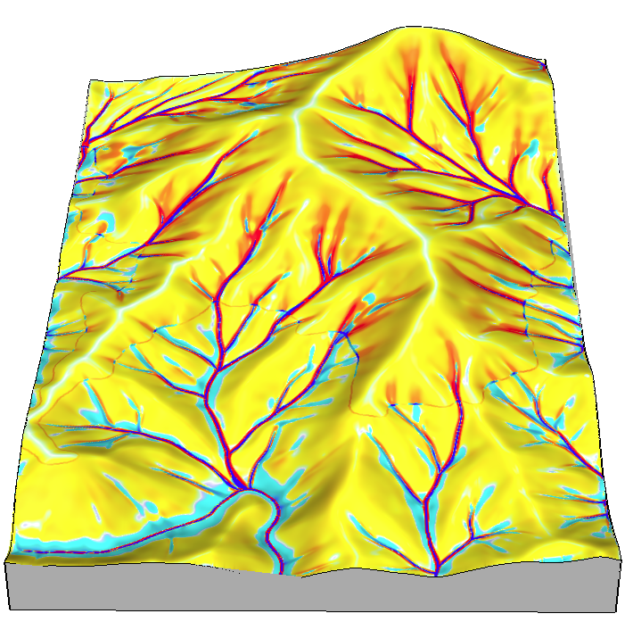
erosion
deposition
(a) (b) (c)
500m

Slide 11
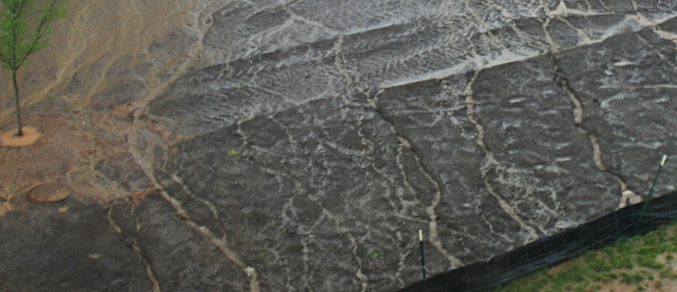
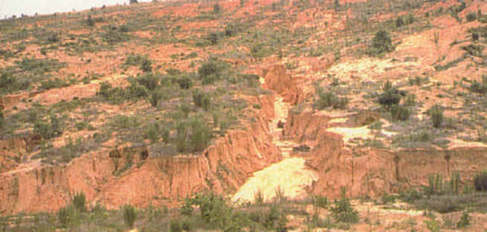
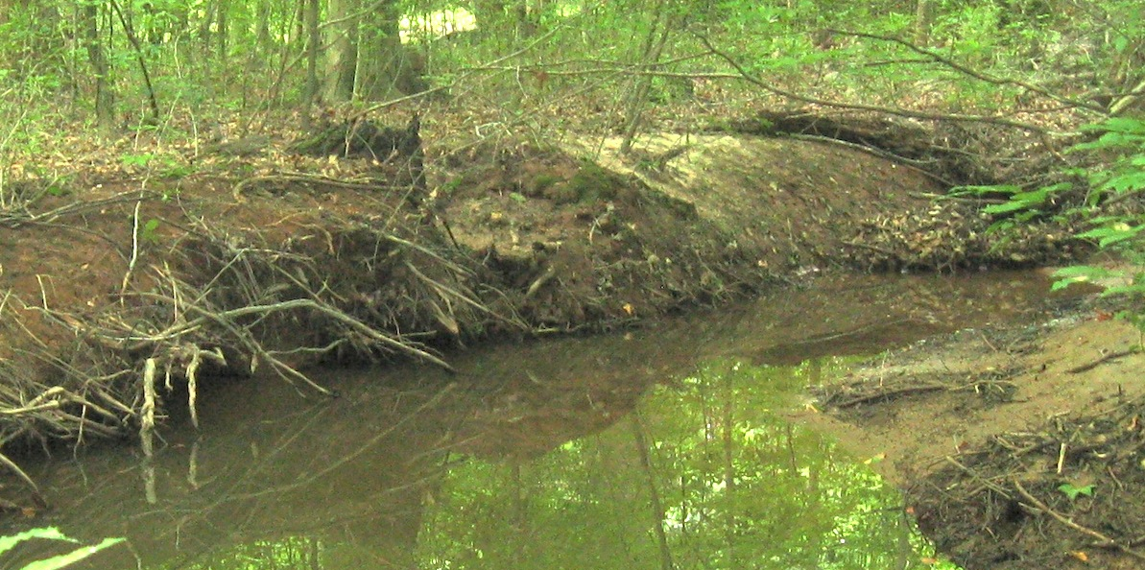
Helena Mitasova
NCSU
(a)
(b)
(c)

