Slide 1
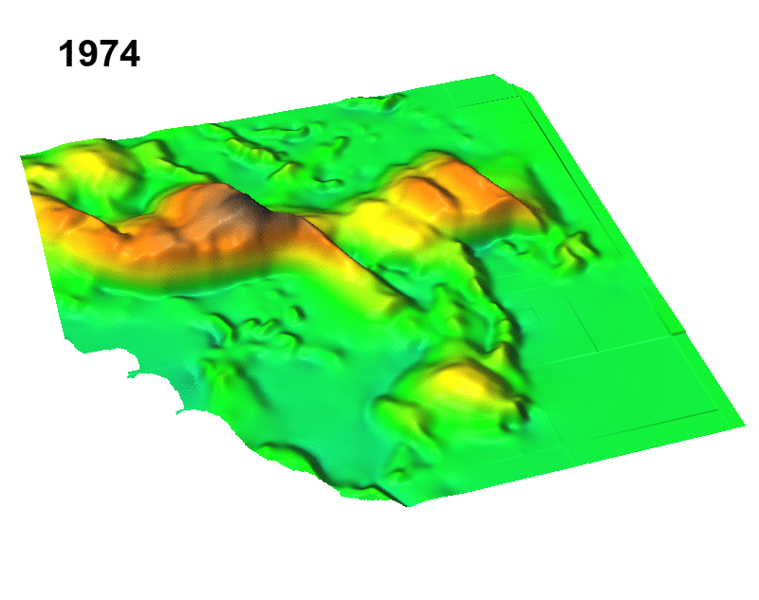
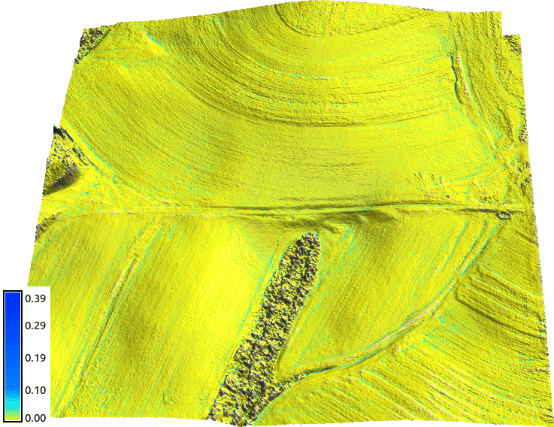
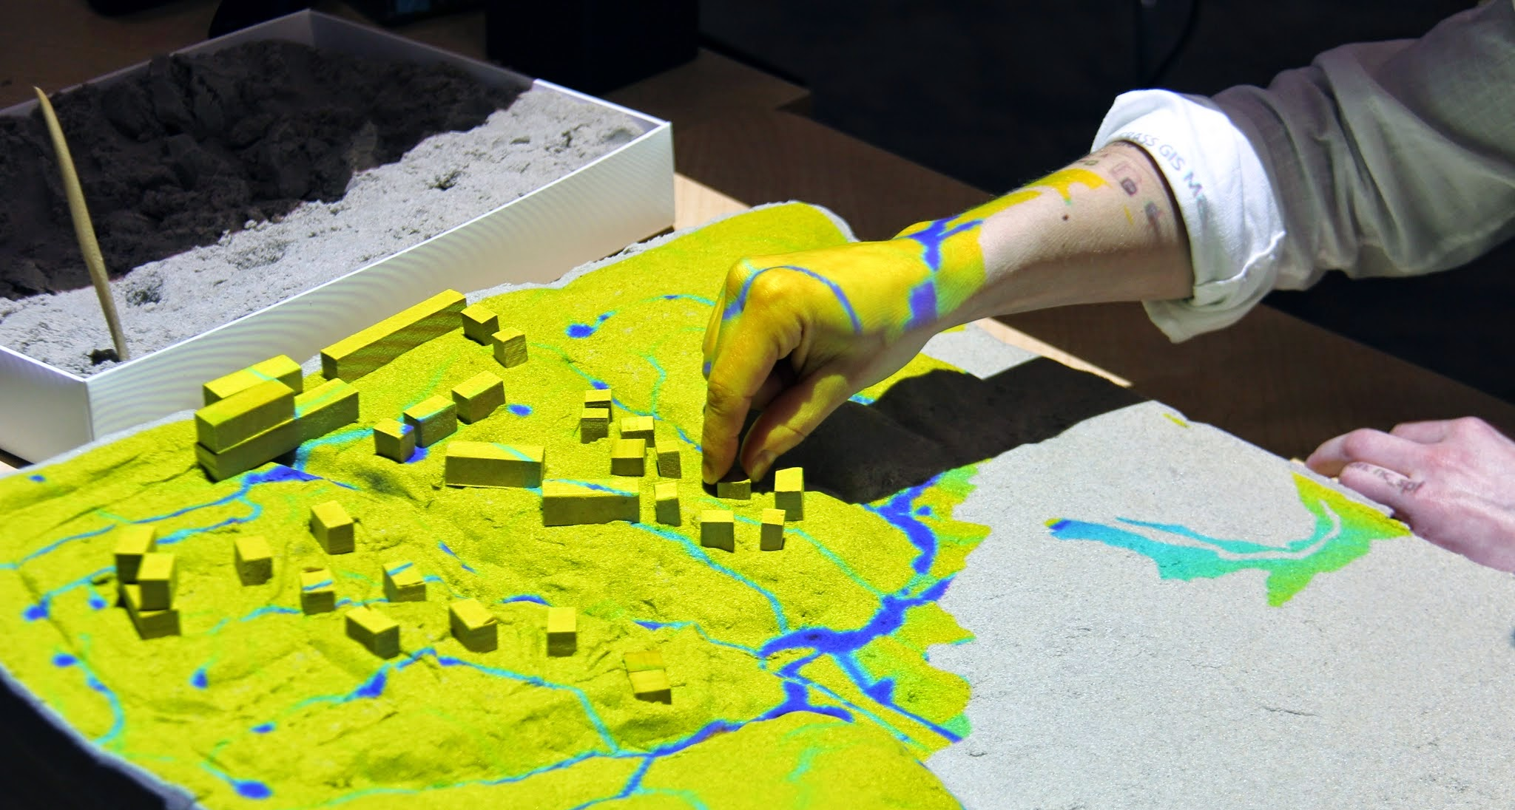
Geospatial Analytics of Dynamic Landscapes
Helena Mitasova, MEAS and Center for Geospatial Analytics, OSGeo Laboratory
http://geospatial.ncsu.edu/osgeorel/
processing and integration of 2D and 3D data (lidar, sUAS, sonar, imagery) that capture land surface dynamics
development of open source GIS-based toolboxes to map, model and predict 3D landscape processes (Coastal dynamics book by Springer 2014)
development of open source visualization and tangible modeling environments to support planning and decision making

