Slide 1
Geospatial Analytics and Modeling Laboratory
Helena Mitasova
http://skagit.meas.ncsu.edu/~helena/ email:hmitaso@ncsu.edu
Katherine Weaver, Keren Cepero, Emily Russ,
Eric Hardin, Paul Paris, Nathan Lyons
North Carolina State University, Raleigh, NC, USA

Slide 2
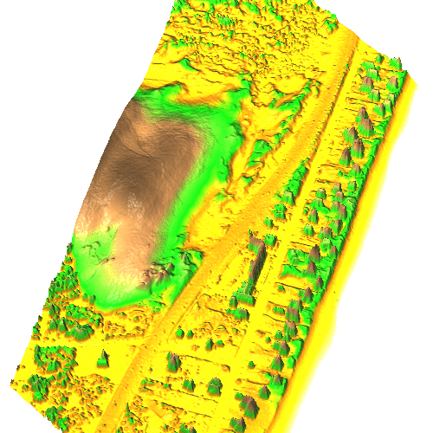
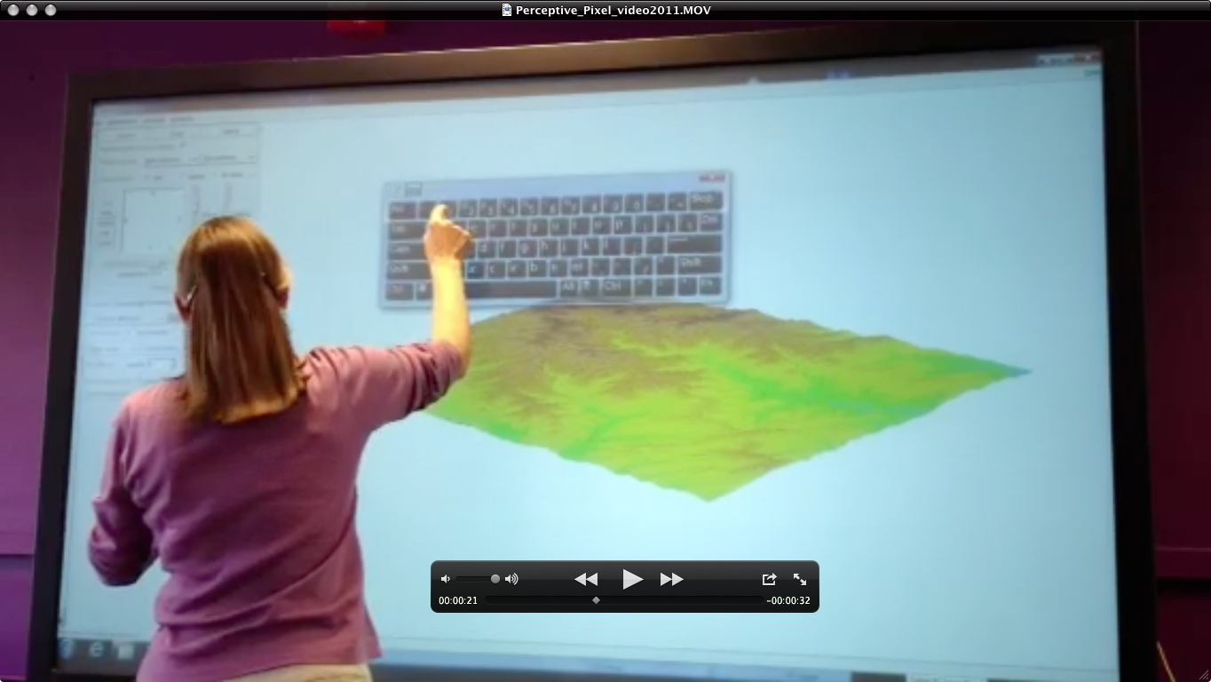
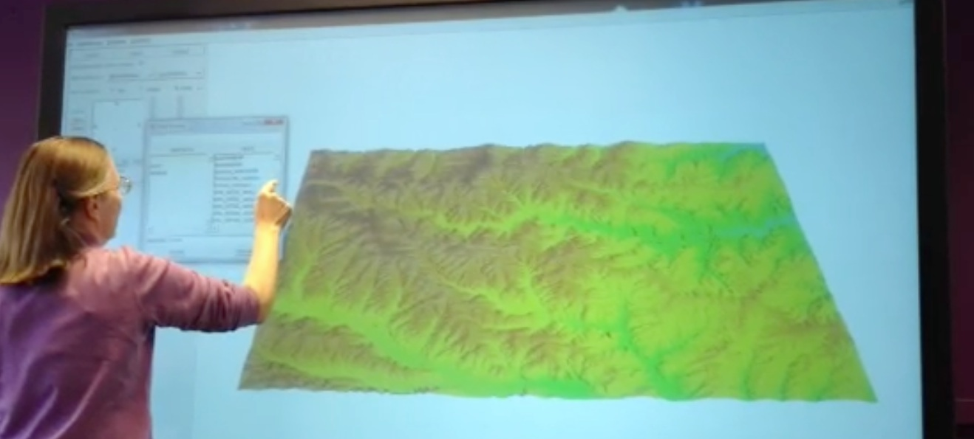
Geospatial Analytics of Landscape Dynamics
processing and integration of 2D and 3D data (LiDAR) that capture landscape dynamics
development of open source GIS-based toolboxes to measure and map 3D landscape dynamics
development of open source visualization and tangible modeling environments to support planning and decision making

Slide 3
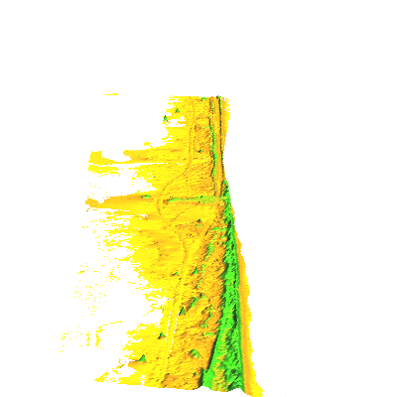
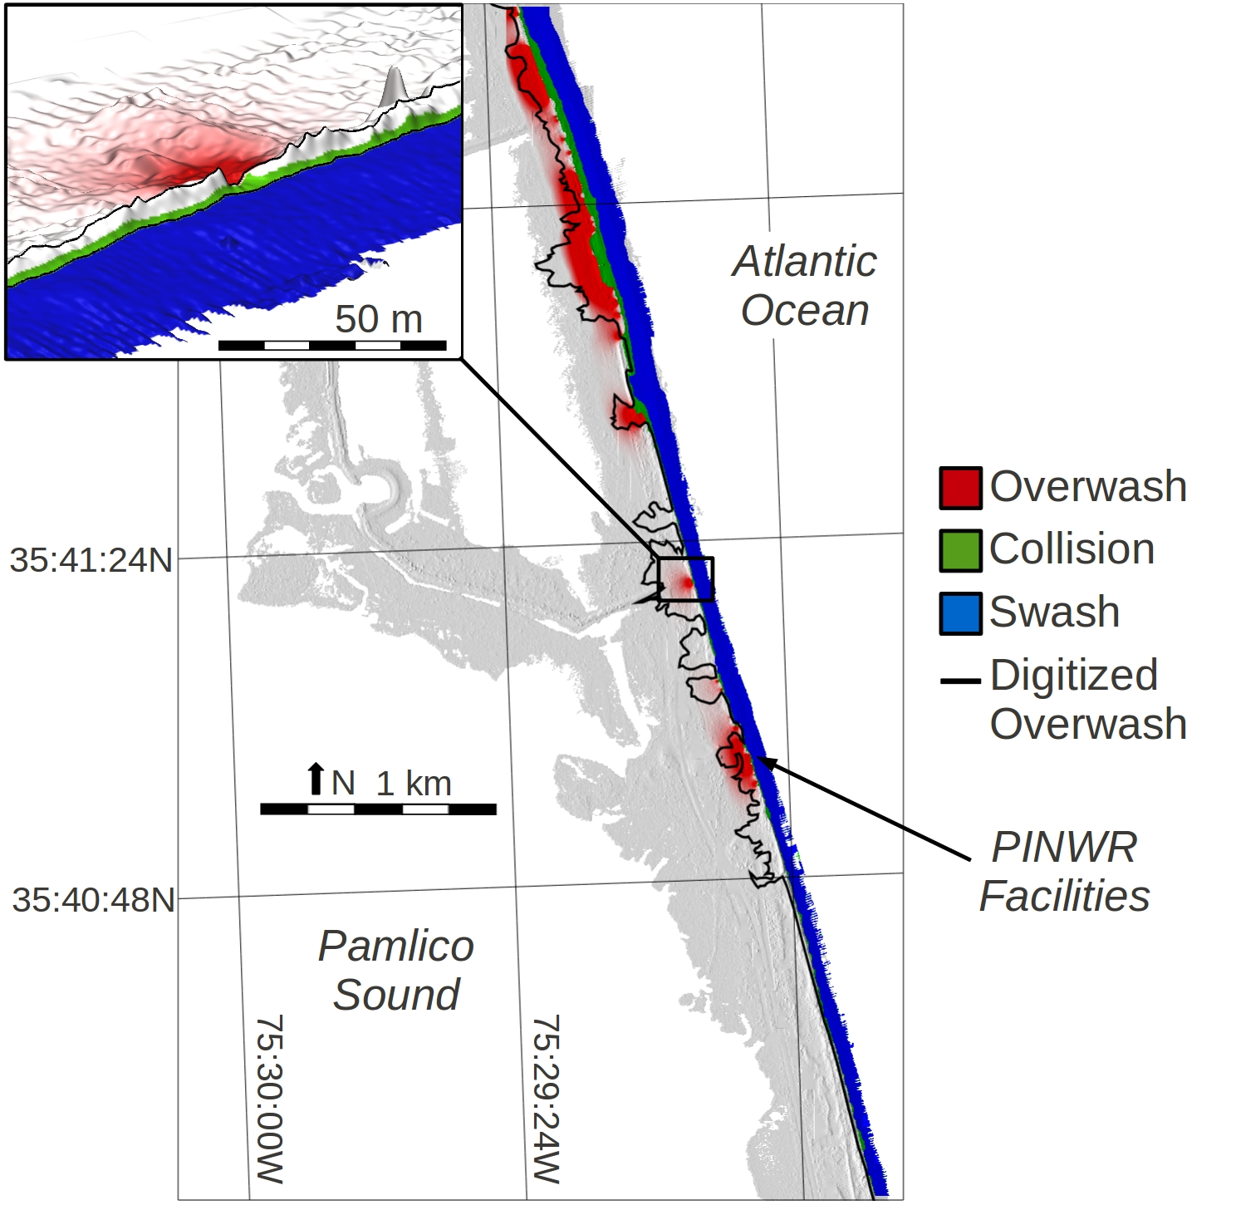
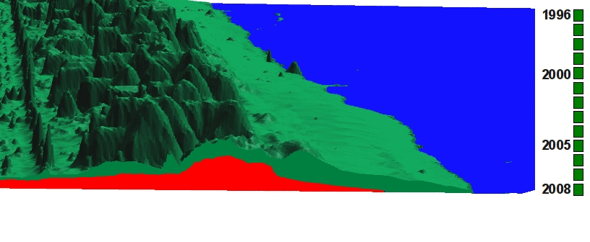
Coastal change analytics toolbox
Pea island change 1996-2009
USGS Storm Impact Scale: automated updates using the most recent LiDAR surveys
Stable core Actual elevation

Slide 4
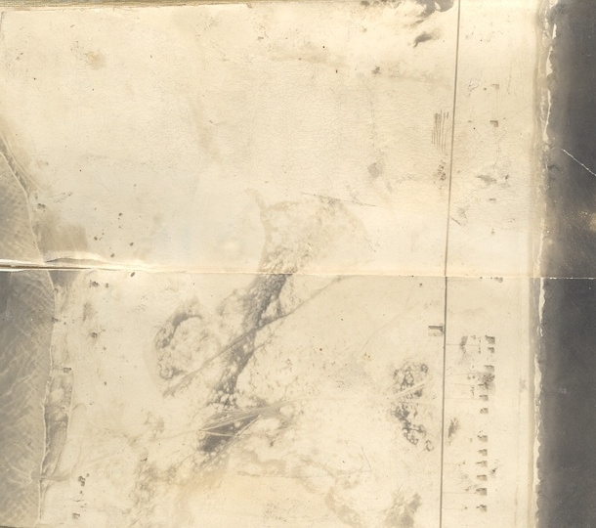
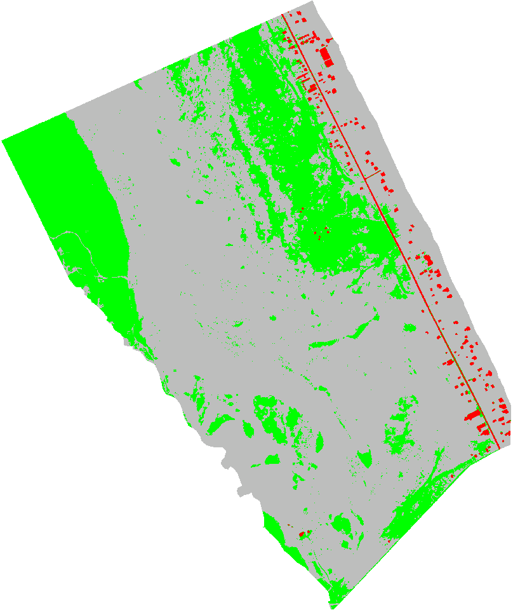
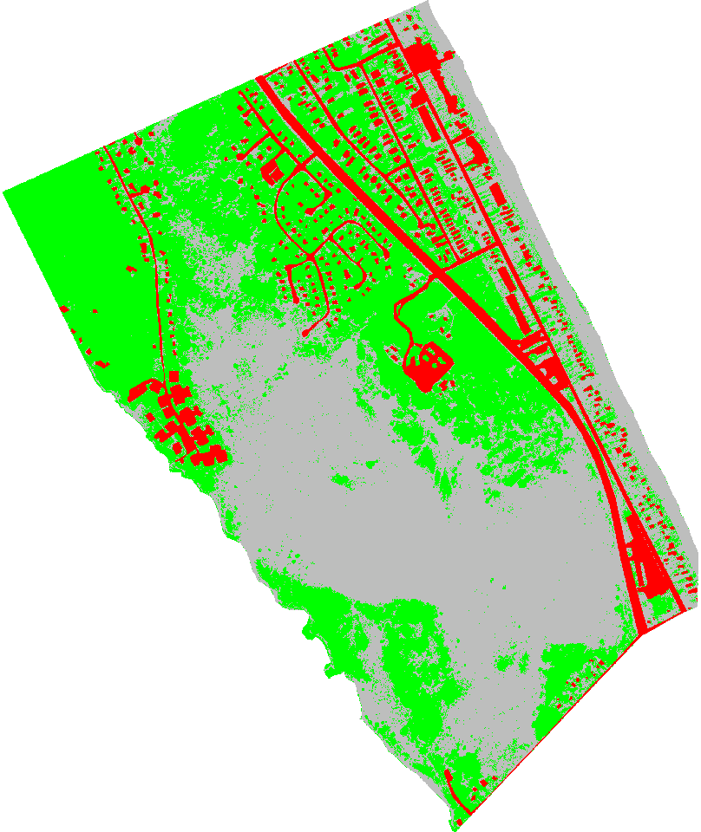
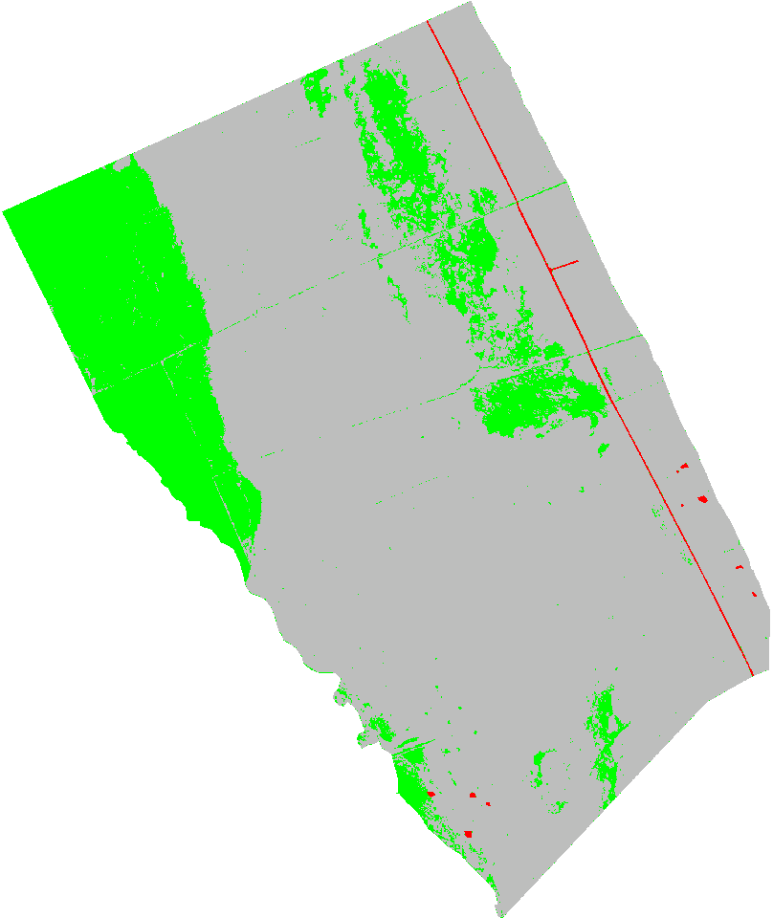
Coastal vegetation dynamics
dramatic increase in vegetation and development since 1900
GIS-based classification of historical and current airphotos
1932 1943 2003
Climate change driven (?)
dune evolution over
past 1000+ years
2020? Forested
1810 Modern dunes
1700 Forested
1932 1955 2009
1260 Active dunes
1000 Forested
765 Active dunes
vegetation
sand
development

Slide 5
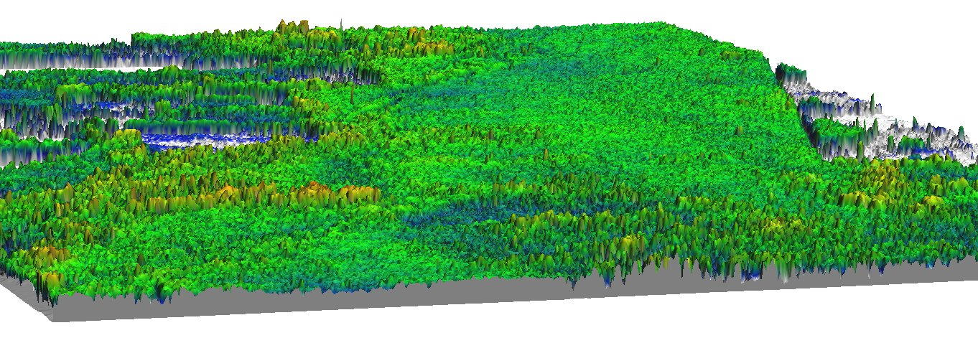
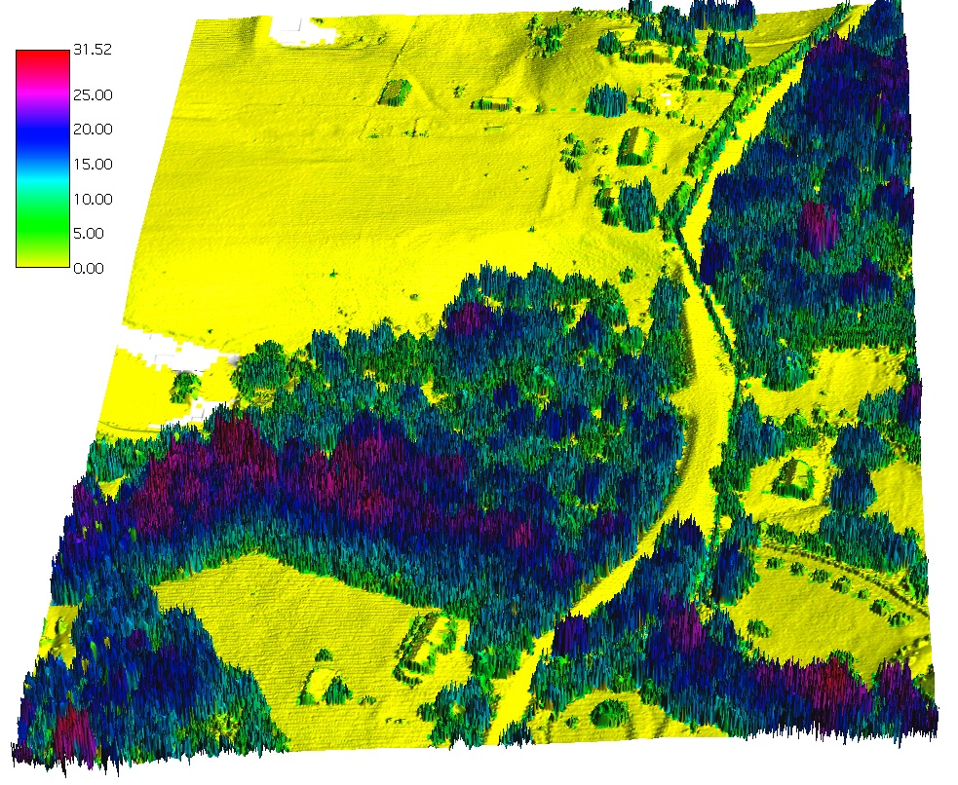
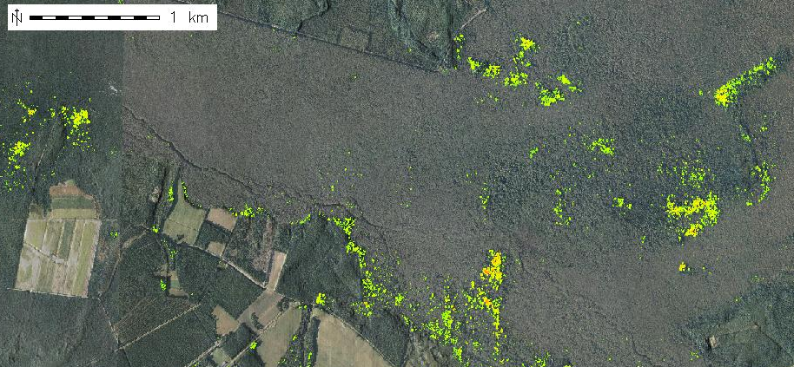
Canopy height pattern and change
Forest canopy height analysis from LiDAR
Higher canopy along a stream
Canopy height > 25m

Slide 6
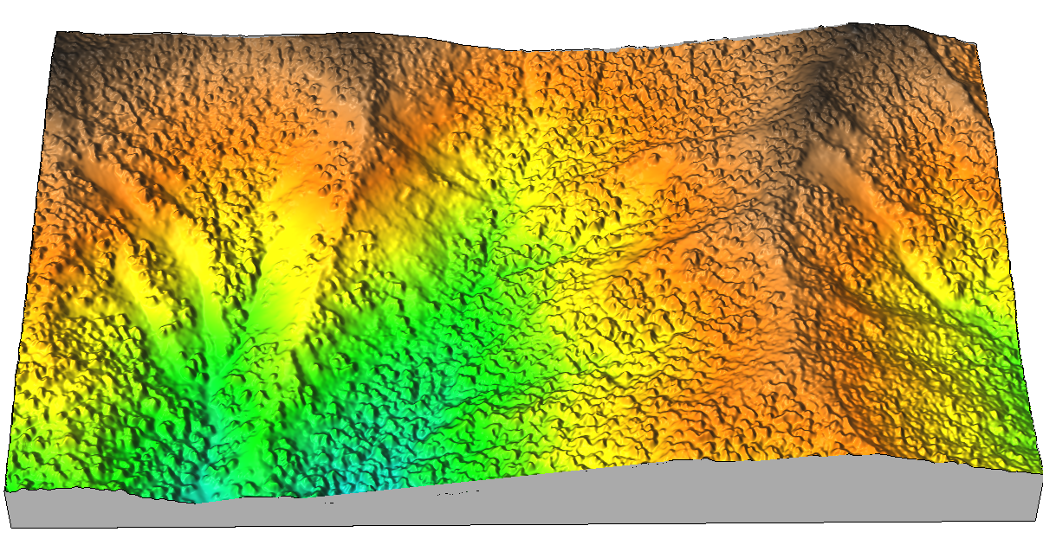
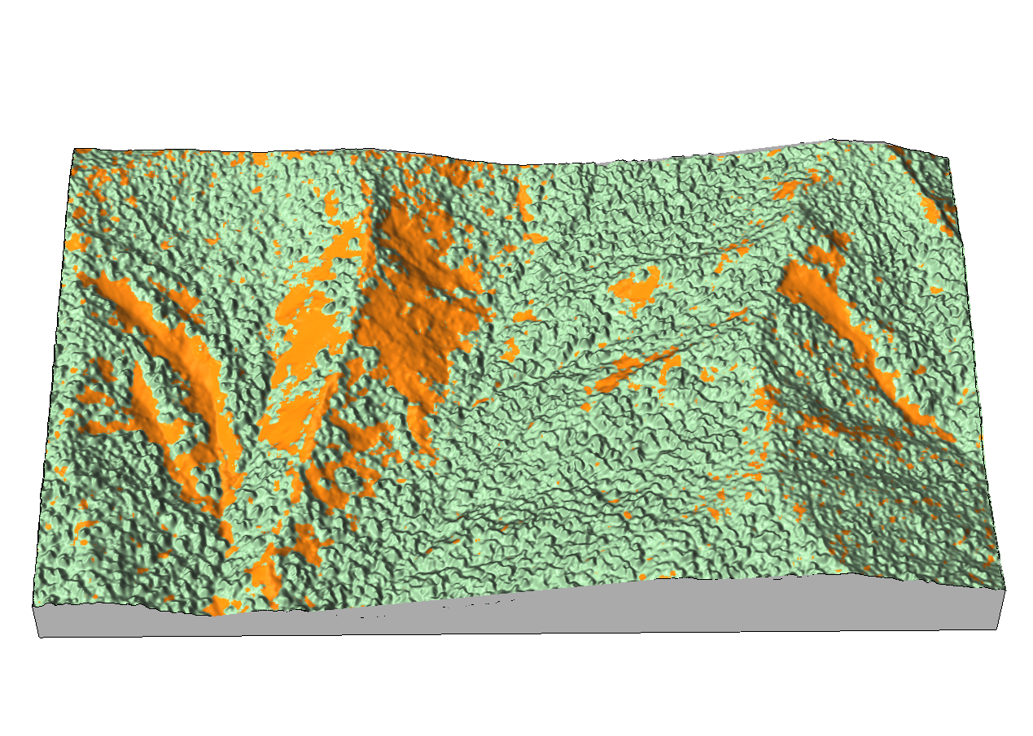
Landslides and surface flow
GIS-based mapping of landslides from airborne imagery and lidar,
flow tracing on landslides: impact on streams
m
1700
1500
1300
N
N
potential recent debris flow
0 400m

Slide 7
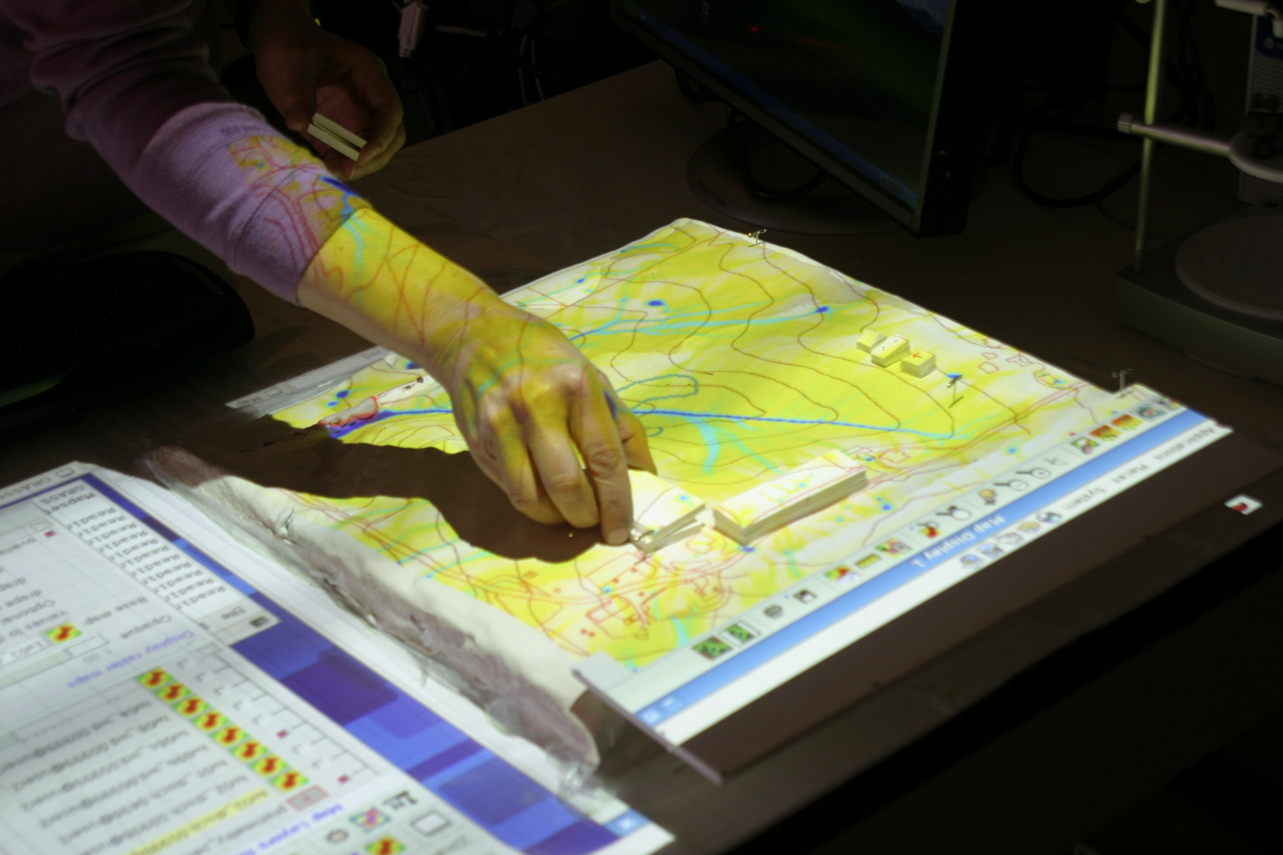
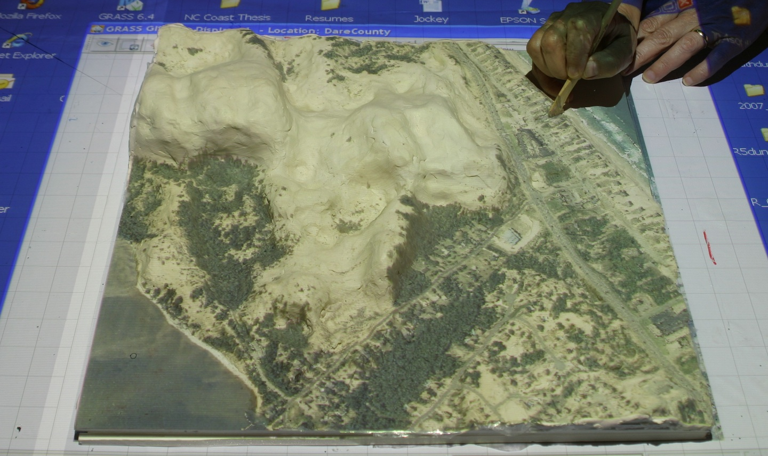
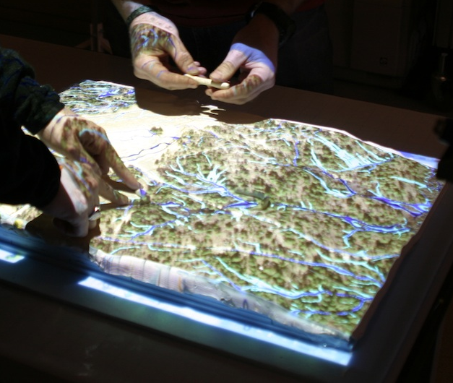
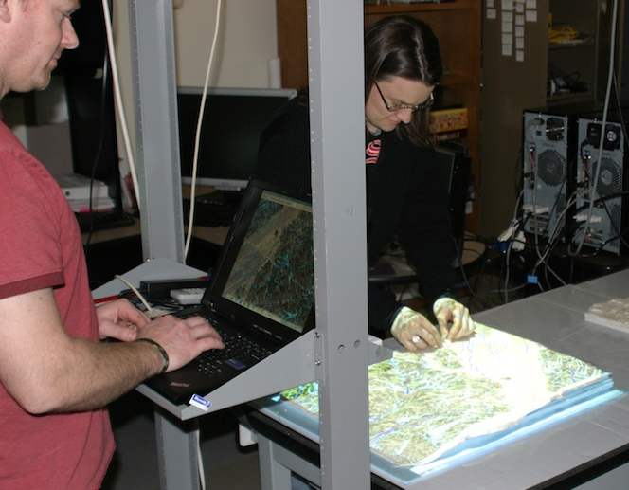
Modeling and visualization
watershed analysis from LiDAR: overland flow distribution and contributing areas, stream extraction, watershed hierarchies
multitouch visualization and tangible modeling systems for planning and decision making
geospatial optimization problems

