Slide 1
Coupling Open Source GIS with tangible interface and immersive visualization for collaborative geodesign Helena Mitasova, Anna Petrasova, Vaclav Petras, Brendan Harmon Center for Geospatial Analytics, North Carolina State University

Slide 2
Collaborative Geodesign
Motivation for tangible interface and large scale visualization:
allow participants with different backgrounds to generate ideas
present baseline information in intuitive and engaging way
change landscape easily
get instant feedback on impacts of changes

Slide 3
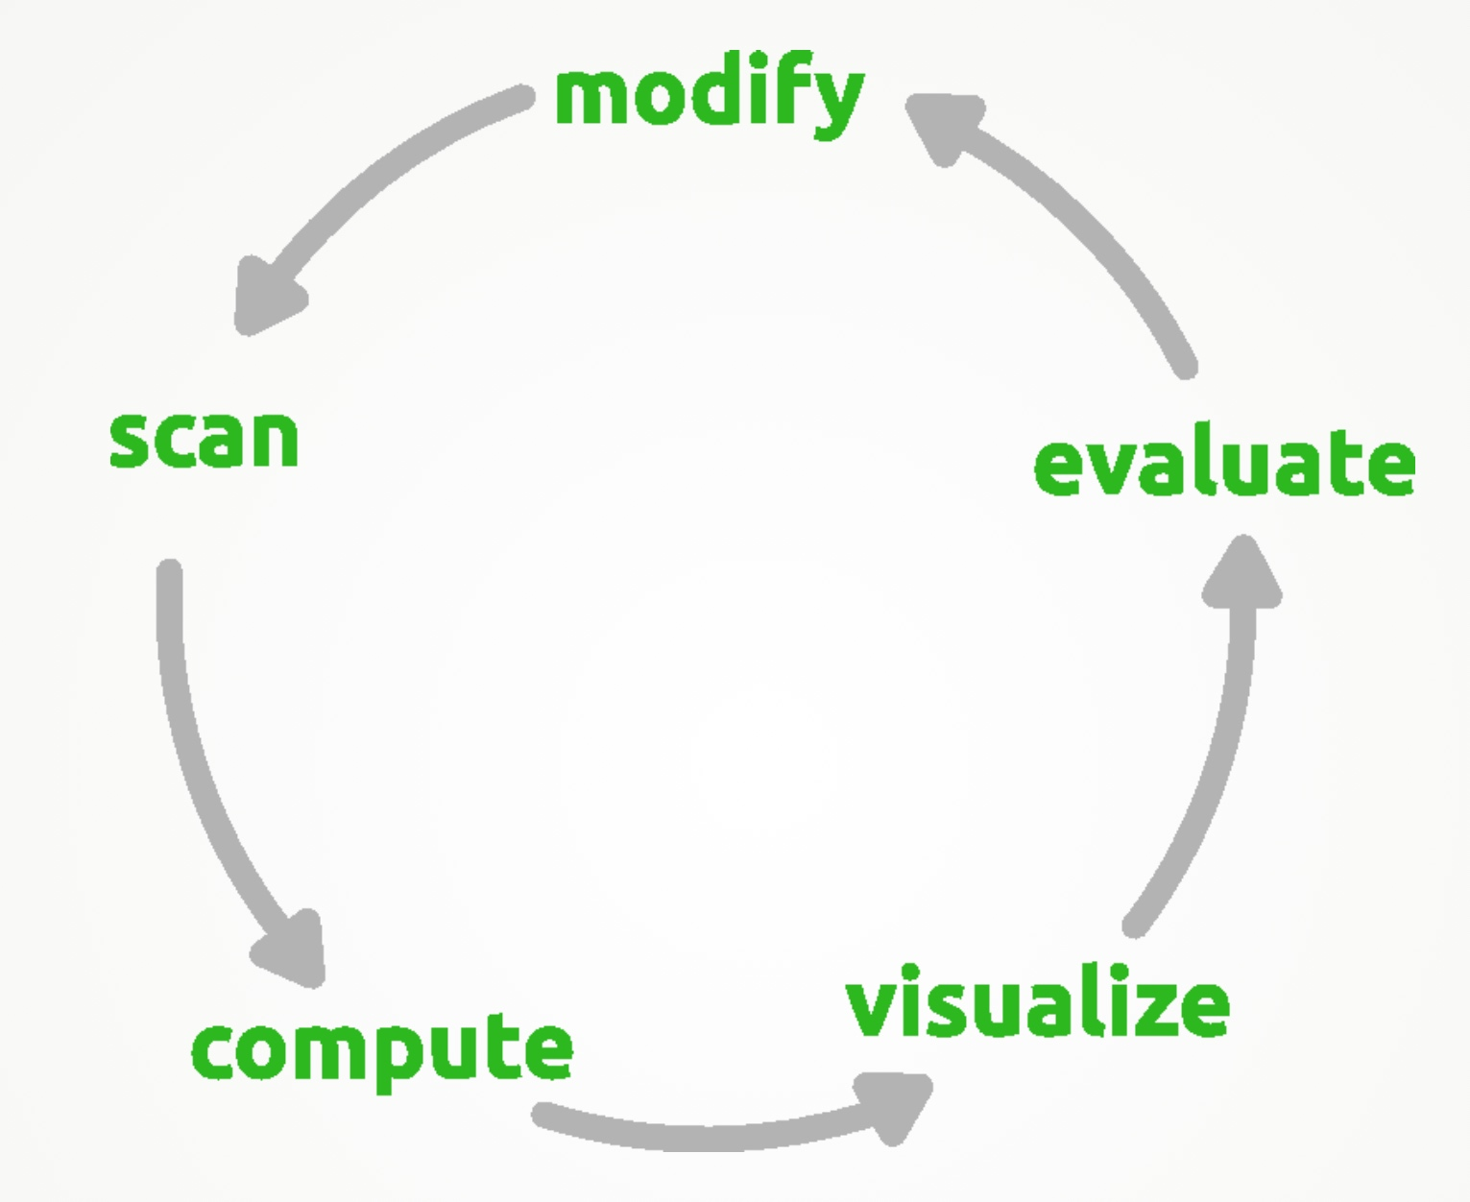
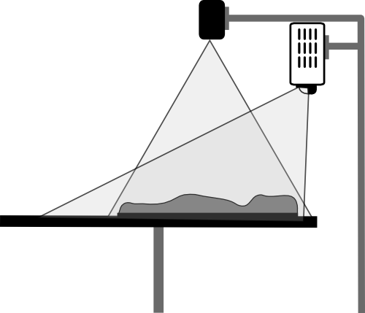
Tangible Landscape
Hardware: projector, Kinect, computer, 3D physical model
Software: Kinect for Windows SDK, GRASS GIS, custom python script

Slide 4
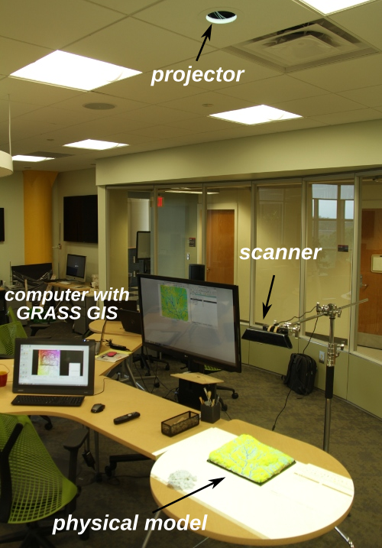
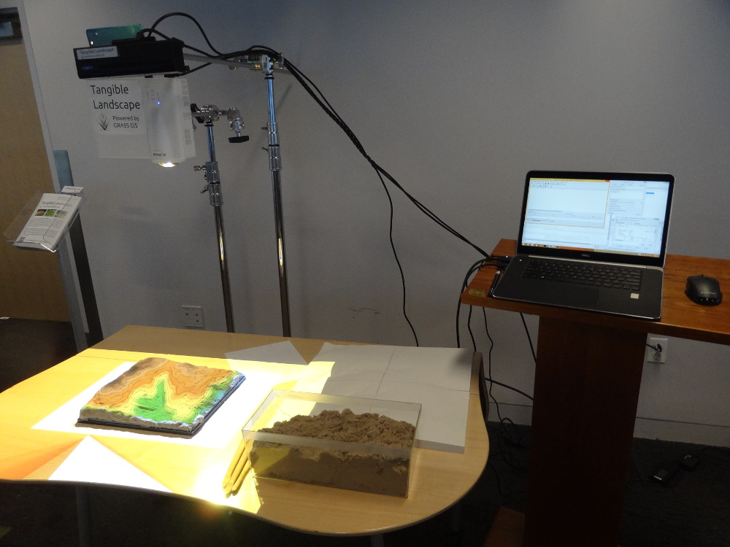
Tangible Landscape set up
Laboratory and mobile systems

Slide 5
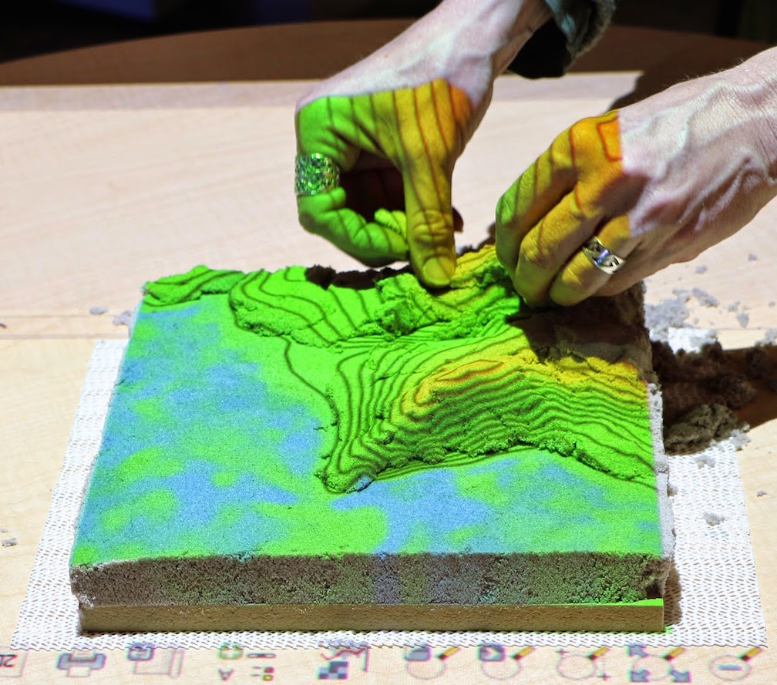
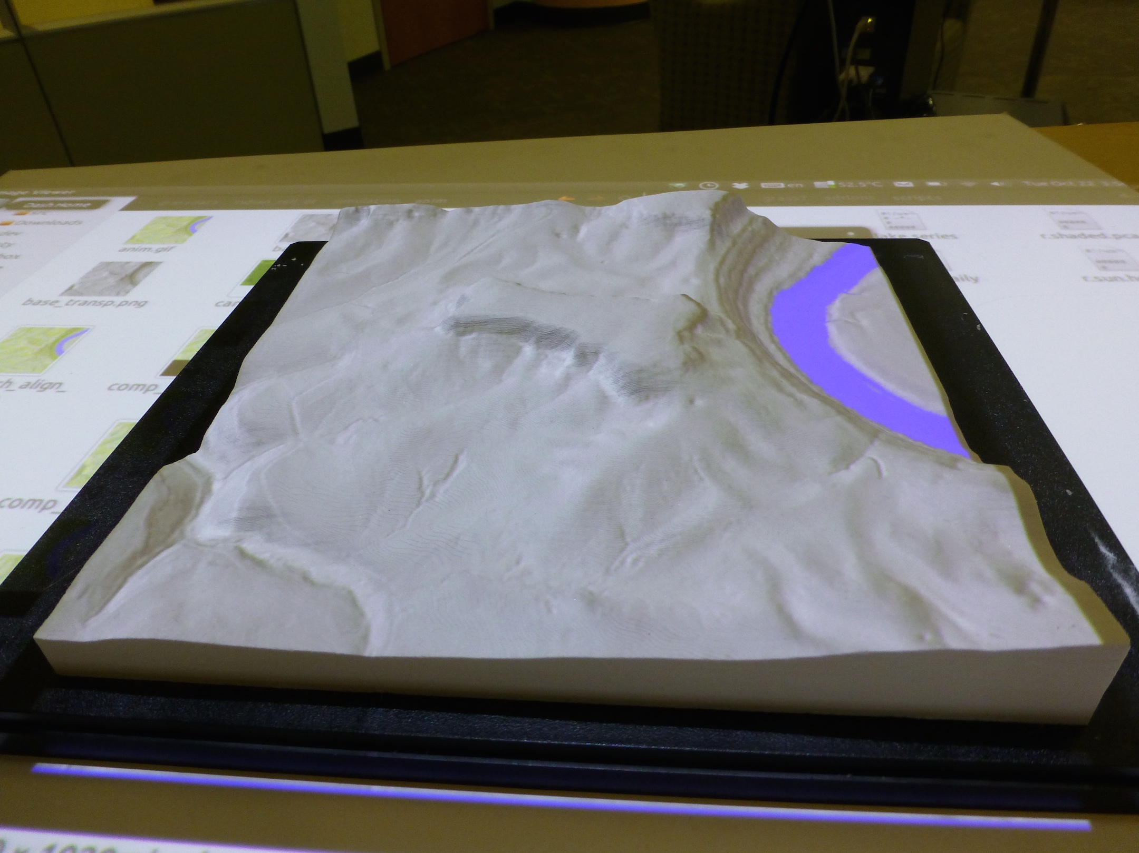
Creating 3D models
Kinetic sand model from contours and a 3D printed model

Slide 6
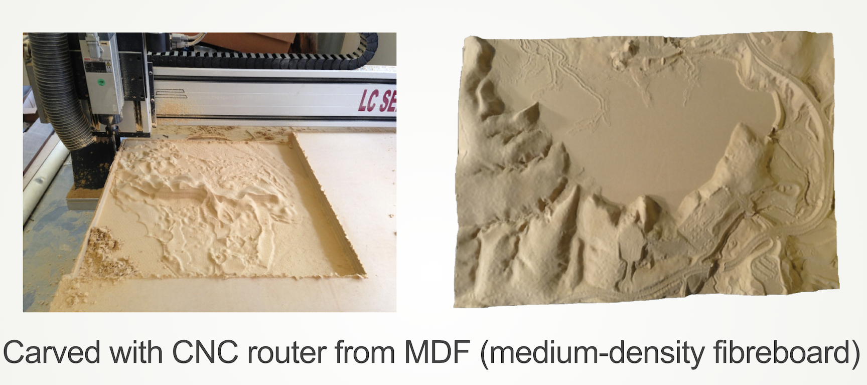
Creating 3D models
CNC routing for models and molds

Slide 7
Creating 3D models
Solid models with molded kinetic sand layer

Slide 8
Coupling with GRASS GIS
Open source GRASS GIS:
general purpose GIS and geospatial science computing platform
Custom Python scripts:
coupling with scanner, data display, analysis, and modeling

Slide 9
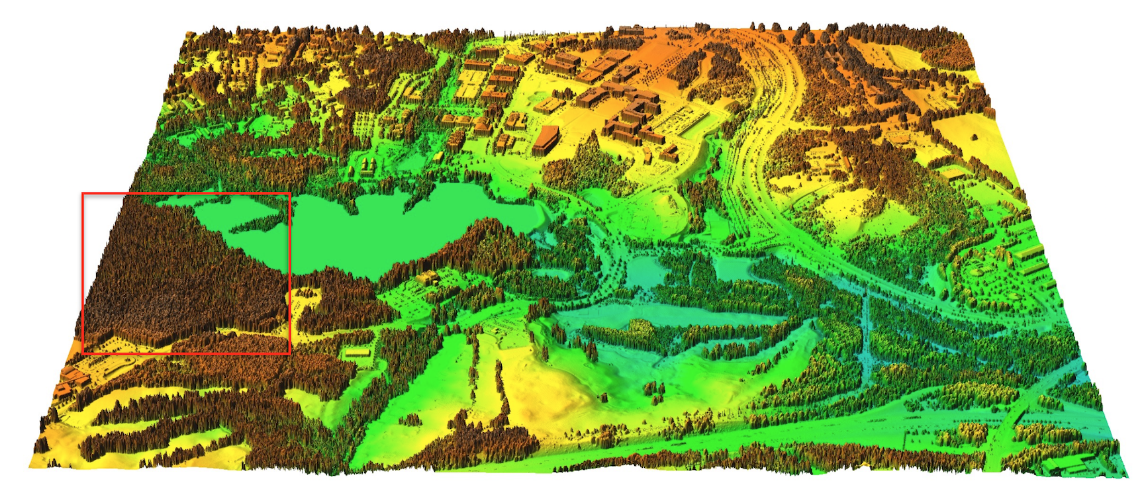
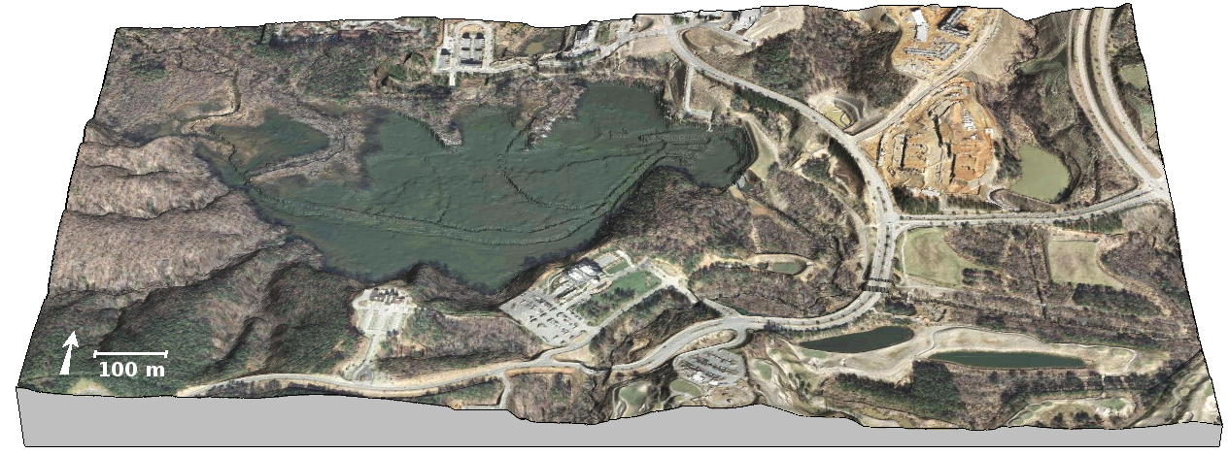
Data: Centennial Campus
Rapidly urbanizing area: fields transformed into research campus
3D data acquired by lidar in 2001 and 2013

Slide 10
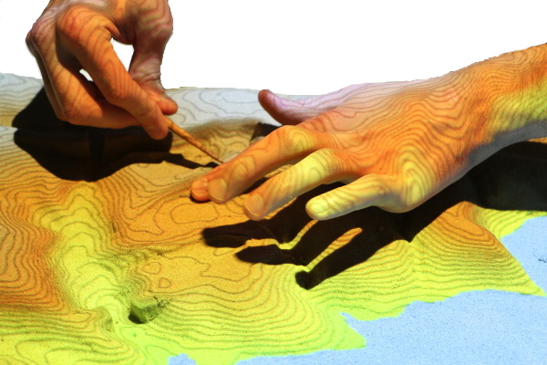
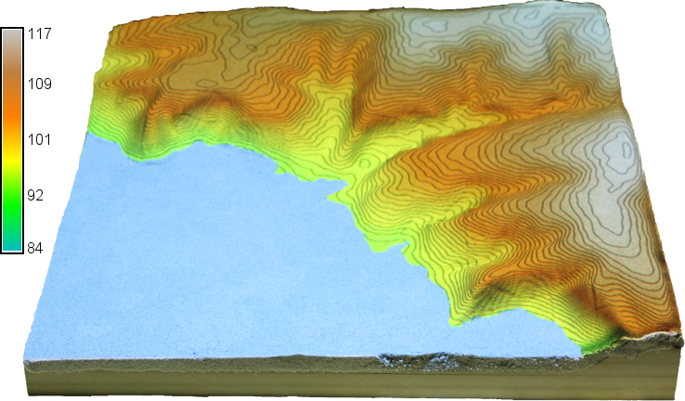
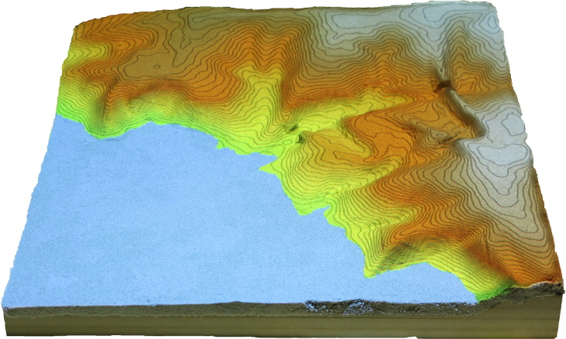
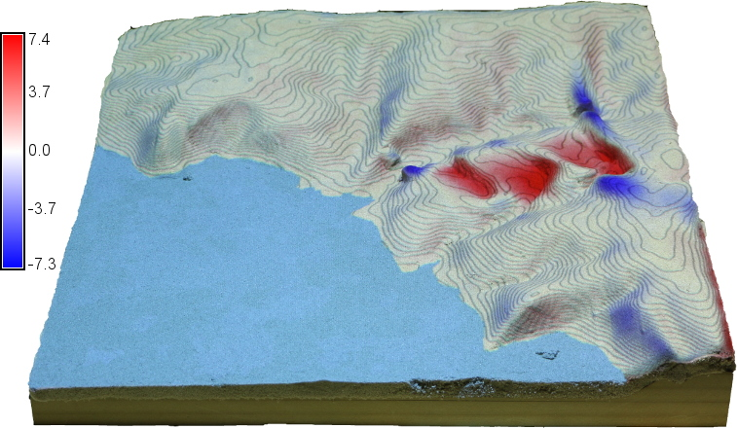
Landscape modification
Modifying the landscape with feedback on elevation change
100m

Slide 11
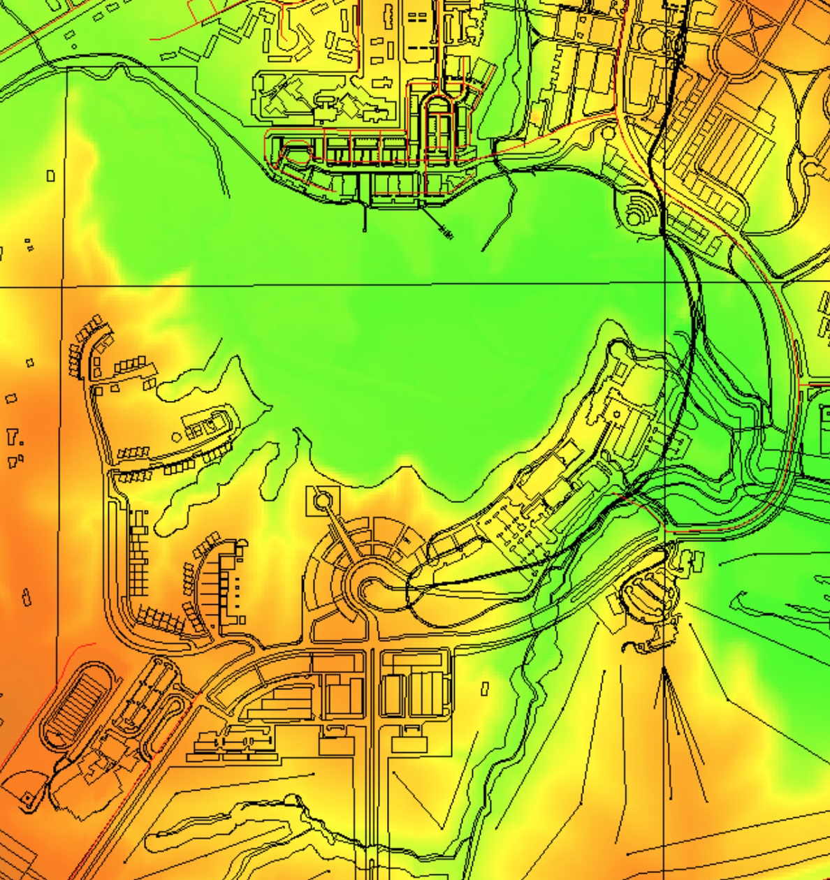
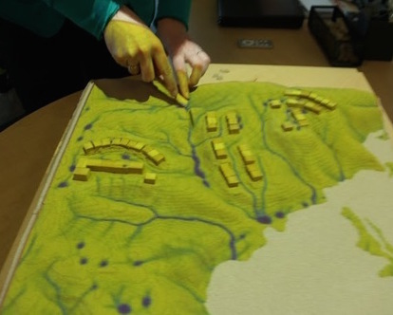
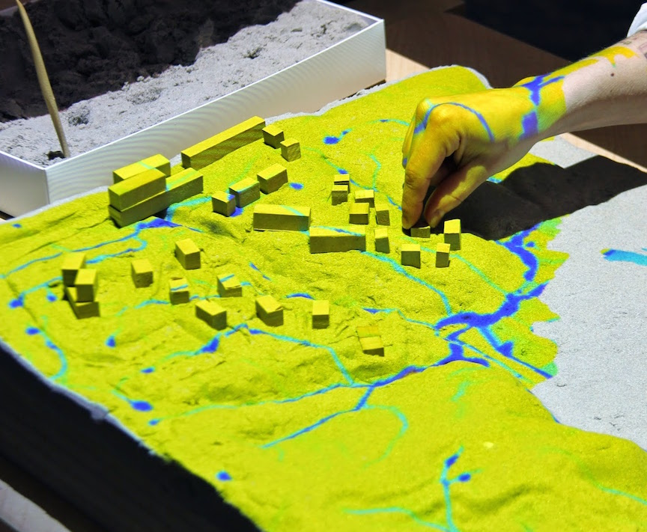
Surface water flow
Exploring the impact of development on runoff

Slide 12
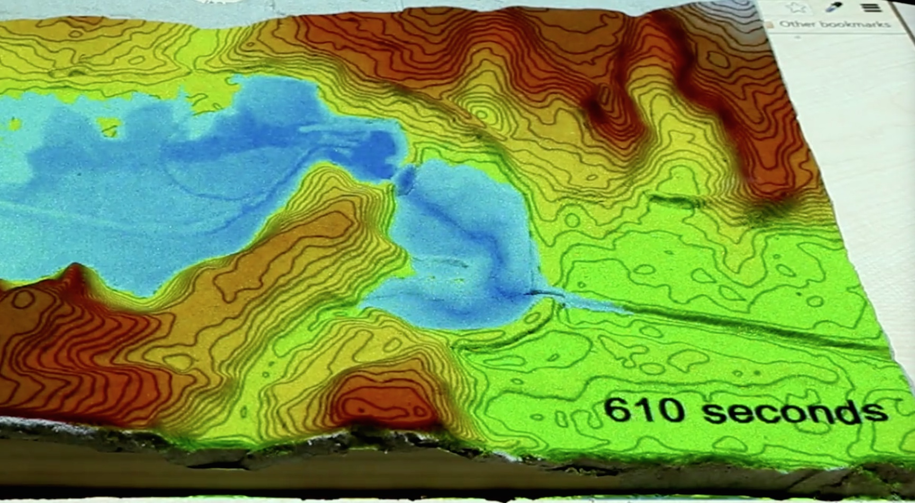
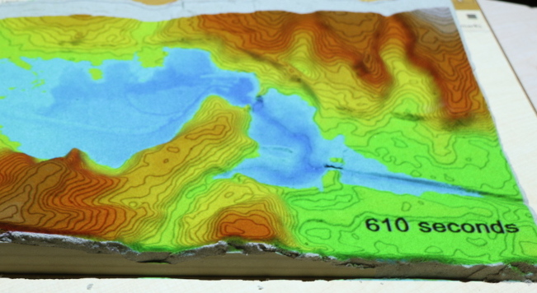
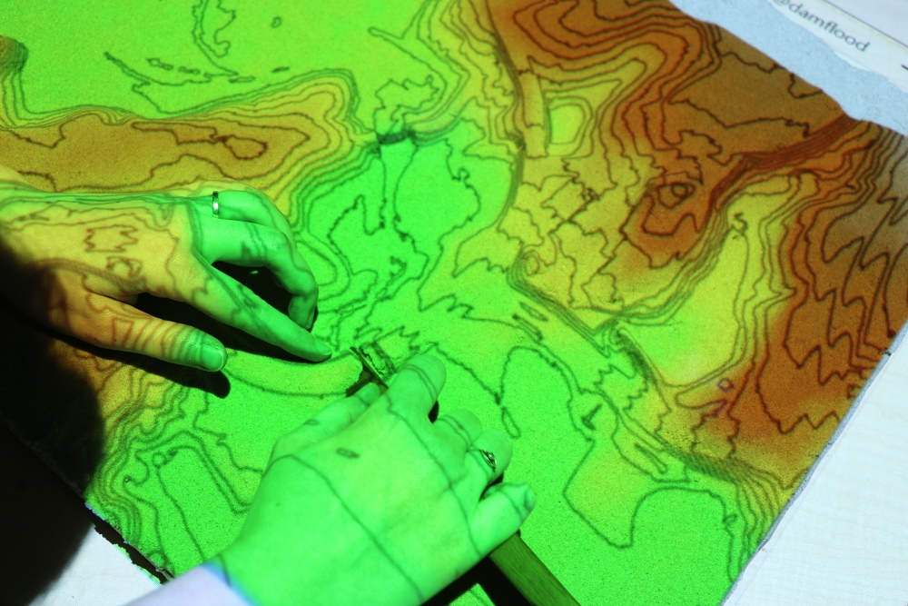
Dam Break
Dam broke on the Lake Raleigh in 1996 during Hurricane Fran
Dam break flooding impact: current and with road removed

Slide 13
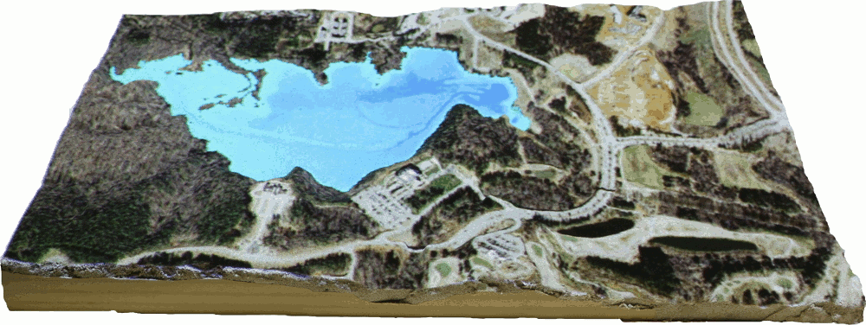
Dam Break
Dam break simulation under the current topographic conditions

Slide 14
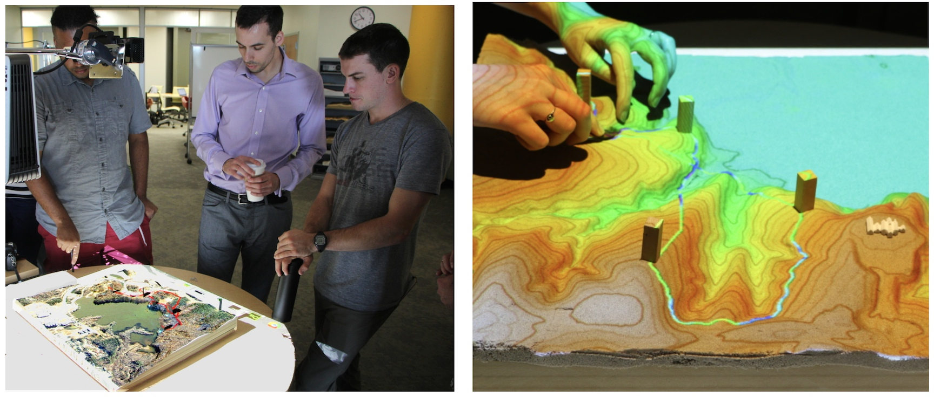
Trails
Least cost path over cumulative cost surface
Blocks define waypoints
Sand layer modified to explore grading, bridges

Slide 15
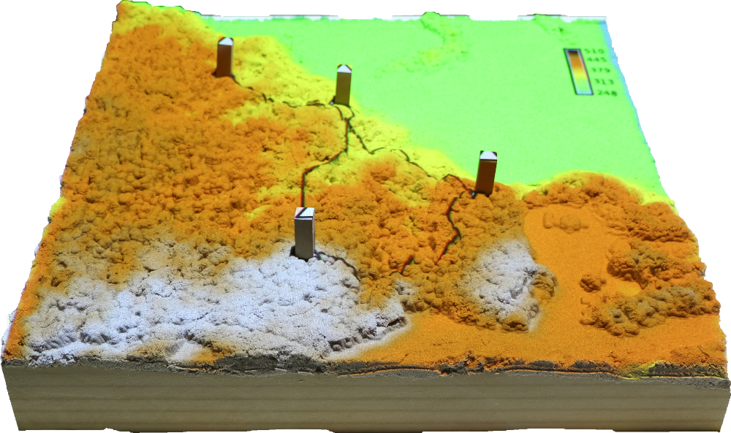
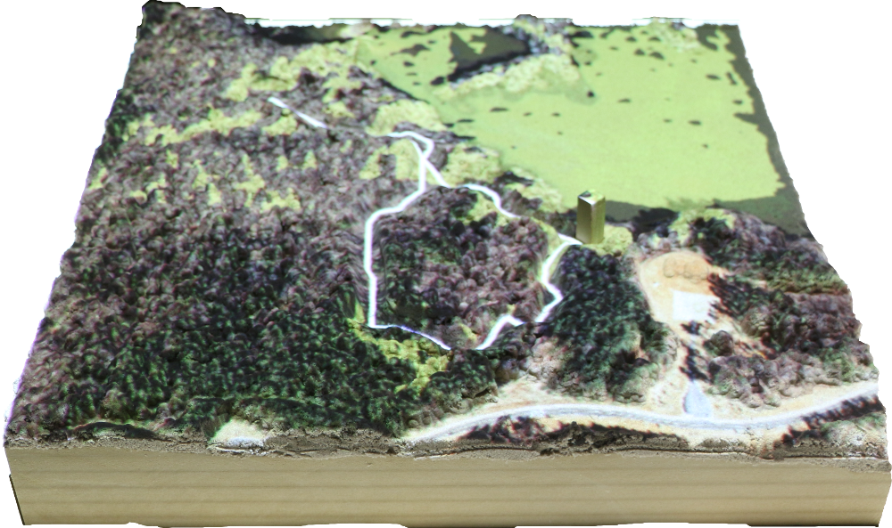
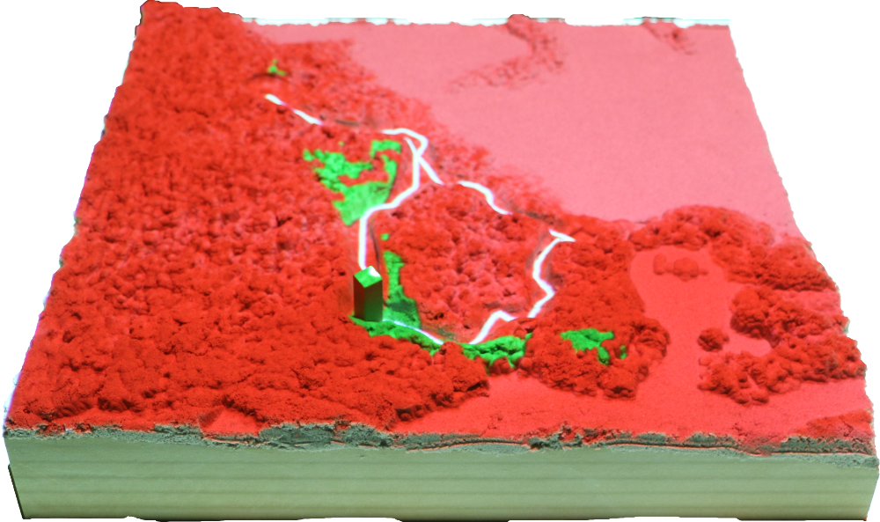
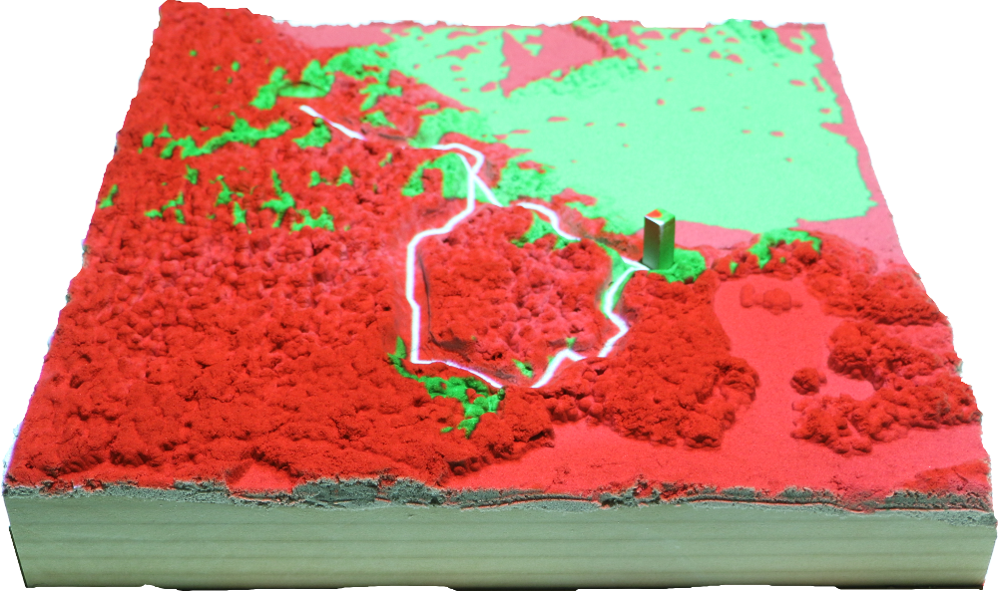
Viewsheds
Planning waypoints with views: block defines viewing site

Slide 16
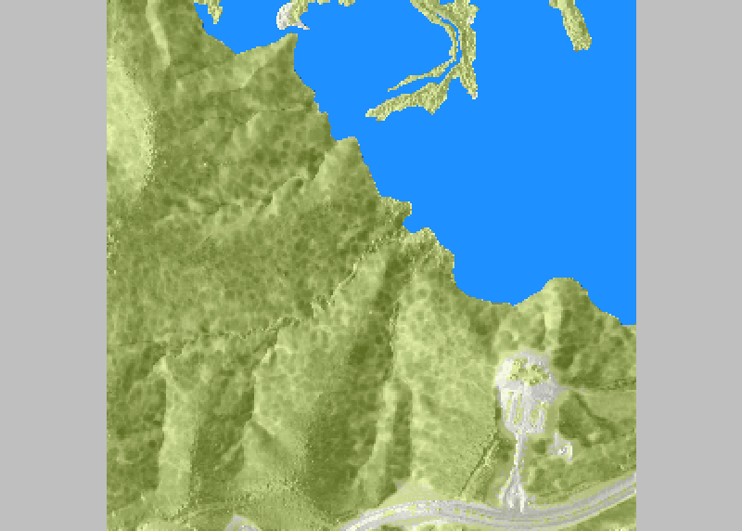
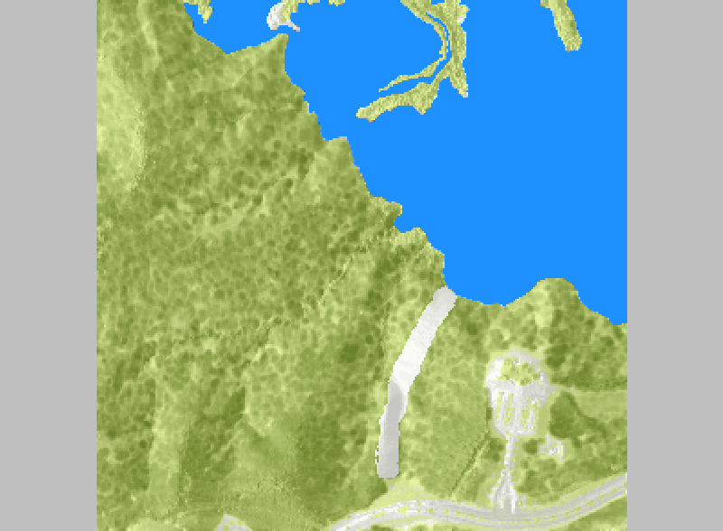
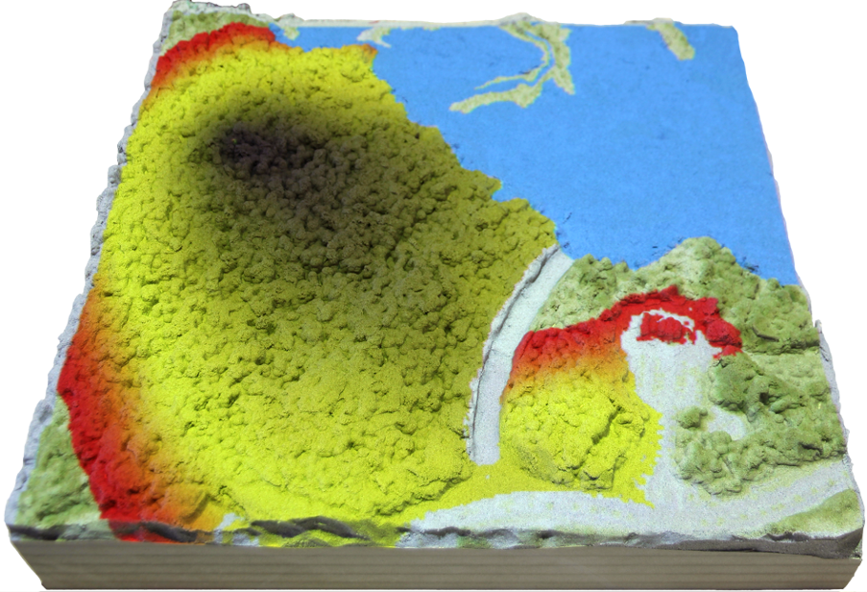
Fire spread
Fire spread modeling using fuel estimates from lidar data:
Exploring effectiveness of a firebreak

Slide 17
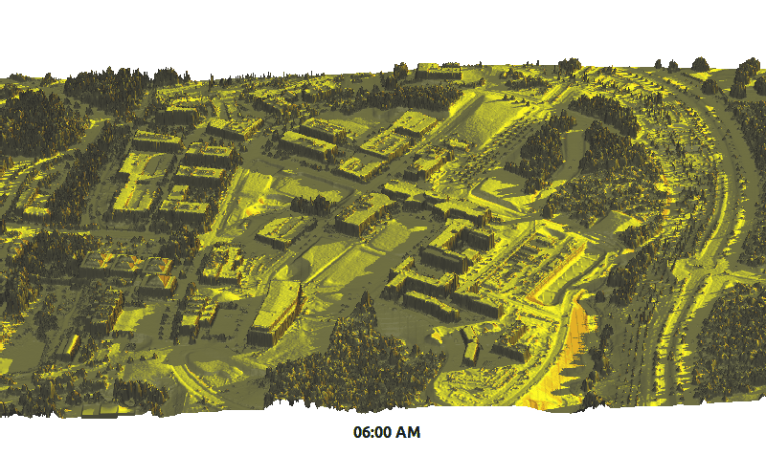
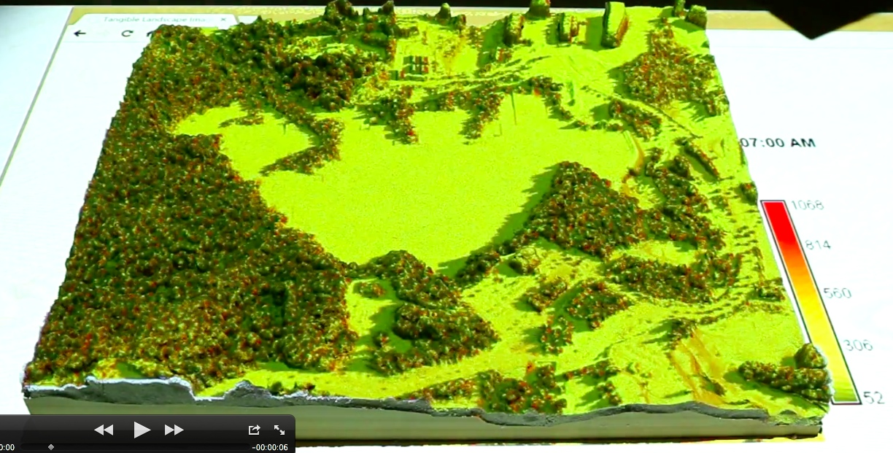
Solar radiation
Solar radiation modeling: summer solstice dynamics
Virtual 3D dynamic model and projected over 3D physical model

Slide 18
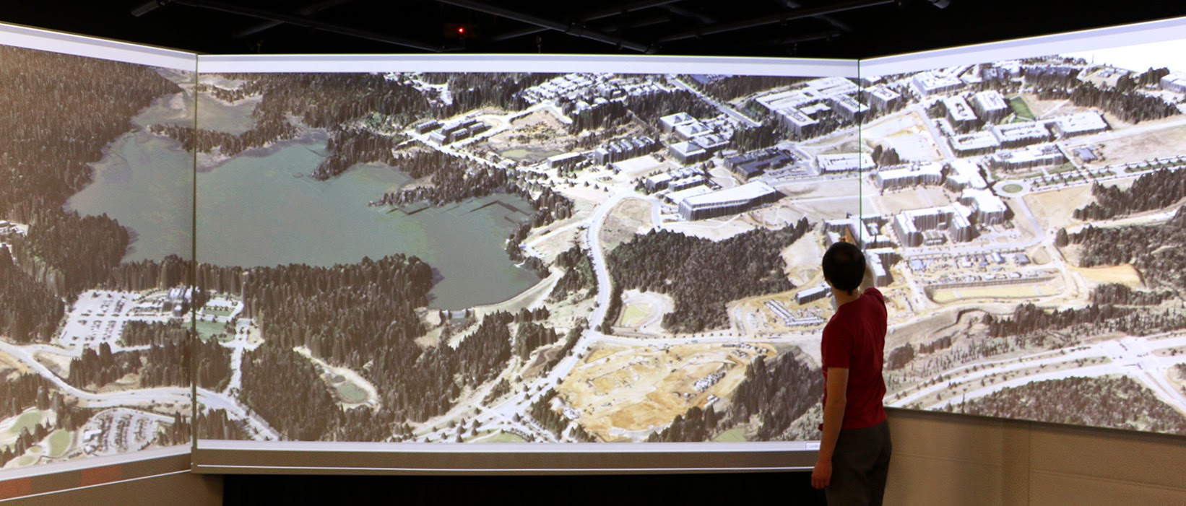
Bringing the digital models to large screen
Large scale, interactive 3D visualization with GRASS GIS

Slide 19
GIS for landscape architects projects
The best explored ideas are then optimized using
GIS modeling and design

Slide 20
Conclusion
Tangible Landscape systems can provide 3D sketching with real-time feedback for geodesign
Book: Tangible modeling with open source GIS Springer, coming later in 2015
http://geospatial.ncsu.edu/osgeorel/
Photos and videos on Google+

Slide 21
Interactive viewsheds
Exploring views from different viewing sites

Slide 22
Interactive trails
adding a waypoint

