Slide 1
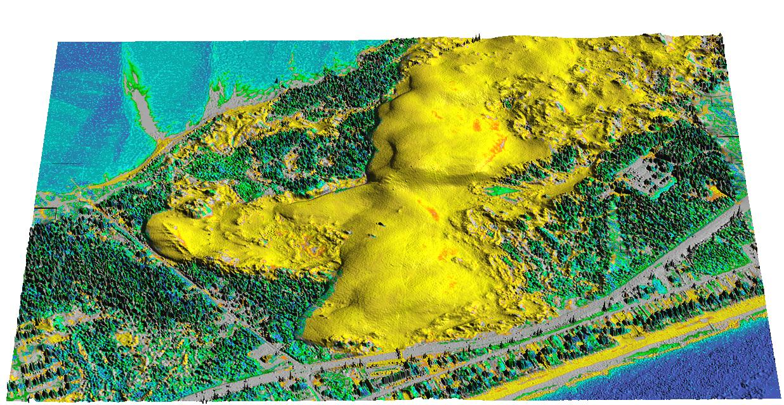
Managing change at a dune landscape
Ondrej Mitas, NHTV, Netherlands
Helena Mitasova, Katherine Weaver, Gene Brothers
North Carolina State University

Slide 2
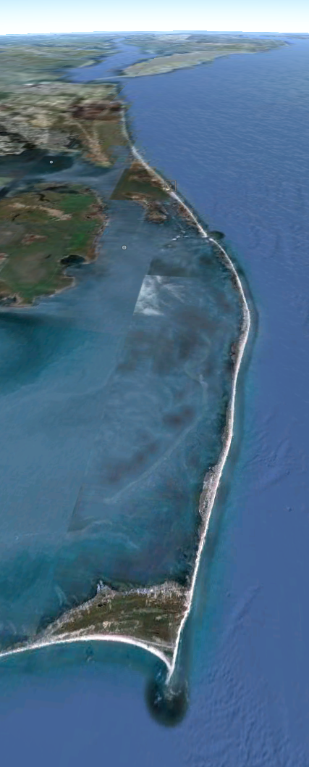
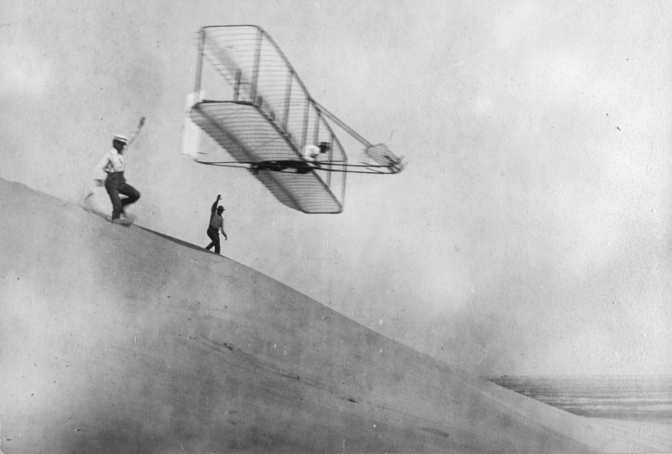
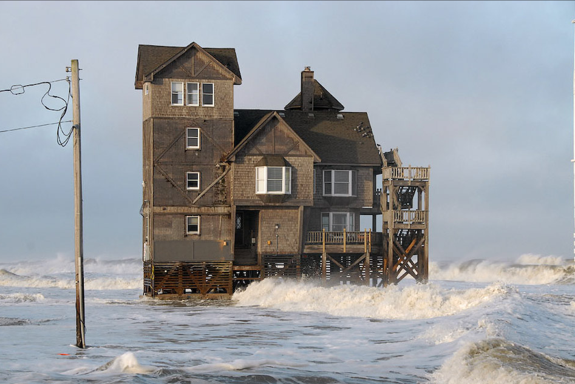
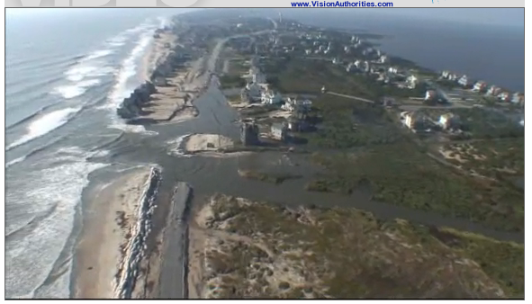
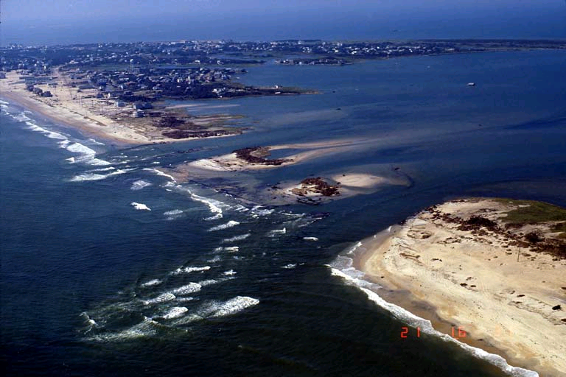
North Carolina Outer Banks
Barrier islands
Atlantic Ocean
Favorite tourist
destination
Dynamic landscape:
sand redistributed
by wind, waves, storm surge
Vulnerable:
coastal erosion,
sea level rise, breach
Nags Head
Pea Island
1903 Wright brothers
Cape Hatteras
0 10km
Notes:
The Outer Banks are historically known for their constant battering from intense storms and sea level rise which expose vulnerable areas such as the Isabel Breach south of Cape Hatteras created during Hurricane Isabel. These storms also destroy personal properties such as this picture of a porsche being submerged under sand and overwash. And with the steady increase of sea level, infrastructure that was once a safe distance away are merely feet away from the shoreline (for example the moving of the Cape Hatteras Lighthouse in 1999). This area is also well known for its high dunes that once permitted the Wright Brother’s to successfully take flight in 1903.

Slide 3
Jockey’s Ridge: The largest active sand dune on the east coast

Slide 4
The most visited state park in NC
1.5 million visitors per year
New York City
Philadelphia
Washington DC
Richmond, Norfolk
Raleigh
Visitors,
participants in the survey,
come from close metropolitan areas

Slide 5
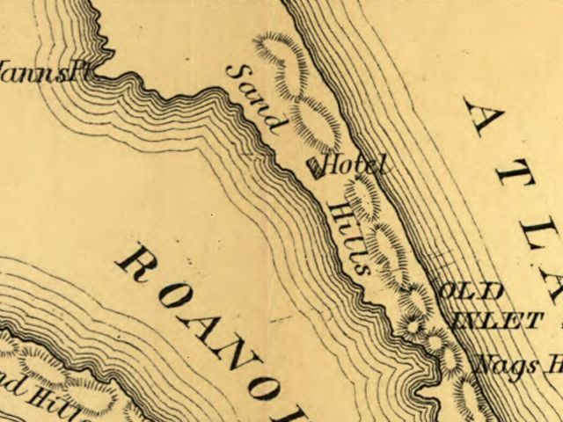
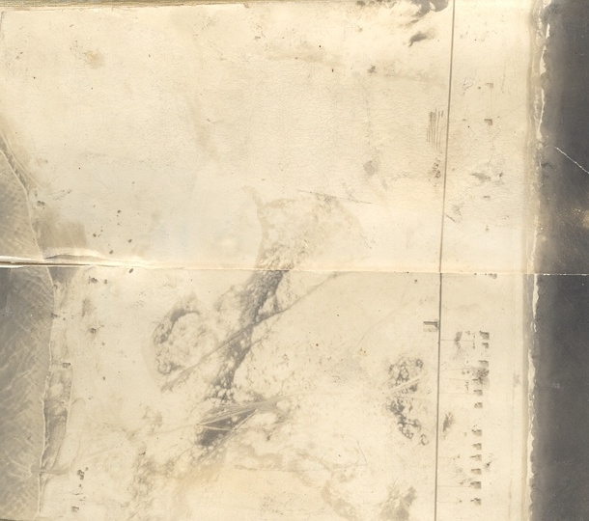
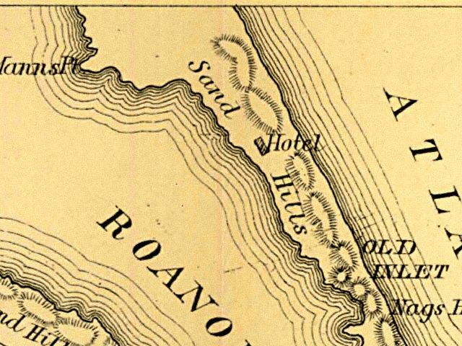
Jockey’s Ridge history
1879
1862
1932
1932: all sand
2003: post Isabel lot of vegetation
1940: sand, new vegetation
State park established in 1974 to save the dune from development

Slide 6
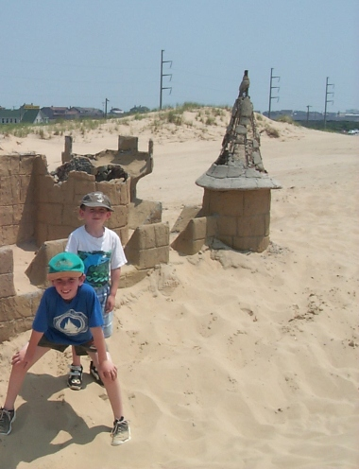
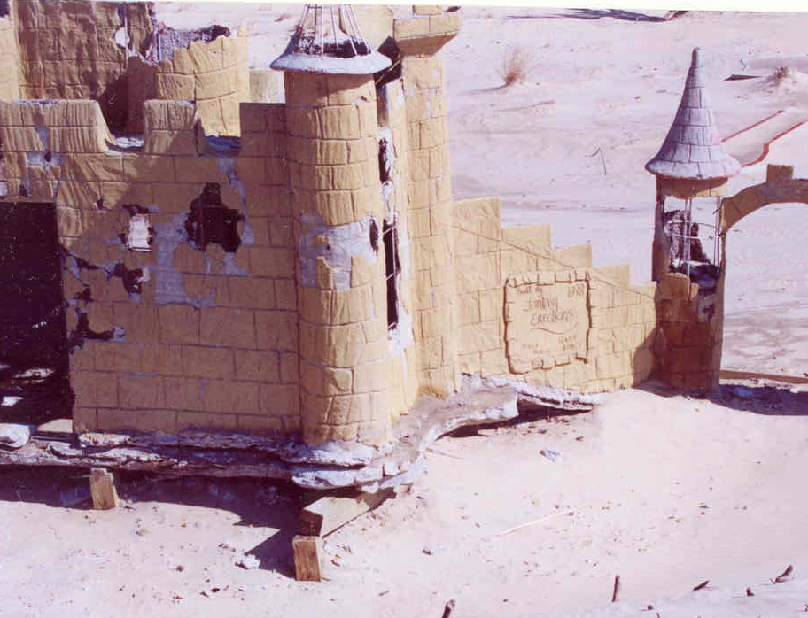
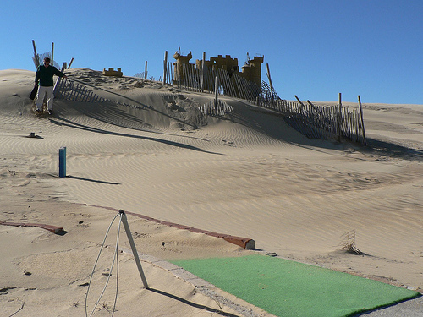
Sand transport: management problems
2003
2000 2002
Minigolf castle buried by the dune in 80s emerged in 2000

Slide 7
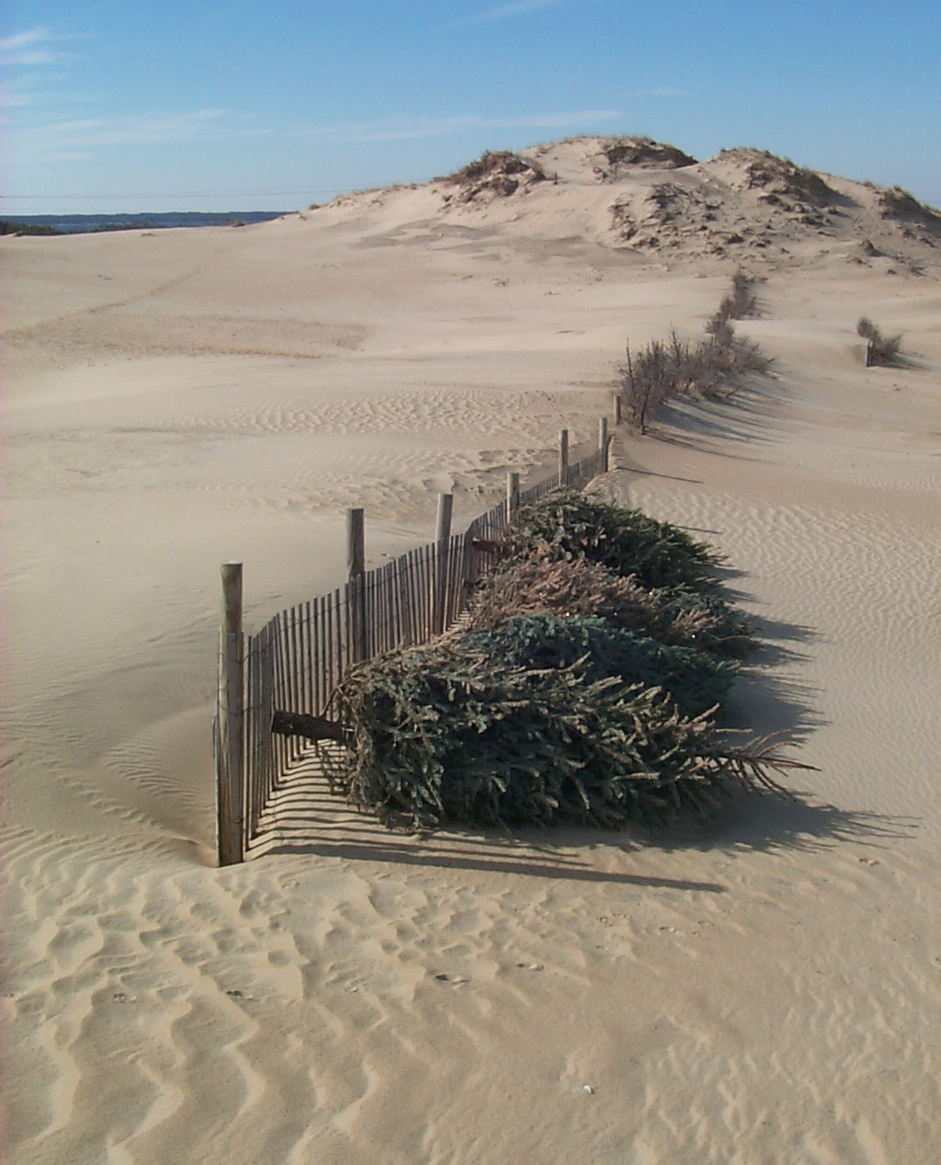
Efforts to stop the dune
Stabilization fences were
installed but the result was mixed:
Dune was losing its unique shape

Slide 8
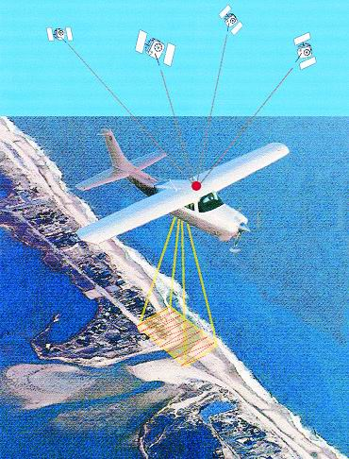
Surveying Jockey’s Ridge
Airborne
LiDAR
LiDAR data by NOAA, USACE; RTK GPS mapping and modeling by Geodynamics llt., NC

Slide 9
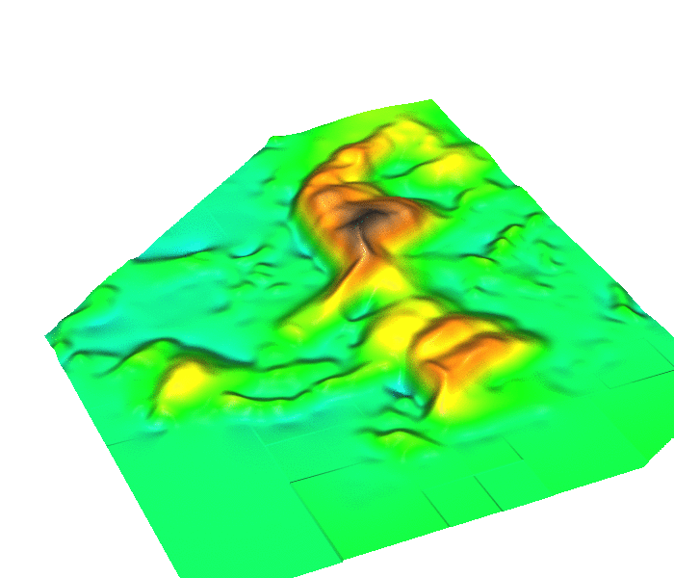
Dune migrating out of the park
Jockey’s Ridge:
active dune system within
fixed state park boundaries
How long will it stay within the park boundaries?
What is the rate of migration?
Migration measured as change in location of dune crests extracted from time series of Digital Elevation Models (DEMs)
Dune migration
1974-2008
200m

Slide 10
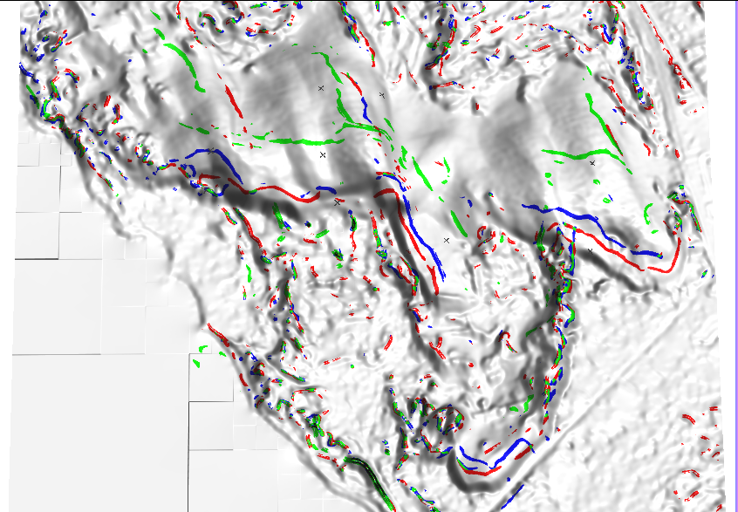
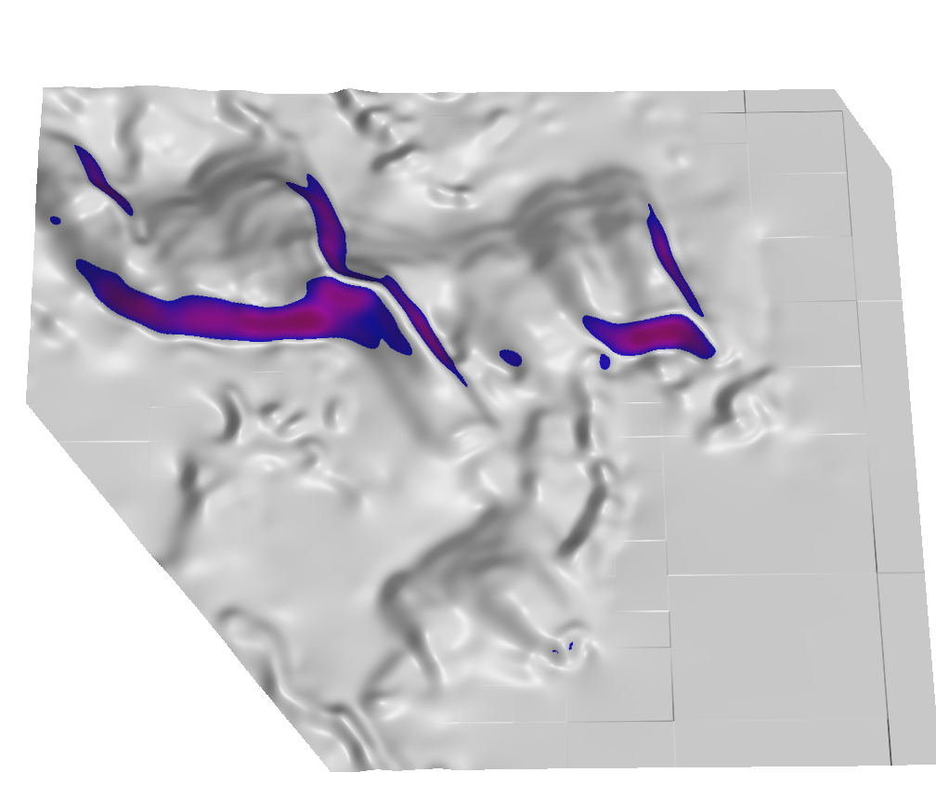
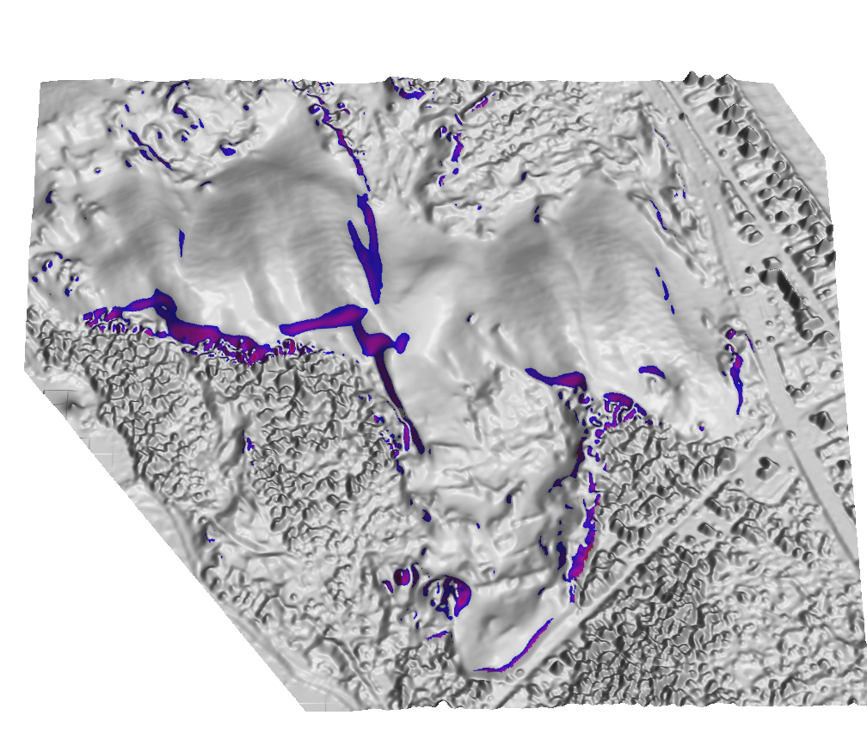
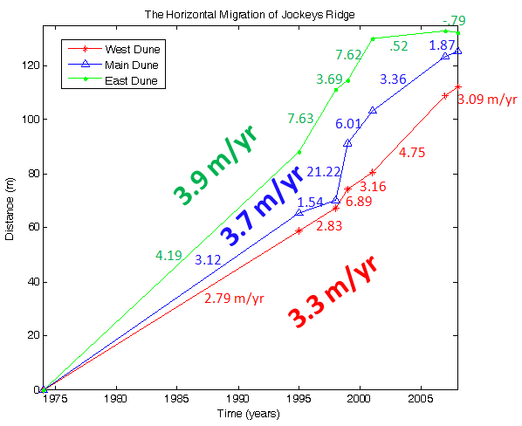
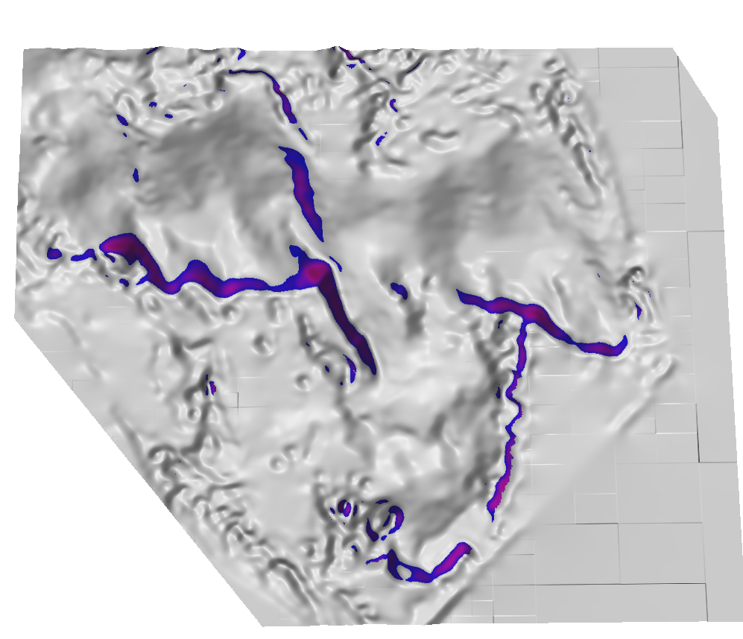
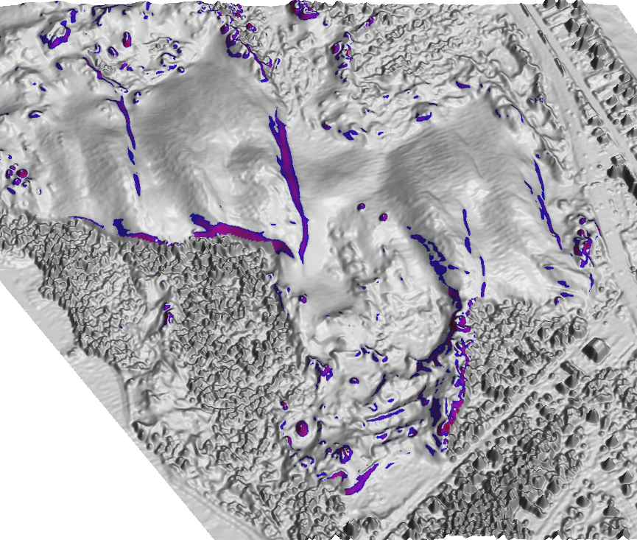
Rate of migration and transformation
1974
0 200m
2001
2008
1995
Notes:
10
10

Slide 11
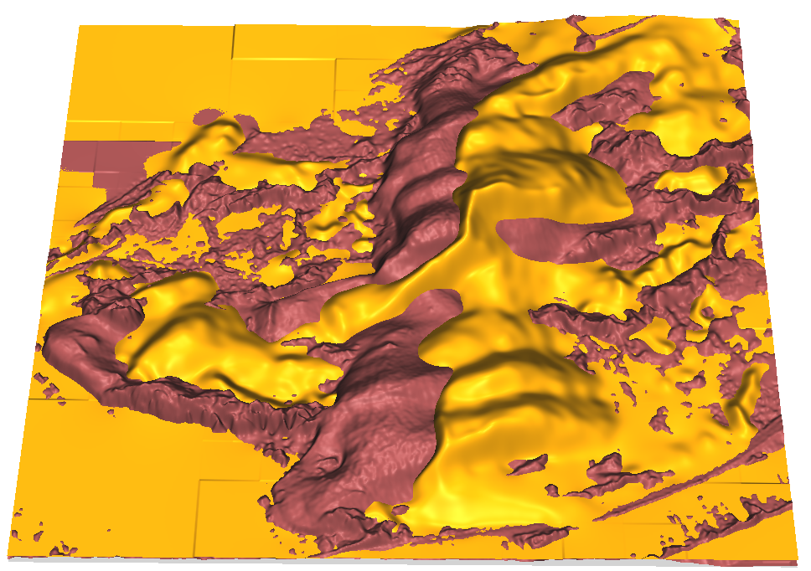
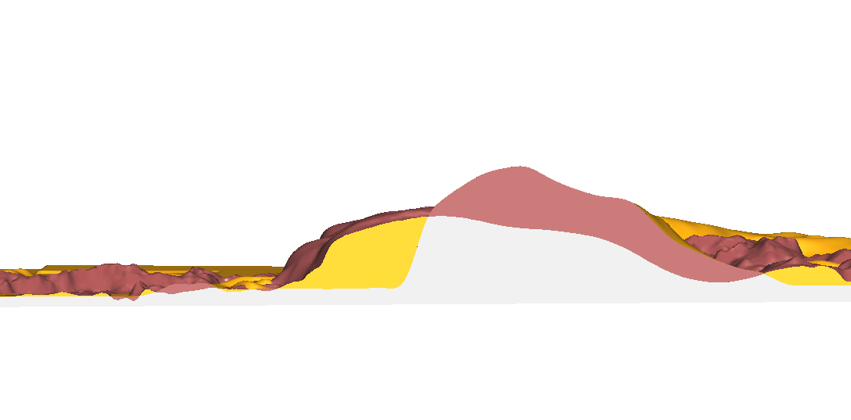
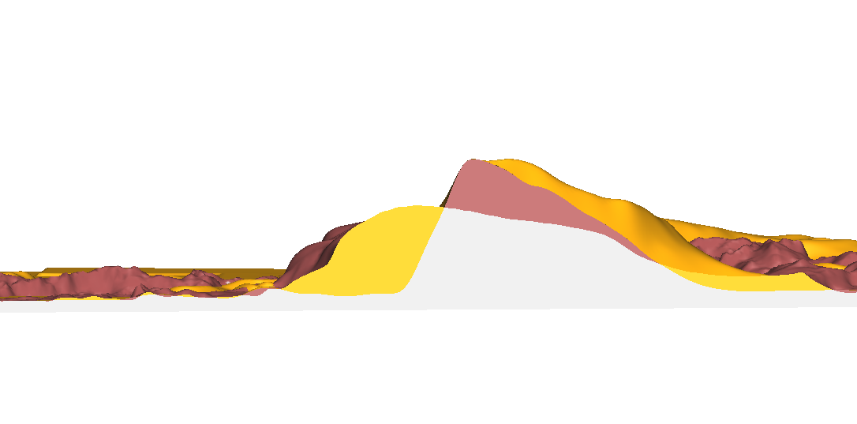
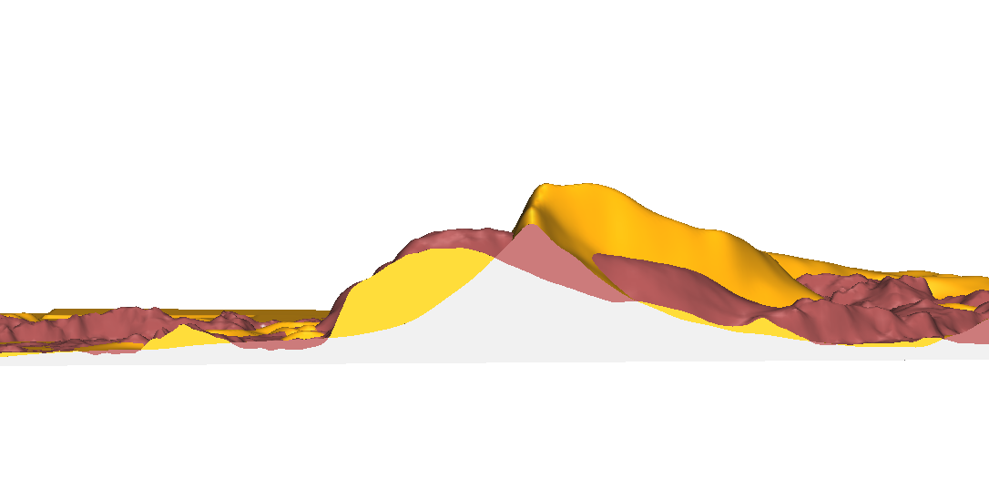
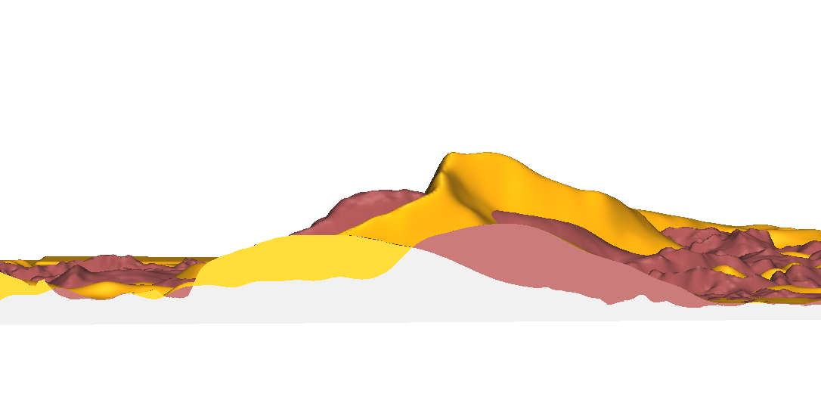
Sand transport
a
N
a
b
b
sand lost
c
d
sand
gained
stable
e
c
d
1974: peak at 42 m
2001: peak at 23 m
As the dune migrates it loses sand on
windward side and gains it at leeward side.
The sand stays within the park except for
areas where the dune reached its borders.
e

Slide 12
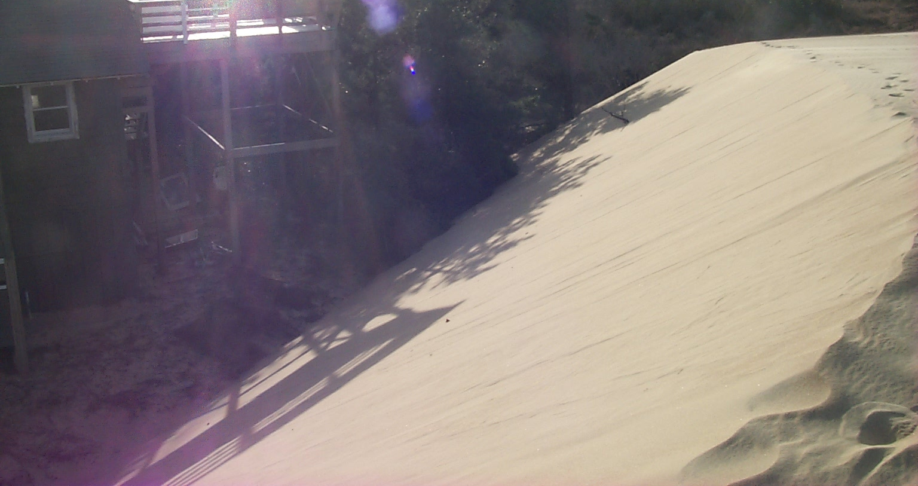
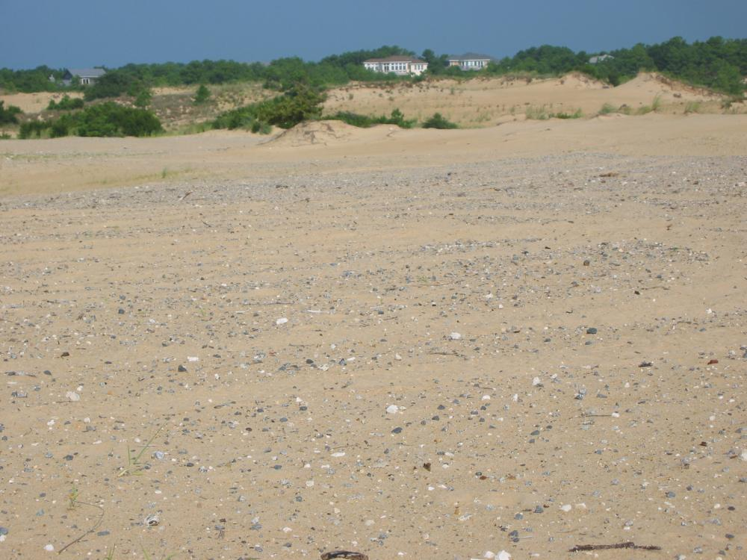
Managing dune migration and height
South dune encroachment on a house and street.
Removal of the south dune and disposal at windward side in 2003

Slide 13
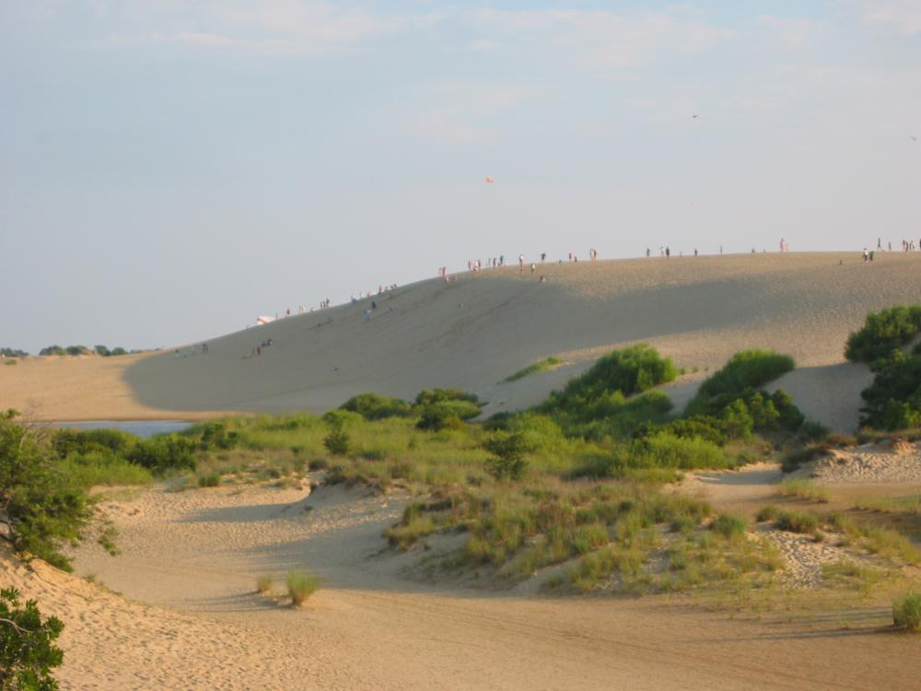
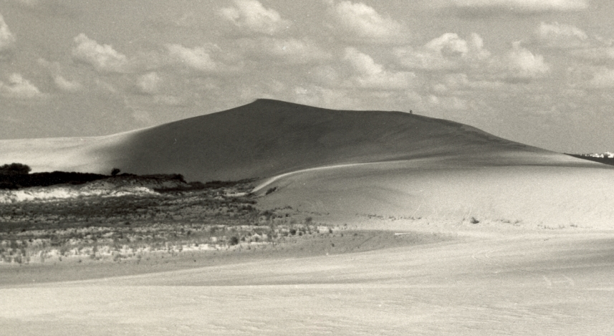
Change in dune height
sand lost
sand
gained
stable
1949: 42 m
1974: 33 m
2008: 21 m
N
2008: 21 m 1950: 42 m
Since 2004 dune height has stabilized at 21 – 22 me
Notes:
13

Slide 14
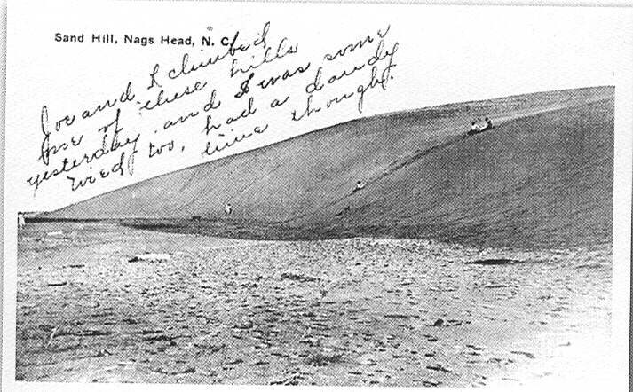
Change in dune height
sand lost
sand
gained
stable
1949: 42 m
1974: 33 m
2008: 21 m
1930: 32 m ?
N
1917: 20 m ?
2008: 21 m 1950: 42 m 1917 20 m ?
High active dune: result of bad land management?
Landscape going back to its more stable form
Notes:
14

Slide 15
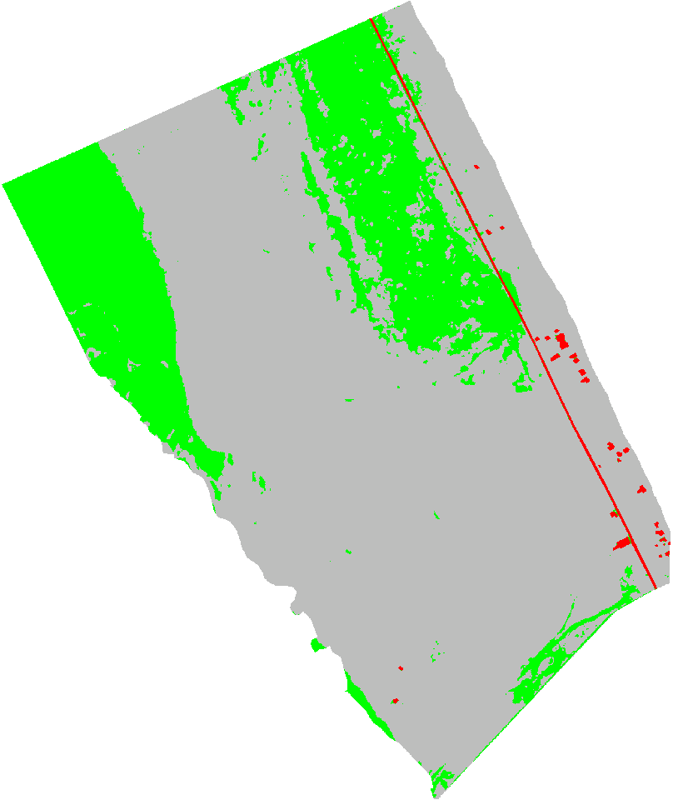
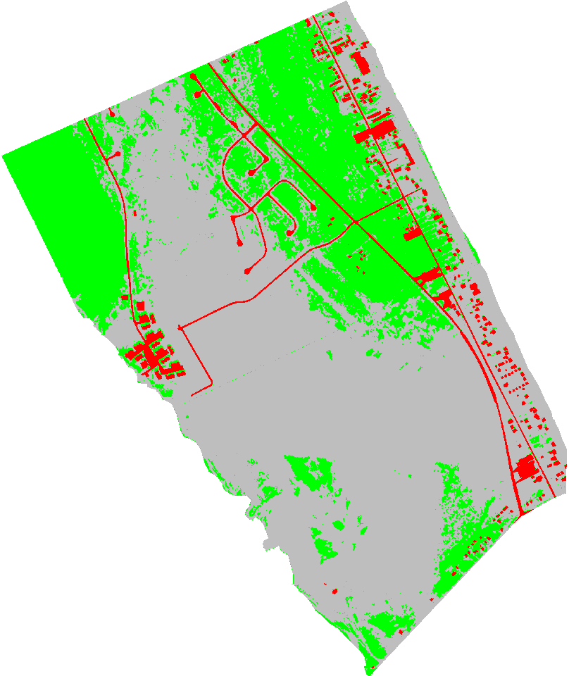
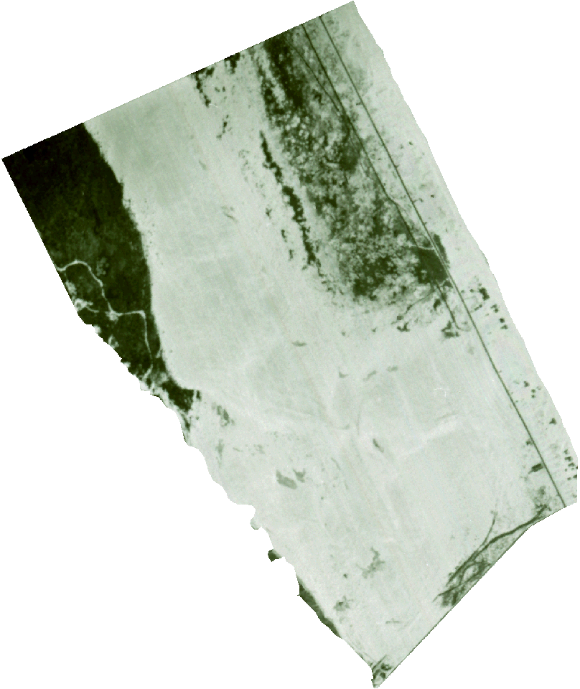
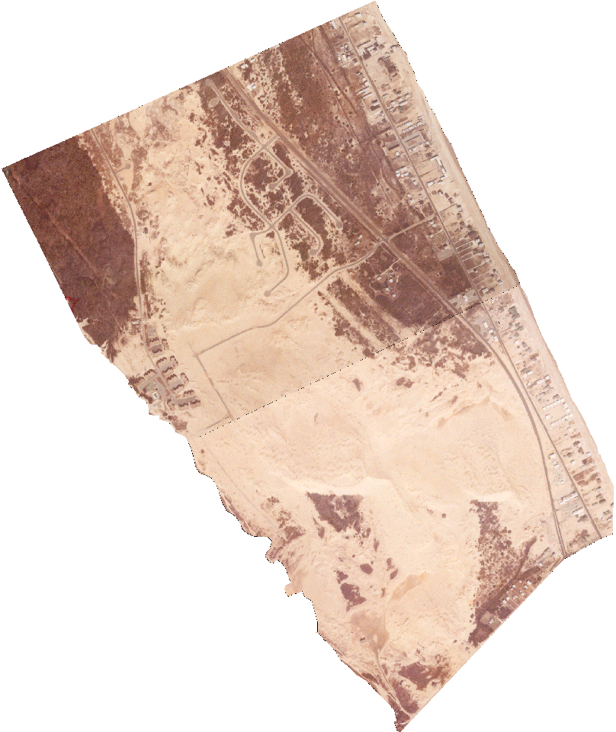
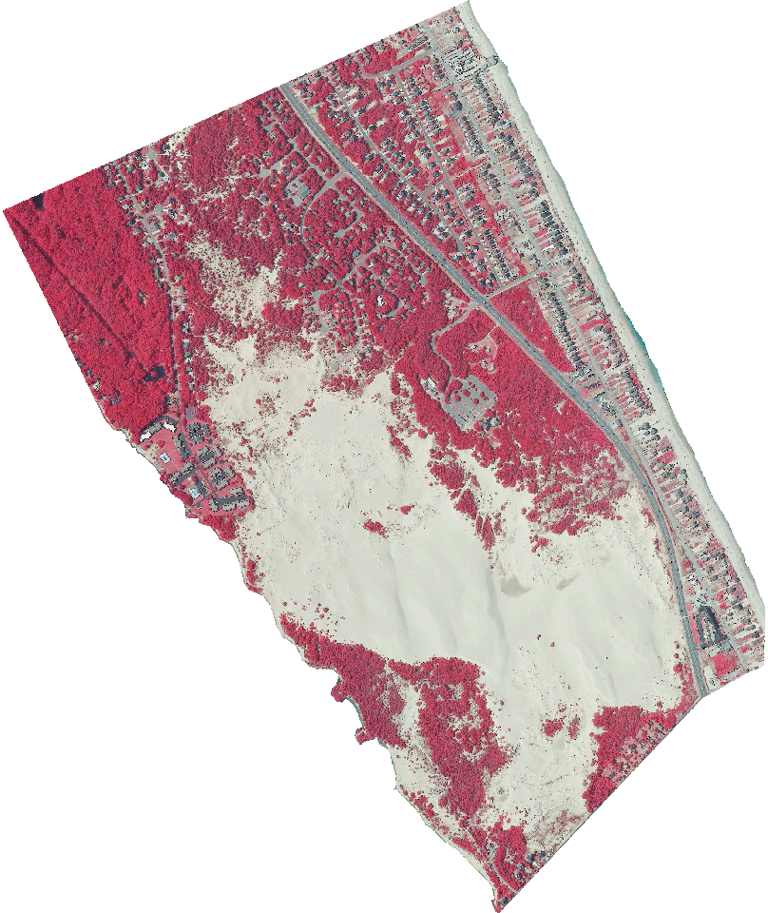
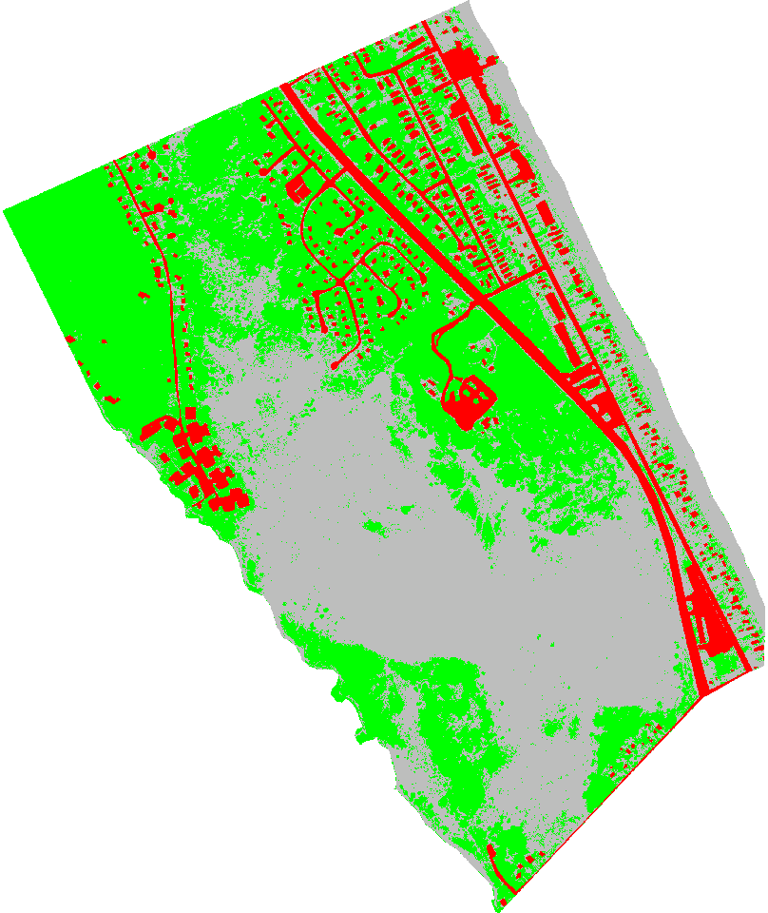
Dramatic change in land cover
1945
1974
74% sand 25% vegetated 1% developed
64% sand 31% vegetated 5% developed
2009
46% sand 42% vegetated 11% developed

Slide 16
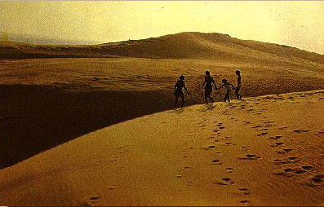
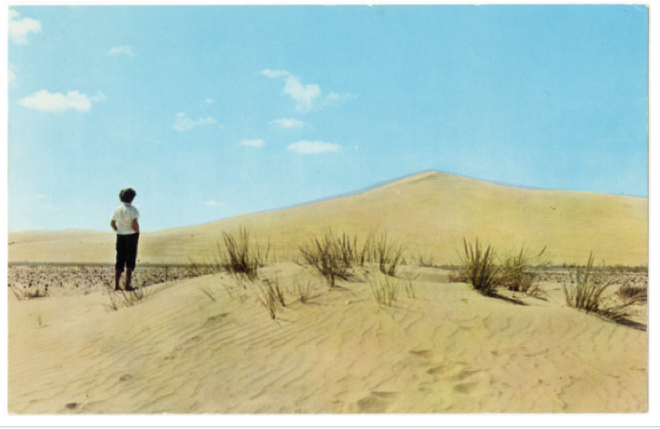
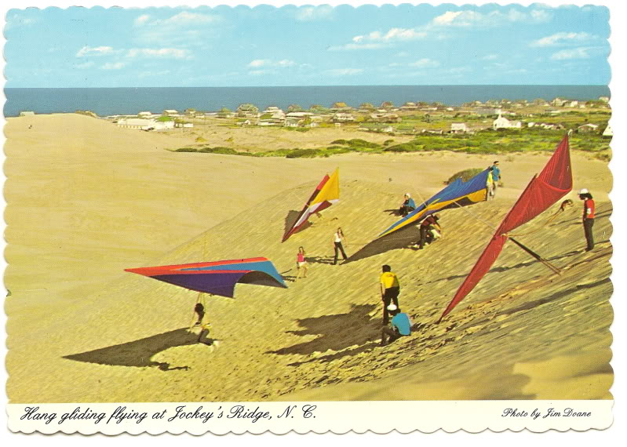
Dune past captured on postcards
Post cards show very little vegetation in 1912 - 1977

Slide 17
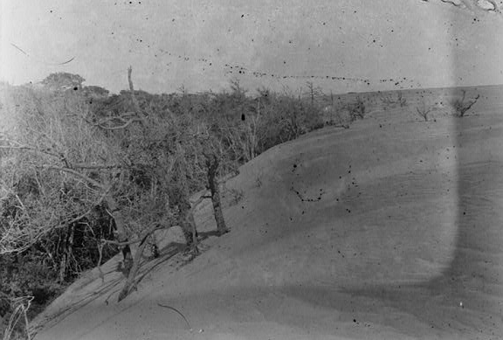
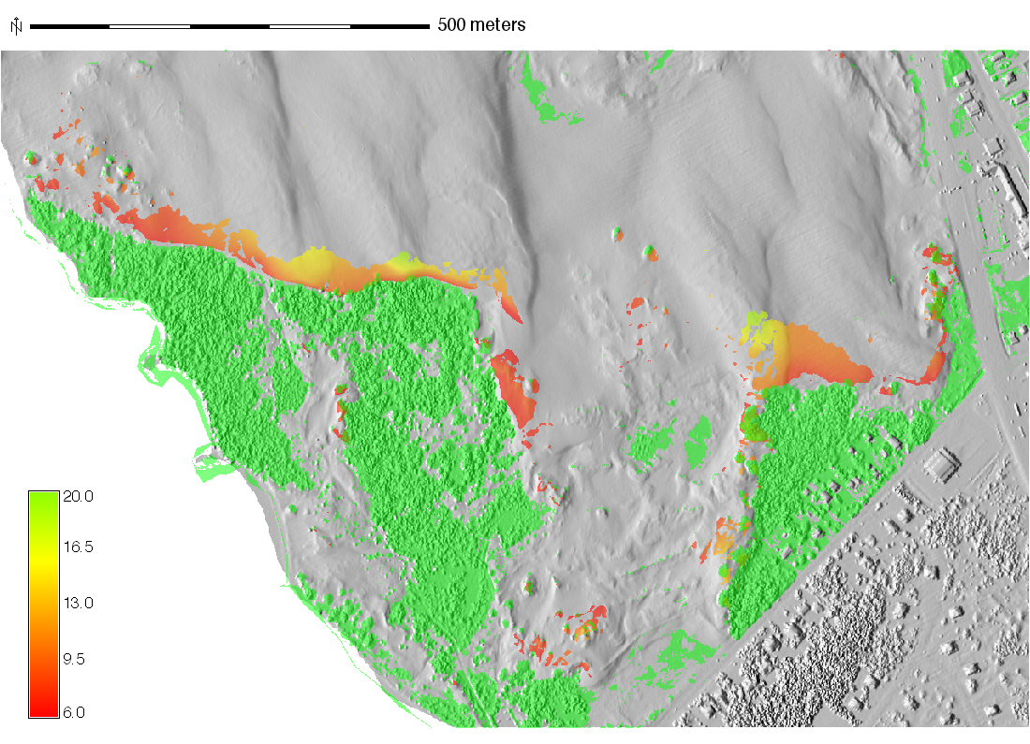
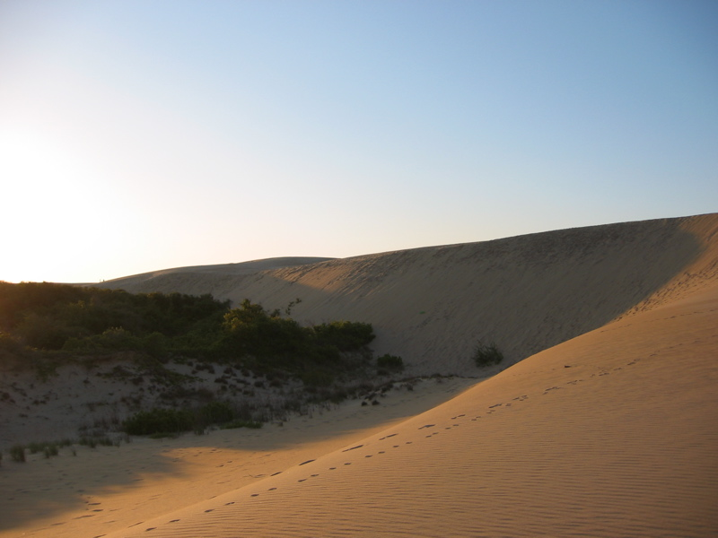
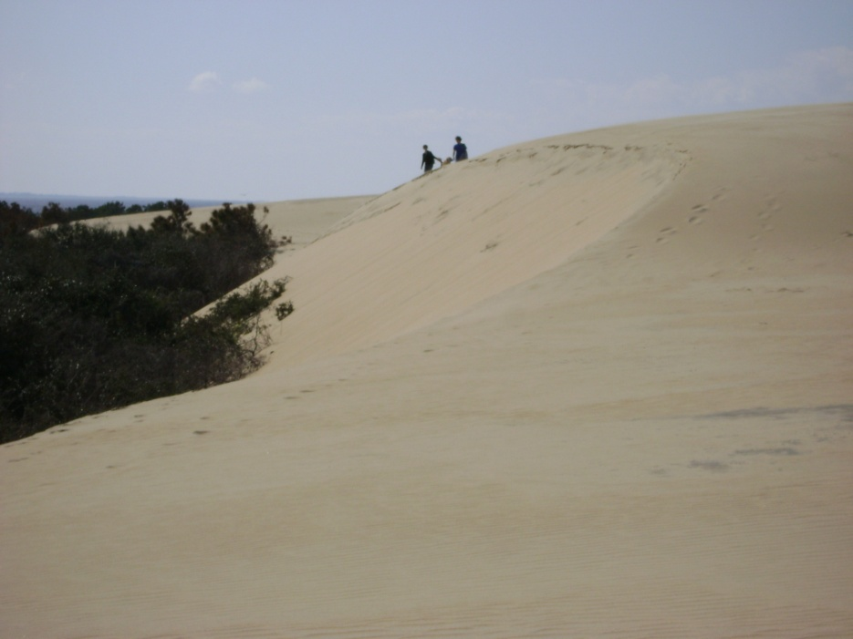
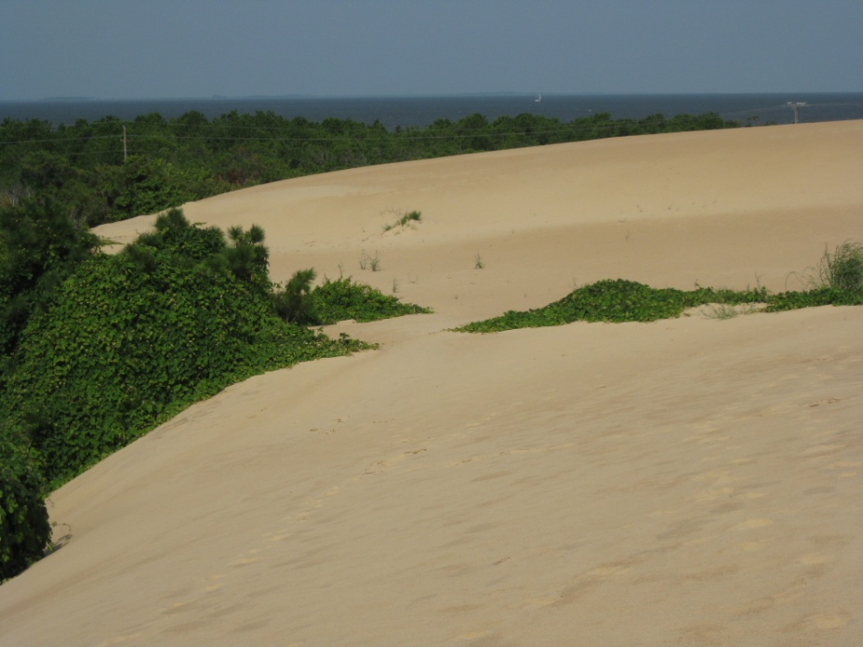
Dune – vegetation interaction
1905 Wright brothers’ photos:
dunes were destroying the vegetation Vegetation lost to dune between 1998-2007
Vegetation gradually starts taking over, in 2010 vegetation grows over slip face,
2003 2005 2010
Vegetation is now limiting the dune migration, sand disposal stabilized the dune height

Slide 18
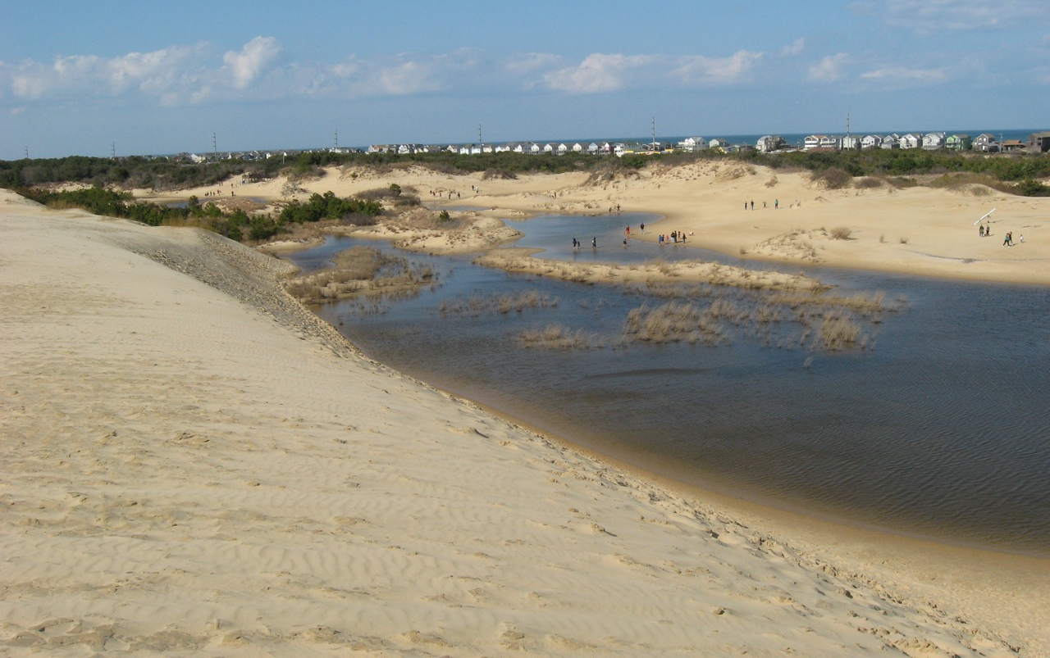
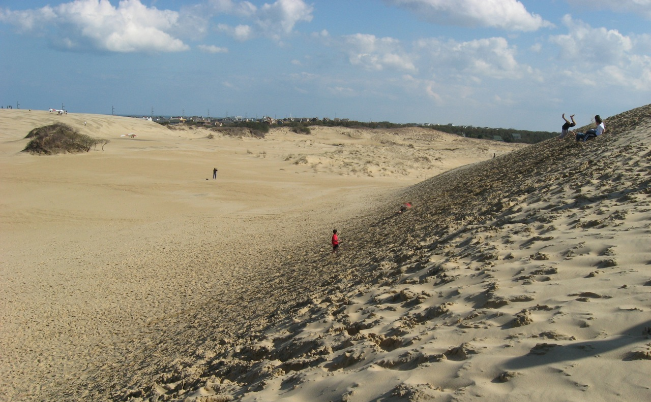
Visitor impacts
Data do not support the notion of negative visitors impact on dune height:
dune was losing elevation even before the park was established
height has stabilized over past 5 years when the number of visitors reached the highest levels
extreme storm in 1962 and gradual increase in vegetation limiting the sand supply probably triggered the dune decline.
March 2010 after a storm
jumping and rolling down the slip face

Slide 19
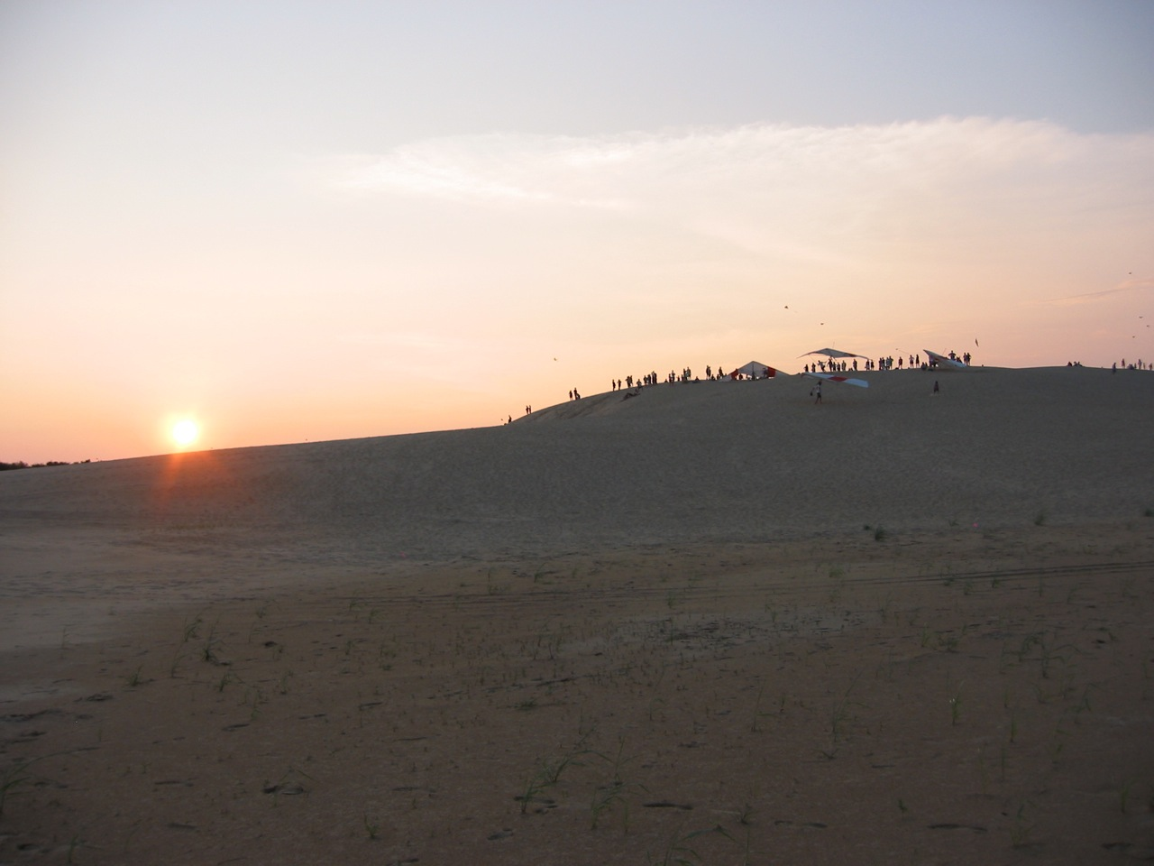
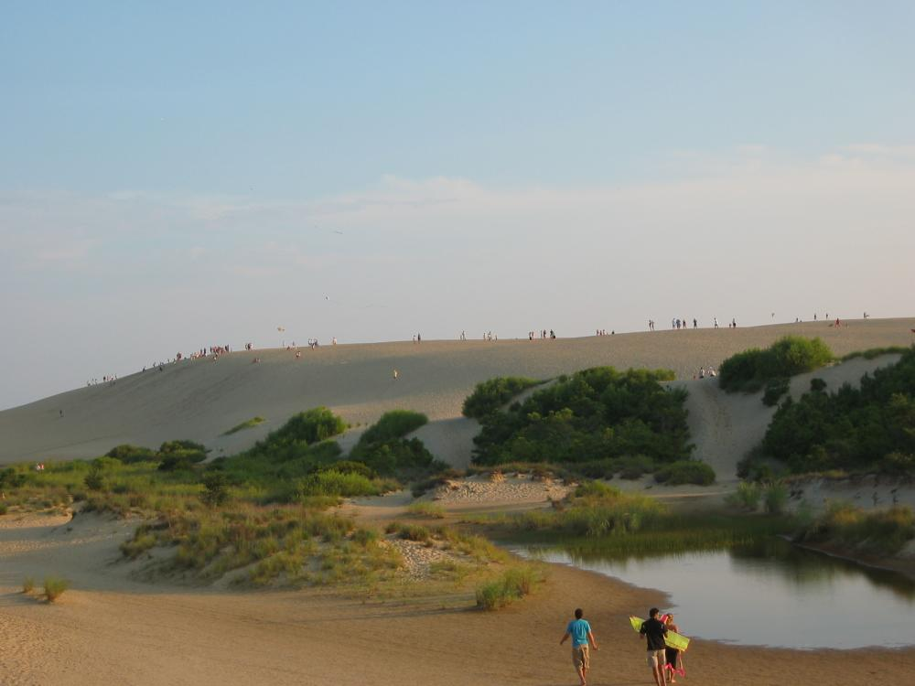
Visitor preferences
Visitor’s survey: 200 visitors in July, August, October of 2005
What do visitors value about the dune in terms of features and processes?
Change was perceived as valuable/positive if natural
august 2005 during data collection

Slide 20
Conclusions
Vegetation is now limiting the dune migration
Sand disposal stabilized the dune height
Stabilization measures limited to boundary areas preserved the dune morphology
Positive visitor experience is contingent upon the perception that the changes are natural
Management focus is on preserving processes rather than features: living landscape
August 2005

Slide 21
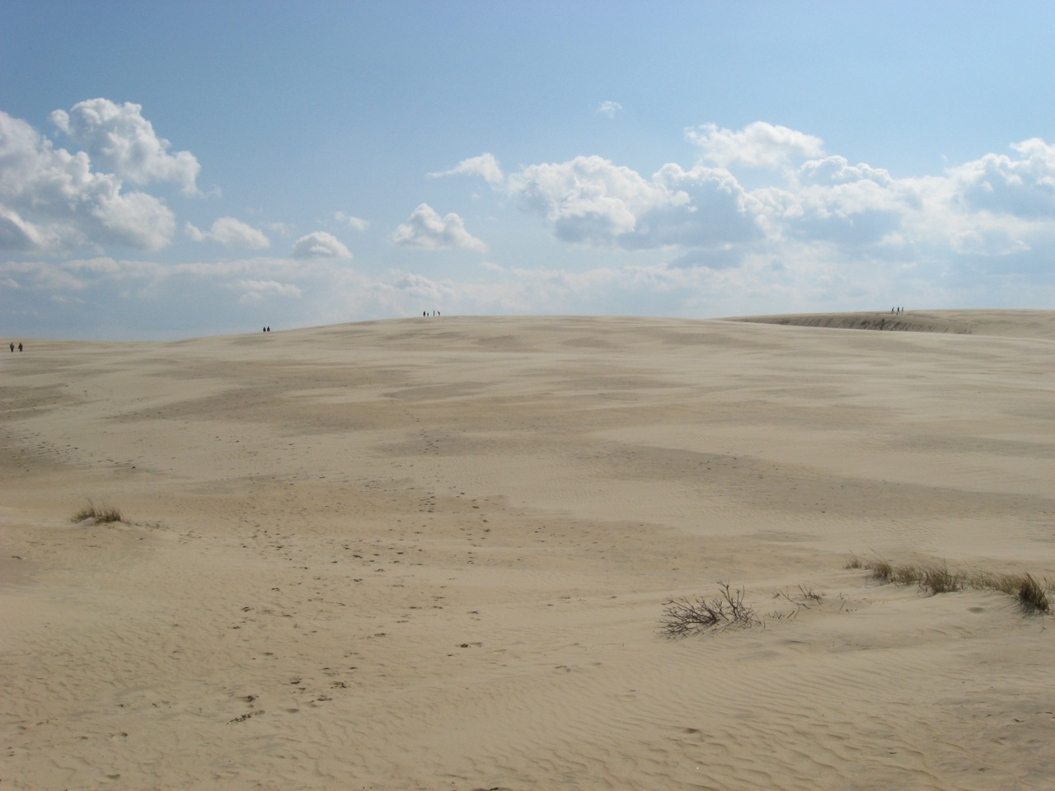
Thank You
march 2010 - spring break, it can be crowded and deserted at the same time

