Slide 1
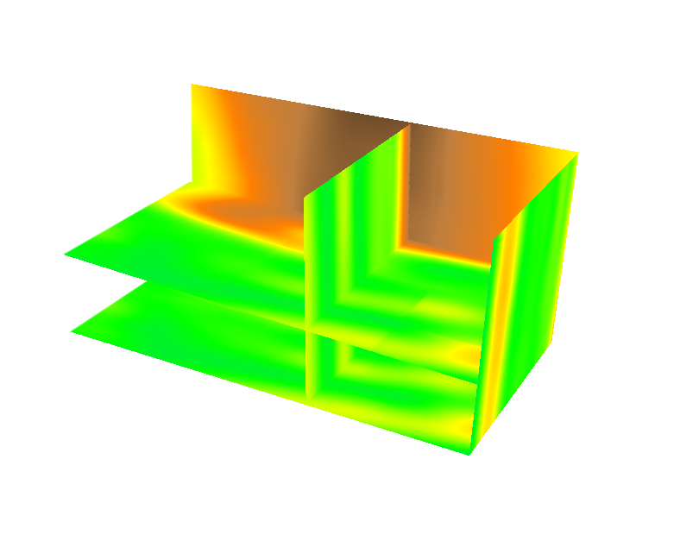
space-time cube
(x,y,z)
t_{n}
…
(x,y,z)
t₂
(x,y,z)
t₁
reorder
as
(x,y,t,z)
interpolate
z=f(x,y,t)
15
7
0 m
Time
[year]
Y[m]
X[m]
H. Mitasova, NCSU
Fig. 3
Notes:
1
1
Figure 3: Representation of landscape evolution using trivariate space-time function: merged time series of point clouds is interpolated into space-time voxel model (Mitasova et al., 2011).

Slide 2
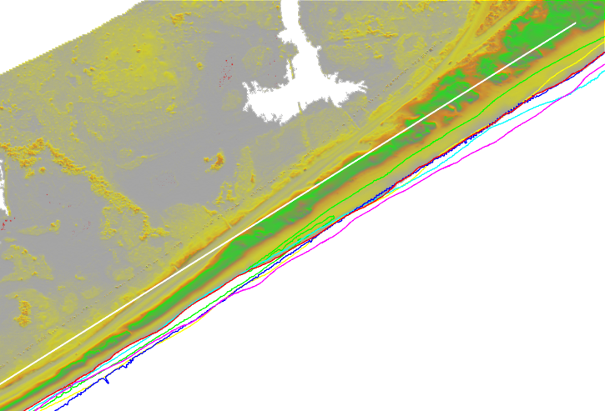
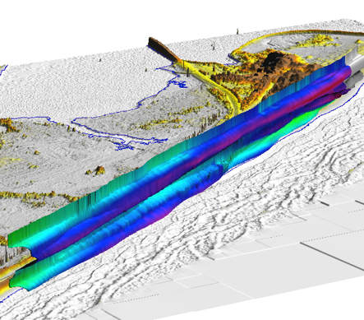
Oregon Inlet
Year
1997
1999
2001
2003
2005
2008
(B)
z=0.3 m
(C)
N
sound
sand disposal
beach
Distance
N
75
90
105
120
135
150 m
waves
2008
2008
2003
2001
1999
1997
(A)
Time
[year]
0 1 km
Fig. 6
H. Mitasova, NCSU
Y[m]
X[m]
Notes:
Figure 6: (A) Lidar surface DEM showing coastline near Oregon Inlet, NC; (B) Mean high water (MHW) shoreline contours overlaid on a DEM by year. The white line is the alongshore baseline from which cross-shore distance in shoreline movement is referenced. The plot shows how messy it can become to try and visualize a time series of 2D shoreline contours; (C) Evolution represented as a contour isosurface showing the dynamic movement (retreat or advance) of the 0.3 m MHW contour alongshore during the study period.

Slide 3
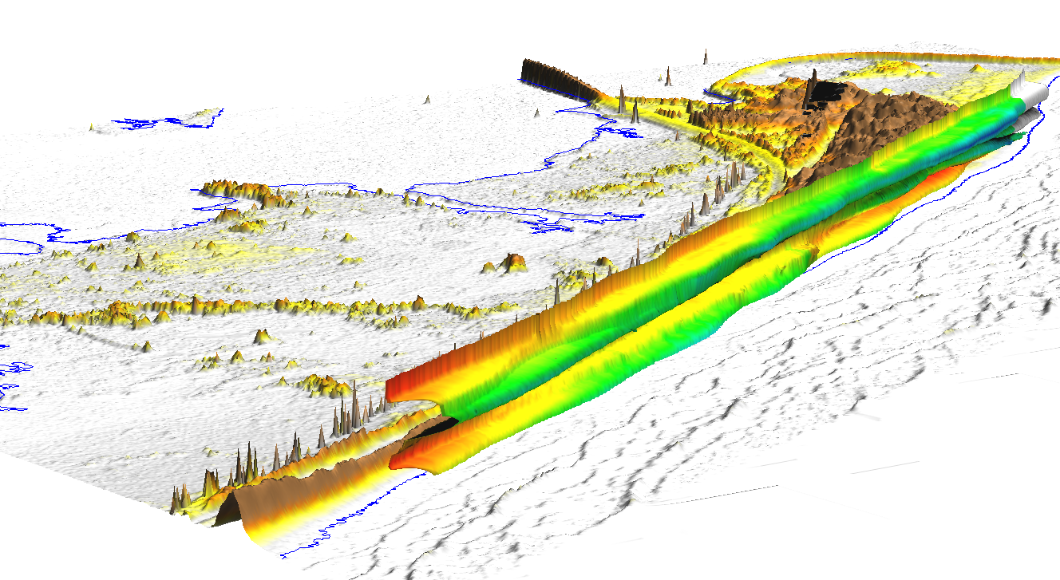
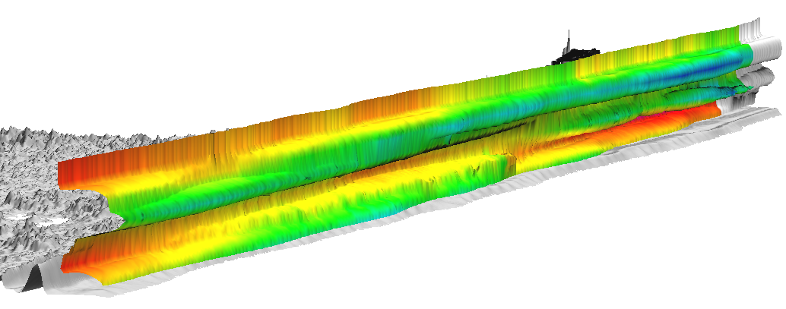
same as previous
except for different color –
red is eroded, blue green
has sand added
H. Mitasova, NCSU

Slide 4
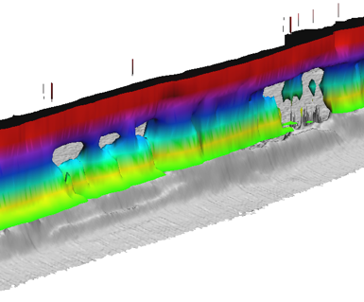
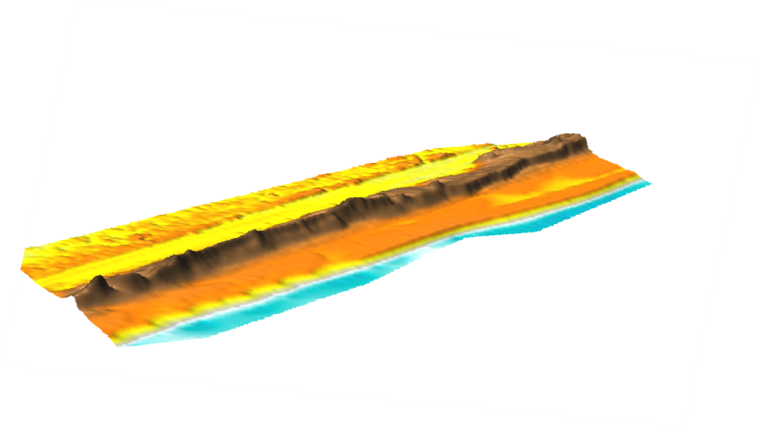
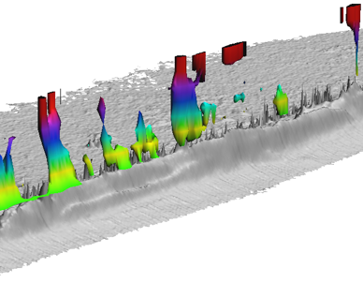
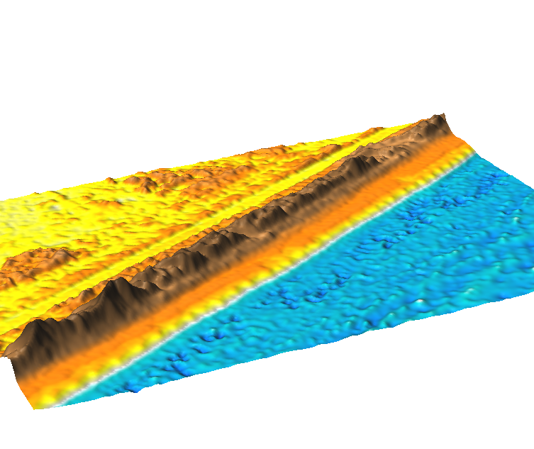
z=4.5 m
dune overwash
DEM [year]
2005
2003
1997
`
z=7.5 m
(B)
N
1997
1999
2001
2003
2005
2008
(A)
0 200m`
stable dune peaks
(C)
H. Mitasova, NCSU
Fig. 7
Notes:
4
4
Figure 7: Evolution of the foredune near Oregon Inlet, NC: (A) three snapshots from bare-earth DEM time series illustrating changes in the beach-foredune system, including an overwash in the year 2003; (B) evolution of a 4.5 m contour displayed as isosurface, holes (ellipse) represent the dune overwash caused by Hurricane Isabel in 2003, after which the dune was repaired; (C) evolution of a 7.5 m contour displayed as isosurface representing the highest dune peaks along this stretch of beach (see more details about this site in Mitasova et al.,2009a).

Slide 5
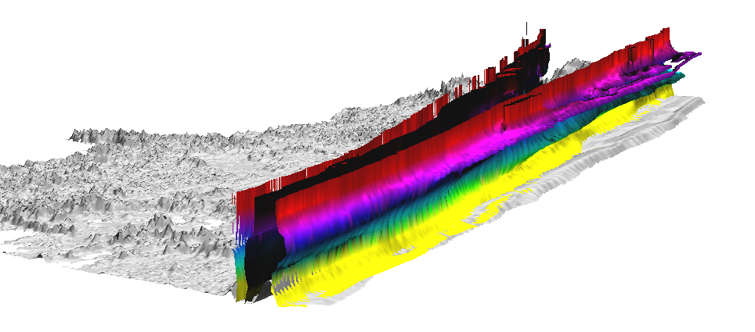
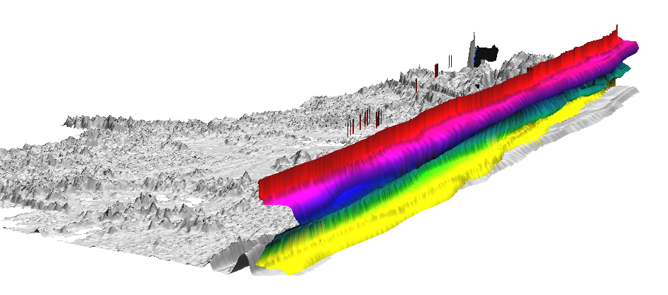
1.5m
0.7m
H. Mitasova, NCSU

Slide 6
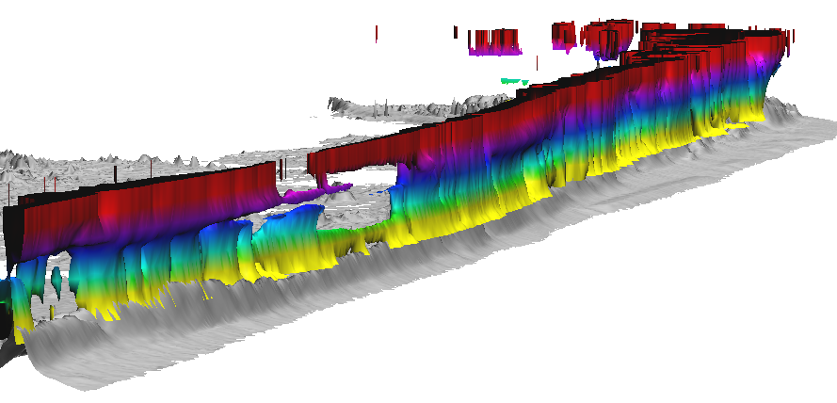
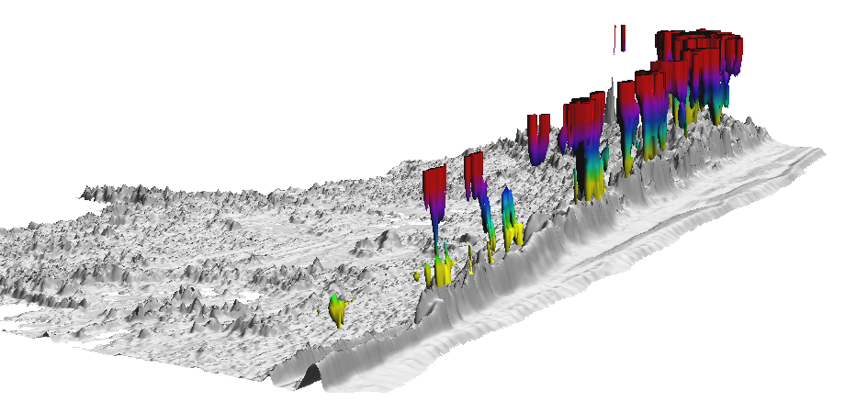
5m
8m
H. Mitasova, NCSU

