Slide 1
Rodanthe

Slide 2
Rodanthe change in 14 years:
DEM with Ortho 1997 and 2011
what happened? How did it get there?
animation (in presentation)
shorelines
ridgelines
volumes
isosurfaces
STC crossections
homes
refer to previous paper for core and envelope

Slide 3
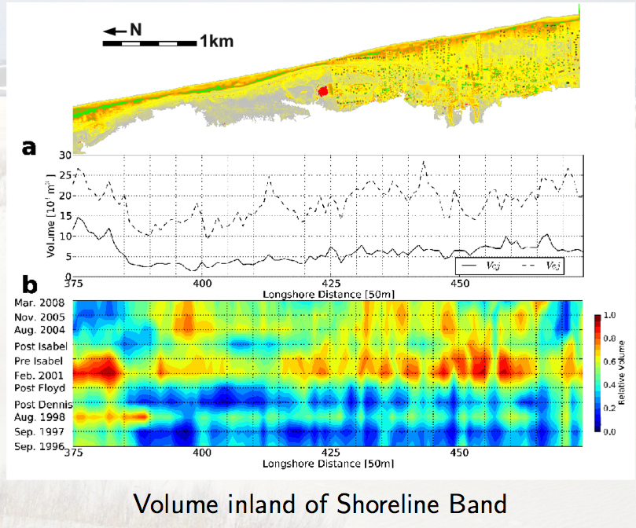
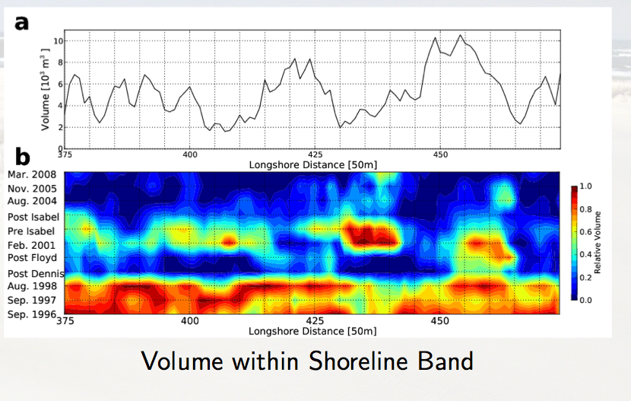
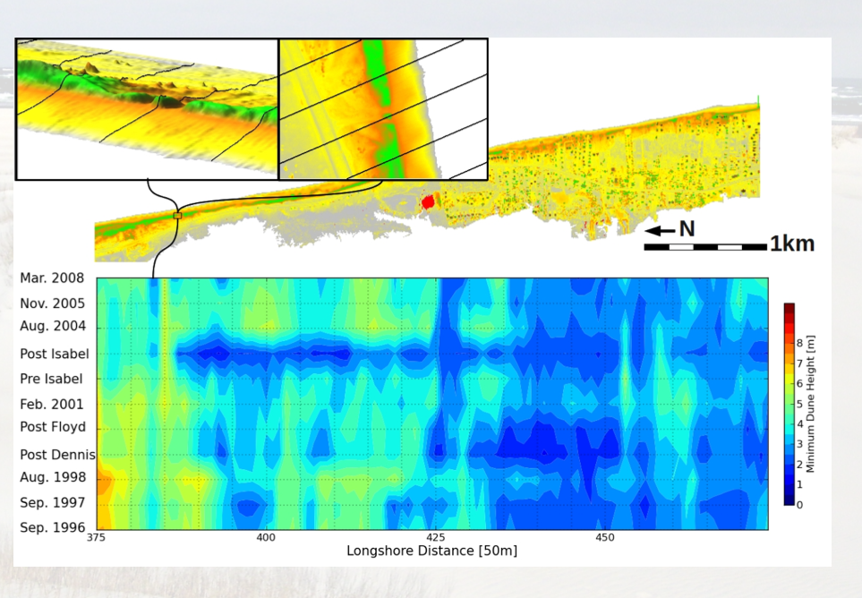
acceleration?

Slide 4
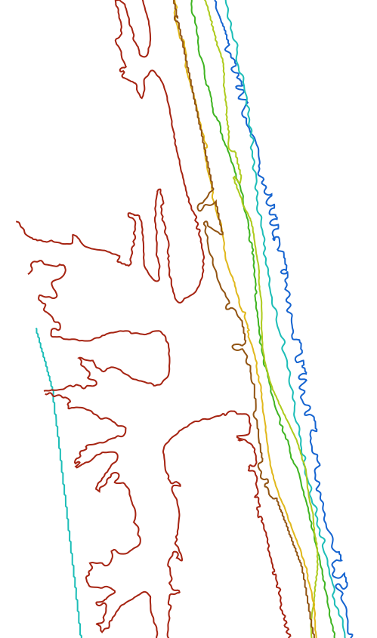
z=0.5m, colored by year
2011 breach
2011
2009
2008
2005
2004
2003
2003
2001
1999
200m
Notes:
4
4
I need to find a more attractive area to show this - it can be skipped

Slide 5
z=3.0m
z=2.0m
colored by rate of change
2003 overwash after which
the foredune was rebuilt
at 3m height and above

Slide 6
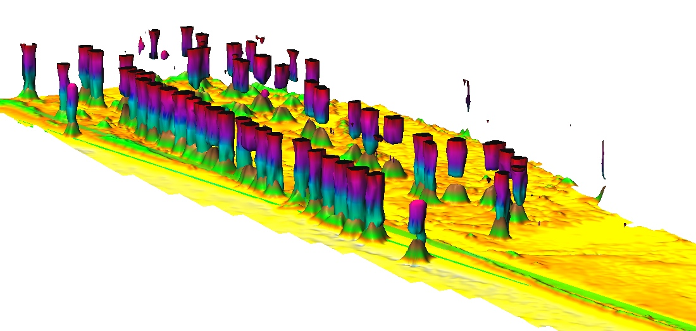
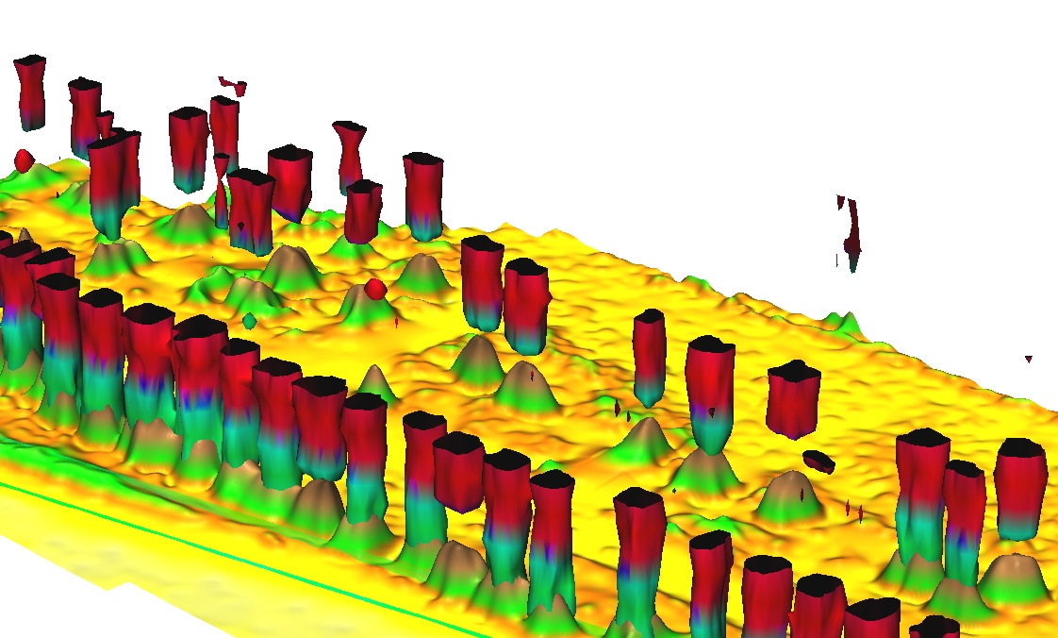
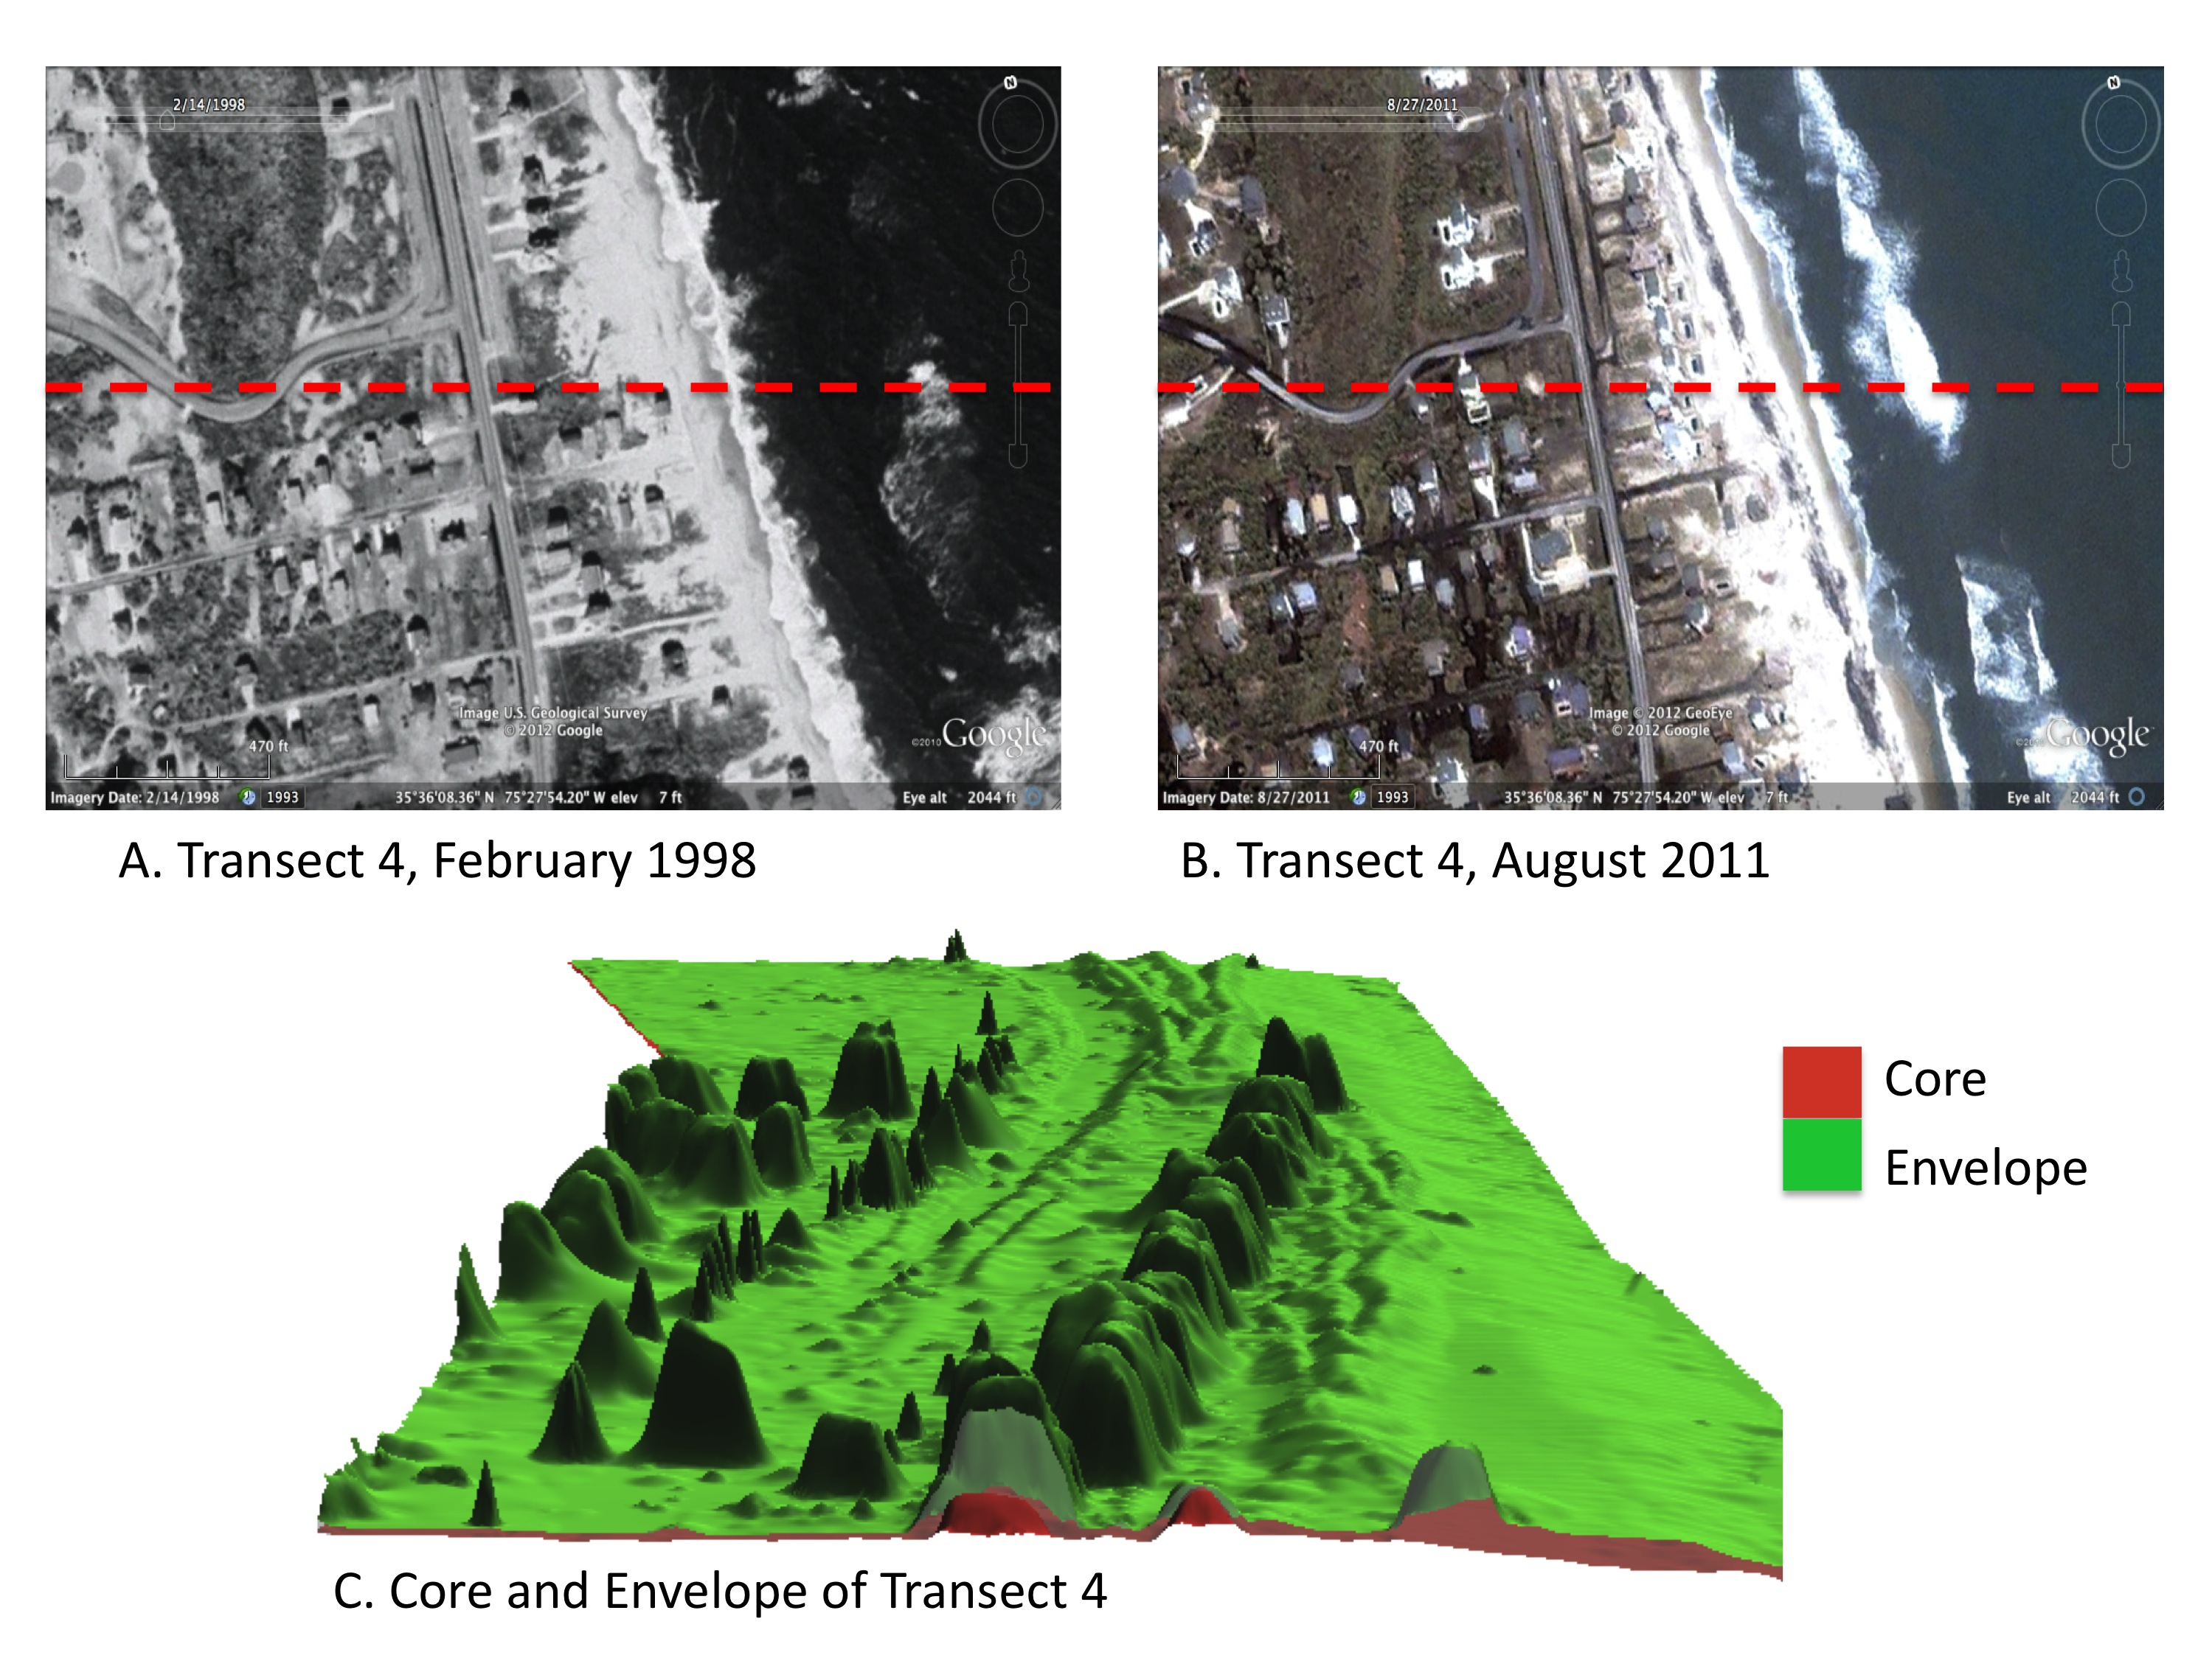
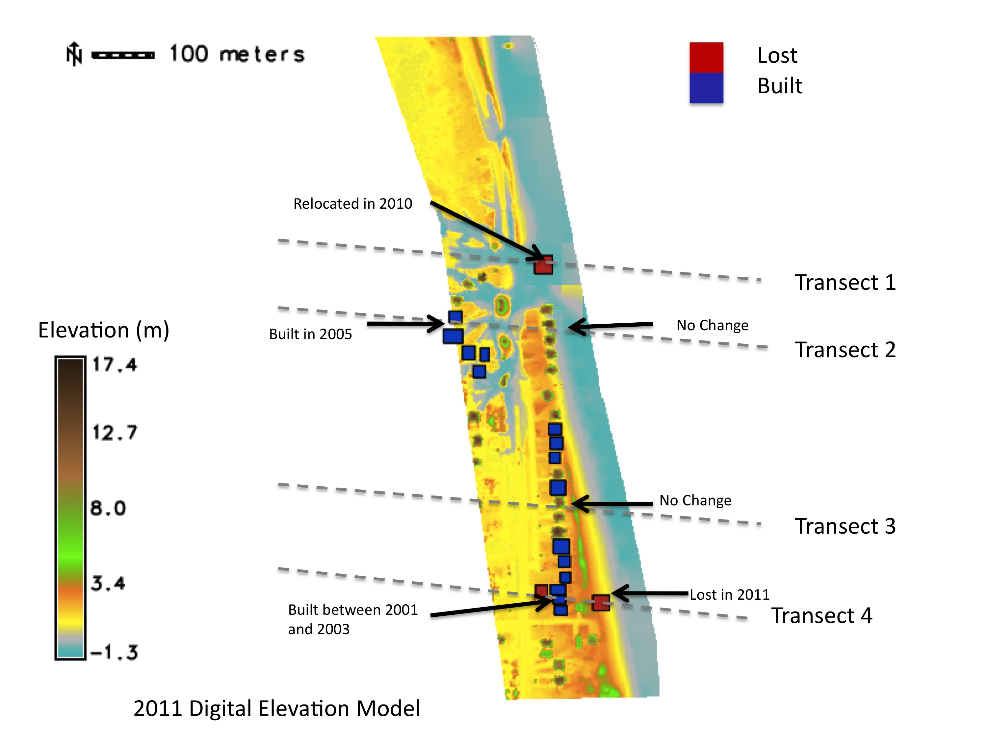
colored by occupancy

Slide 7
Cape Hatteras 1997-2011

Slide 8
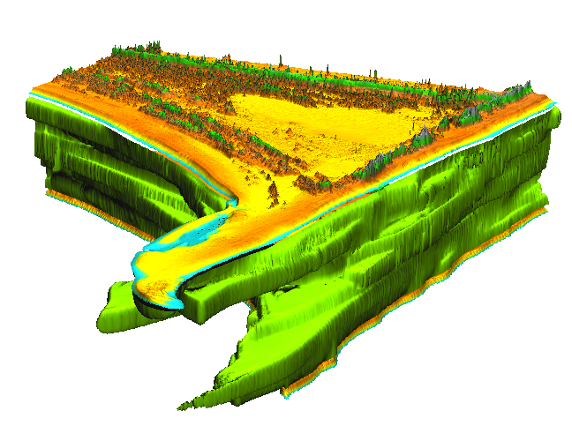
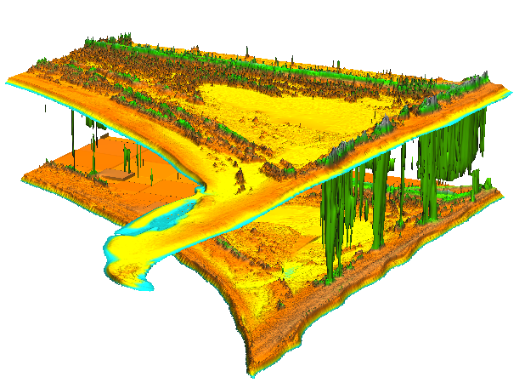
z=3.5
Cape Hatteras 1997-2011
shoreline and 4.5m
200m
evolution of
fore-dunes
at z=4.5 m
evolution
of shoreline
Cape Hatteras 1997-2011

Slide 9
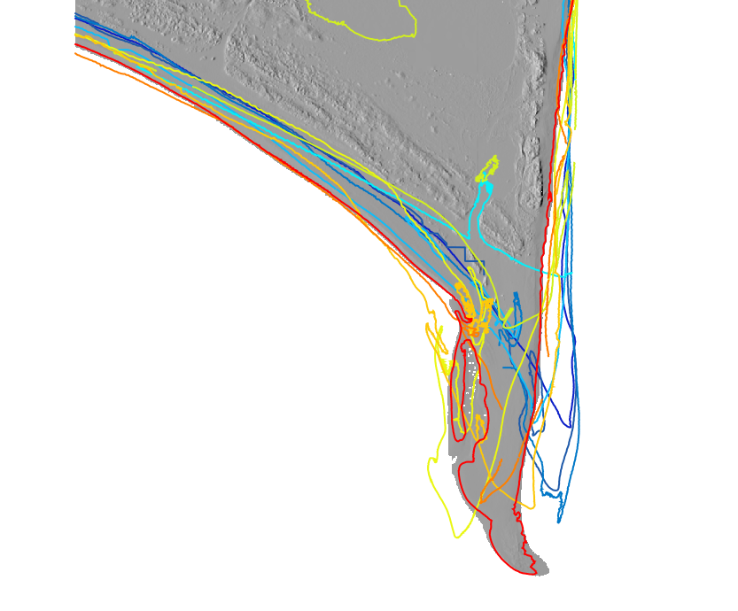
200m
evolution of
fore-dunes
at z=4.5 m
evolution
of shoreline
Cape Hatteras 1997-2011

Slide 10
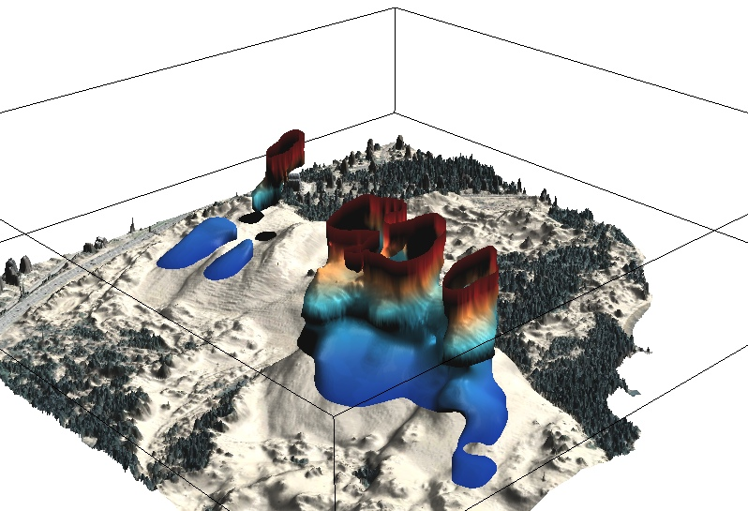
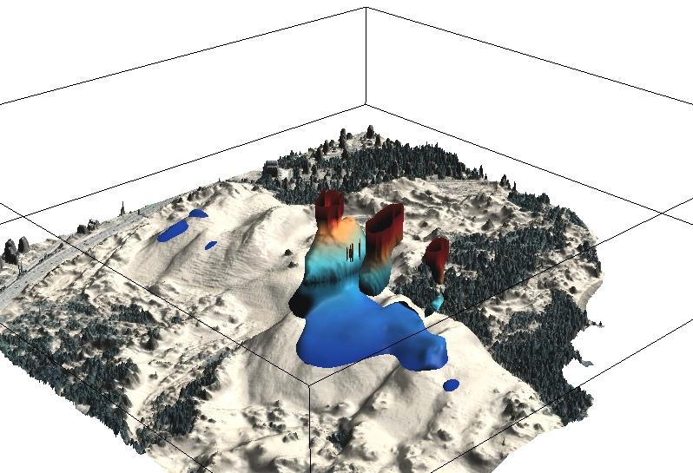
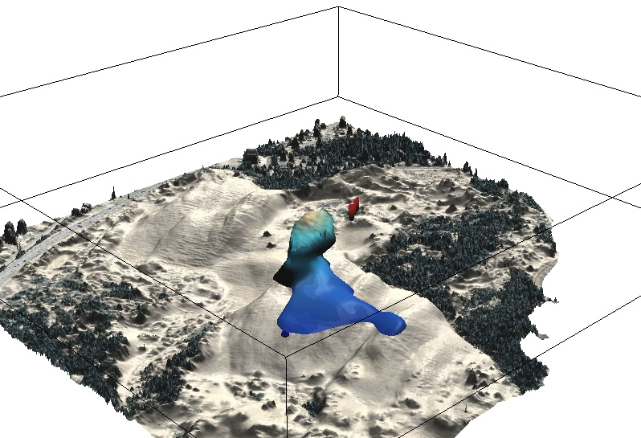
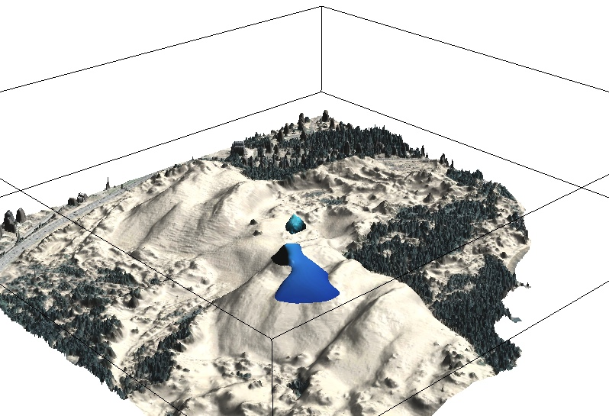
gradual split into 3 ridges, recovery of east dune
growth of west dune
17m, 20, 22, 25

Slide 11
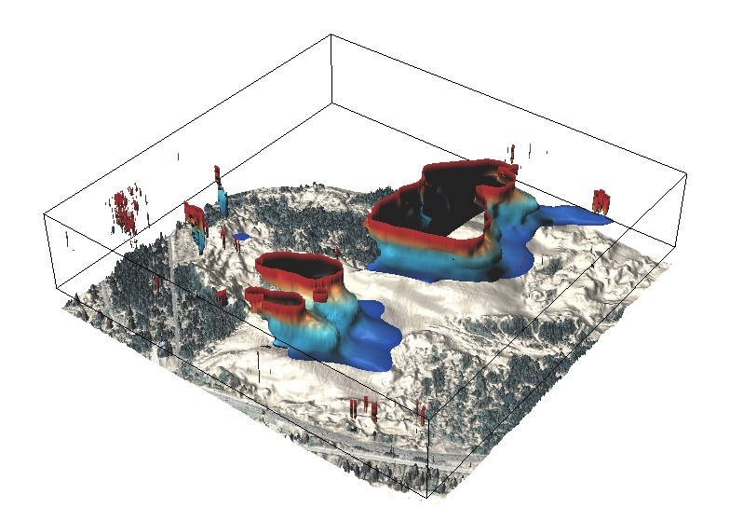
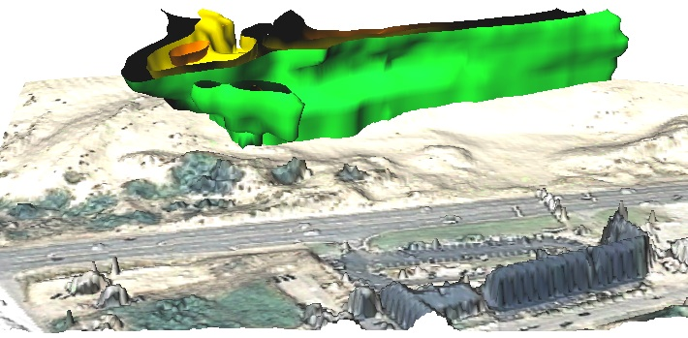
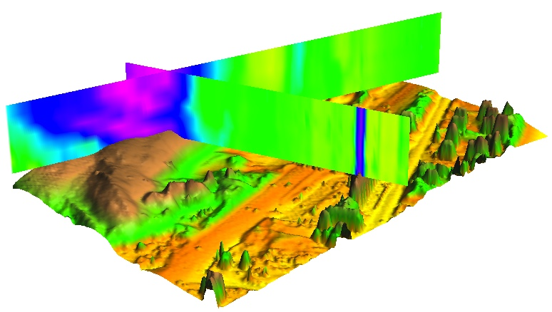
13m: 1974-2008
split of east dune into 2 ridges at
13m elevation
Slip face migration (slope > 15deg)
Time
migrating
2008
2005
2001
1999
Y
stable
X
Looking East
Isosurface Elevations: 10 11 12 m

Slide 12
additional images to help decide what and how
needs to be modified/redone

Slide 13
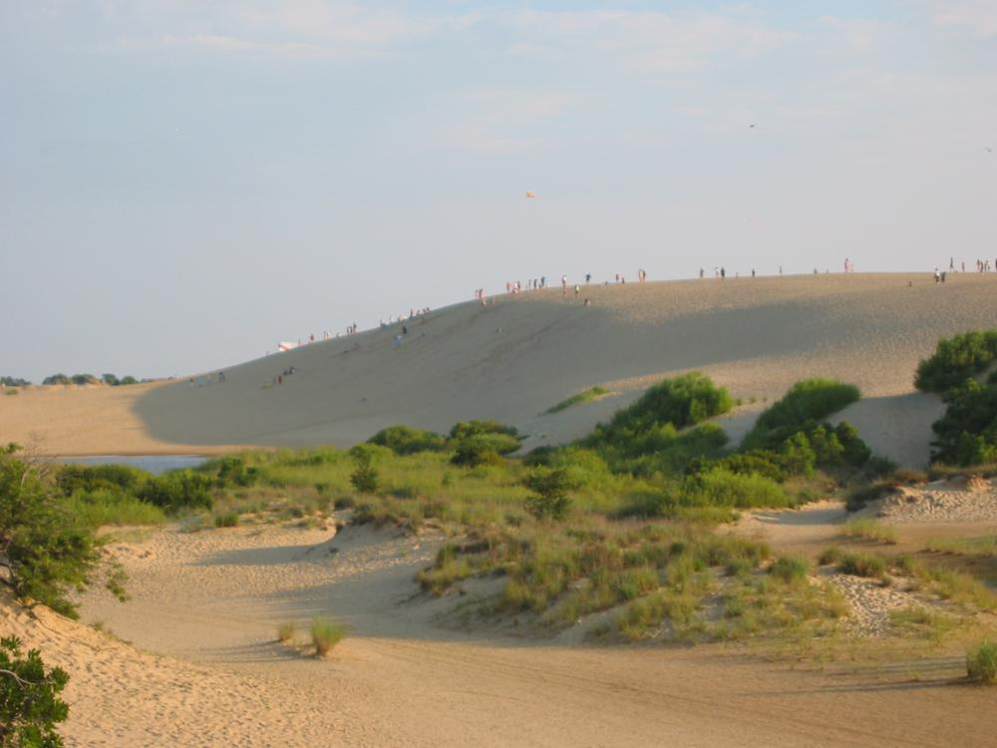
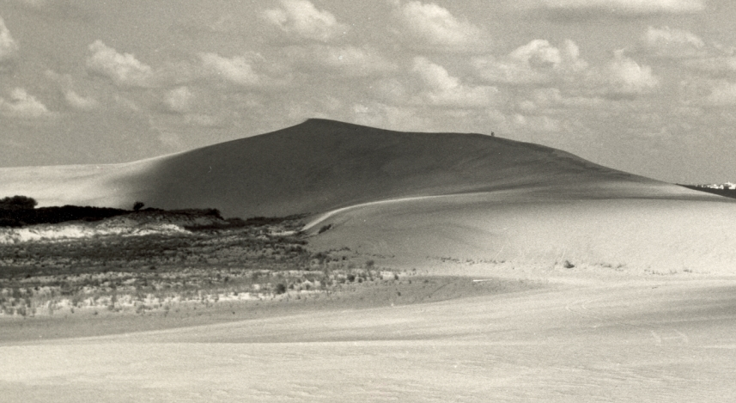
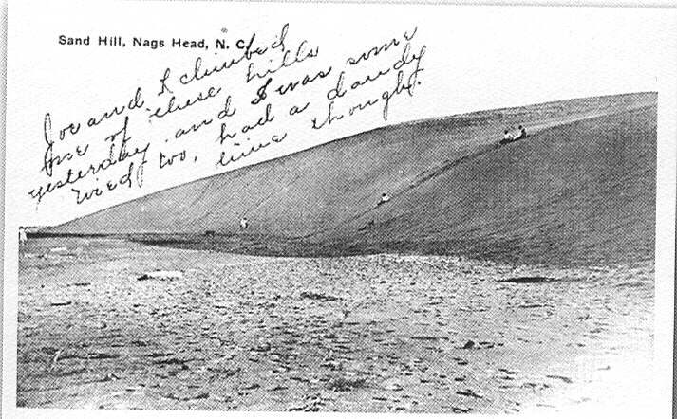
Change in dune height
sand lost
sand
gained
stable
1949: 42 m
1974: 33 m
2008: 21 m
1930: 32 m ?
N
1917: 20 m ?
2008: 21 m 1950: 42 m 1917 20 m ?
High active dune: result of bad land management?
Landscape going back to its more stable form
Notes:
13

Slide 14
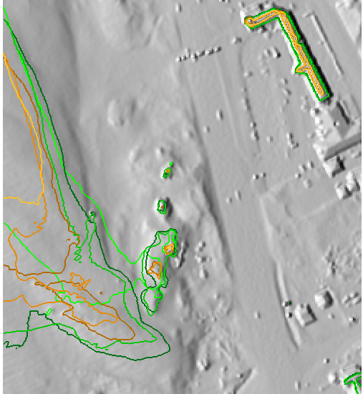
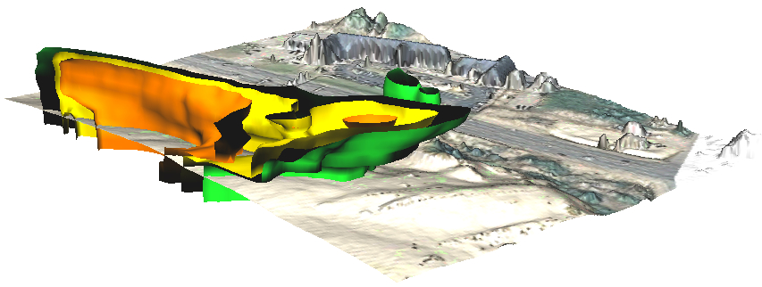
Contour evolution as isosurface
10m and 12m elevation contours for 3 years
Isosurface representation of 10, 11 and 12m elevation contours for time series
Elevation: 10 11 12 m
2008
2005
2001
1999
10 | 12 | z[m]
~~ | ~~ | 2008
~~ | ~~ | 2005
~~ | ~~ | 1999
Time
Y
X
0 100m
NHiso*.tif has the entire series –so this can be
replaced by unpublished images?
Notes:
14
14
I need to find a more attractive area to show this - it can be skipped

Slide 15
use figures with change
instead
z=4.0m
z=3.0m
z=2.0m
colored by year
2003 overwash after which
the foredune was rebuilt
at 3m height and above
major hurricanes
2011 and 2003
2011
2009
2008
2005
2004
2003
2003
2001
1999
200m
Notes:
15
15
I need to find a more attractive area to show this - it can be skipped

Slide 16
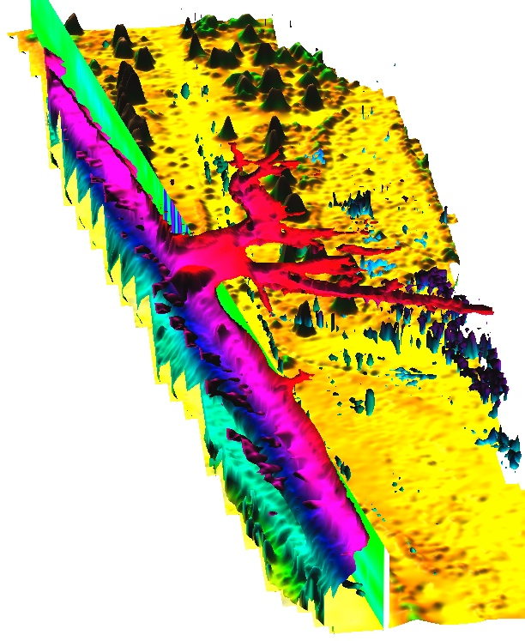
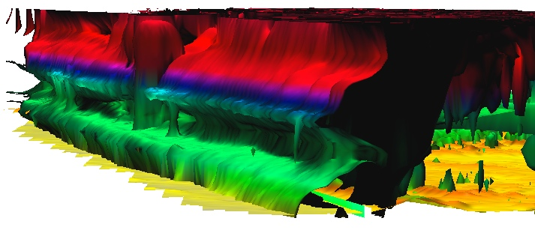
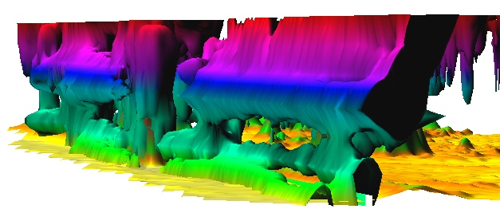
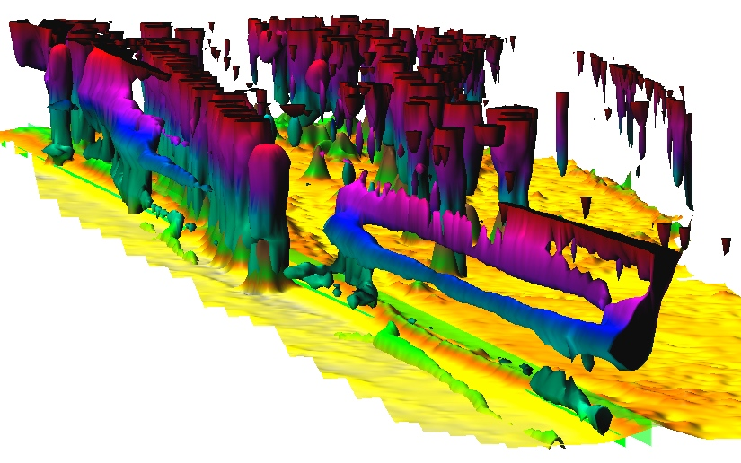
Dynamics at Rodanthe
z=2m, colored by occupancy $$
Irene breach
2011
2008
2004
2003
2001
1999
Isabel
z=0.7m
z=4.0m
sand disposal
post Isabel
constructed dune
migrating inlands
200m
Time
[year]
X[m]
Y[m]
Notes:
16
16
I need to find a more attractive area to show this - it can be skipped

