Slide 1


Geospatial analysis and modeling of interactions between the climate (change) and evolution of vegetation, landforms and storm impacts on NC barrier islands
Helena Mitasova
Katherine Weaver, Keren Cepero, Emily Russ,
Eric Hardin, Paul Paris
North Carolina State University, Raleigh, NC, USA
GRASS GIS

Slide 2
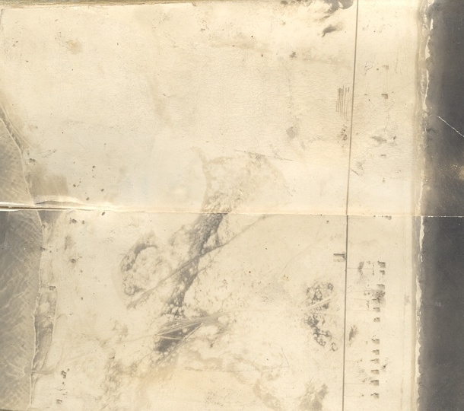
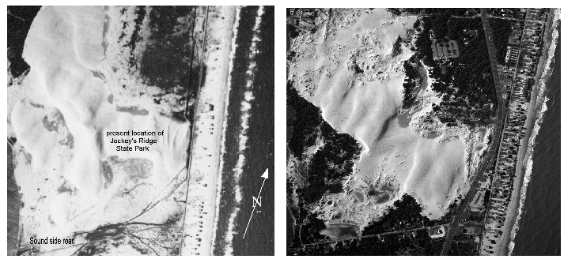
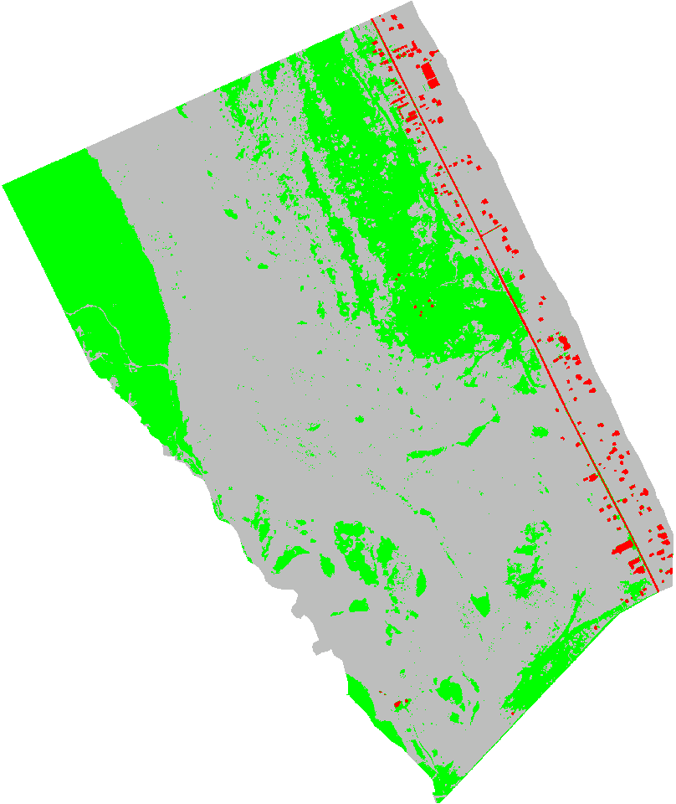
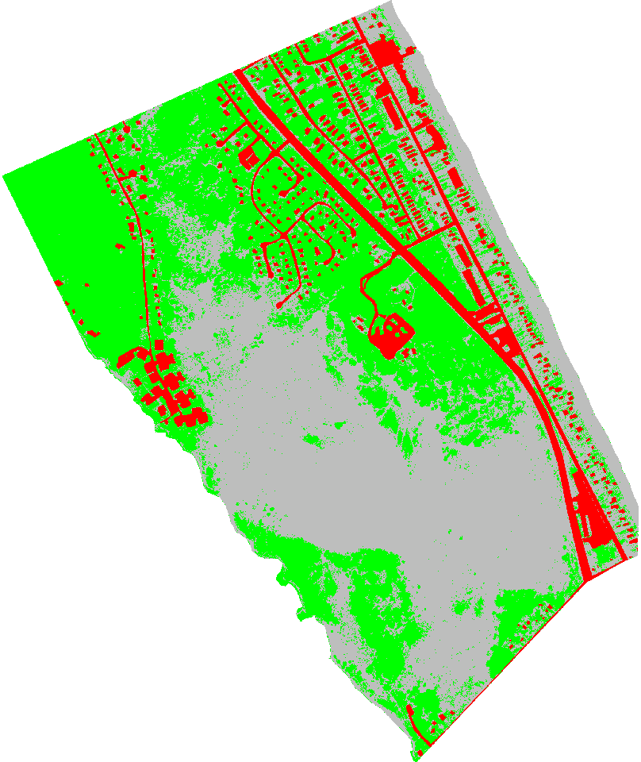
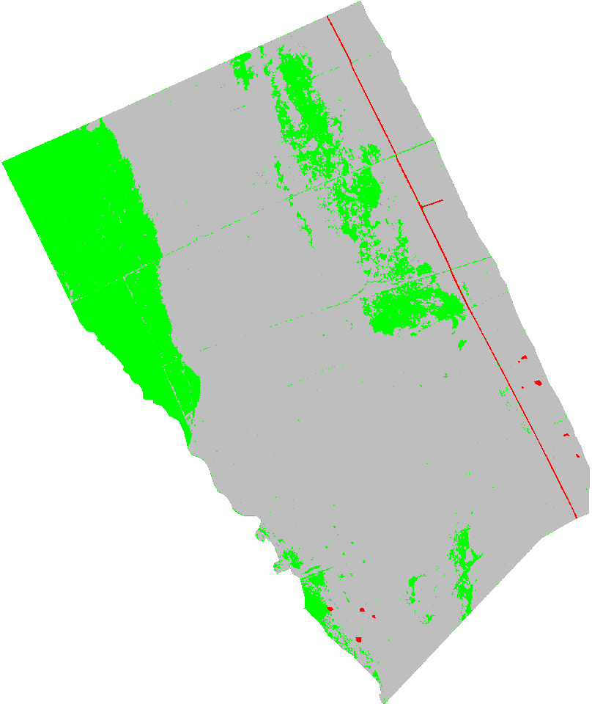
Background
dramatic change in vegetation (past 2000 years and past 100 years)
increase in population and development
1932 1943 2003
Dune evolution
Forested by 2020?
Modern dunes 1810
Forested, soil developed by 1700
Active dunes by 1260
Forested, soil developed by 1000
Dunes active by 765 A.D. (PSL)
1932 1955 2009
Population
density in Dare county
1800-1970:15-23
1980 35
2000 78
2010 88

Slide 3
Geospatial analysis of vegetation and landform change
Develop GIS-based methods and tools for assessment of dramatic change in vegetation and morphology on barrier islands over past 100 years:
fill the gaps in data, especially on vegetation change using aerial imagery starting in 1930
quantify the 3D vegetation and landform change at high resolutions for past 10-15 years using lidar and imagery
develop methods for fast, automated updates to track the changes and capture possible acceleration
Results will provide inputs for related projects on sea level rise, storms, biodiversity, etc.
The developed methodology and tools can be applied to other coastal areas.

Slide 4
Research questions
Investigate the links and feedbacks between the climate, vegetation and landform change over past 100 years and evaluate the implications for future
does increase of vegetation limit the barrier island migration and lead to eventual breakdown by limiting the sand transport?
how does the change in landforms (e.g. types of dunes) influence the type and extent of vegetation? Is there a feedback mechanism?
is there an acceleration in vegetation and landform change? If yes, is climate the primary driver?
is the impact of vegetation increase more significant than increase in development?
how does change in vegetation extent and structure influence the storm impacts? (more likely breaches even from small storms, slower recovery? reduced dune erosion and flooding?)

Slide 5
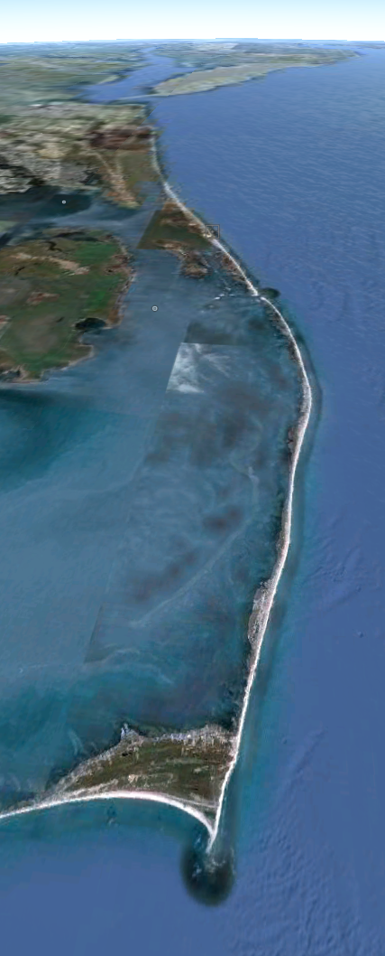
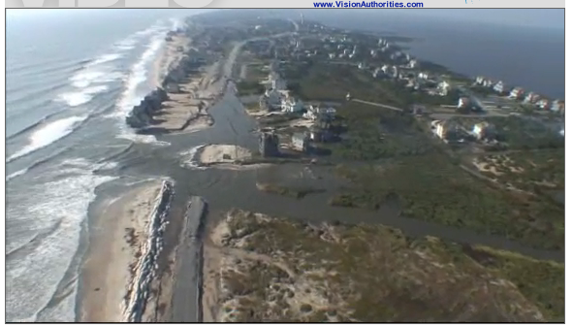
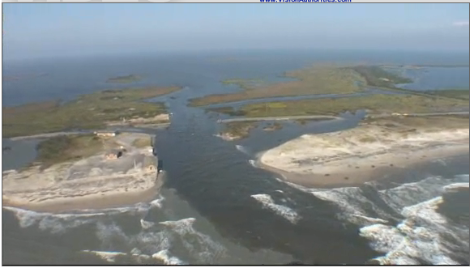
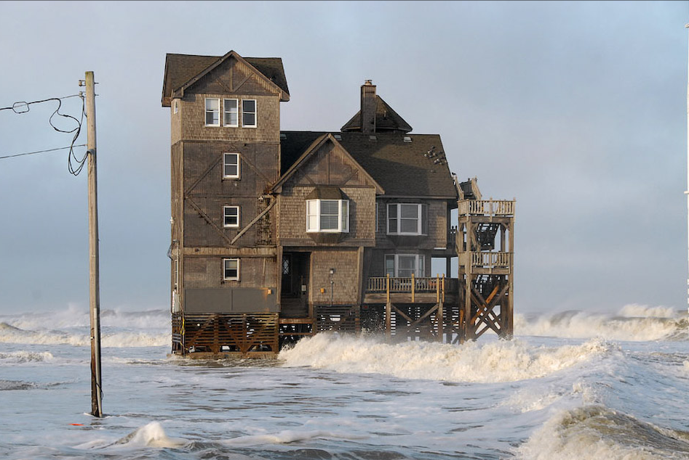
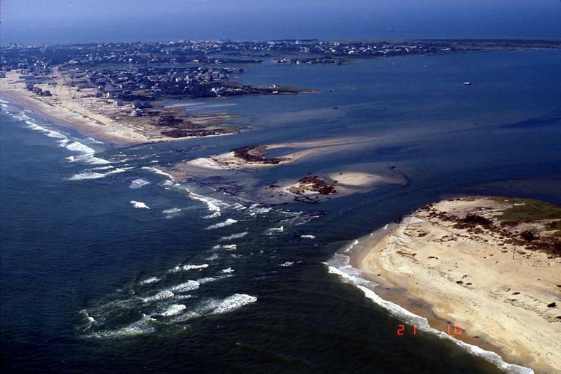
Barrier islands
Dynamic topography: sand is redistributed by wind, waves, storm surge
Vulnerable: sea level rise, coastal erosion, inundation, breach
Atlantic Ocean
Nags Head
Pea Island
Cape Hatteras
0 10km
N
Notes:
Over the past decade free and open source software (FOSS) has moved into mainstreem and its growth includes a wide range of geospatial software tools. The presentation will briefly describe the principles of FOSS and provide an overview of major FOSS projects that support management, processing, analysis, visualization and on-line distribution of georeferenced data. Interoperability between the different tools enabled by the FOSS concept will be highlighted using examples of applications that combine software developed by several projects, such as GRASS, Mapserver, GDAL, PROJ, R-stats, PostGIS, paraview and others. Special focus will be given to the recent new developments in Geographic Resources Analysis Support System (GRASS, http://grass.itc.it). Since its original design as a land management tool for military installationsthe system has evolved into one of the most comprehensive, general purpose GIS and support for environmental modeling has been an integral part of its development. Overview of the GRASS6 capabilities relevant to environmental modeling will be provided, including tools for working with 2D and 3D raster data, the completely redesigned topological 2D/3D vector engine, vector network analysis and SQL-based attribute management. Various graphical user interfaces, such as QGIS and JAVAGRASS, that are being used with GRASS will be introduced and enhancements to 3D dynamic visualization will be presented. Environmental modeling will be illustrated by examples in the area of coastal management and sediment pollution control using the latest lidar data and new or updated GRASS6 modules. The talk will conclude with discussion of visions for the future of FOSS geospatial modeling.

Slide 6
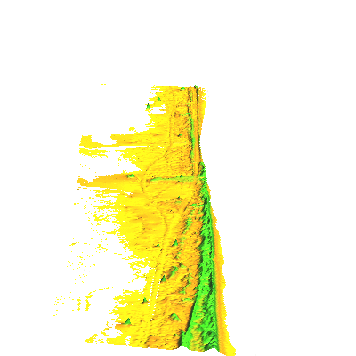

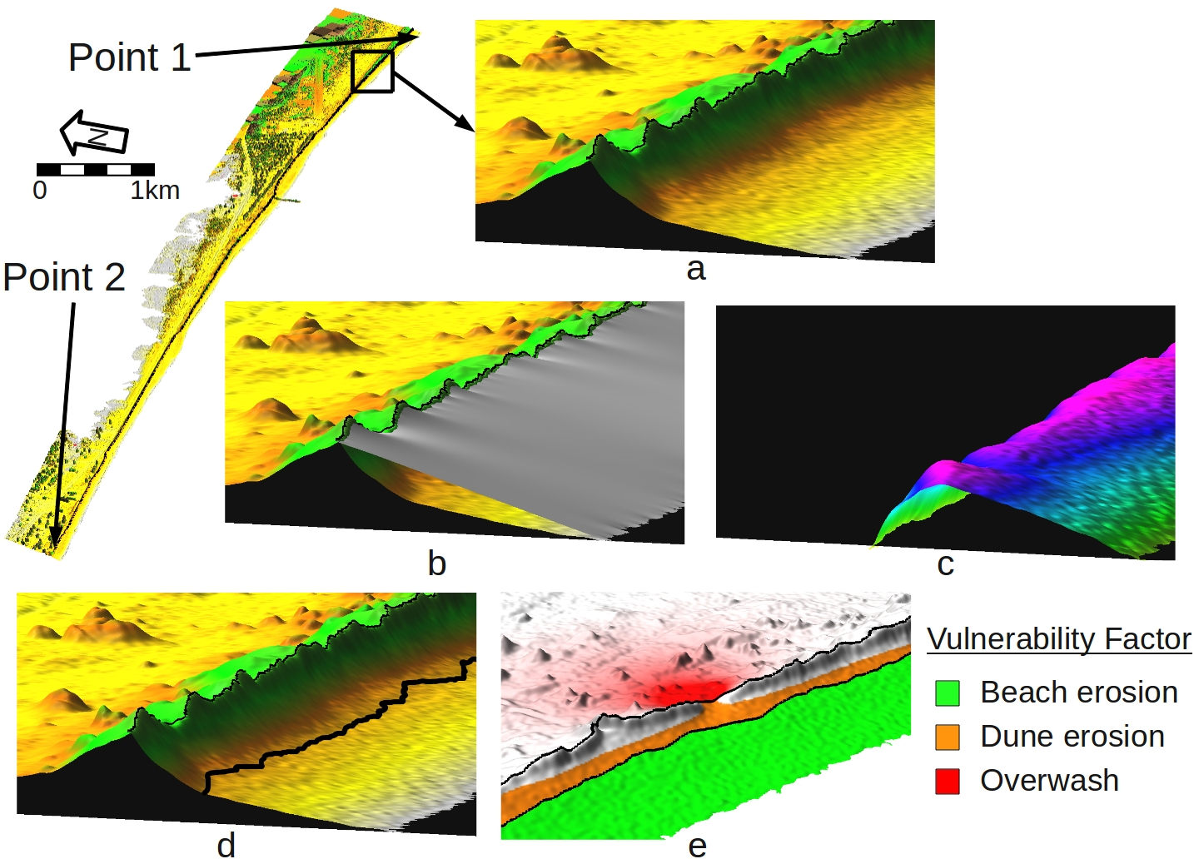
Storm Vulnerability
1km
High resolution representation

Slide 7
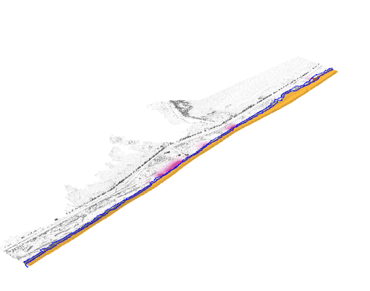
Storm Vulnerability Factor

Slide 8
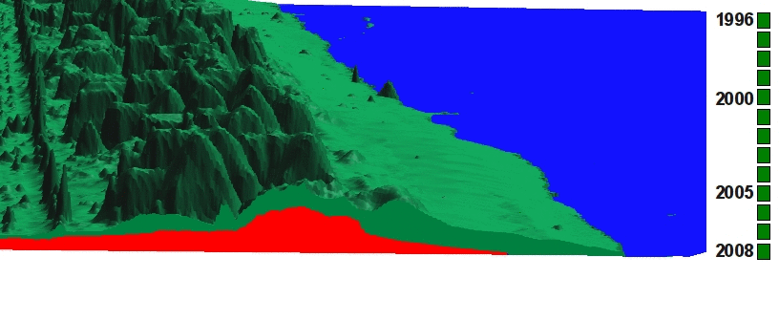
Dynamic layer for beach-foredune
Core surface: stable for a given period
Envelope surface: upper bound of terrain evolution
Actual elevation surface
1996
.
.
.
.
2008

Slide 9
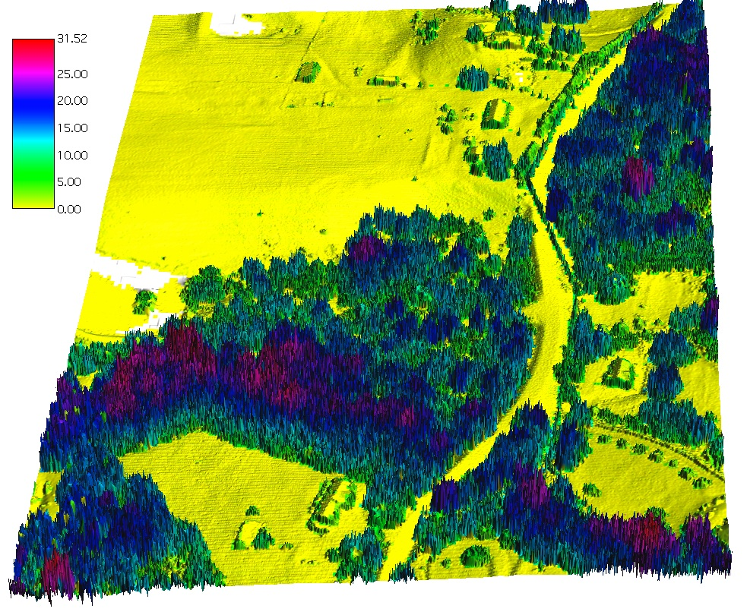
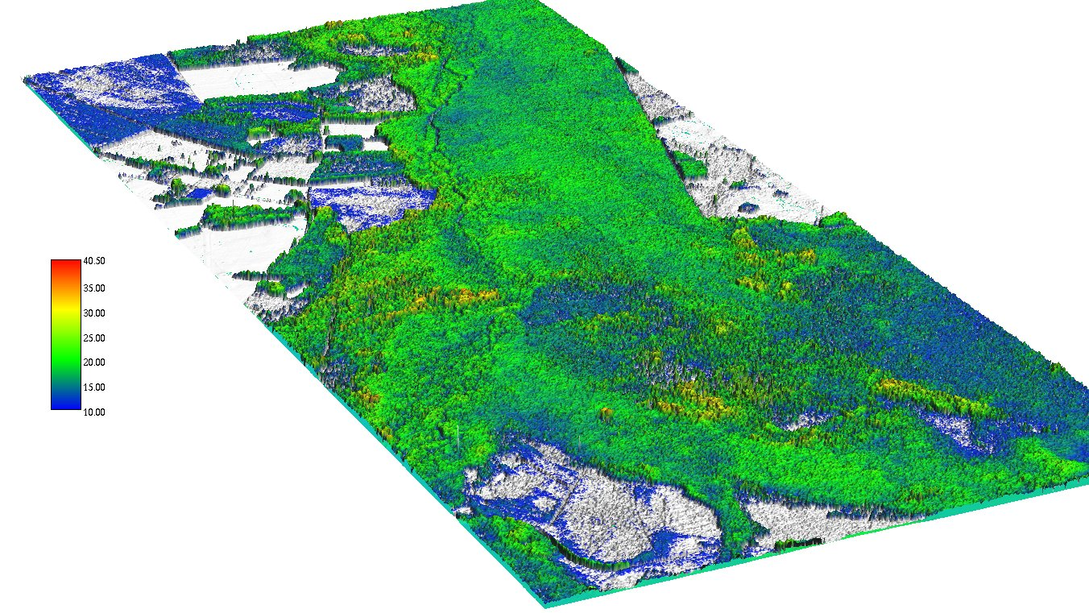
Canopy height pattern and change
Mountain and coastal forest canopy height mapping
from lidar

Slide 10
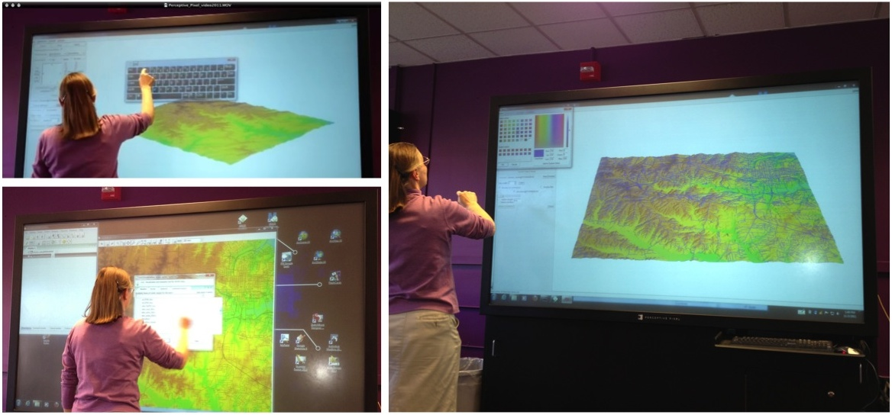
Visualization
Tangible interactive environments

Slide 11
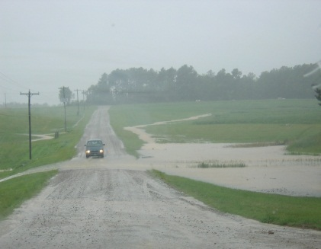
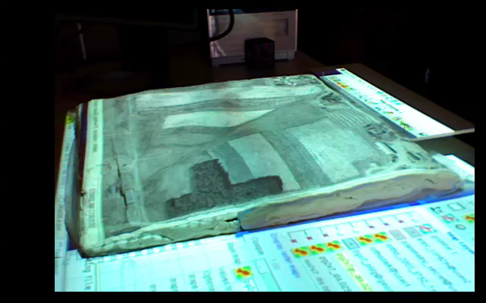
Tangible Geospatial Modeling System
http://skagit.meas.ncsu.edu/~helena/wrriwork/tangis/tg1bak2_ed4_1min640.mov
N
Notes:
11

Slide 12
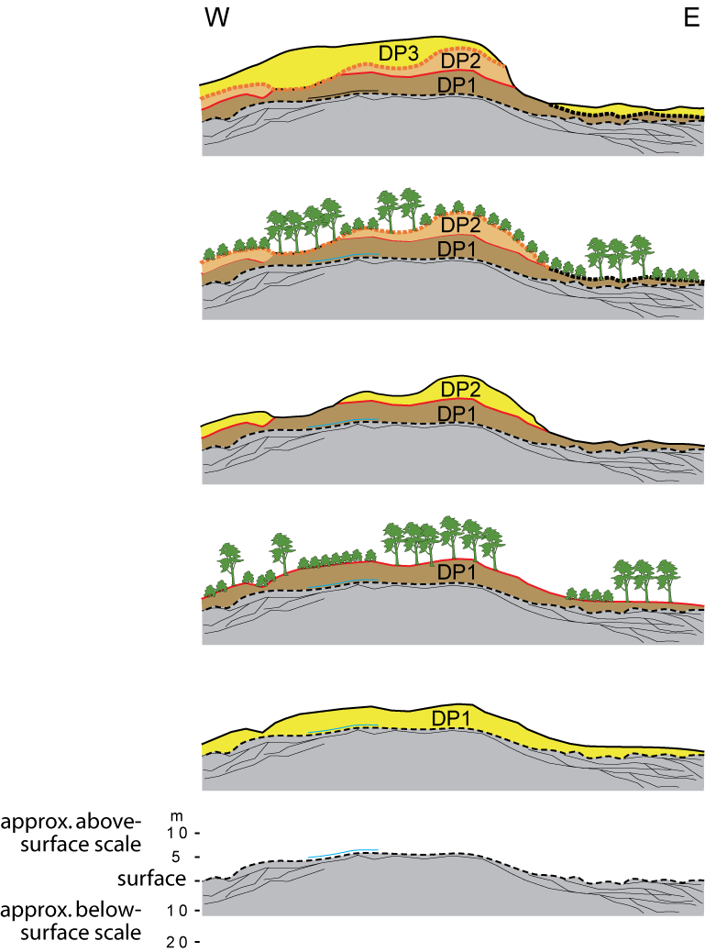
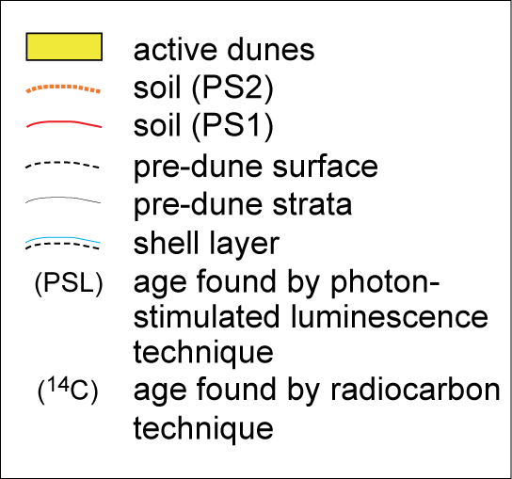
Dune evolution
Jockeys Ridge has buried soils that indicate that there have been times in the past when these dunes have been stabilized and covered with soil and vegetation. These times of stability have alternated with times when the dunes were active.
DP3: Modern dunes active by 1810 A.D. (PSL)
PS2: Stabilization, soil developed by 1700 A.D. (¹⁴C)
DP2: Dunes of phase 2, active by 1260 A.D. (PSL)
PS1: Stabilization, soil developed by 1000 A.D. (¹⁴C)
DP1: Dunes of phase 1, active by 765 A.D. (PSL)
Pre-dune barrier island
Havholm, K.G., Ames, D.V., Whittecar, G.R., Wenell, B.A., Riggs, S.R., Jol, H.M., Berger, G.W., Holmes, M.A., 2004. Stratigraphy of back-barrier coastal dunes, northern North Carolina and southern Virginia. Journal of Coastal Research 20(4), 980-999.

