Slide 1
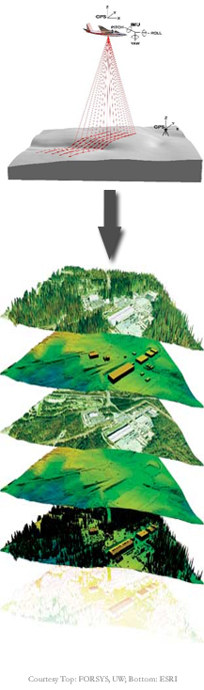

Airborne Topographic LiDAR Systems:
Michael Starek

Slide 2
Outline
Introduction
System Components / Types
Data Products
Data Artifacts and Error Sources
System Examples

Slide 3
Introduction

Slide 4
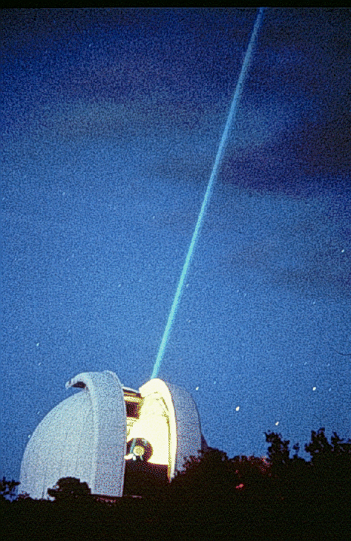
History of LiDAR Mapping
Light Detection and Ranging (LiDAR)
  Geodimeter: 1953
  Gould coins the term LASER: 1959
  Lunar laser ranging: 1960’s
  Early NASA airborne lidar prototypes: 1970’s
  Integrated GPS/IMU navigation: late 1980’s to 90’s
    gave rise to modern airborne LiDAR systems
Other names for Airborne LiDAR
  Airborne Laser Scanning (ALS)
  Airborne Laser Swath Mapping (ALSM)
  Laser Altimetry - NASA
  Laser Radar (LADAR) – military

Slide 5
Basic Principle
Pulse Ranging
Fire a laser pulse from transmitter mounted in aircraft and capture reflected energy
Measure round trip time-of-travel (T_{l} ) to determine range to target
outgoing pulse
Laser
return pulse
Receiver
Reflector
  Speed of light c ~= 3 x 10⁸ m/s → Range = T_{l} / 2 * c

Slide 6
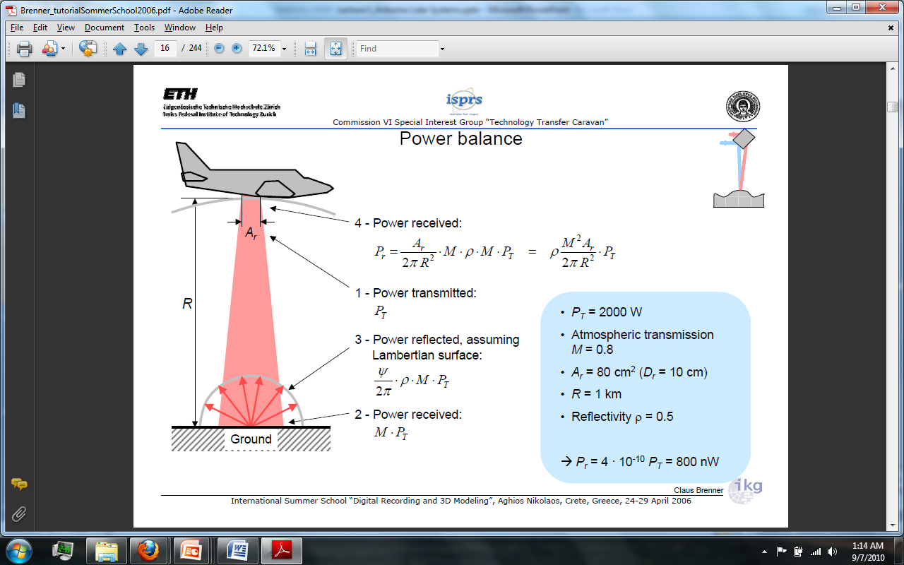
Lidar Equation
Relates transmit to received power
Post-Processing
Example
Image from International Summer School “Digital Recording and 3D Modeling”, Claus Brenner 2006.

Slide 7
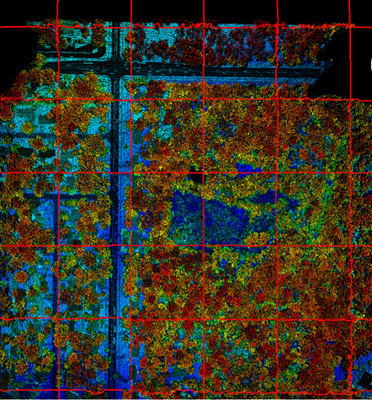
LiDAR Final Outputs
Geolocated point cloud
  Irregularly distributed x,y,z values in 3D space representing the location of reflection objects
Intensity
  Relative measure of reflection energy (watts/m²)
  *Note: Varies by system, some do not record (e.g. photon-counting LiDAR)
Point Cloud
Intensity Plot
Elevation =color
Brightness = intensity

Slide 8
Overview of Airborne Lidar Systems

Slide 9
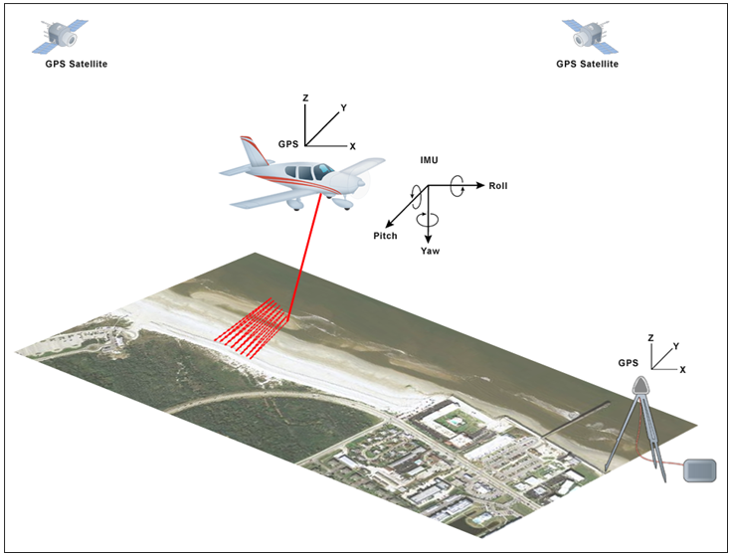
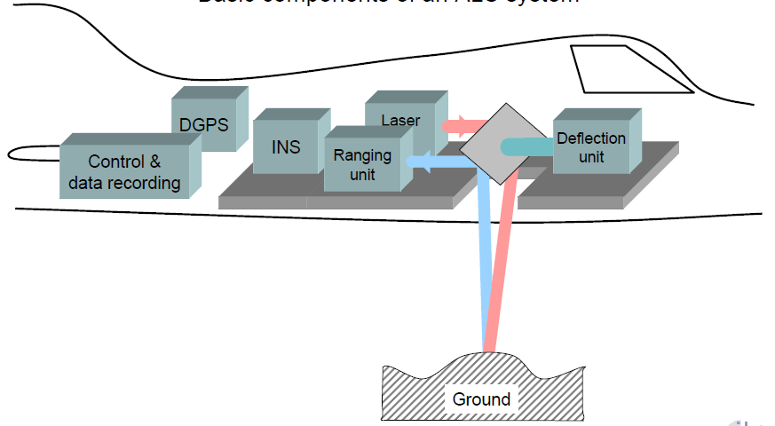
3 Main Components
Laser ranging unit laser transmitter, scanner, receiver
Position Orientation System (POS) GPS & Inertial Measurement Unit (IMU)
Control and Data Acquisition Unit
Scanner Swath
Image from Claus Brenner 2006.

Slide 10
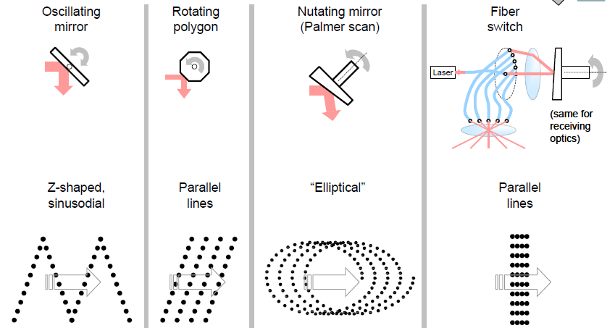
Scanning Mechanisms
e.g. NASA EAARL , Optech ALTM (most common)
e.g. IGI LM 6800
e.g. TopEye MK II
e.g. TopoSys Falcon III
Image from International Summer School “Digital Recording and 3D Modeling”, Claus Brenner 2006.

Slide 11
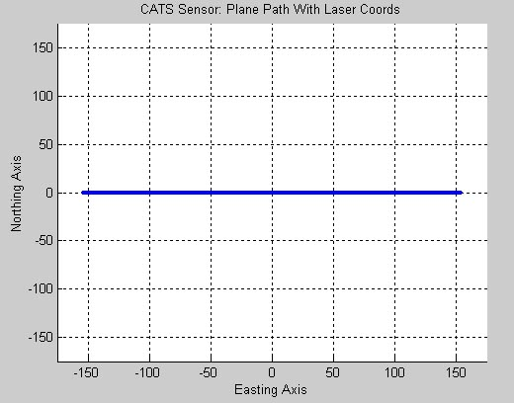
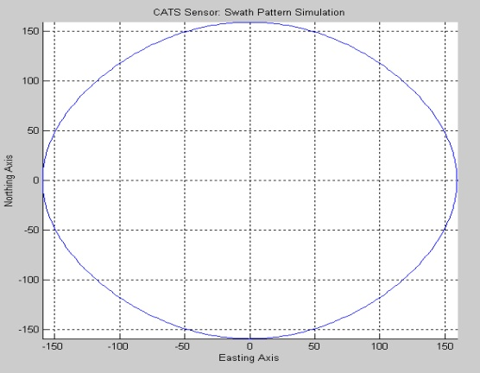
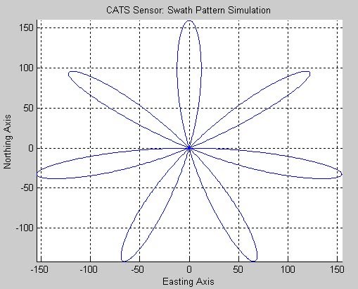
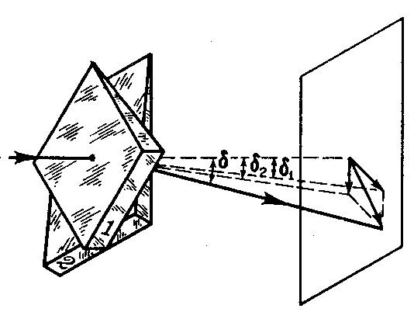
Prism Scanning
Example of Scan Patterns
Risley Prism Scanner
(index of refraction)
Can generate various scan patterns dependent on rotational prism offset.
e.g. CATS UF bathymetric system

Slide 12
LiDAR System Classification
Topographic
Bathymetric
Discrete Return
Full Waveform
Photon Counting
Small footprint
Large footprint

Slide 13
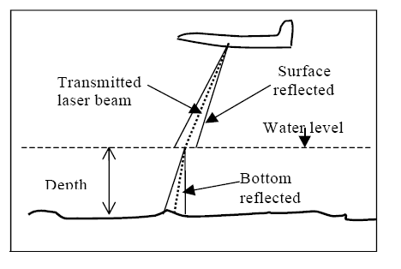
Topographic vs Bathymetric
Topographic Systems
  Typically operate in Near-IR range of EM spectrum
    Reflective over common terrain surfaces (e.g. green vegetation)
    E.g. 1064 nm λ, Nd:YAG solid-state laser
Bathymetric Systems
  Blue-green penetrates water. Near-IR is mostly absorbed.
    E.g. 532 nm λ, frequency doubled Nd:YAG laser
  Penetration upwards of 40+ m
    Depends heavily on water clarity and bottom reflectivity
Principle of bathymetric lidar showing refraction of light in water
Image from Dr, Bharat Lohani; http://home.iitk.ac.in/~blohani/LiDAR_Tutorial

Slide 14
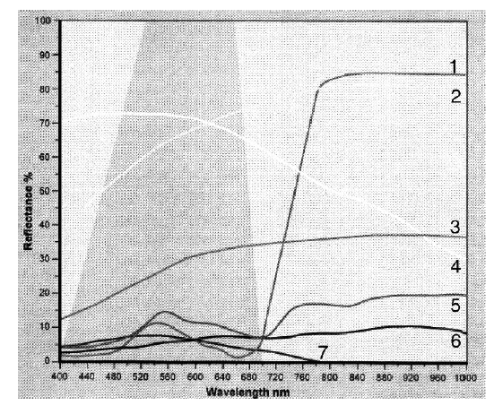
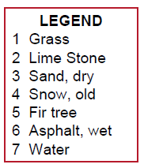
Spectral Reflectance of Various Target Types
Higher reflectivity in water for blue-green wavelength
High grass reflectivity in near-IR
Image from Optech 2007

Slide 15
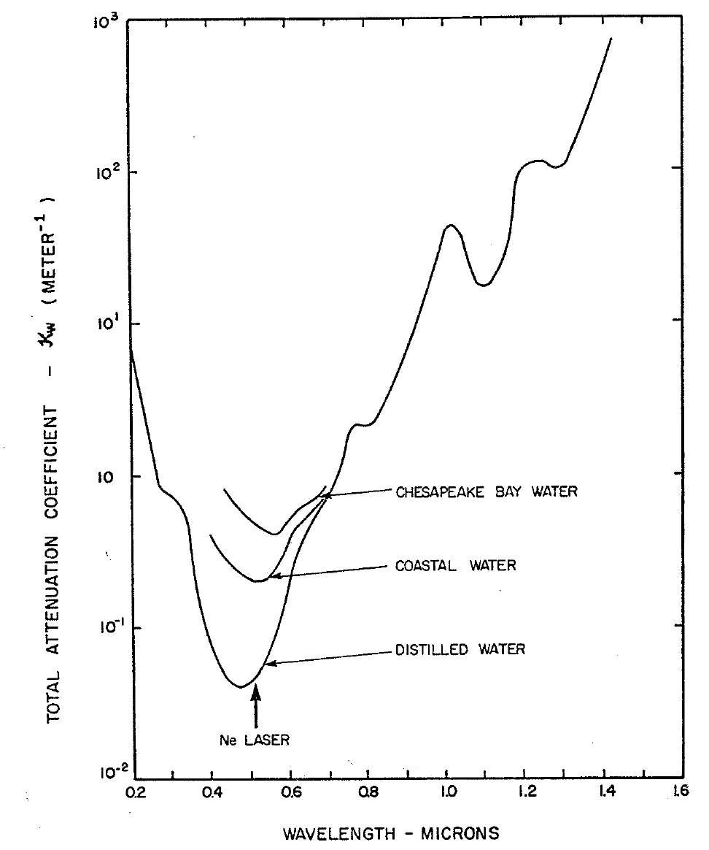
Attenuation Coefficient of Water
Less attenuation of blue-green light
Image adapted from Tyler and Preisendorfer ,1962

Slide 16
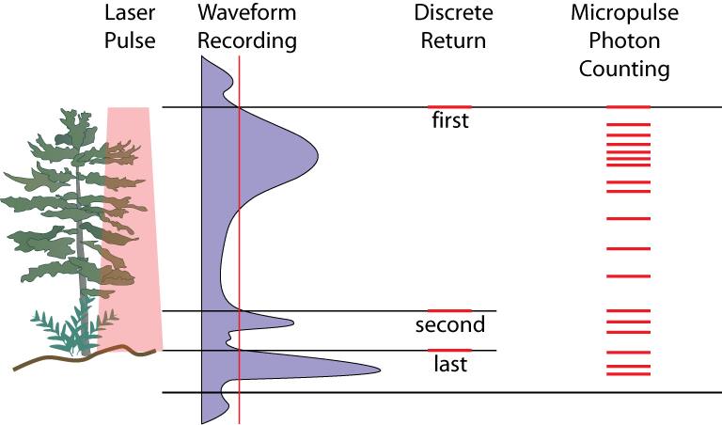
Ranging Methods
Discrete return
  Logs time when return intensity exceeds threshold
  Common for commercial systems
  Pros: Quick hardware
  Cons: no flexibility; elevation bias on short vegetation
  Waveform recording
  digitize entire return intensity profile (waveform)
  Pros: processing flexibility; canopy mapping
  Cons: info-overload potential
  Photon counting
  Records individual photons
  Pros: low power, good cloud penetration, map higher
  Cons: sensitive to ambient noise
Image from Dave Harding, NASA

Slide 17
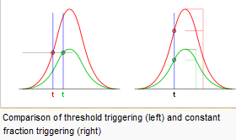
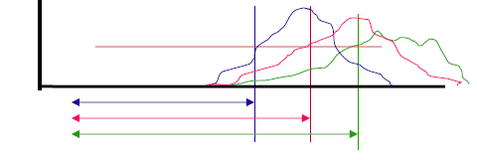
Discrete Return Detection
Constant Fraction Discriminator (CFD)
  Leading edge set as a constant fraction of return peak amplitude
    Hardware implemented
    Measured time not impacted by signal peak
    Rise time and signal convolution can cause range errors
    E.g. range walk
Return signals
T = time
Example showing CFD travel time impacted by pulse rise times -> can cause range walk

Slide 18
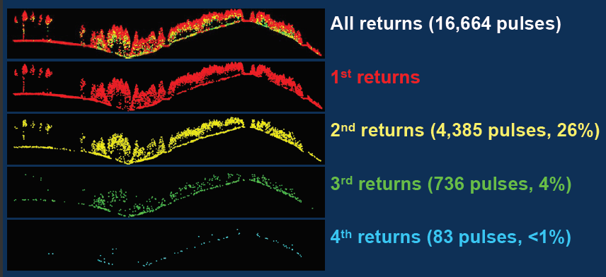
Example of discrete system with maximum of 4 returns per pulse
Image modified from USGS; Hans-Erik Anderson
Point cloud lingo
Last-returns can be 2nd, 3rd, or 4th return.
Last-returns not necessarily reflected from ground but do have higher probaility
*Pulses with only 1-return -> 1st return = Last-return

Slide 19
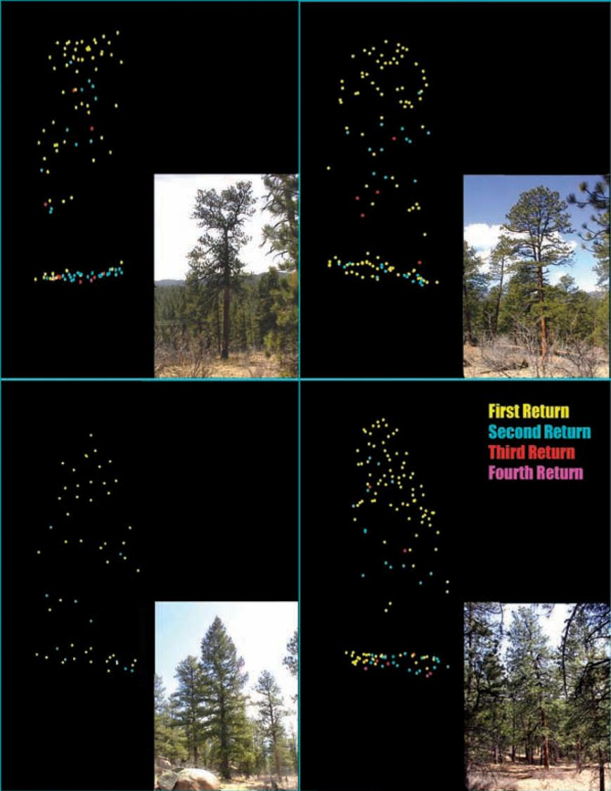
Example of Point Clouds for Different Trees
From Stoker et al., 2006

Slide 20
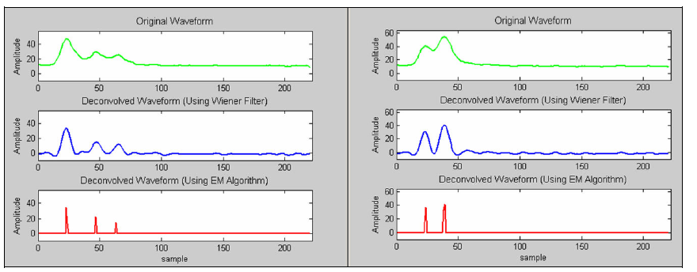
Waveform Return Detection
Allows flexible signal processing implementations on software side
Examples of two lidar waveforms (top, green) and returns detected using two different algorithms algorithm (bottom, red). Parrish and Nowak, 2009

Slide 21
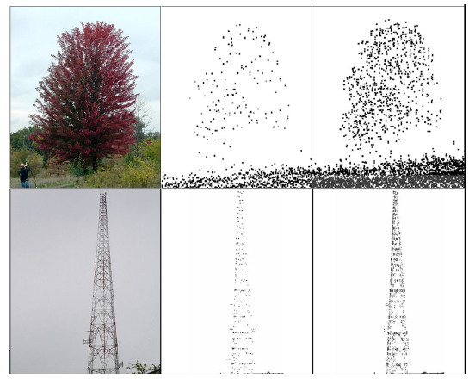
Discrete Return
Waveform
Discrete vs full waveform point clouds for two different objects shaded by intensity. Parrish and Nowak, 2009

Slide 22
Small footprint vs large footprint
Small footprint systems
  Small beam divergence
  Designed for high-res
  E.g. spot size of 15-30 cm at 600 m height
    *Type used for terrain
Large footprint systems
  Large beam divergence
  Canopy mapping
  Typical spot size > 10 m
Image from UNAVCO

Slide 23
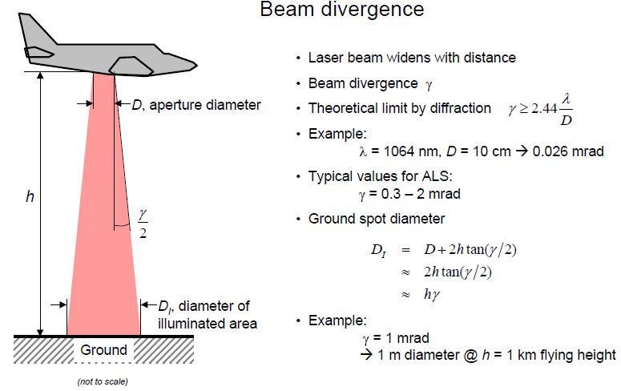
Footprint size on surface impacts positional accuracy.
Depends on Flying Height (h) and Beam Divergence ϒ
Image from International Summer School “Digital Recording and 3D Modeling”, Claus Brenner 2006.

Slide 24
Data Generation

Slide 25
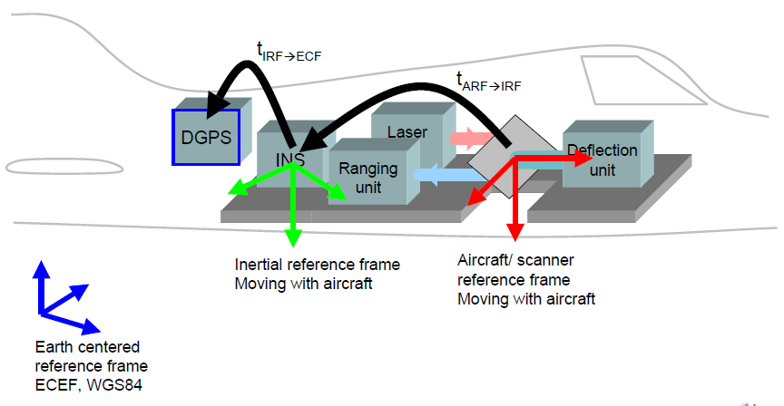
How do we get a point cloud?
LiDAR raw measurements
  Range measured for each return
  Scan angle for each pulse(angle encoder)
  Aircraft orientation (Inertial Measurement Unit)
  Aircraft position (GPS)
  Time tag (GPS)
Geolocation: combine measurements to derive points in an Earth Centered Earth Fixed frame
  GPS at its frequency (1 or 10 Hz typical)
  IMU at its frequency (e.g. 200 Hz)
  Laser at its pulse rate (e.g. 167 kHz)
  Scanner mirror at its rate (e.g. 30 Hz)

Slide 26
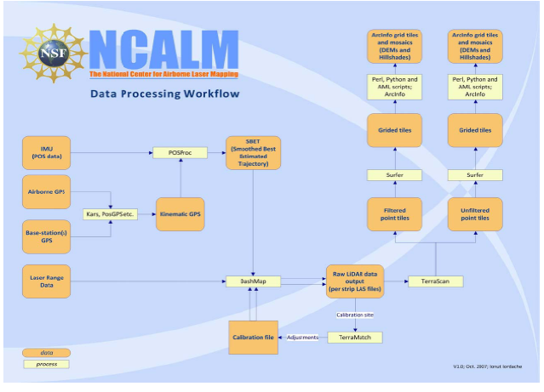

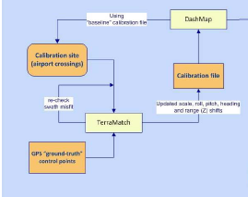
Example Processing Workflow
QA/QC Procedure
Post-Processing
Software may differ but overall process will be similar

Slide 27
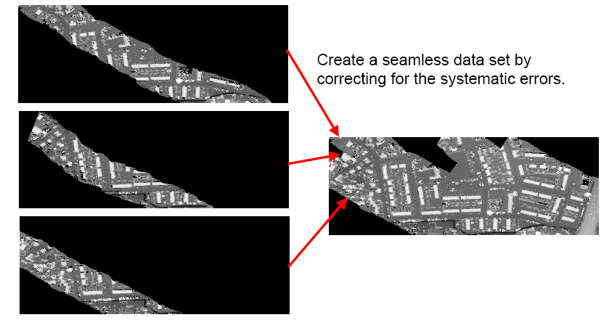
Calibration: Strip Adjustment
Different survey flight lines (strips)
Roll, pitch, scale offset, etc…
Image adapted from Vosselman

Slide 28
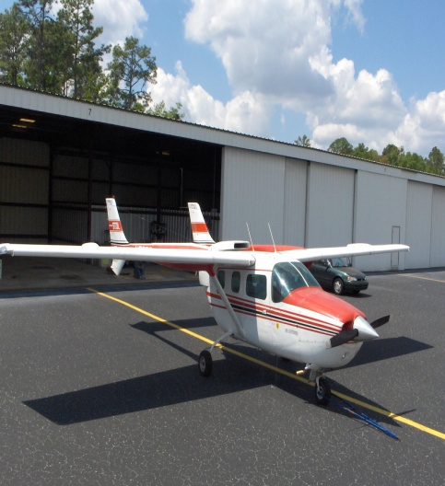
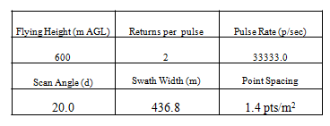
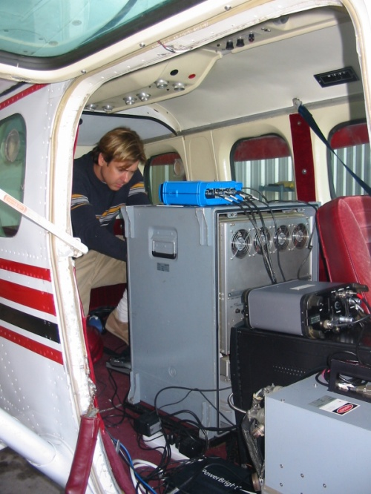
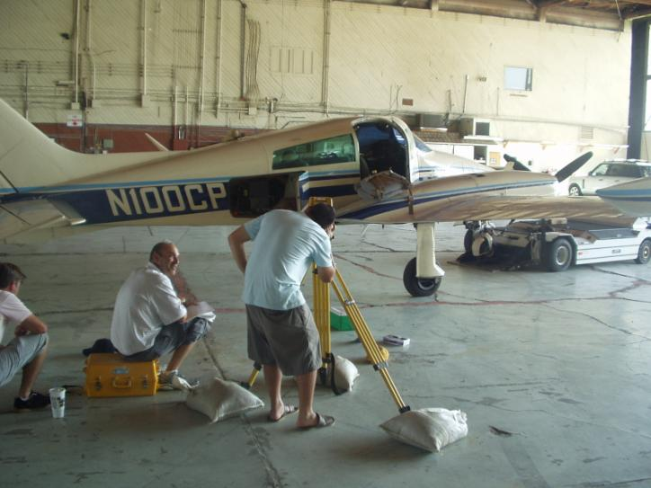
Example Survey Parameters
Optech ALTM 33kHz system (older system)
Post-Processing
Determining relative positions of GPS, sensor, IMU

Slide 29
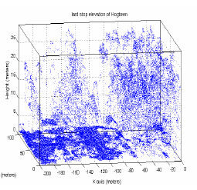
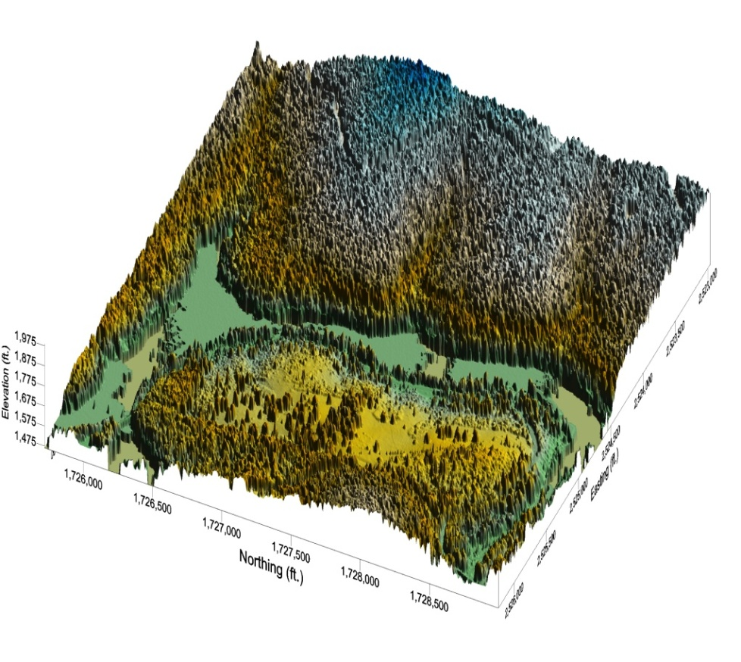
Examples of Lidar-Derived Products
Discrete Return Point cloud
Digital Surface Model (first-returns)

Slide 30
Ground Point Filtering
For many analyses, desired end-product is a digital elevation model (DEM) of the bare-earth terrain
  Desire only points from ground
  Last-returns are typically used
Filter algorithm
  tries to separate ground / non-ground points
Accuracy of resultant DEM depends heavily on filtering
  e.g. non-filtered vegetation or building points bias elevation

Slide 31
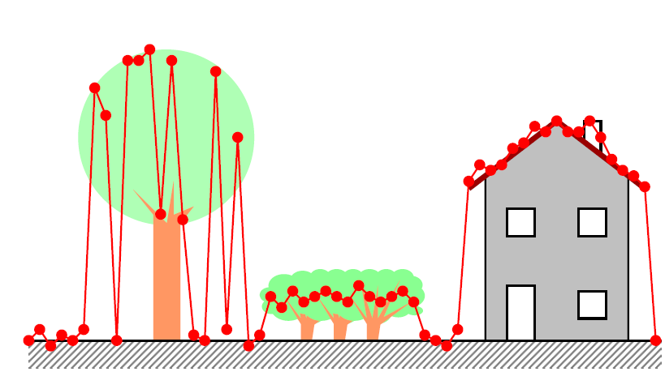
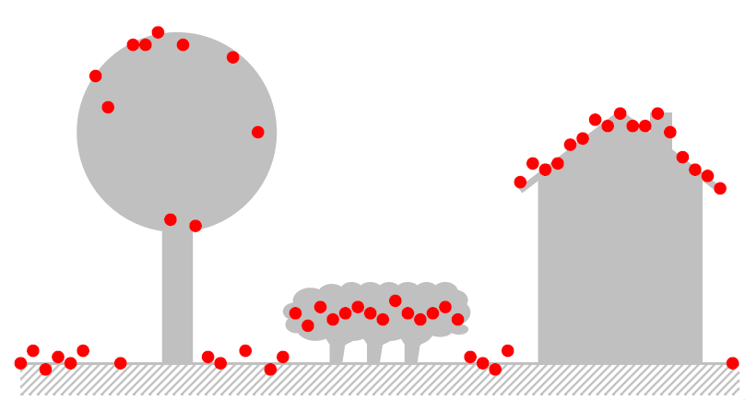
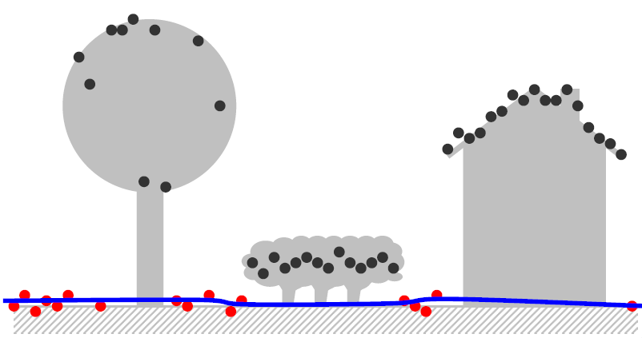
What is ground? Filter tries to determine this based on certain criteria. (e.g. local slope)
Image from International Summer School “Digital Recording and 3D Modeling”, Claus Brenner 2006.

Slide 32
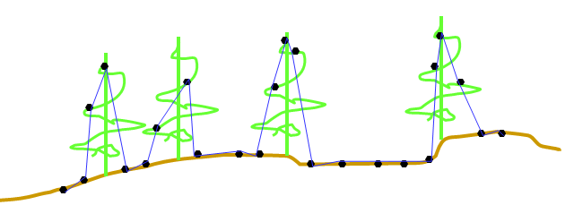
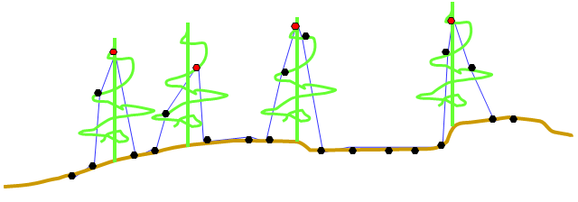
Example: TIN Densification Filter
Start with mixed, ground and canopy and build TIN
Flag points that define spikes (strong convexities)
Example from USGS Ralph Haugerud

Slide 33
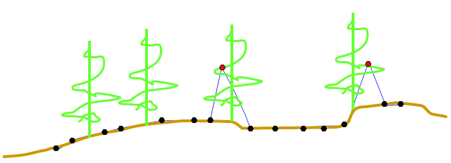
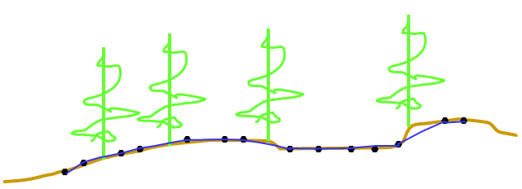
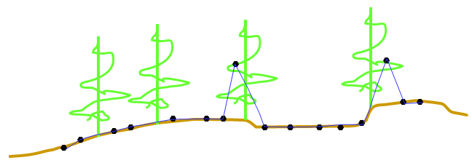
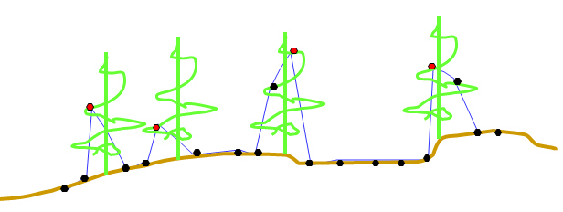
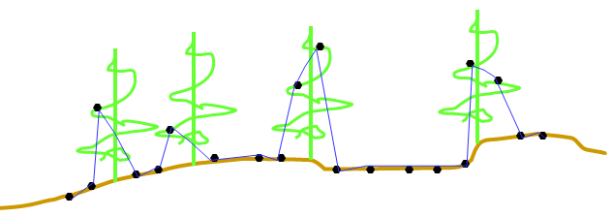
Rebuild TIN, flag points on spikes and repeat until done

Slide 34
Filter Performance
Numerous LiDAR filters have been developed
No single filter is ideal
Performance will vary with terrain
Most do well on smooth terrain
Most have issues on rough terrain & complex urban areas
Still very much an active area of ongoing research.
ISPRS Report on LiDAR filter performance:
http://www.geo.tudelft.nl/frs/isprs/filtertest

Slide 35
Difficult Ground Features for Lidar Filtering
  Shrubs, especially those below one meter (low-vegetation noise)
  Short walls along walkways
  Bridges
  Buildings with different size and shape
  Hill cut-off edges
  Complex mixed covering
  Areas combined with low and high-relief (jagged terrain)
  [from Meng et. al 2010]

Slide 36
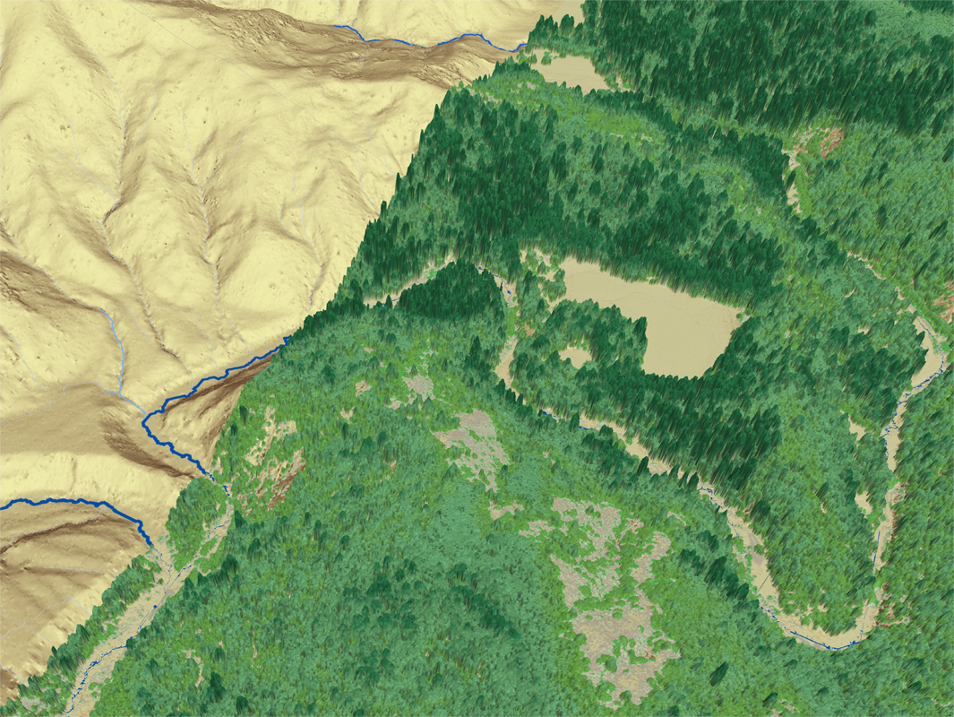
Filter to get bare-earth DEM

Slide 37
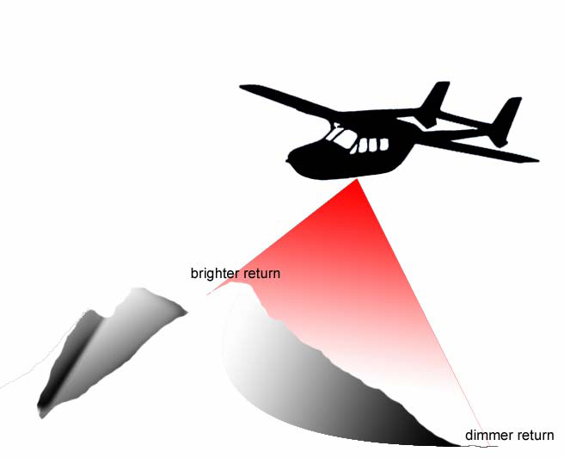
A bit more on lidar intensity
Changes in path length (R) due to elevation changes result in brighter and dimmer returns (intensities).

Slide 38
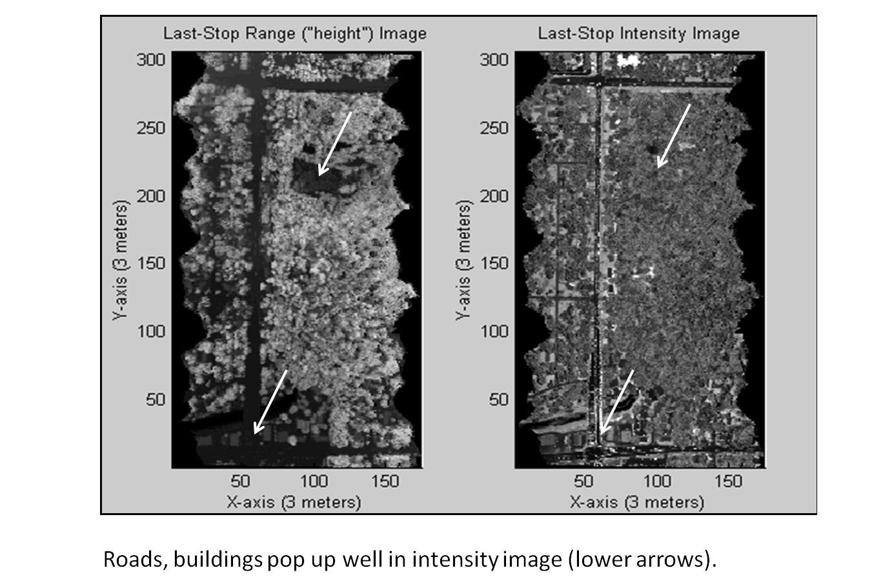
What use is intensity?
Can provide additional information about the surface
  Good for segmentation and classification algorithms
  E.g. buildings and vegetation segmentation

Slide 39
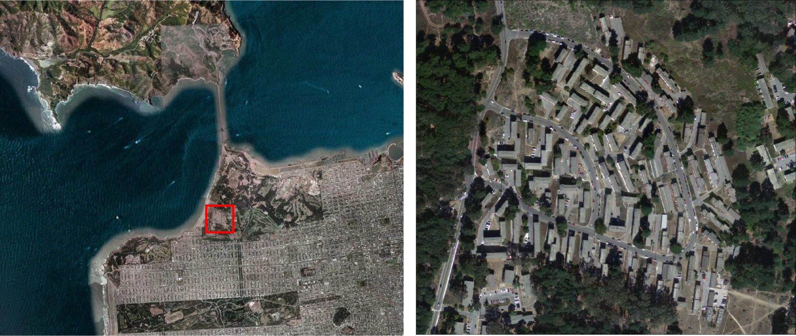
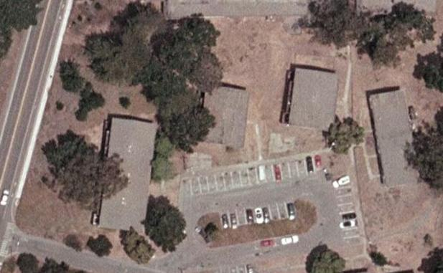
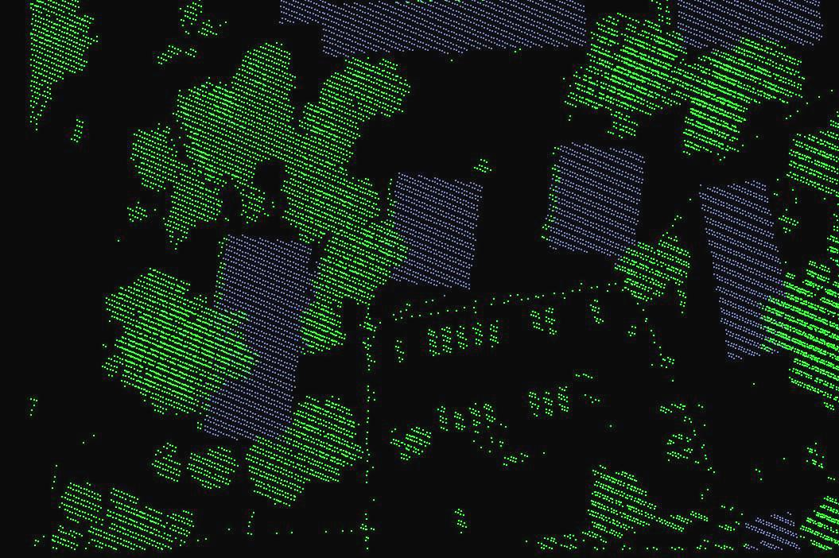
Intensity-based segmentation of Buildings and Trees

Slide 40
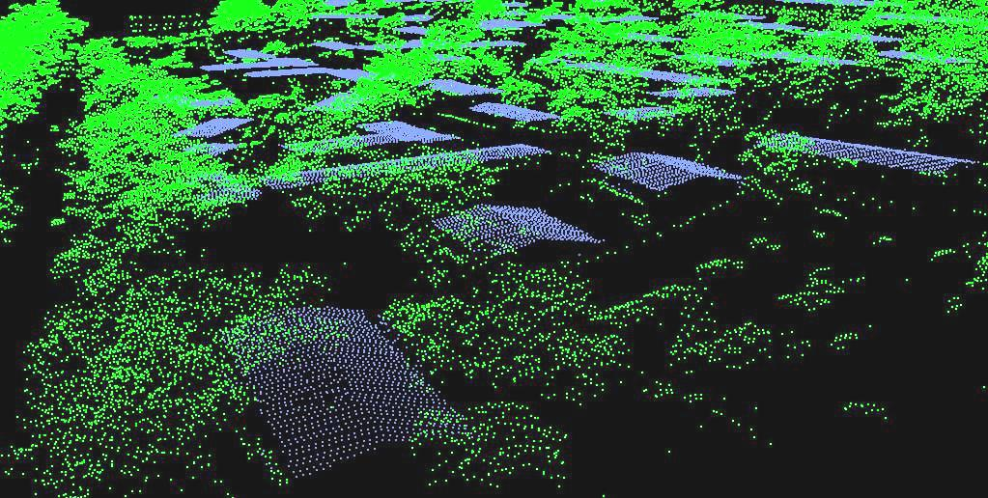
Segmentation Example (cont’d)
Notice points on walls and roofs underneath canopy correctly classified. Intensity and spin-image geometry allowed us to discriminate objects in overlapping spaces.

Slide 41
Data Artifacts & Error Sources

Slide 42


Data Density
Point spacing depends on several factors
  Pulse rate
  Scan angle
  Flying height & speed
  Beam divergence
  Surface properties
Useful relations for mirror scan
Images from Open Topography Portal and UNAVCO

Slide 43

Data Dropouts
Dark surfaces can absorb pulse (e.g. dark asphalt)
Image from Claus Brenner 2006.
Maximum range decreases dramatically for combination of steep, smooth, wet and black surface properties (rain or fog will attenuate laser pulse to ground)
*Water will still produce a measurable return at near-orthogonal incidence angle

Slide 44

Multipathing
Sensor places point here causing spurious data.
E.g. Laser pulse reflects specularly from building away from sensor to ground and then back to sensor.
Results in a lower elevation than should be measured causing an outlier.
Image courtesy of Dr, Bharat Lohani, 2010

Slide 45


Example of Corduroy Artifacts
Corduroy effect caused by mirror shift in direction at scan edge
swath misalignment
Inner swath is consistently lower than outer swath where they overlap
Color is elevation

Slide 46

Example of corduroy effect in NASA EAARL 2009 first surface Outer Banks data

Slide 47

Swath Offset in DEM

Slide 48



Range Walk (issue with discrete return systems)
Aerial photograph showing bright
paint stripes on runway
Notice elevated stripes on runway

Slide 49
LiDAR Error Budget
1. Laser ranging accuracy 1 –5 cm
2. GPS aircraft positioning error 5 –100 cm
3. Attitude IMU system error 3 –15 cm
4. Terrain type (vegetation “noise”) 1 –100 cm
5. Datum / coordinate shifts 1 –10 cm
Total Error 11 –230 cm (quoted from USGS)
“Research grade lidar” : 15-30 cm horizontal; < 10 cm vertical over flat terrain and standard flying height

Slide 50


Vertical error caused by Lidar horizontal error on steeply sloping terrain.
Vertical error increase with slope of the terrain ; Hodgson et. al, 2003

Slide 51
Comparisons of LiDAR to other measurement techniques *
 | GPS | InSAR | LiDAR | TLS
Sample Density | 1 site/10 km² | 10,000 pixels/ km² | 1-10 hits/ m² | 1000 hits/ m²
Position Precision | 1-20 mm | 2-3 m | 5-15 cm | 0.6-5 cm
Change Detection | 1 mm | 1-2 cm | 10 cm | 1 cm
Scale | Global | 100 km | 10-100 Km | 1 km
* Ball park numbers for typical applications from UNAVCO

Slide 52
System Examples

Slide 53



Optech ALTM Gemini
- near-IR (1064 nm) laser
- up to 167 kHz pulse repetition frequency
- Discrete return: up to 4 per pulse
Max flying height of ~4500 m above ground at lowest pulse repetition frequency
Gemini system mounted in aircraft

Slide 54


Dense Gemini data collected over UC Berkley stadium by NCALM. At 167 kHz Can get > 10 pts/m²
Northern California (from GeoEarthScope)

Slide 55

SHOALS-3000 Bathymetric Lidar
SHOALS laser generates Near-IR and Blue Green
Infrared pulse reflects from water surface
Blue-green penetrates water & reflects off bottom
Return blue-waveform compared to IR to determine water depth
Specs:
Max Depth 60 m
*depends on water clarity
- 20 kHz topo-laser
- 3 kHz bathy-laser
- 200 to 400 m nominal fly height
Developed by Optech Inc. USACE coastal charting group uses this system

Slide 56



Borrow Pits
SHOALS bathymetry data collected by UASCE along Panama City Beach FL
Data drop-outs in shallow surf zone

Slide 57


NASA/USGS EAARL
532 nm Bathymetric LiDAR system, 10 kHz pulse rate
Short laser pulse
Narrowed receiver field-of-view (FOV)
Full waveform digitizer
Real-time signal processing software to extract returns
Short pulse helps detect terrain under short vegetation and shallow water.
EAARL Nominal Specs. (from USGS 2010)

Slide 58

Mosaic of 2001-2002 & 2006 Florida Keys
EAARL Submerged Topography (from NASA)

Slide 59

EAARL 2009 first surface data of Ocracoke Island on Outer Banks

Slide 60

Coastal Area Tactical-mapping System (CATS)
Photon-counting system
  Operates at blue-green light (532 nm)
    water penetration
  Multi-channel
  Uses two rotating prisms instead of mirror to scan
  Designed for target detection in shallow surf zone (< 5 m)
  UF system developed for Office of Naval Research

Slide 61


CATS Multi-Channel

Slide 62




CATS water penetration test
Kris Shrestha

Slide 63
Thank you!
Any Questions?

Slide 64

Gaussian Shaped Laser Pulse
T_{l}
Signal Amplitude
T₀ pulse
Ideal return pulse
Time t
Leading edge of pulse
Typical Characteristics
t_{rise} = pulse rise time
t_{p} = pulse width; 10 ns (→ 3 m @ speed of light)
P_{peak} = 2000 Watts
*Separation of two returns depends on pulse width and receiver response

