Slide 1
From particles and point clouds to Voxel Models: High Resolution Modeling of Dynamic Landscapes in Open Source GIS
Helena Mitasova, Eric Hardin,
North Carolina State University, Raleigh, NC, USA
Anna Kratochvilova, Martin Landa
Czech Technical University, Prague, Czech Republic
GRASS GIS

Slide 2
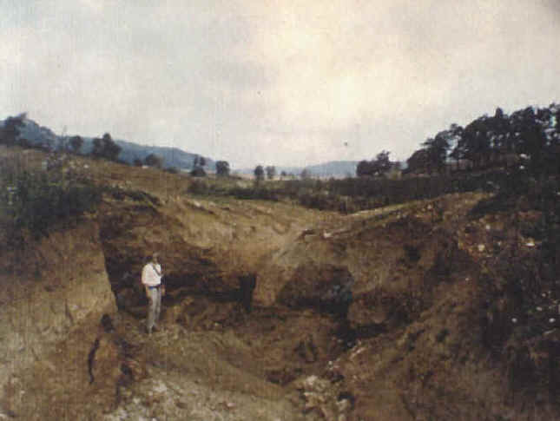
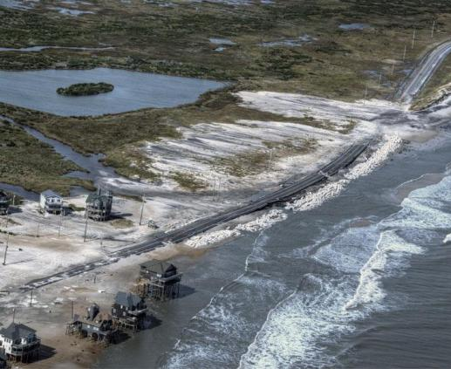
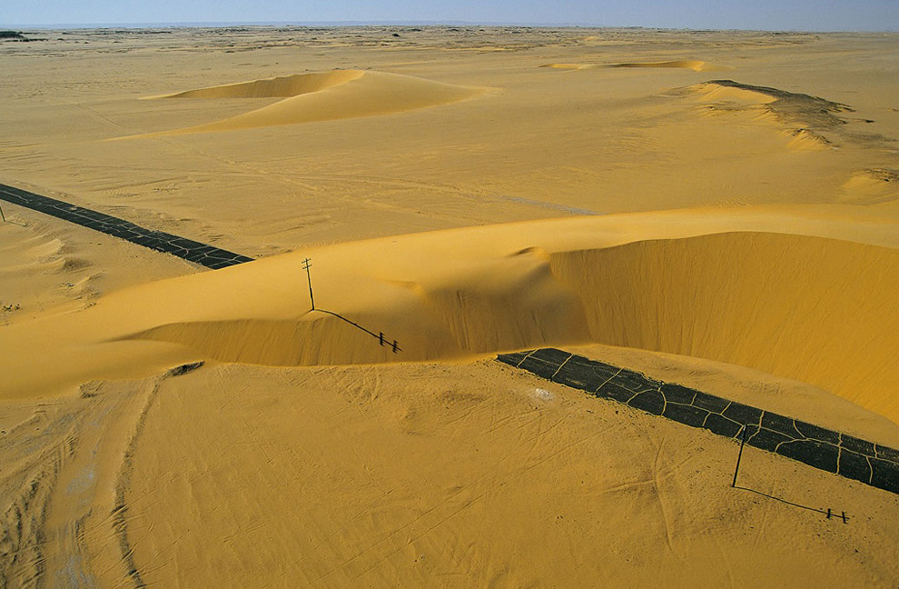
Landscape Dynamics
Water, wind, gravitation, plants, animals and humans continuously change landscape surface
Land surface processes are poorly understood and our predictive capabilities are limited
Management decisions are often based on insufficient information
Motivation for monitoring, analysis and predictive modeling

Slide 3
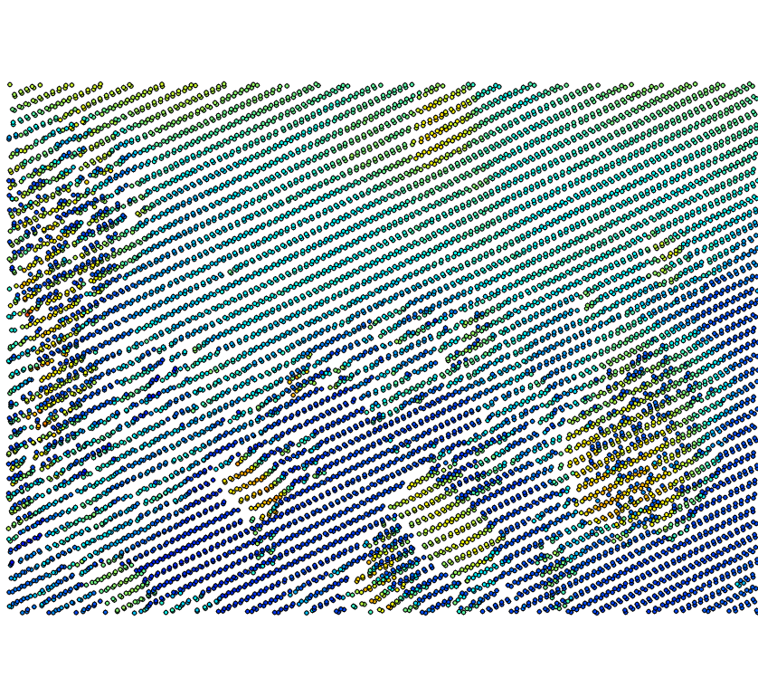
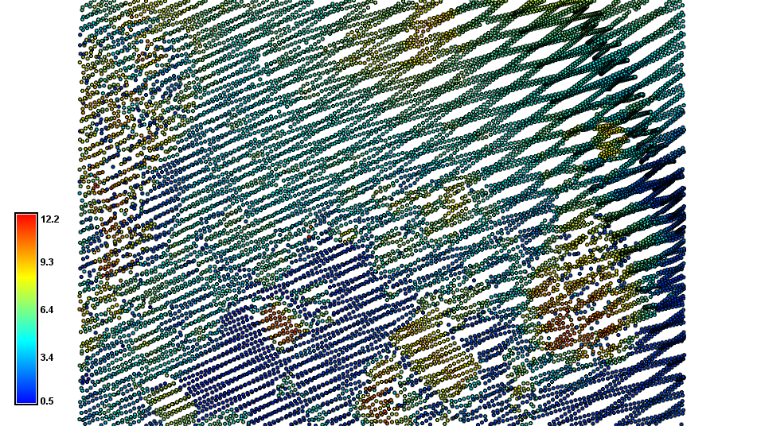
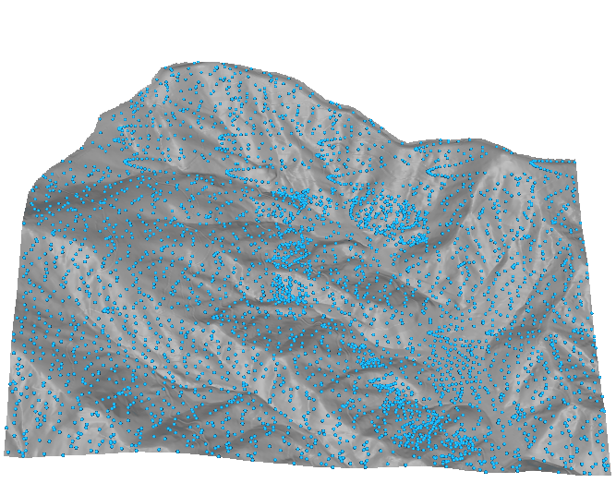
Point clouds and particles
Discrete representation of dynamic surfaces and processes
Monitoring:
Repeated, high density point sampling of landscape surfaces > lidar
Analysis of terrain evolution
Modeling
Simulation of fluxes over complex surfaces > path/particle sampling methods
Prediction and simulations of alternatives

Slide 4
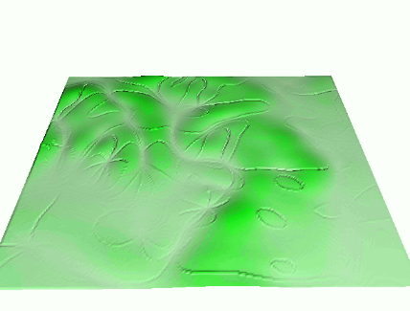
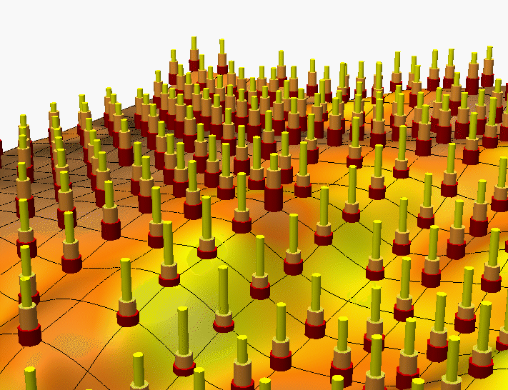
GRASS GIS for dynamic landscapes
First open source GIS with dynamic landscape support:
hydrologic and erosion simulations
Visualization
1993 Dynamic Surfaces: SG3d
some capabilities developed and lost, some became obsolete
20th anniversary:
2013 – GRASS7
new generation of tools for dynamic landscapes
Notes:
Over the past decade free and open source software (FOSS) has moved into mainstreem and its growth includes a wide range of geospatial software tools. The presentation will briefly describe the principles of FOSS and provide an overview of major FOSS projects that support management, processing, analysis, visualization and on-line distribution of georeferenced data. Interoperability between the different tools enabled by the FOSS concept will be highlighted using examples of applications that combine software developed by several projects, such as GRASS, Mapserver, GDAL, PROJ, R-stats, PostGIS, paraview and others. Special focus will be given to the recent new developments in Geographic Resources Analysis Support System (GRASS, http://grass.itc.it). Since its original design as a land management tool for military installationsthe system has evolved into one of the most comprehensive, general purpose GIS and support for environmental modeling has been an integral part of its development. Overview of the GRASS6 capabilities relevant to environmental modeling will be provided, including tools for working with 2D and 3D raster data, the completely redesigned topological 2D/3D vector engine, vector network analysis and SQL-based attribute management. Various graphical user interfaces, such as QGIS and JAVAGRASS, that are being used with GRASS will be introduced and enhancements to 3D dynamic visualization will be presented. Environmental modeling will be illustrated by examples in the area of coastal management and sediment pollution control using the latest lidar data and new or updated GRASS6 modules. The talk will conclude with discussion of visions for the future of FOSS geospatial modeling.

Slide 5
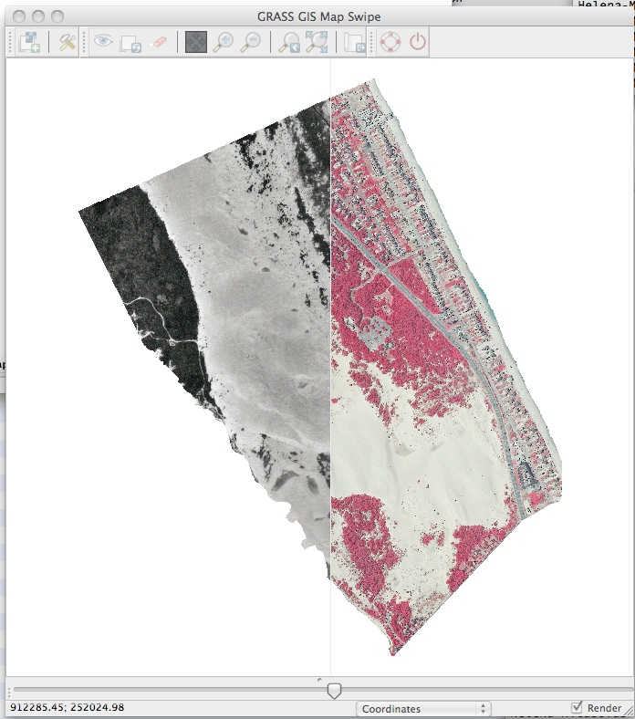
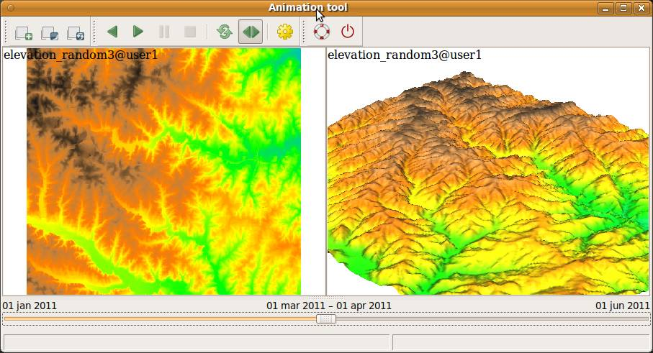
GRASS7: multitemporal data tools
New/updated visualization tools
new GUI environment: wxpython
slider
3D visualization with voxel support
animation tool
Temporal data support
developed by Soeren Gebbert (vTI)
http://www.geostat-course.org/Topic_Gebbert
Applications:
Coastal terrain dynamics

Slide 6
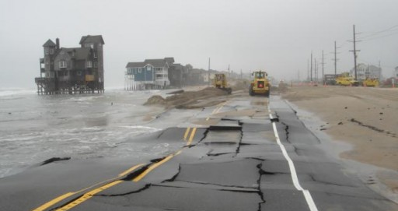
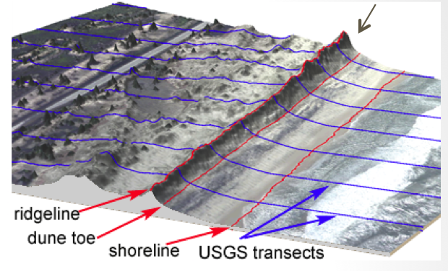
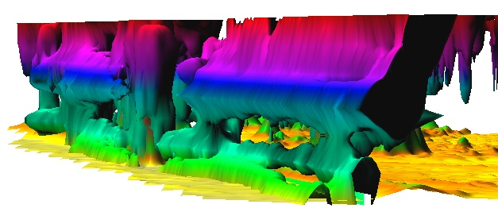
Analysis: coastal dynamics toolbox
Volume Surfaces Lines Points
Processing lidar time series: point clouds to consistent DEMs
Talk on Tuesday 11:05am 3011 Moscone West
Feature extraction: shoreline, dune ridge,
Transect-based analysis: feature migration, volume change mapping
Raster-based analysis: core, envelope, rate of change
Derived metrics: storm vulnerability
Inundation analysis: flooding extent
Space-Time voxel model
Notes:
Over the past decade free and open source software (FOSS) has moved into mainstreem and its growth includes a wide range of geospatial software tools. The presentation will briefly describe the principles of FOSS and provide an overview of major FOSS projects that support management, processing, analysis, visualization and on-line distribution of georeferenced data. Interoperability between the different tools enabled by the FOSS concept will be highlighted using examples of applications that combine software developed by several projects, such as GRASS, Mapserver, GDAL, PROJ, R-stats, PostGIS, paraview and others. Special focus will be given to the recent new developments in Geographic Resources Analysis Support System (GRASS, http://grass.itc.it). Since its original design as a land management tool for military installationsthe system has evolved into one of the most comprehensive, general purpose GIS and support for environmental modeling has been an integral part of its development. Overview of the GRASS6 capabilities relevant to environmental modeling will be provided, including tools for working with 2D and 3D raster data, the completely redesigned topological 2D/3D vector engine, vector network analysis and SQL-based attribute management. Various graphical user interfaces, such as QGIS and JAVAGRASS, that are being used with GRASS will be introduced and enhancements to 3D dynamic visualization will be presented. Environmental modeling will be illustrated by examples in the area of coastal management and sediment pollution control using the latest lidar data and new or updated GRASS6 modules. The talk will conclude with discussion of visions for the future of FOSS geospatial modeling.

Slide 7
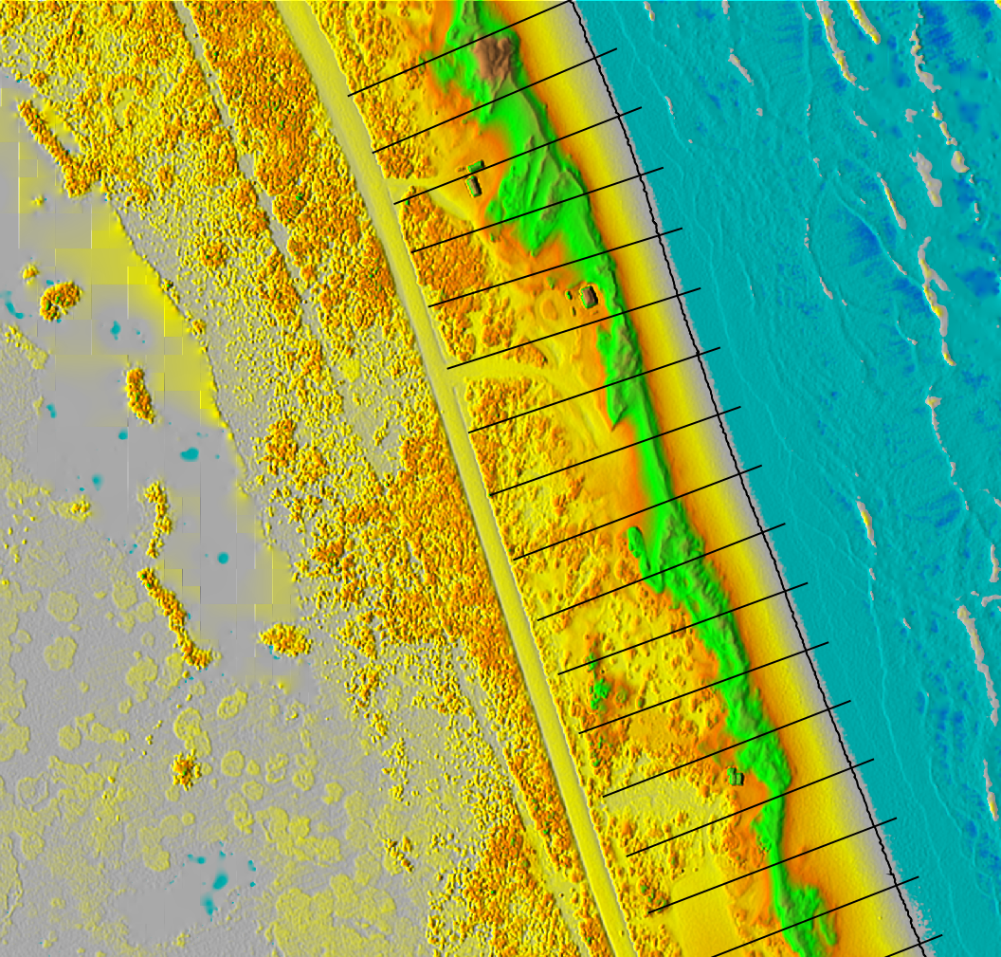
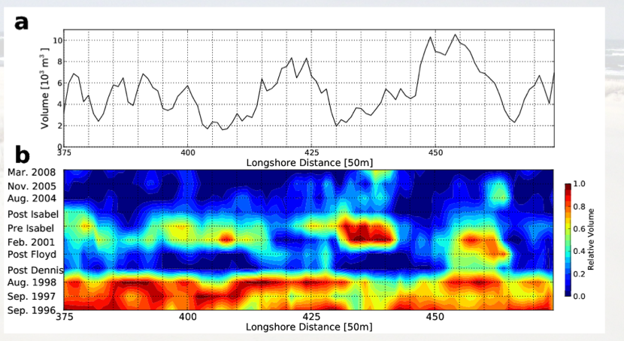
Transect-based analysis
[m]
Profile and volume evolution:
v.transects add-on
15.0
7.5
0.0
500m

Slide 8
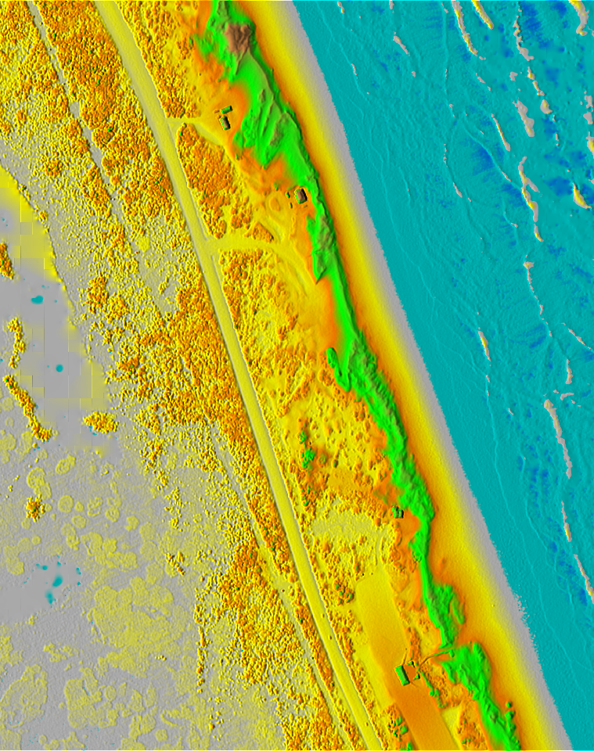
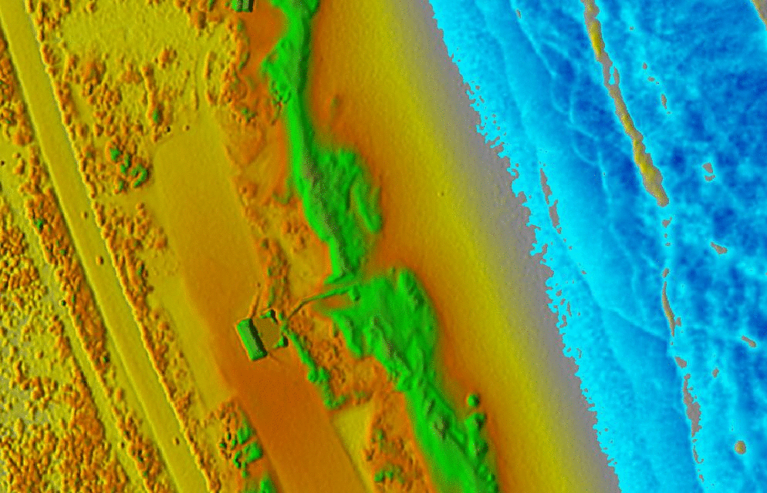
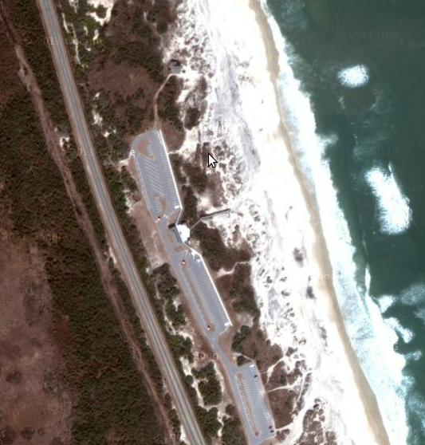
Inundation impact analysis
Input: storm surge water levels from external model,
Result: local flooding extent at 0.5m resolution using r.lake
500m
[m]
15.0
7.5
[m]
4.0
0.0
2.0
1.0
0.0
Water level increasing to 4.4m NAVD88

Slide 9
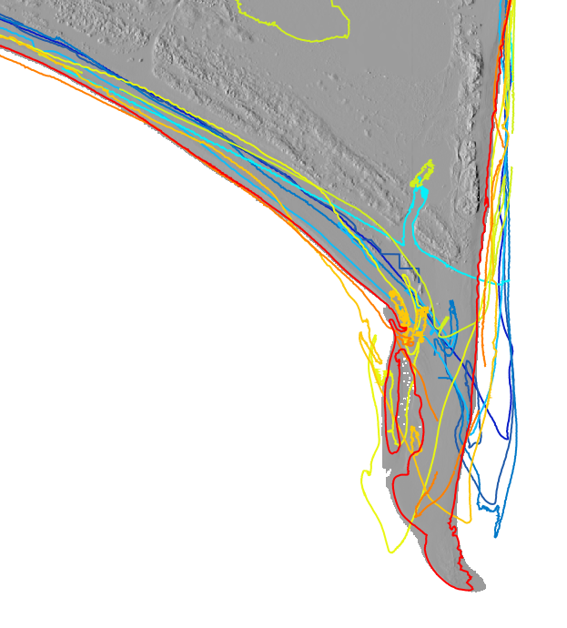
Shoreline evolution: contours
Cape Hatteras dynamics: shorelines 1997 - 2011
2011
2009
2008
2005
2004
2003
2001
1999
1997
shorelines extracted as
0.5m elevation contours
from lidar-based DEMs
200m
Cape Hatteras 1997-2011

Slide 10
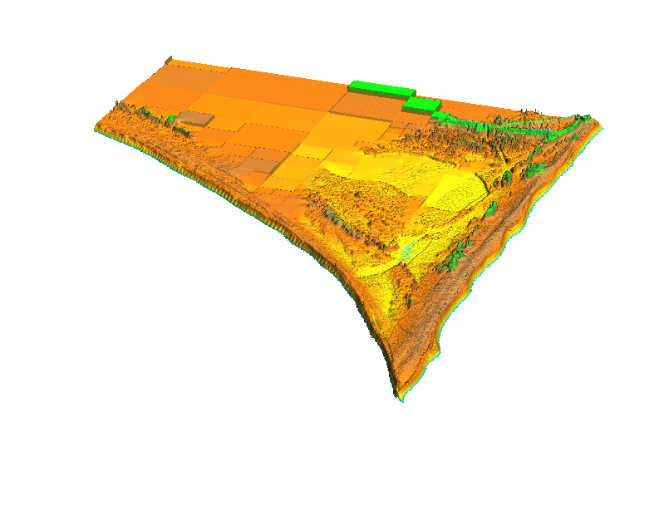
Shoreline evolution: animation
Cape Hatteras dynamics: DEM series animation 1997 - 2011
2011
2009
2008
2005
2004
2003
2001
1999
1997
200m
Cape Hatteras 1997-2011

Slide 11
Shoreline evolution from voxel model
Cape Hatteras: shoreline evolution as 0.5m isosurface
2011
2009
2008
2005
2004
2003
2003
2001
1999
DEMs are stacked
into voxel model
200m
Cape Hatteras 1997-2011

Slide 12
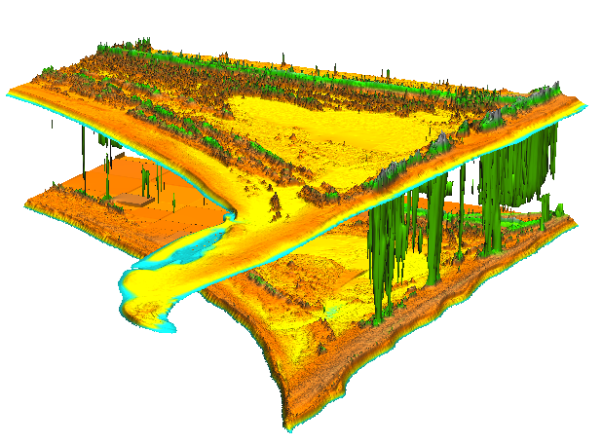
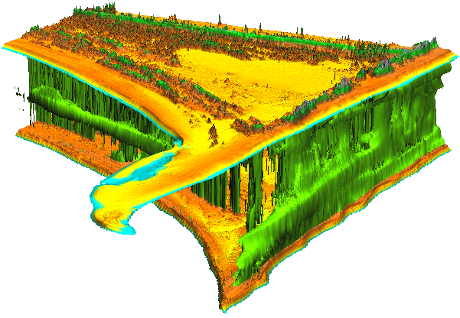
Dune evolution from voxel model
Evolution of contours along dune ridge and dune base
2011
2009
2008
2005
2004
2003
2001
1999
1997
Elevation isosurfaces: 4.5m 2.5m
200m
Cape Hatteras 1997-2011

Slide 13
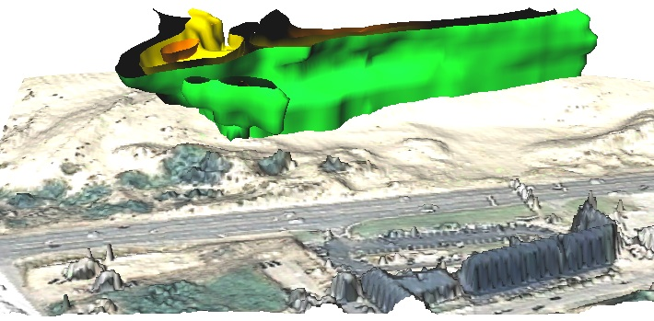
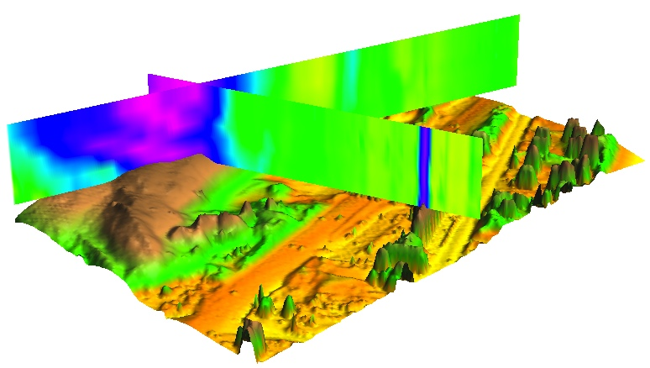
Point cloud to voxel model
t_{n}
Gaps in data:
Time series of (x,y,z) point clouds
directly to voxel model:
re-order (x,y,z,t) to (x,y,t,z)
interpolate voxel model
z = f(x,y,t)
where f is trivariate smoothing spline
t₂
t₁
Time
2008
2005
2001
1999
Y
X
15
7
0 m
Elevations: 10 11 12 m
Notes:
13
13
Figure 3: Representation of terrain evolution using trivariate space-time function: merged time series of point clouds is interpolated into space-time voxel model (Mitasova et al., 2011).
*Reviewer asks for a more thorough explanation of how 3D information fits into the 4d cube (3D shape)? The reviewer seems confused here as it is not a 4D cube but a 3D cube for elevation values at space time. Perhaps this figure can be modified to show that at a specific time constat for a lidar-survey you get back out your DEM for that survey. Note also this figure was used in your geomorph paper.

Slide 14
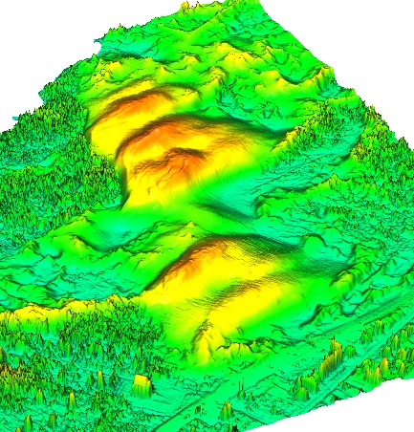
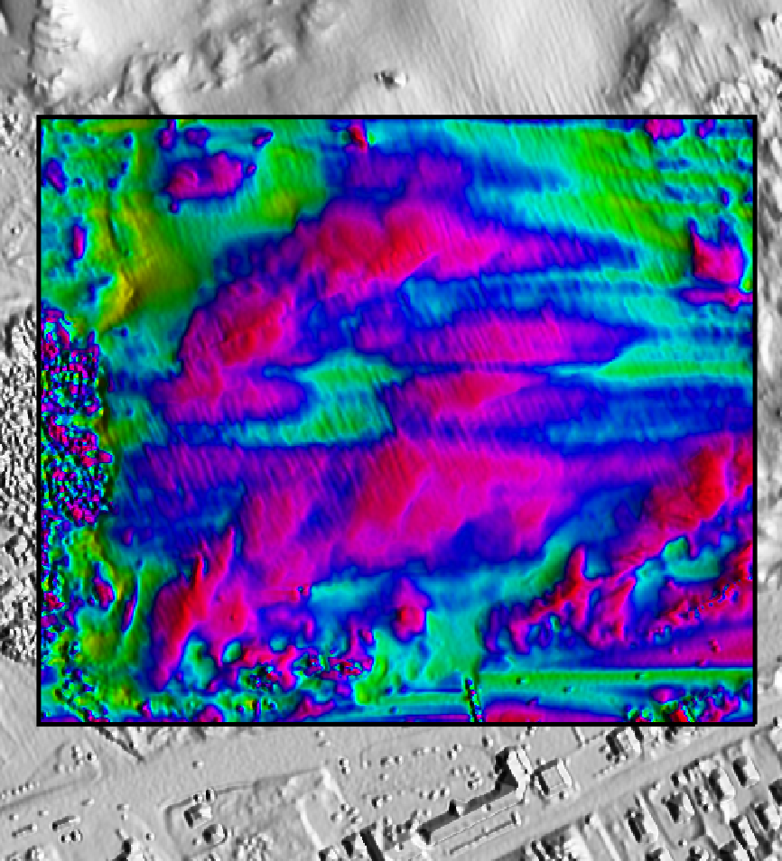
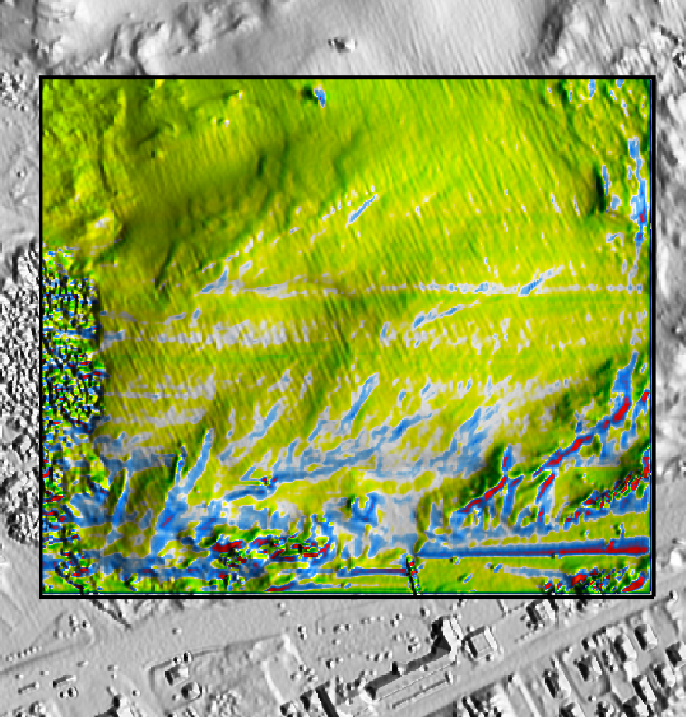
Process simulation: saltation
Wind field simulated with OpenFoam® CFD toolbox
output: surface shear stress
Sand transport:
Smoothed Particle Hydrodynamics module for GRASS
[cm/
day]
[Pa]
0.5
2.0
1.0
0.0
0.2
-1.0
0.0
-2.0
Surface Shear Stress
Rate of Elevation Change
200m

Slide 15
GE-GRASS user interface
Class project in Geospatial Modeling and Analysis
Rate of change in elevation for Jockey’s Ridge, Nags Head, NC
Steve Ansari
steve.ansari@noaa.gov

Slide 16
Conclusion
GRASS7: new tools open for analysis and modeling dynamics of coastal landscapes
Coupled with python scripts, lasTools, OpenFoam for processing point clouds and particle-based modeling
Native viewer for large point data is needed in GRASS
NCSU OSGeo Research and Education Laboratory: first North American lab in the worldwide network set up under OSGeo-ICA MOU
http://gis.ncsu.edu/osgeorel/
Funding for this research has been provided
by US Army Research Office and NC Sea grant
GRASS GIS

Slide 17
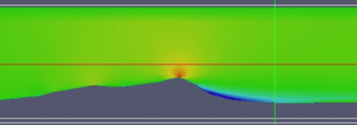
Process simulation: saltation
Smoothed Particle
Hydrodynamics
sand transport by wind
Wind shear stress:
OpenFoam,
python and GRASS
simulation on Pea island
200m
Surface Shear Stress
Rate of Elevation Change

