Slide 1
Space-Time Cube Analytics of Evolving Landforms Captured by Airborne and Terrestrial Lidar
Helena Mitasova, Eric Hardin,
Michael Starek, Blundell SB, Wegmann KW
North Carolina State University, Raleigh, NC, USA
GRASS GIS

Slide 2
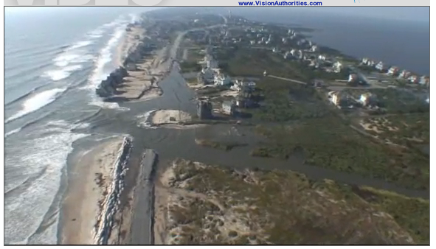
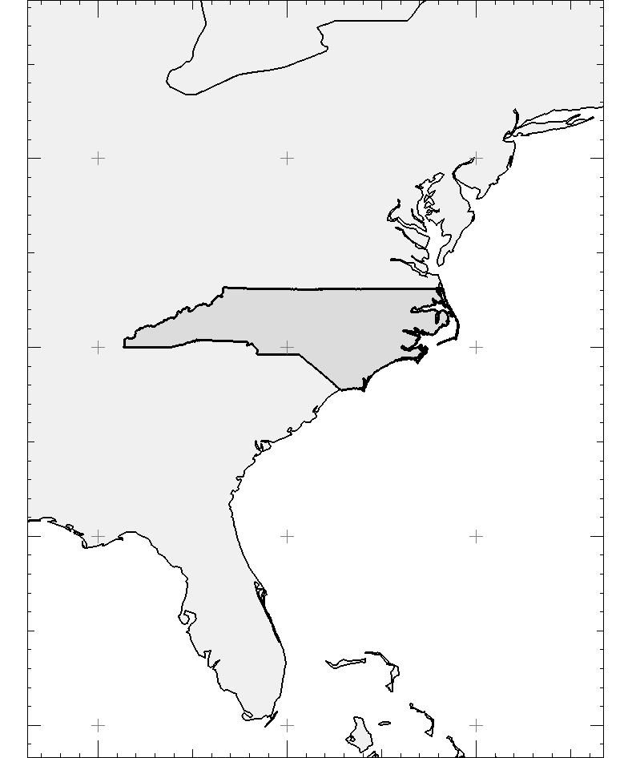
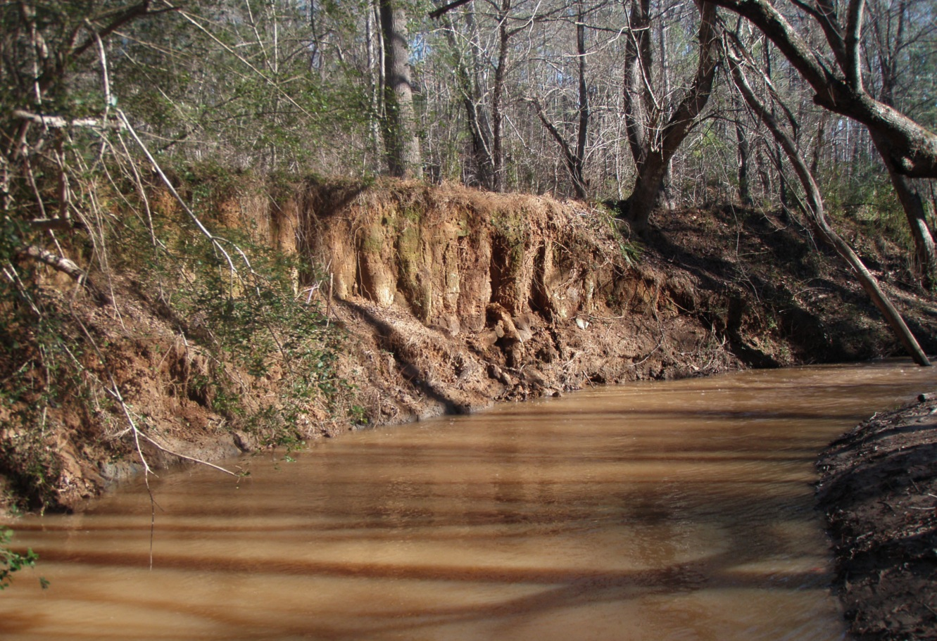
Rapidly changing landscapes
Coastal terrain dynamics mapped by airborne lidar: 1996 - 2011
Eroding stream bank mapped by terrestrial lidar
Canada
40N
35N
30N
25N
USA
North Carolina
Atlantic Ocean
75W
80W
85W
N
Notes:
cite work by others here! Add figure for all features – crests, peaks, shorelines

Slide 3
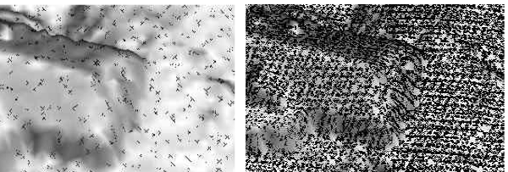
Coastal airborne lidar: 1996 - 2011
Agency Year pts/1m cell
NOAA/NASA/USGS 1996 0.1
NOAA/NASA/USGS 1997 0.3
NOAA/NASA/USGS 1998 0.2
NOAA/NASA/USGS 1999 0.4
NC Floodplain 2001 0.1
NASA/USGS 2003 0.6
USACE Topobathy 2004 4.0
USACE Topobathy 2005 1.2
NSF NCALM UoF 2006 1.0
NSF NCALM UoF 2007 1.0
NOAA 2008 1.0
USGS 2009 5.0
USACE 2010
NOAA 2011
1998
2004
100m
1m res. DEM, computed by RST, 1998 lidar data
2004 lidar, 0.3m DEM
computed by RST
point density and spatial coverage
varies for each survey

Slide 4
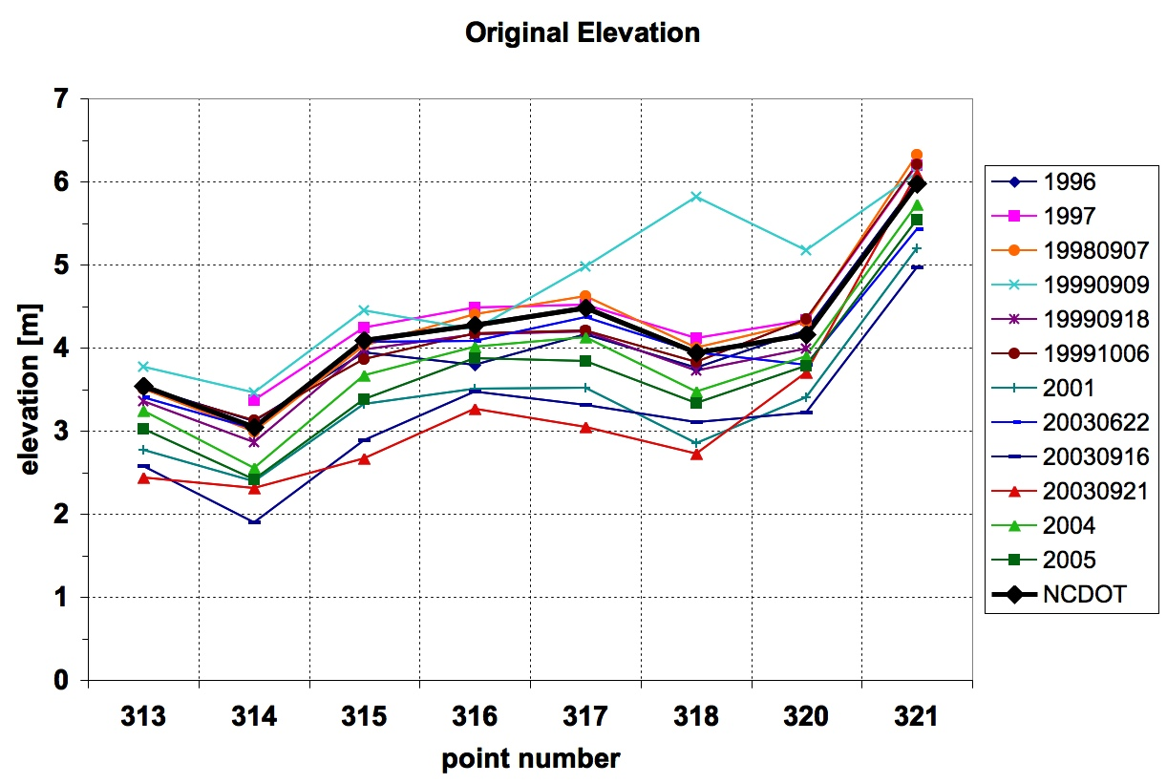
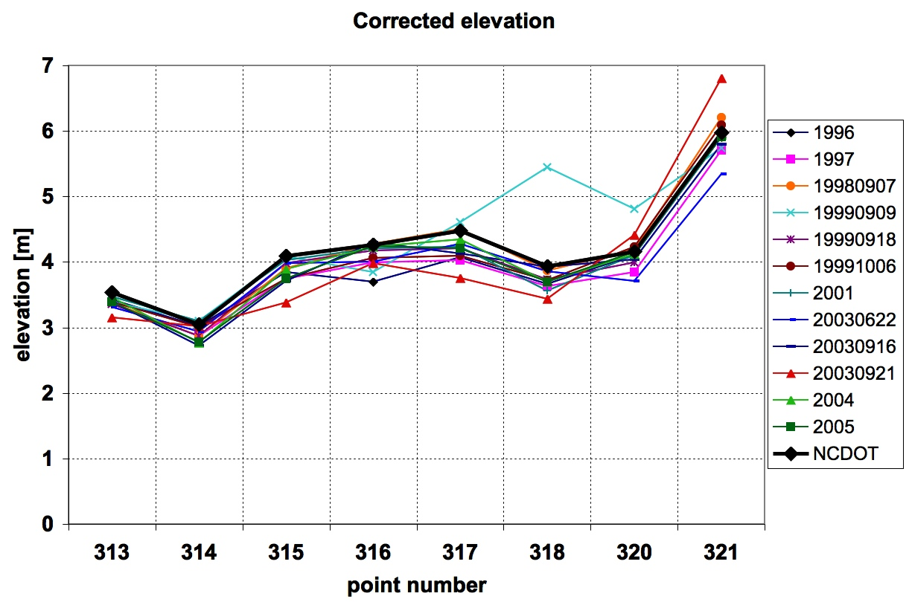
Lidar data series processing
RTKGPS
2001 Lidar 0.2m lower
Point cloud analysis
DEM interpolation by smoothing spline 0.3 - 2m resolution
Vertical shifts assessment using
RTK-GPS along road centerline
road geodetic benchmarks
max. median shift was -0.20 m
Horizontal shifts:
using home contours
Road geodetic benchmarks: limited spatial extent and density
0 road centerline RTK GPS survey 2.4km
before and after correction
Mitasova et al. 2009, JCR.
Notes:
get RTKGPS and benchmarks accuracy numbers
Benchmarks: every 100m along centerline
RTKGPS – RMSE less than 5cm

Slide 5
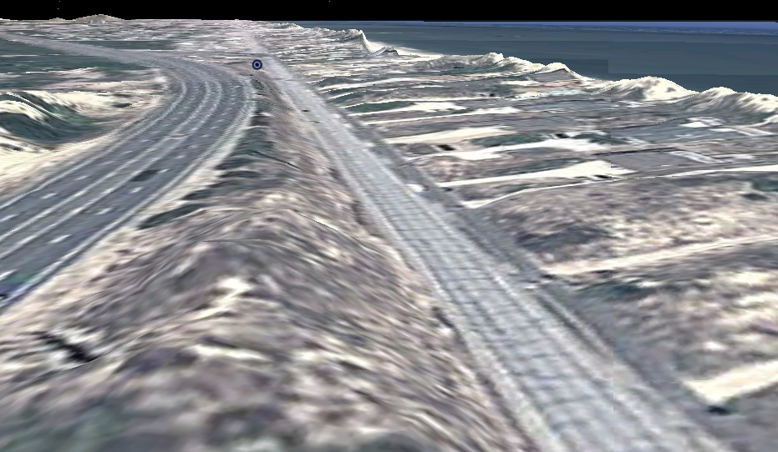
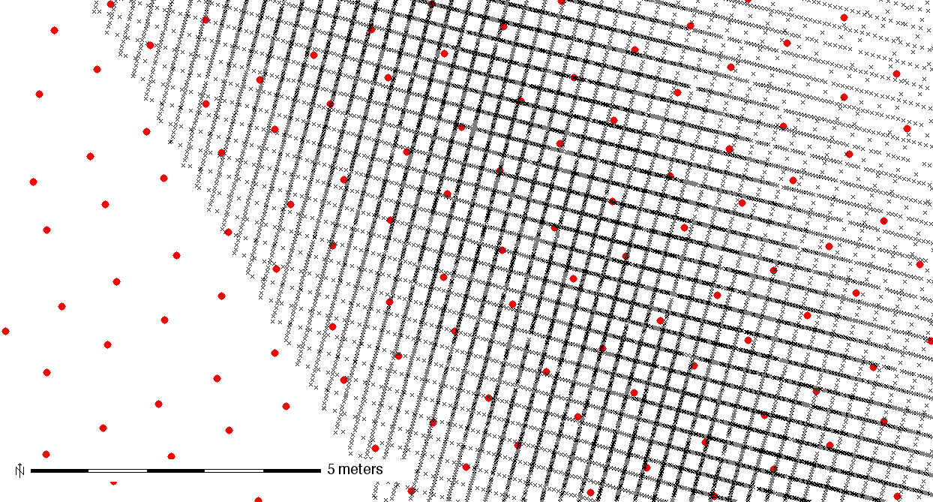
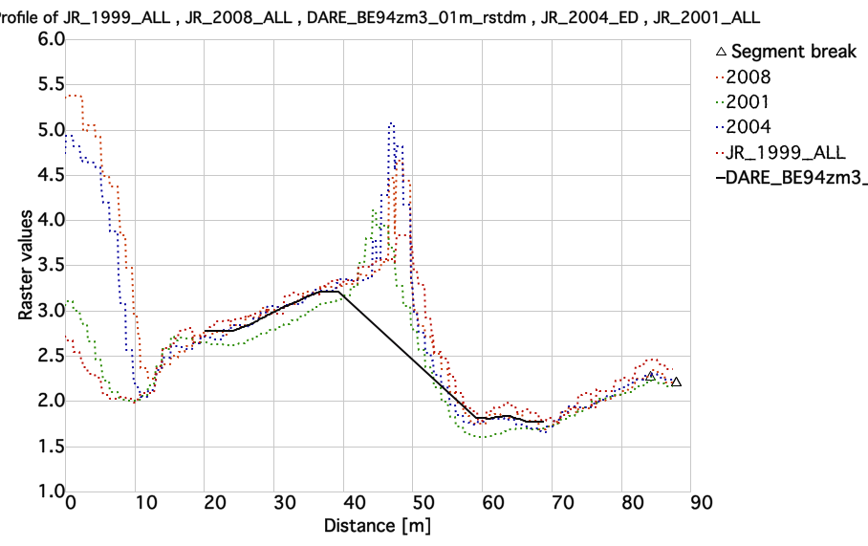
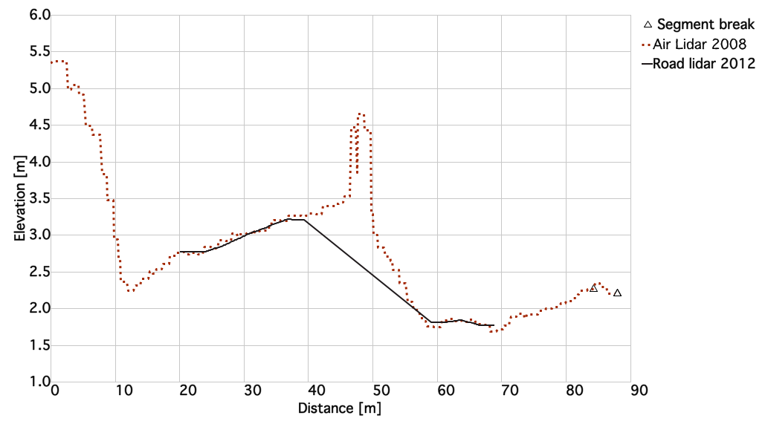
Road lidar data: 2012
New mobile terrestrial lidar road survey for all NC coastal counties
scan lines: 15-20cm
masked 10cm resolution DEMs
captures road profile
I-158 NC-12
airborne + terrestrial
20m
10m
2001 1m res. DEM, 2012 0.1m res. road DEM
Thanks to Doug Newcomb and Hope Morgan for sharing the data
Notes:
Road lidar 15cm profiles, sub 1cm along profile

Slide 6
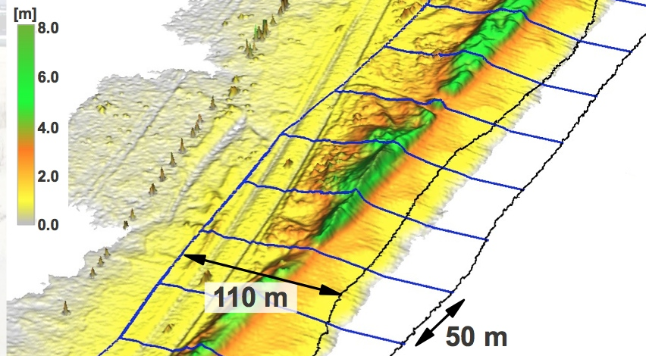
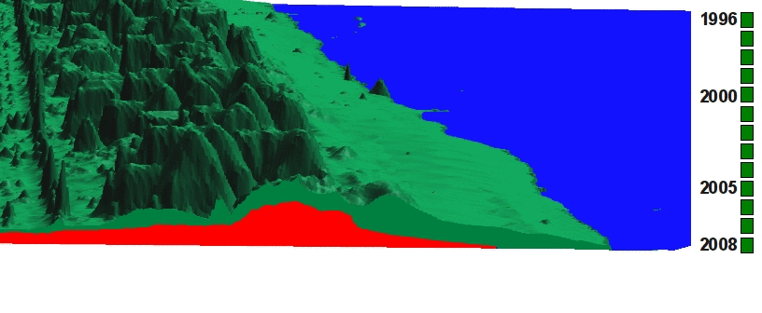
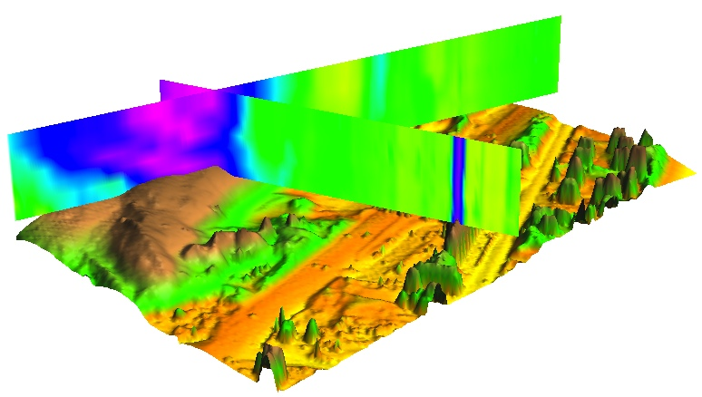
Measuring and mapping change
1D feature change:
shorelines, dune crests
tracing feature migration along transects
2D pattern of elevation change:
difference of DEMs, volumes
per cell statistics on DEM time series : core and envelope concept
3D space-time cube: z=f(x,y,t)
Time
[year]
Y[m]
X[m]
Notes:
cite work by others here! Add figure for all features – crests, peaks, shorelines

Slide 7
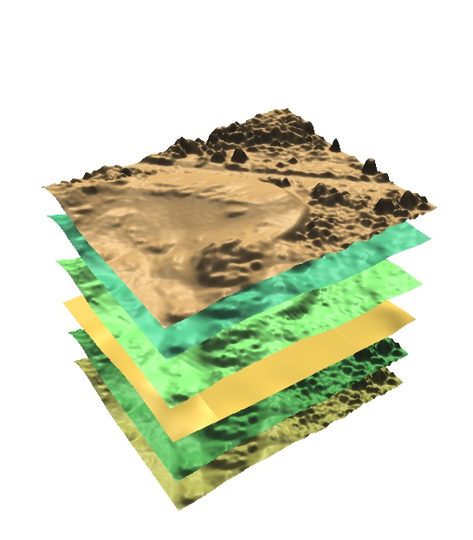
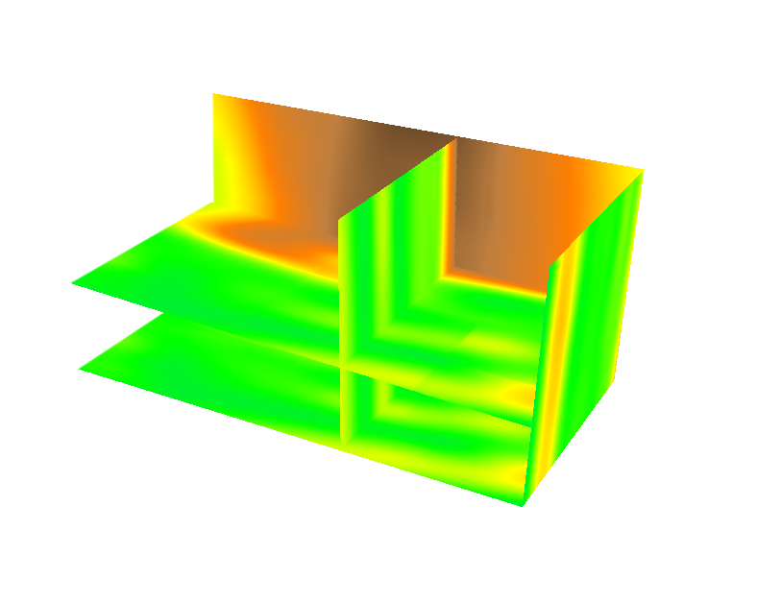
Terrain evolution in space-time cube
t_{n}
How did terrain evolve at a given elevation?
How does evolution pattern change with elevation?
Create space-time voxel model
z=f(x,y,t)
stack time series of DEMs
interpolate time series of (x,y,z) point clouds using trivariate spline
t₂
t₁
stack 2D rasters
interpolate
point clouds
Time
[year]
Y[m]
15
7
0 m
X[m]
Notes:
7
7
Figure 3: Representation of terrain evolution using trivariate space-time function: merged time series of point clouds is interpolated into space-time voxel model (Mitasova et al., 2011).
*Reviewer asks for a more thorough explanation of how 3D information fits into the 4d cube (3D shape)? The reviewer seems confused here as it is not a 4D cube but a 3D cube for elevation values at space time. Perhaps this figure can be modified to show that at a specific time constat for a lidar-survey you get back out your DEM for that survey. Note also this figure was used in your geomorph paper.

Slide 8
Shoreline evolution at Rodanthe
Standard representation: contours extracted
from series of DEMs
2011
2011
2009
2008
2005
2004
2003
2003
2001
1999
z=0.5m, colored by year
200m
Notes:
8
8

Slide 9
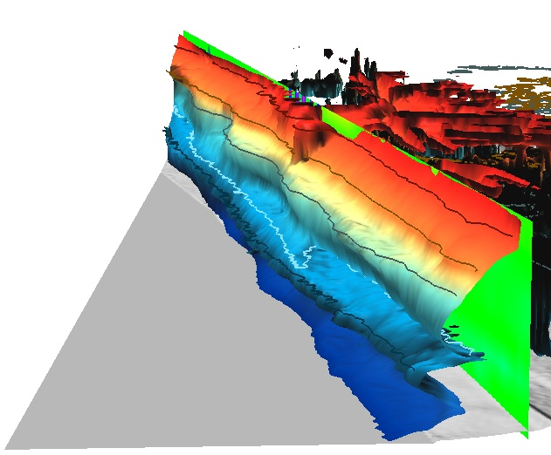
Shoreline evolution at Rodanthe
New representation as isosurface using Space-Time Cube concept
2011
Time
[year]
2011
2009
2008
2005
2004
2003
2003
2001
1999
200m
z=0.5m, colored by year
Notes:
9
9
I need to find a more attractive area to show this - it can be skipped

Slide 10
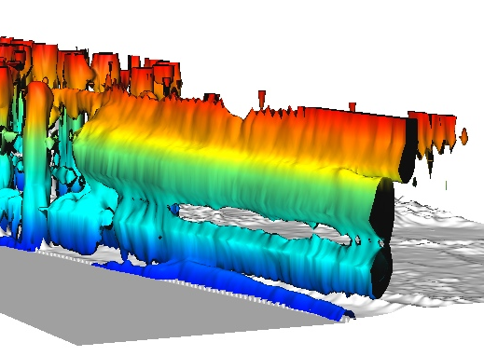
Evolution of foredune
Evolution at mid-dune and ridge elevation
showing past overwash and dune degradation before 2011 hurricane
z=3m
2011
2009
2008
2005
2004
2003
2003
2001
1999
z=4m
100m
Notes:
10
10
I need to find a more attractive area to show this - it can be skipped

Slide 11
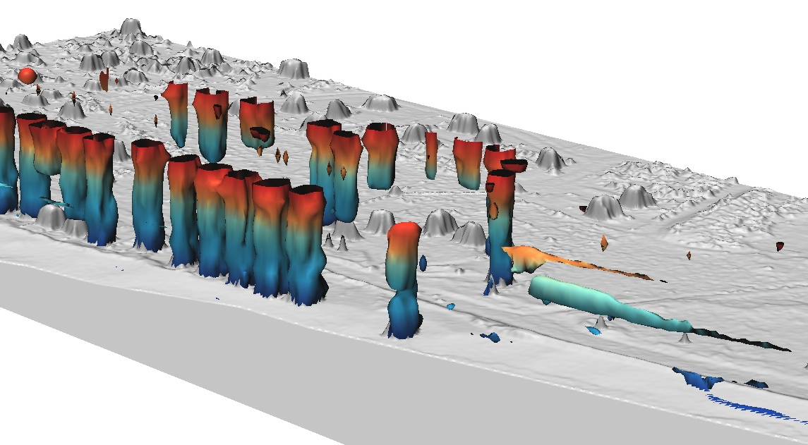
Evolution of foredune and homes
Evolution at dune toe and mid-home elevation
Evolution at mid-dune and ridge elevation
rate of change
m/yr
z = 2m
z = 3m
2011
2009
2008
2005
2004
2003
2003
2001
1999
z = 4m
z=6m
100m
Notes:
11
11
I need to find a more attractive area to show this - it can be skipped

Slide 12
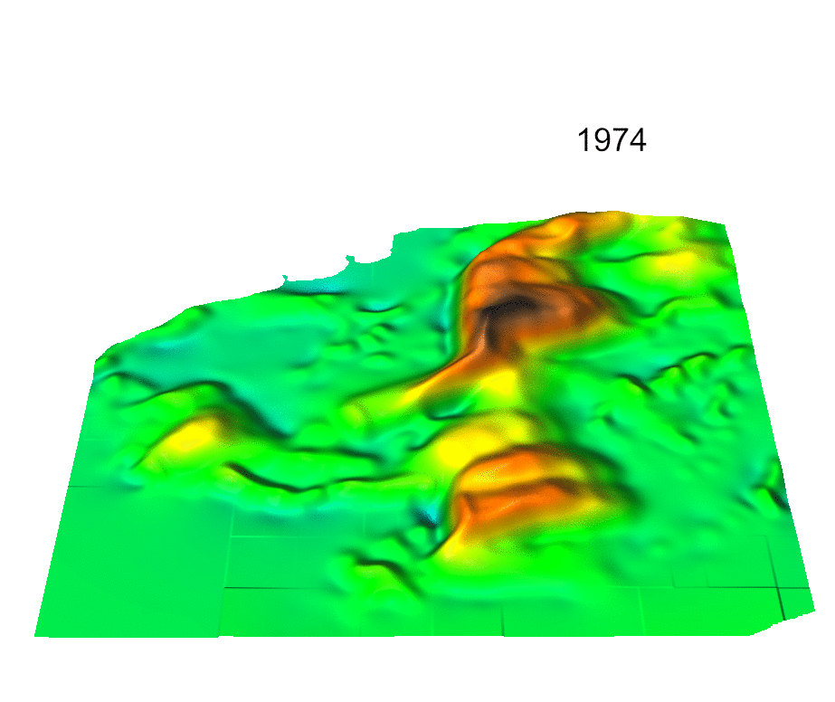
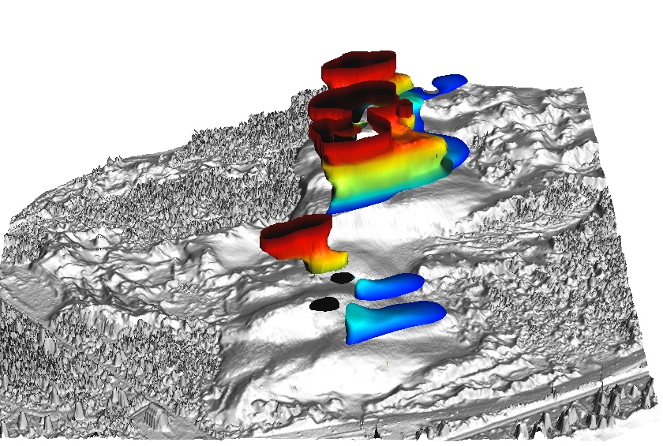
Back-island dune migration
Jockey’s Ridge: active dune system within state park
How long will it stay within the park boundaries?
Photogrammetry and lidar:
1974 - 2008 DEMs
Migration measured as change in location of dune crests
Landform evolution through STC
17m
200m
2008
2005
2001
1999
1998
1995
1974
17m

Slide 13
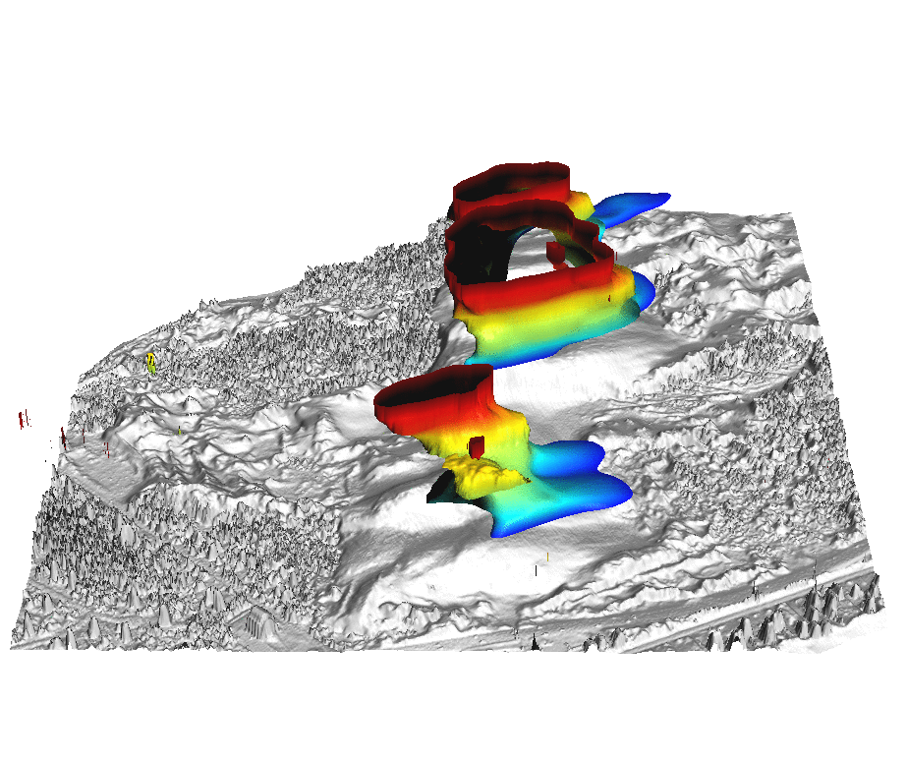
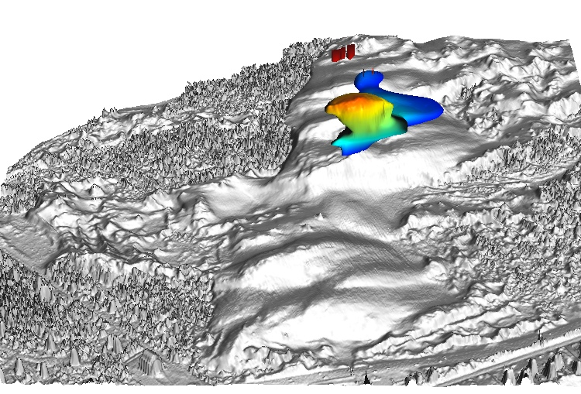
Evolution along contours
When and at which elevation
has the dune started to split into
parallel ridges?
Where and when did the elevation
rebound ?
Animation through elevation
isosurfaces 15m – 20m
2008
2005
2001
1999
1998
1995
1974
Elevation isosurface at 23m
Time
[year]
Y[m]
X[m]

Slide 14
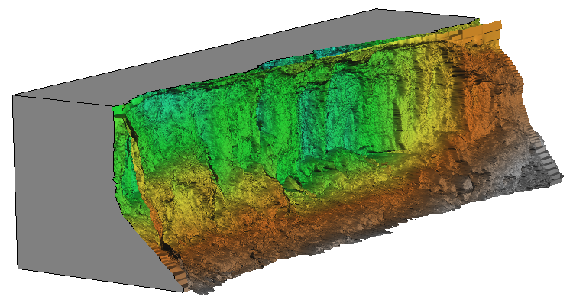
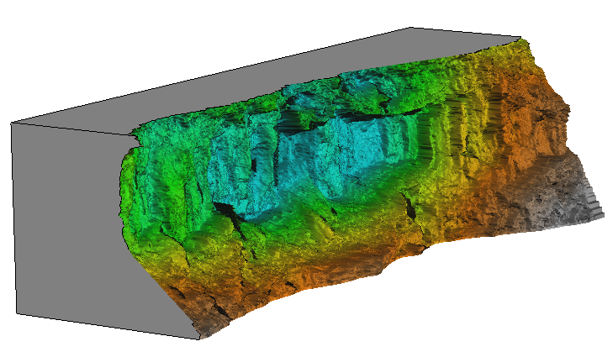
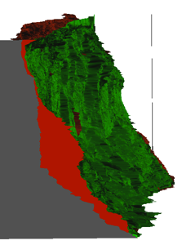
Monitoring eroding stream bank
first and last survey
Dr. Mike Starek, Nathan Lyons, Keren Cepero, Dr. Wegmann
Talk EP33D-06: Wednesday
Legacy sediment from old millpond
monitoring by Leica Scan TCL:
9 epochs 2010 – 2012
1cm resolution bank surface
represented as tilted DEM
distance to base plane [m]

Slide 15
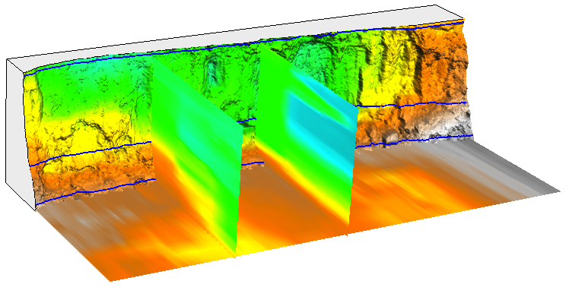
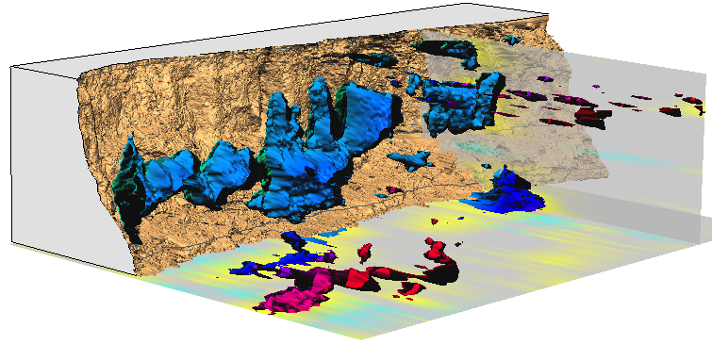
Evolution of distance from base plane
Where and when was the change between two surveys greater than 0.5m and what was its pattern?
massive fallout from milldam sediment layer in epoch 3 (April, after storms),
smaller, more scattered loss from lower layers
1 epochs 8
distance from base plane [m]
epochs
distance difference [m]

Slide 16
Conclusions
Analysis of systematic errors is important for time series from multiple sources
Multidim framework provides comprehensive metrics for quantification of change
STC methodology is simple to implement yet powerful in its ability to condense surface evolution complexity into meaningful information.
lasTools and GRASS GIS (6.4.3 and 7) used for processing, analysis and visualization
Acknowledgment:
This research was funded by ARO project W911NF1110146
Mirlo beach: Nov. 20 2012
http://www.youtube.com/watch?v=MrGub6bNuoU&sns=fb

Slide 17
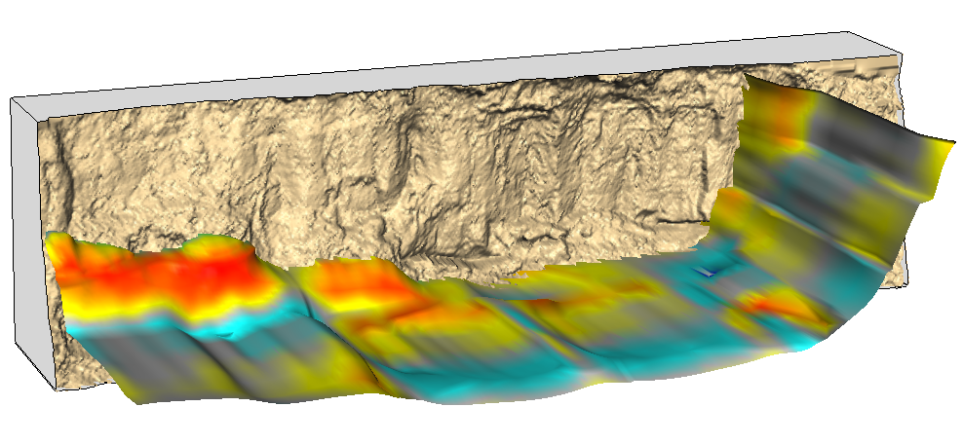
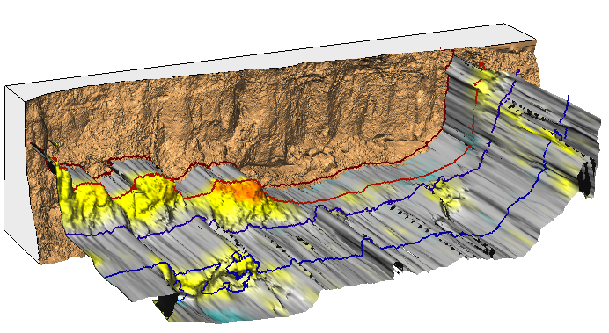
Fig 7 STC isosurface – show contours > isosurface with draped change and lines for year
epochs
distance difference [m]

Slide 18
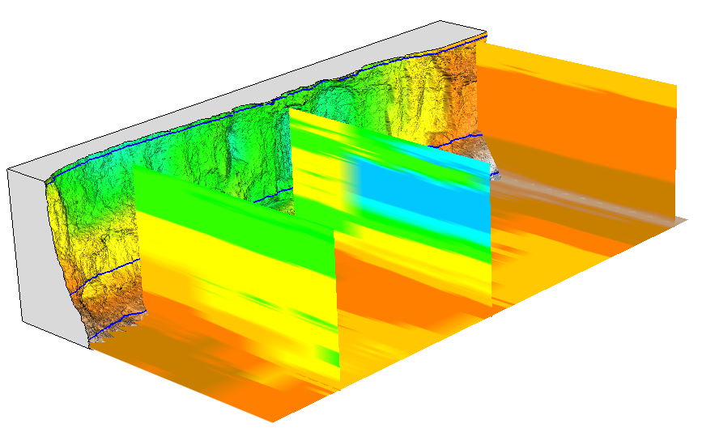
L1
L2
L3
0 epochs 8
distance from base plane [m]

Slide 19
Two scans when most of the change have been observed over 137 days
- april-august 2011 – was there a single event or several storms?
(others were 45,67,56 days)

