Slide 1
Geomorphometry I: Terrain modeling
Geospatial Analysis and Modeling:
Lecture notes
Helena Mitasova, NCSU MEAS

Slide 2
Outline
Definitions
3D mapping technologies
mathematical and digital terrain models
point clouds, multiple return data
triangular irregular networks
regular grid (raster)
isolines and meshes
point cloud analysis and binning

Slide 3
Definitions
Land (bare earth) surface: interface between solid Earth and atmosphere/anthroposphere/biosphere
Terrain surface : interface between Earth with water, vegetation, structures and atmosphere
Bathymetry: interface between solid Earth surface and hydrosphere (bottom surface of lakes, rivers and ocean)
Seamless topobathy: continuous solid earth surface
Notes:
Intro - this has been already covered

Slide 4
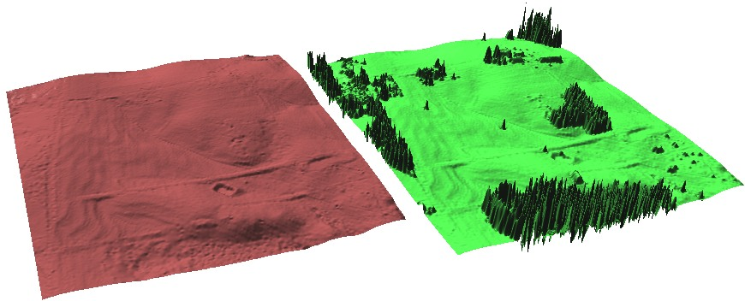
Bare Earth and Terrain surface
Bare ground surface
Terrain surface:
bare ground + vegetation and structures
Notes:
Intro - this has been already covered

Slide 5
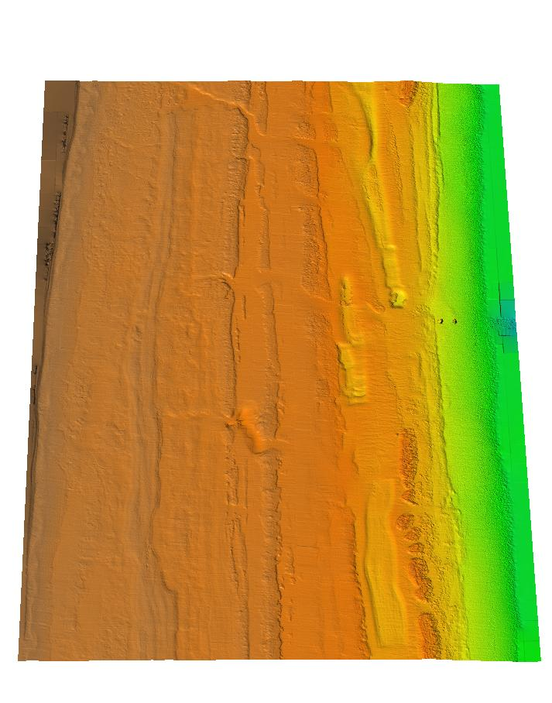
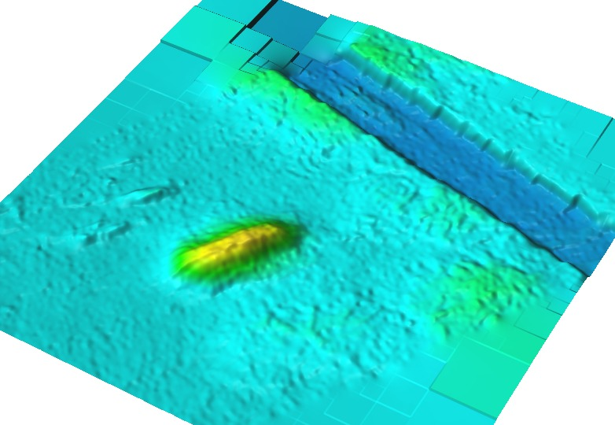
Bathymetry
Bathymetry:
sand disposal
Nearshore bathymetry
Notes:
Intro - this has been already covered

Slide 6
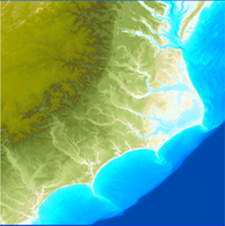
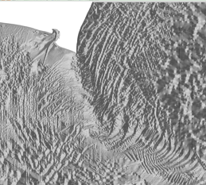
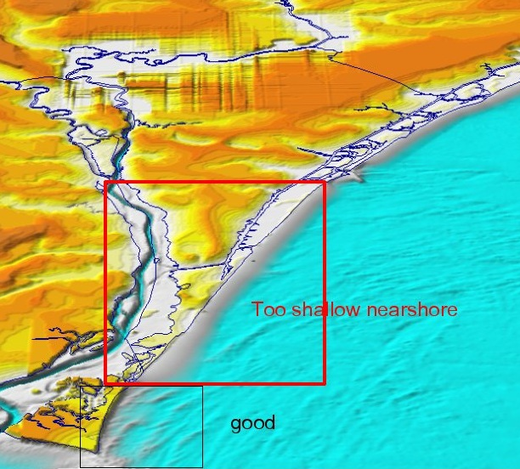
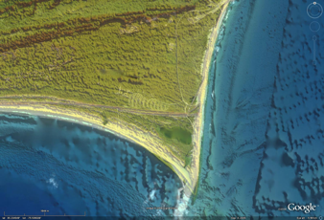
Seamless topobathy
Notes:
Intro - this has been already covered

Slide 7
Mathematical terrain models
Mathematical representations of bare Earth surface:
bivariate function (for each x,y there is only one value of z):
z = f(x,y)
Notes:
Intro - this has been already covered

Slide 8
Mathematical terrain models
Mathematical representations of bare surface:
bivariate function:
z=f(x,y)
non-stationary signal consisting of multiscale components
z(x,y)=S(x,y)+D_{j}(x,y)+D_{j-1}(x,y).....D₁(x,y)
where S(x,y) is the smoothest component, D_{i} (x,y) are progressively more detailed components
deterministic component z_{d} +random spatially correlated error + noise
z(x,y)=z_{d}(x,y)+e'(x,y)+e”(x,y)
Notes:
Intro - this has been already covered

Slide 9
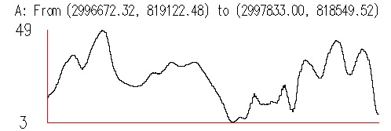
Multiscale terrain components
Terrain profiles at different level of detail
Sand dune vegetated area
z(x,y)=S(x,y)
z(x,y)=S(x,y)+D_{j}(x,y)
Notes:
Intro - this has been already covered

Slide 10
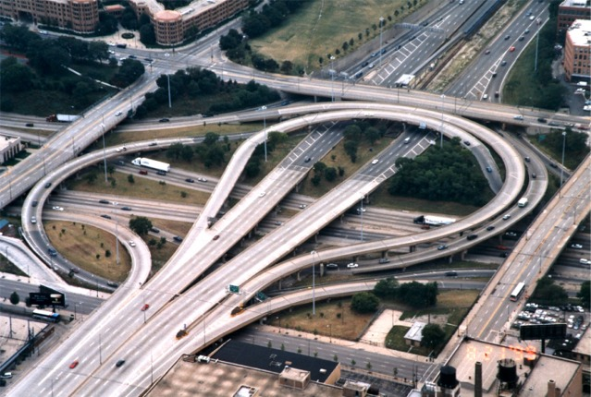
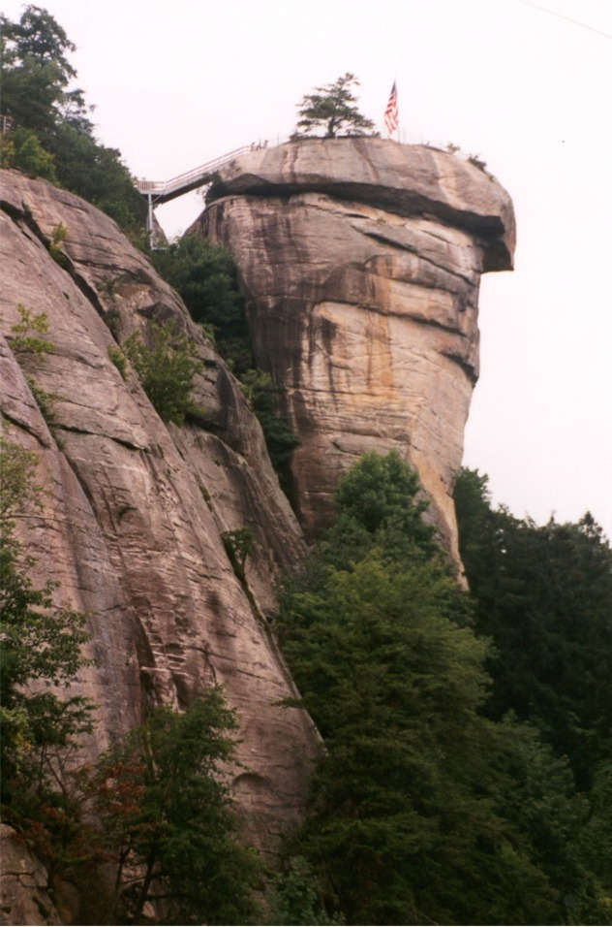
Mathematical terrain models
Is the bivariate function representation general enough?
General 3D surface defined using
parametric representation: x=f(u,v), y=g(u,v), z=h(u,v,),
Supported by K3DSurf, CAD
GIS: 3D vector model
Notes:
Intro - this has been already covered

Slide 11
Terrain mapping technologies
Continuous surface measured at discrete points
Human selected points (GPS, total station, photogrammetry)
Automated point sampling (lidar, RTK GPS, sonar)
Land terrain mapping
Stereophotogrammetry: mass points and breaklines
IFSARE: raster, Lidar: point cloud
On-ground 3d laser scanner: point cloud
RTK GPS: point profiles
Bathymetry mapping
single and multiple beam sonar
Notes:
Intro - this has been already covered

Slide 12
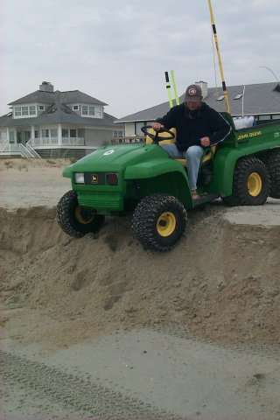
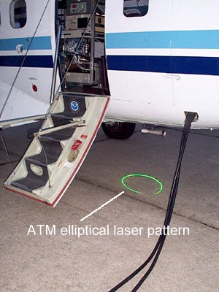
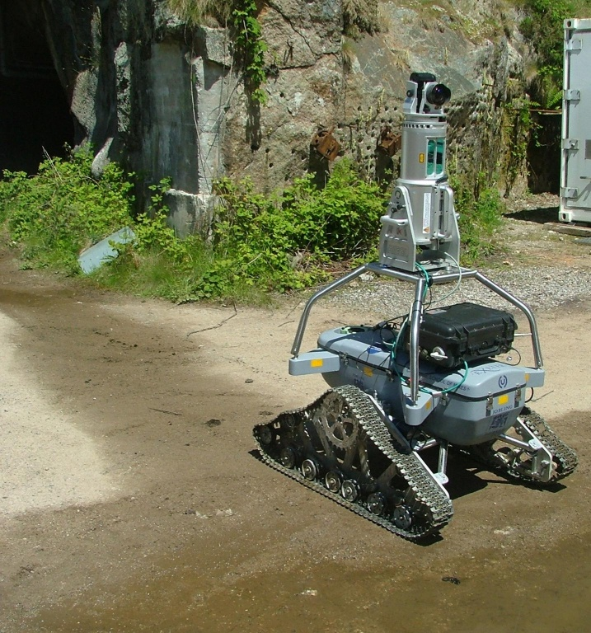
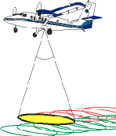
Mapping Technology: land
RTKGPS
LIDAR: Light Detection
and Ranging
USGS/NOAA/NASA
ATM-II, EAARL
On-ground laser scanner
Haiti LIDAR:http://www.wired.com/wiredscience/2010/01/haiti-3d-flyover/

Slide 13
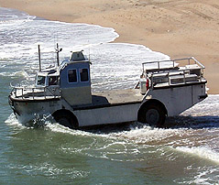
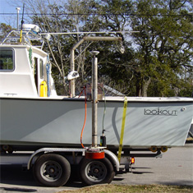
Mapping technology: bathymetry
Nearshore Bathymetry:
single beam sonar
Bathymetry:
multibeam sonar
Notes:
Add here slide with unmanned lidar

Slide 14
Elevation data: point distribution

Slide 15
Elevation data: accuracy

Slide 16
substantially improved
representation of structures
but much larger data sets
2004 lidar, 0.5m resolution DEM
binned and computed by RST
(smoothes out the noise and fills
in the gaps)
1m res. DEM, computed by RST, 1998 lidar data

Slide 17
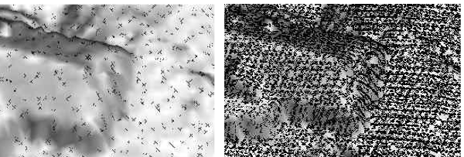
Coastal airborne lidar: 1996 - 2011
Agency Year pts/1m cell
NOAA/NASA/USGS 1996 0.1
NOAA/NASA/USGS 1997 0.3
NOAA/NASA/USGS 1998 0.2
NOAA/NASA/USGS 1999 0.4
NC Floodplain 2001 0.1
NASA/USGS 2003 0.6
USACE Topobathy 2004 4.0
USACE Topobathy 2005 1.2
NSF NCALM UoF 2006 1.0
NSF NCALM UoF 2007 1.0
NOAA 2008 1.0
USGS 2009 5.0
USACE 2010
NOAA 2011
1998
2004
100m
1m res. DEM, computed by RST, 1998 lidar data
2004 lidar, 0.3m DEM
computed by RST
point density and spatial coverage
varies for each survey

Slide 18
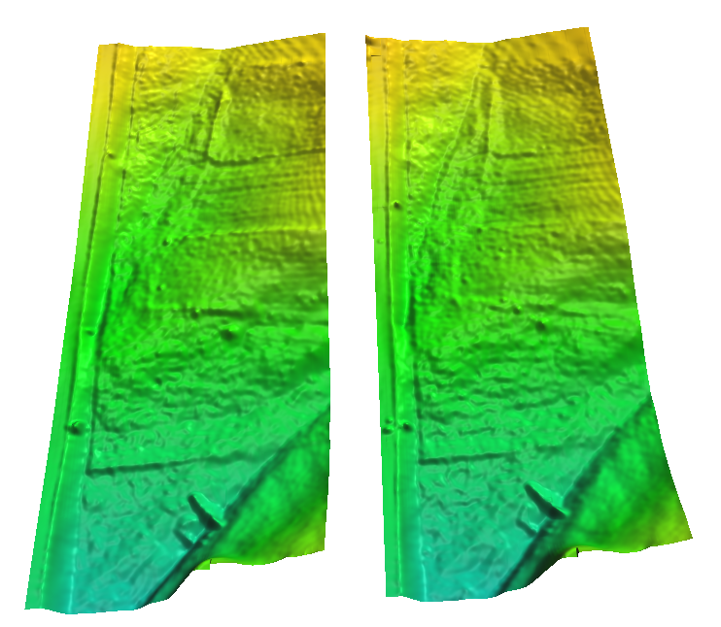
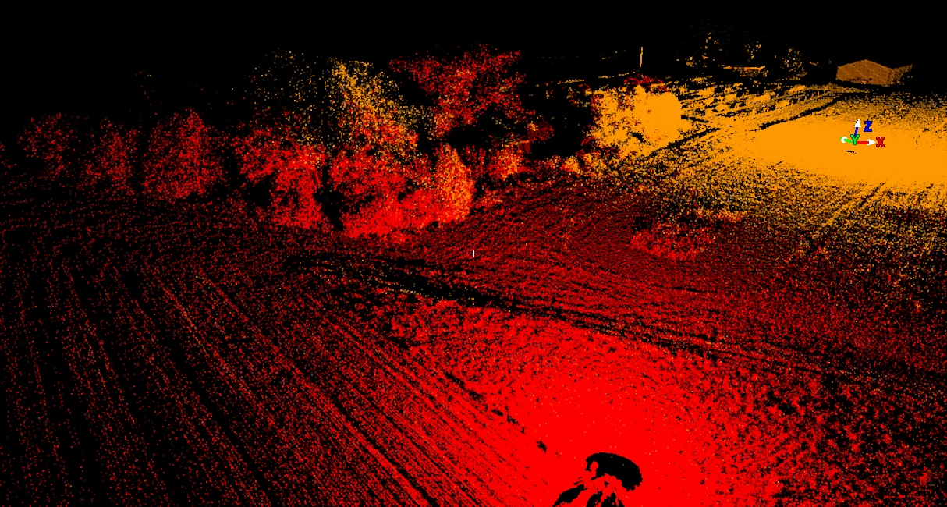
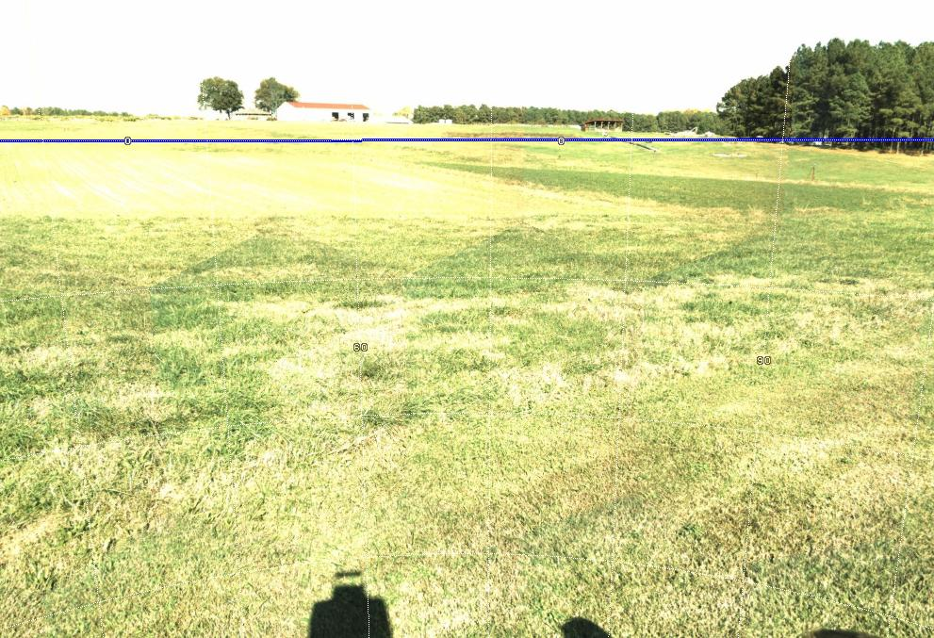
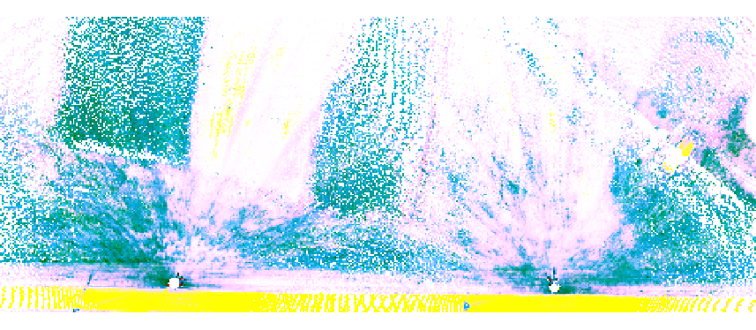
Ground based laser scanner data
Point cloud and image
0.1m res. DEM and rgb image

Slide 19
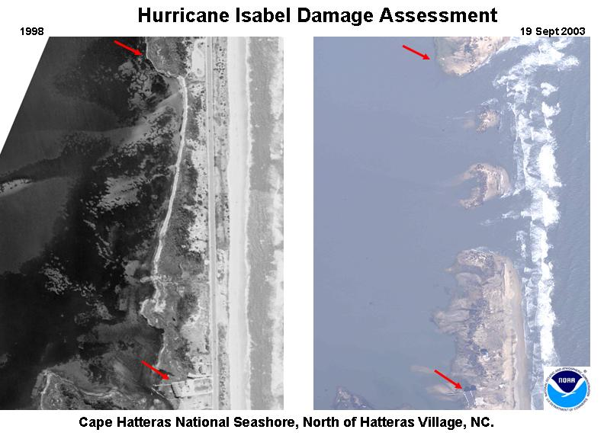
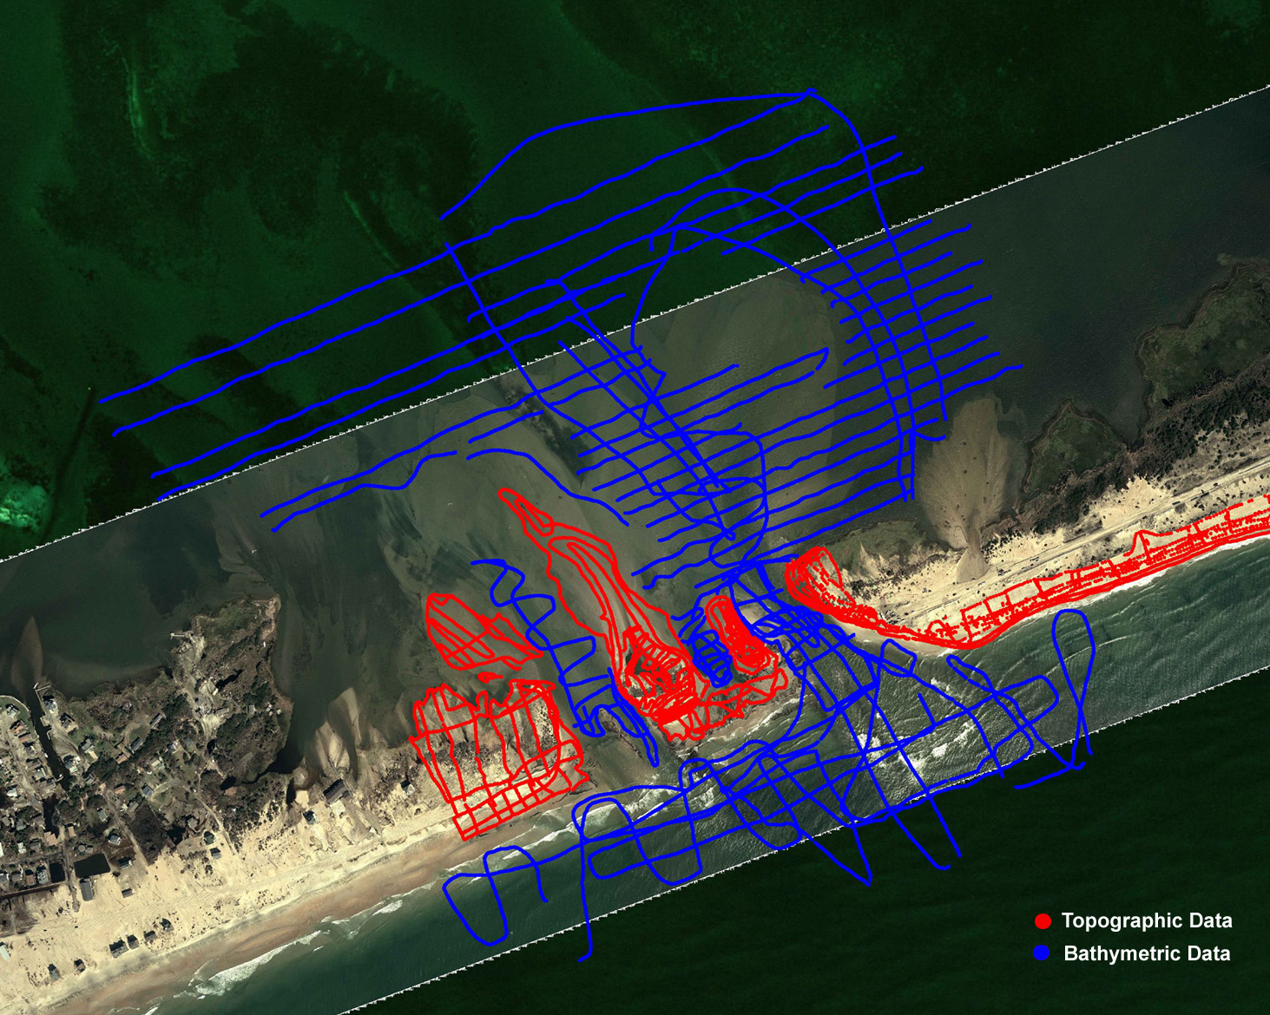
Elevation data: beach and bathymetry
Hatteras Island before
And after Isabel 2003
Bathy-topo survey
of the breach:
single beam sonar
RTK GPS
semiautomated
point selection

Slide 20
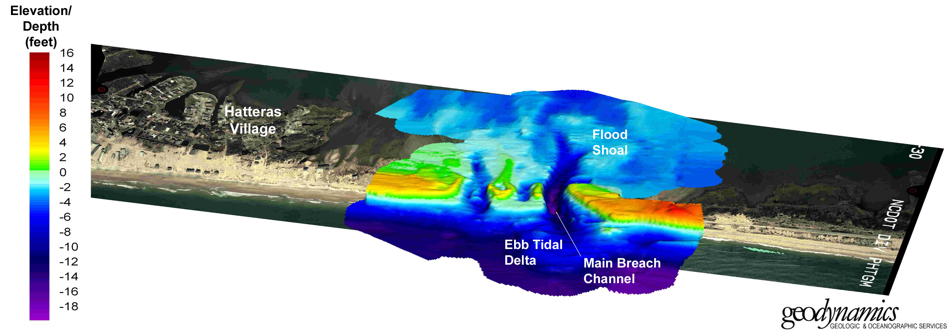
Post Isabel Hatteras Breach

Slide 21
Digital terrain representations
Point clouds – measured data
TIN – Triangular Irregular Network
Regular grid (raster)
Contours - elevation isolines
Mesh
Notes:
Intro - this has been already covered

Slide 22
Point clouds
Set of (x, y, z, r, i, ...) measured points reflected from Earth surface or objects on or above it, where x,y,z are georeferenced coordinates, r is the return number and i is intensity, r:g:b may be also measured
Provided in
ASCII (x,y,z, ...) format
binary LAS format (header, record info, x,y,z,i, scan dir, edge of flight line, classification, etc.), industry lidar data exchange format
Notes:
Intro - this has been already covered

Slide 23
Point clouds
Processing:
filtering outliers (birds etc.)
bare earth point extraction
canopy extraction
structures and power lines extraction
Public data sources (http in Summary slide):
CLICK: raw point clouds usually in LAS format
LDART: costal point clouds with on-fly binning
NC Floodplain Mapping: bare Earth: points, 20ft DEM and 50ft DEM with carved channels
Notes:
Intro - this has been already covered

Slide 24
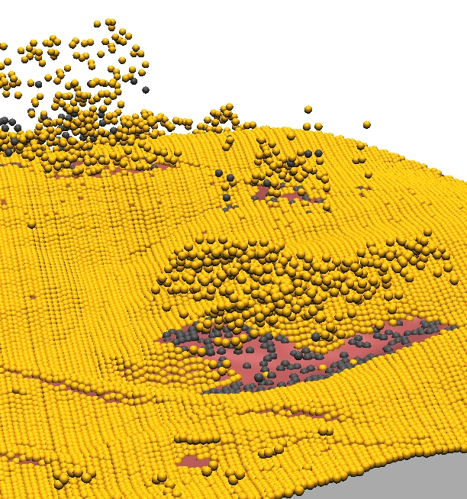
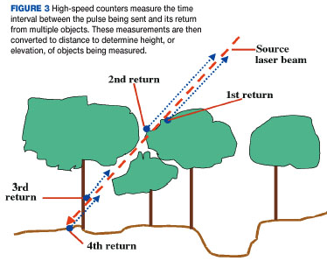
Point clouds
Multiple return point cloud data from 2001 NC Flood mapping program – yellow is first return
Image from LIDAR primer, Geospatial solutions 2002
Notes:
Intro - this has been already covered

Slide 25
TIN
Triangular Irregular Network: constructed from the measured points by triangulation (before computer age this technique was used for manual interpolation of contours from surveyed points)
Delaunay Triangulation: maximizes the smallest angle of the triangles to avoid skinny triangles
Constrained Delaunay Triangulation – includes predefined edges that cannot be flipped
TIN is a vector data model representation, that usually preserves the original data points
Notes:
Intro - this has been already covered

Slide 26
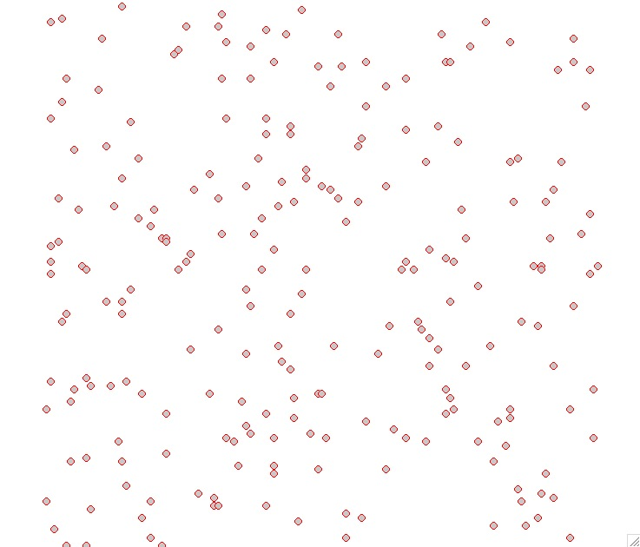
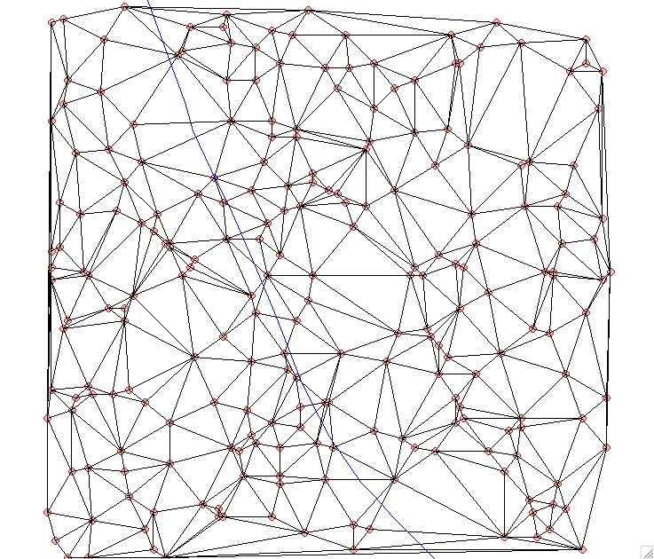
TIN
Given points Delaunay TIN
Notes:
Intro - this has been already covered

Slide 27
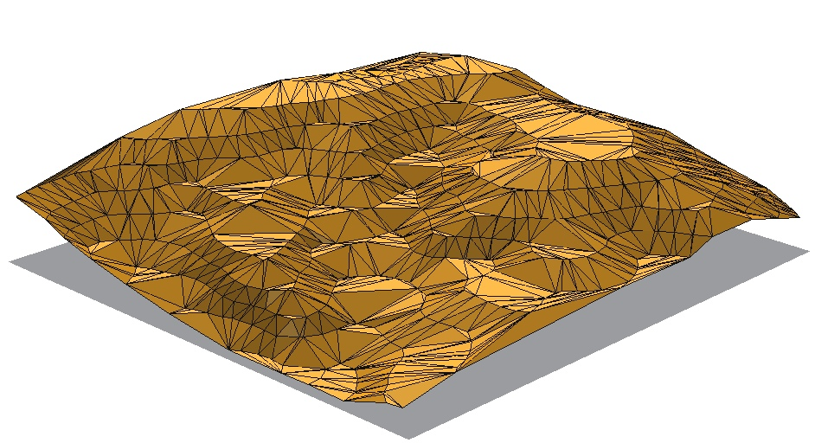
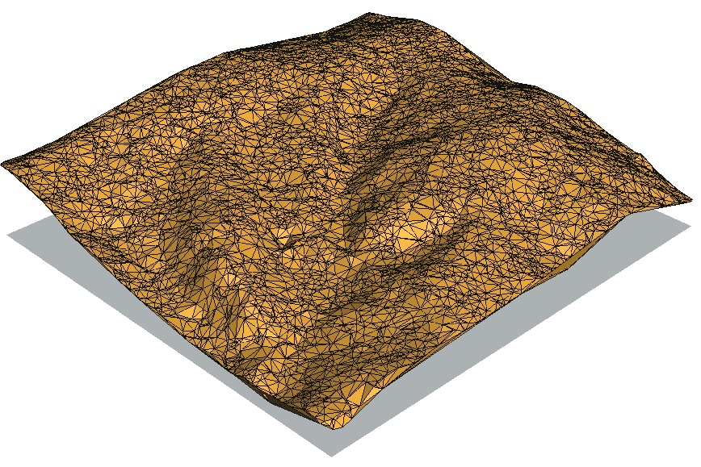
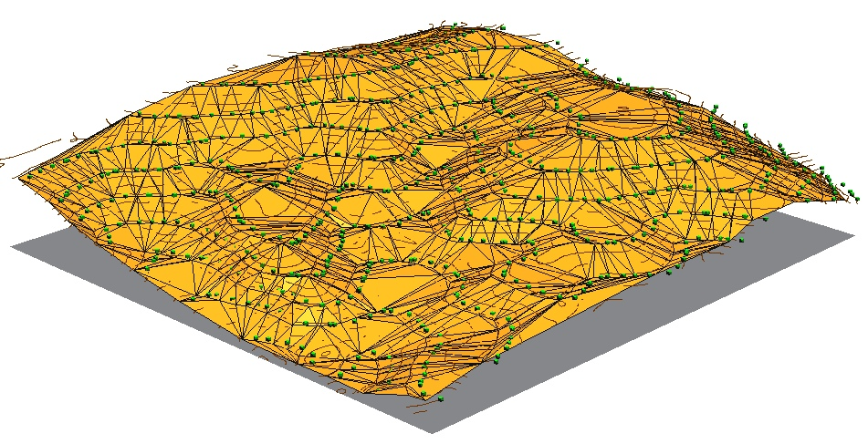
TIN
Delaunay TIN from random points and contour points
Notes:
Intro - this has been already covered

Slide 28
TIN properties
requires pre-defined breaklines for man-made features, valleys, faults, etc.
density of TIN is adjusted to surface complexity
additional points may need to be interpolated to create smooth surface
When to use TIN:
engineering applications,
manual modification of model is desired(design),
complex faults need to be represented,
multiscale representation for visualization
Notes:
Intro - this has been already covered

Slide 29
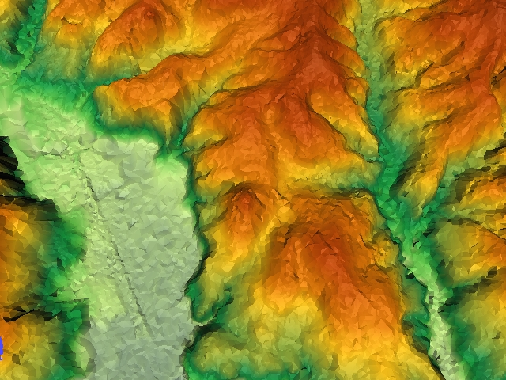
TIN issues
discontinuity in first derivative along edges: artificial triangular structures on the surface
dams can be created across valleys if stream is not defined as a breakline
if input are points on contours: flats on the top of hills or ridges if no peaks are defined
Image by
TERRASTREAM
Dept. of Computer Science,
Duke University
Notes:
Intro - this has been already covered

Slide 30
Regular grid - raster
Two interpretations:
elevation assigned to a grid point – center of the grid cell
elevation assigned to the pixel area
Derived from measured points by gridding:
at least one point for each grid cell – binning,
if some grid cells do not include points – spatial interpolation or approximation
Notes:
Intro - this has been already covered

Slide 31
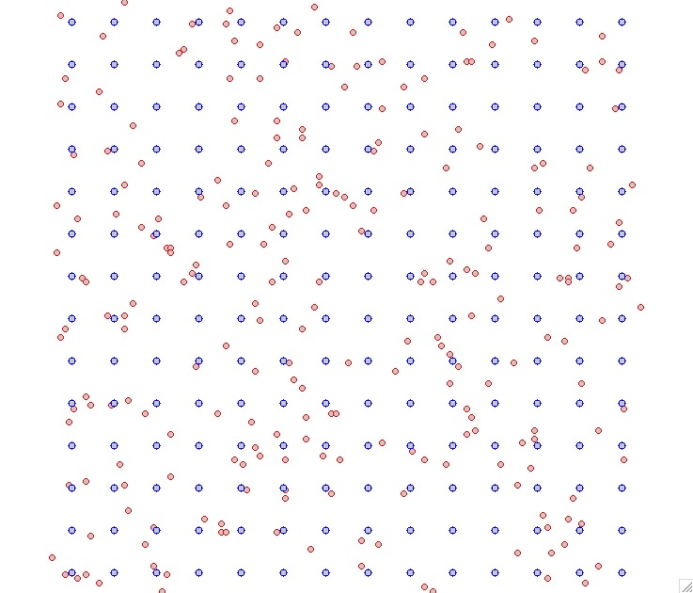
Regular grid - raster
Given Points Regular Grid
Notes:
Intro - this has been already covered

Slide 32
Regular grid: properties
simple data structure and algorithms
easy to combine with imagery
uniform resolution - potential for undersampling and oversampling
representation of faults and sharp breaklines requires very high resolution
Notes:
Intro - this has been already covered

Slide 33
Regular grid -public data
Most available elevation data are distributed as raster data:
USGS Seamless Data Distribution
NED 1/9 (3m),1/3 (10m),1 arc/sec (30m),
SRTM-V4: USA 30m, World 90m
GDEM 15-30m: global, relative height, derived from ASTER satellite stereo bands
NCFlood mapping web site: 20ft and 50ft DEM
CRM for bathymetry: 90m
Seamless Topobathy: Tsunami data and RENCI NC data - 10m
Notes:
Intro - this has been already covered

Slide 34
Isolines, contours
traditional approach for representation of elevation, drawn by hand from measured mass points by interpolating along triangle edges
automated procedures: from TIN or grid,
not very suitable for highly detailed, noisy data such as lidar
needed when the surface has simple geometry
selecting contour interval: depends on slope and resolution
Notes:
Intro - this has been already covered

Slide 35
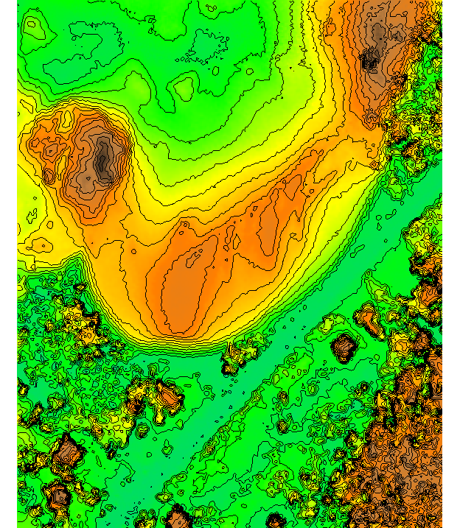
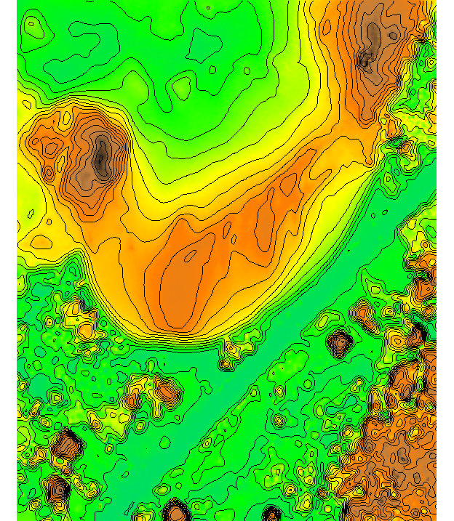
Isolines, contours
Contours from lidar

Slide 36
Point cloud analysis: binning
Binning: fast method for analyzing point clouds and generating DEMs using per-cell processing:
at least one point for each grid cell
analysis: number of points per cell, range, stddv
Methods for DEM: mean, min, max, nearest
sufficient for many applications
no need to import the points, on-fly raster generation
may be noisy, include no-data spots
Notes:
Intro - this has been already covered

Slide 37
Point cloud analysis: input
Multiple return point cloud
all returns
first return
Notes:
Intro - this has been already covered

Slide 38
Point cloud analysis: input
Bare earth and multiple return point cloud
all returns
bare earth
Notes:
Intro - this has been already covered

Slide 39
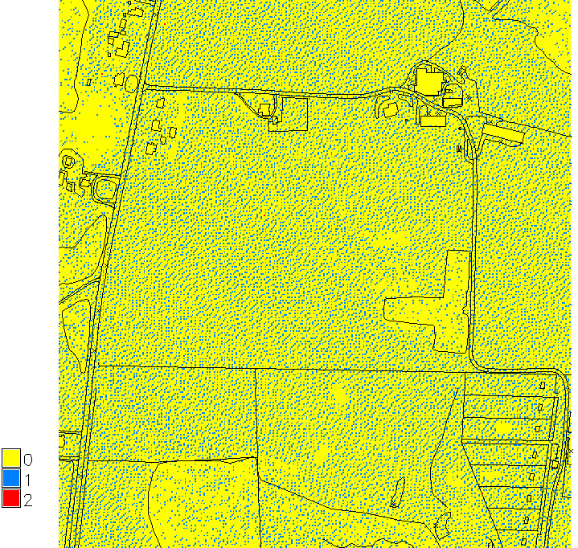
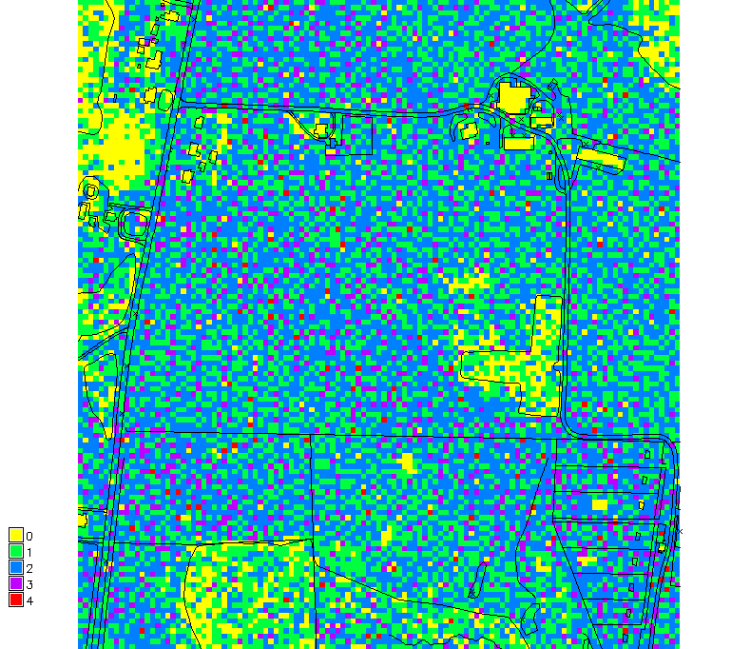
Point density
Number of bare earth points in each 2m and 6m resolution cell
Number of points
from ground based scan
in each 40cm grid cell
Notes:
Intro - this has been already covered

Slide 40
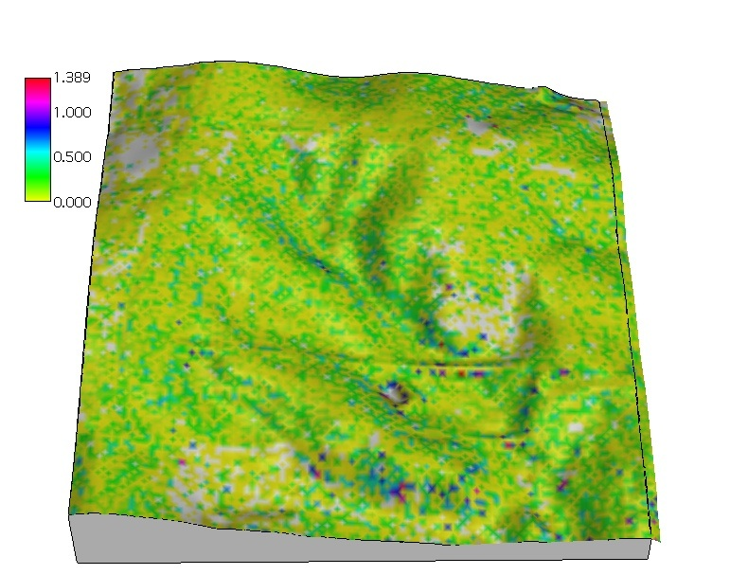
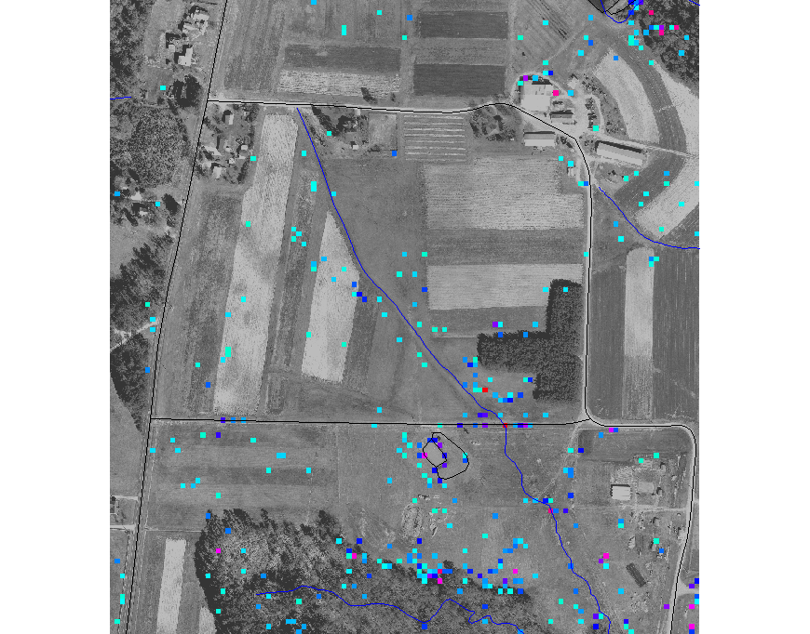
Points per-cell elevation range
Range of bare earth elevations zmax-zmin in each cell at 6m resolution
Notes:
Intro - this has been already covered

Slide 41
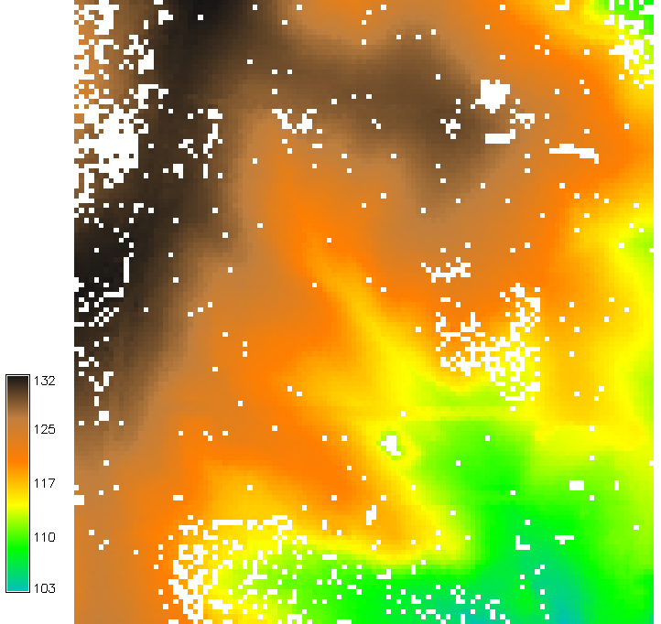
Points to grid: per-cell mean
Mean bare earth elevation for each 6m cell
Not enough bare earth
points : interpolation
is needed
Interpolated DEM and DSM
at 1m resolution
Notes:
Intro - this has been already covered

Slide 42
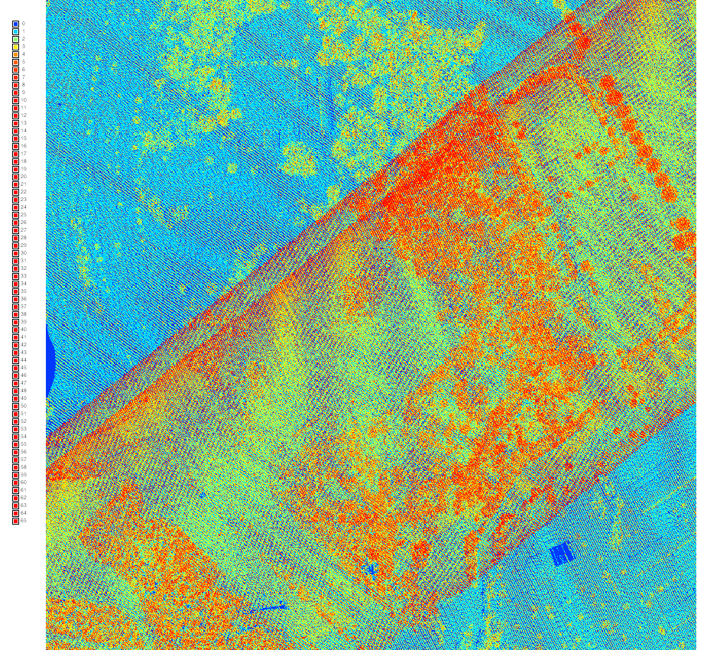
Lidar data examples: 2013 Raleigh
Number of all return and bare earth points in each 1m (3ft) cell
0793_016.las tile point densities
Notes:
Intro - this has been already covered

Slide 43
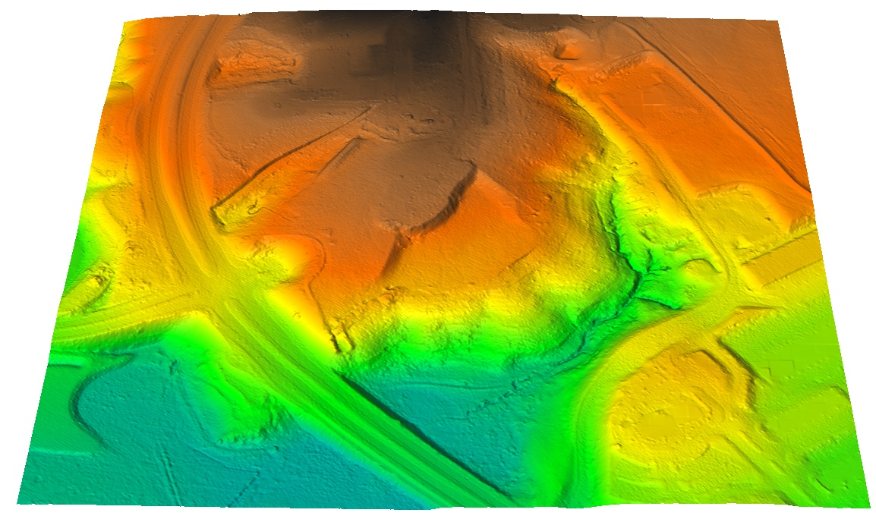
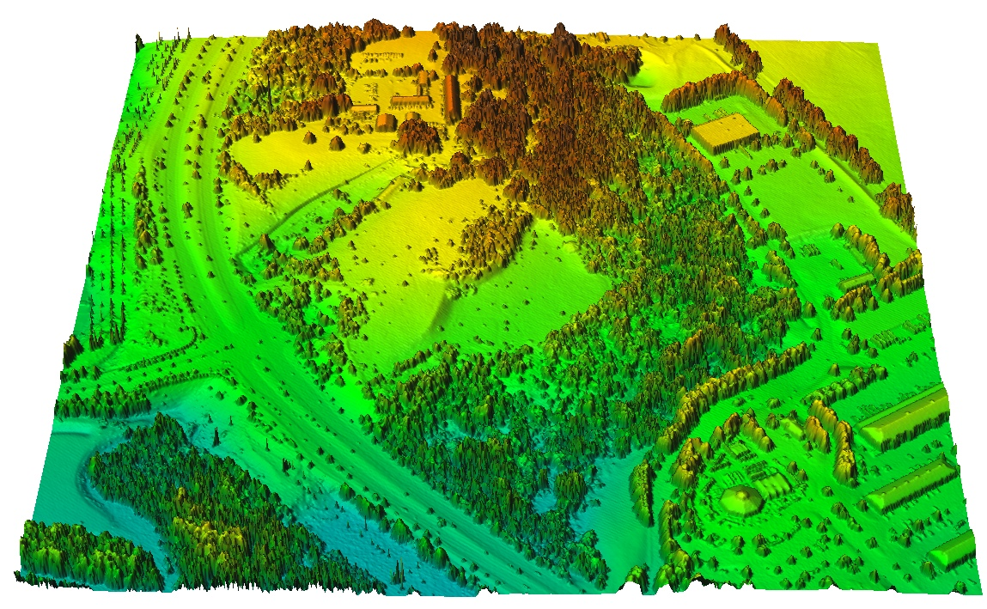
Lidar data examples: 2013 Raleigh
interpolated bare earth
and first return surfaces
Notes:
Intro - this has been already covered

Slide 44
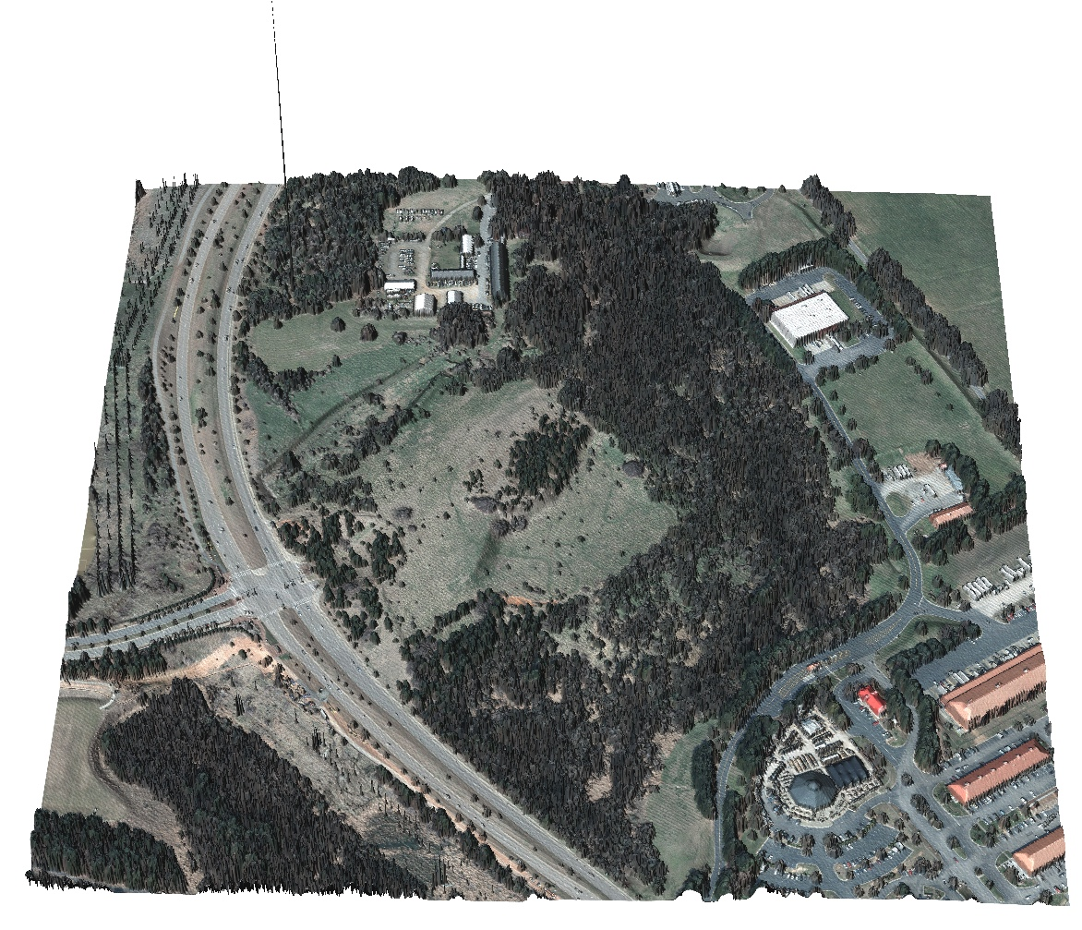
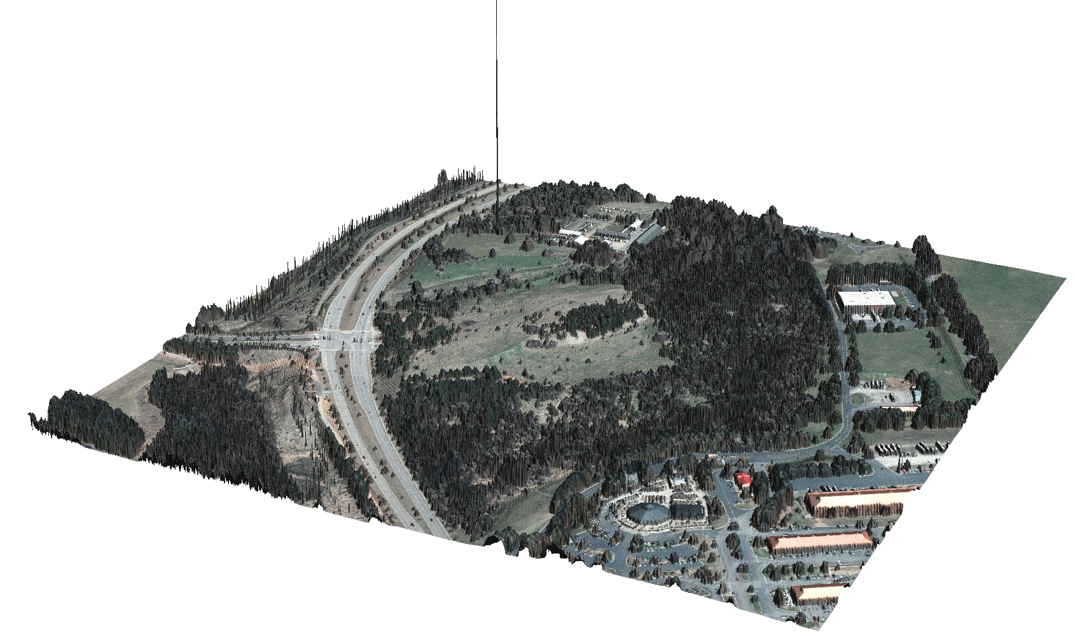
Lidar data examples: 2013 Raleigh
interpolated first return surface with orthophoto draped
over it: note the outlier and power lines
Notes:
Intro - this has been already covered

Slide 45
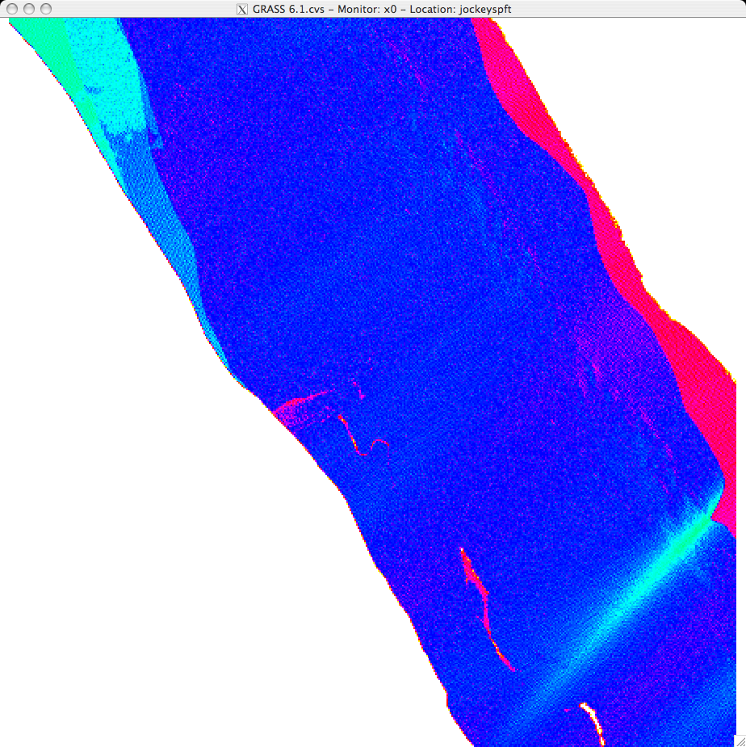
Lidar data example: coastal
Number of points in each 2m resolution cell for 2001 and 2004 lidar survey near Oregon Inlet
1
7
14
21
28
35
Notes:
Intro - this has been already covered

Slide 46
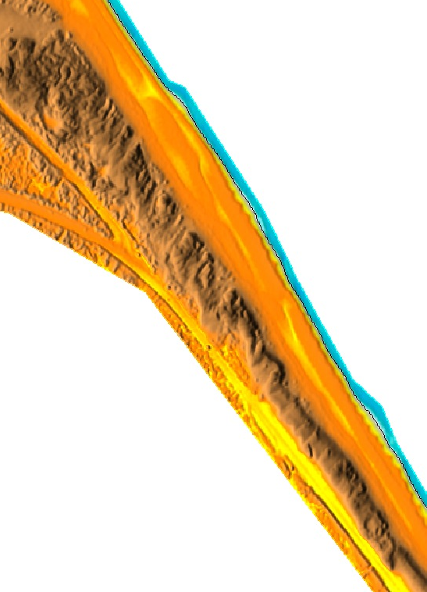
Points per-cell elevation range
Range of elevations zmax-zmin in each cell at 0.3, 1., 5. and 10m resolutions – 2004 lidar near Oregon Inlet
5m
4
3
2
1
0
Notes:
Intro - this has been already covered

Slide 47
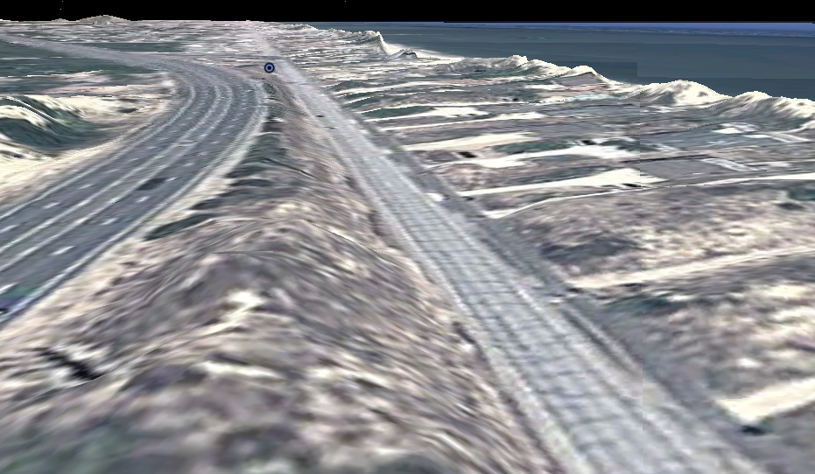
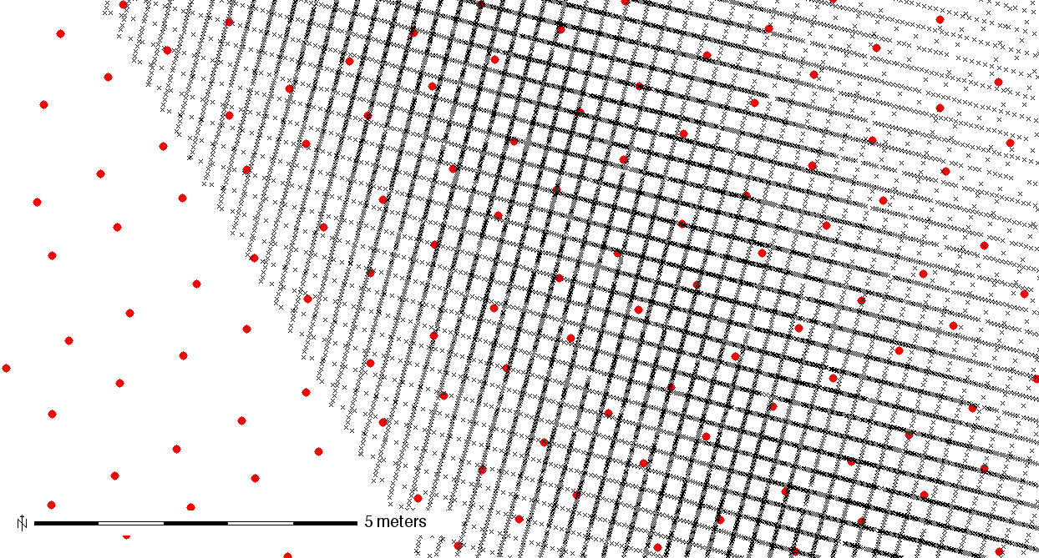
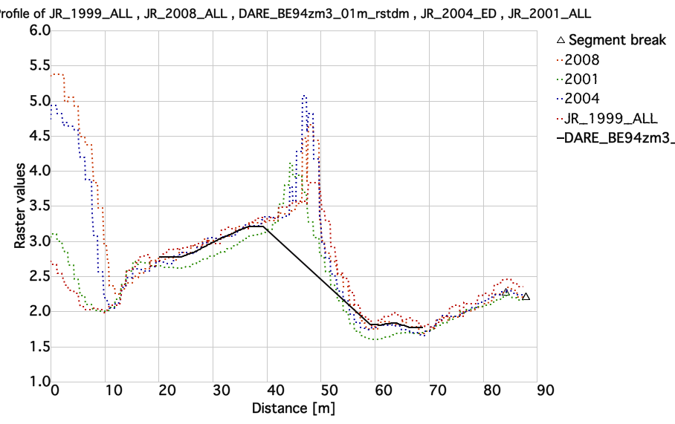
Road lidar data: 2012
New mobile terrestrial lidar road survey for all NC coastal counties
scan lines: 15-20cm
masked 10cm resolution DEMs
captures road profile
I-158 NC-12
airborne + terrestrial
20m
10m
2001 1m res. DEM, 2012 0.1m res. road DEM
Thanks to Doug Newcomb and Hope Morgan for sharing the data
Notes:
Road lidar 15cm profiles, sub 1cm along profile

Slide 48
Lidar data examples: JR binning
Jockey's Ridge 1999, unfiltered single return lidar point cloud: 1m grid cell binning using maximum elevation
Result has many NULL cells – what to do?
Notes:
Intro - this has been already covered

Slide 49
JR 1999 lidar: binning
3m grid cell binning: points to grid with method mean
Notes:
Intro - this has been already covered

Slide 50
JR lidar: interpolated DSM
1m DEM interpolated by splines – see next lectures
Notes:
Intro - this has been already covered

Slide 51
Monitoring eroding stream bank
first and last survey
Dr. Mike Starek, Nathan Lyons, Keren Cepero, Dr. Wegmann
Talk EP33D-06: Wednesday
Legacy sediment from old millpond
monitoring by Leica Scan TCL:
9 epochs 2010 – 2012
1cm resolution bank surface
represented as tilted DEM
distance to base plane [m]

Slide 52
Summary and references
Learn more about Lidar in MEA592-004/GIS595-002:
Multidimensional Geospatial Modeling
Mathematical and digital terrain representation
Neteler Ch. 5,6; Hengl Ch. 2,
Point clouds and TIN
Neteler Ch.6.; Hengl et al. Geomorphometry
Regular grids
Neteler Ch. 7, Hengl
Isolines and meshes
Neteler Ch. 5, Hengl
LIDAR: http://www.forestry.gov.uk/forestry/INFD-6RVC9J
http://www.geospatial-solutions.com/geospatialsolutions/article/articleDetail.jsp?id=10275

