Slide 1
Geospatial Analysis II: proximity, buffers, cost surfaces
Geospatial Analysis and Modeling:
Lecture notes
Helena Mitasova, NCSU MEAS

Slide 2
Project
Two page revised proposal due - see the schedule for date:
Introduction: background, statement of the problem, motivation
Objective or research question
Site and data
coordinates, coordinate system, units
list of data sets: already in GIS, still need to download
images showing your location and sample of data that you have
Approach: general methodology or workflow to accomplish the objective
Expected results: what information will your analysis and modeling provide and in what form (maps, tables, graphs, etc).
References: list of 5-10 research papers that address similar topic that provide the motivation for your project, inspire the approach that you can improve upon, provide sources for your data.
Web documents are OK but at least some should be research papers.

Slide 3
Outline
measuring distance
buffers
cost surfaces
least cost path

Slide 4
Measuring distance
Distance:
Euclidean: shortest distance in plane
Geodesic: shortest distance over curved surface, great circle on sphere: orthodrome
equation: http://mathworld.wolfram.com/GreatCircle.html
Rhumbline (loxodrome): constant bearing path, line in Mercator projection, NOT the shortest path
equation: http://en.wikipedia.org/wiki/Rhumb_line

Slide 5
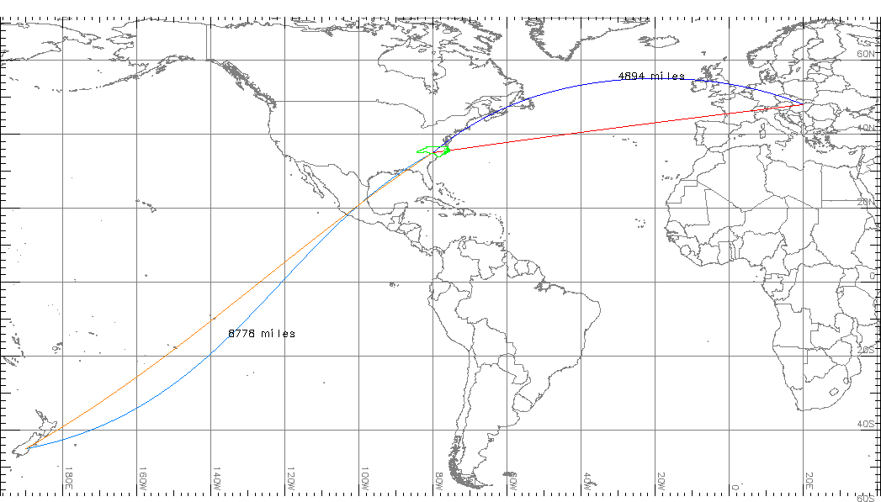
Measuring distance: spheroid
Geodesic: shortest distance over curved surface
Rhumbline: constant bearing path, line in Mercator projection

Slide 6
Measuring distance: networks
Generalized distance: L_{p} metrics for measuring distance on meshes or grids
distance between a(x₁,y₁) and b(x₂,y₂)
d_{p}(a,b)=[(x₁-x₂)^{p} + (y₁-y₂)^{p}]^{1/p}
p=2 : Euclidean distance
p=1 : Manhattan (Taxicab, City block) metric
Linear Referencing Systems: location is defined by its linear distance from a known point on a route (e.g. milepost on a highway), and distance is measured along segments of a network; used for roads, utilities, waterways

Slide 7
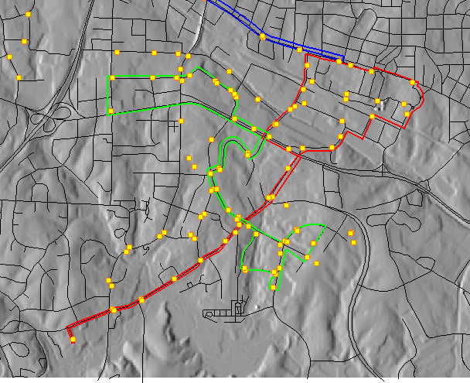
Measuring distance: networks
Manhattan metric
Linear Referencing Systems
Euclidean distance

Slide 8
Measuring feature length
feature length is scale dependent
what is the length of NC coastline? Neuse river?
vector model: length depends on level of detail (point density representing the feature)
raster model: resolution and level of detail

Slide 9
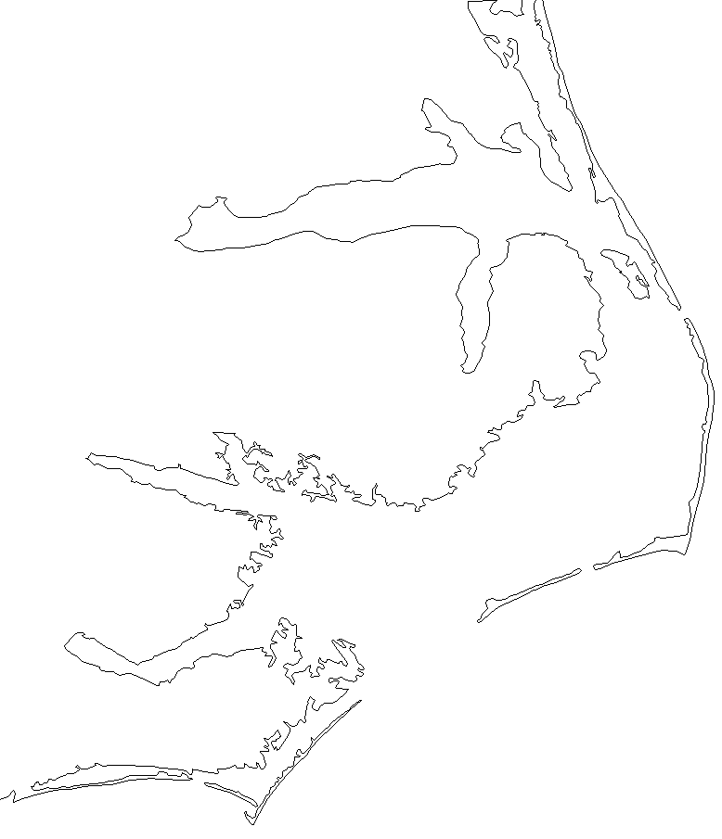
Measuring feature length
Vector representation of NC coastline
NC State GIS official coastline
World Map 1:10M
1km=0.1mm
narrow barrier islands
are not represented

Slide 10
Raster map buffer operations
Proximity analysis function
creates buffer zones (equal distance zones) from a given feature (point, line or area)
applies to raster map layers representing discrete objects
resolution should be sufficiently higher (cell size should be n-times smaller) than distances (buffer widths)

Slide 11
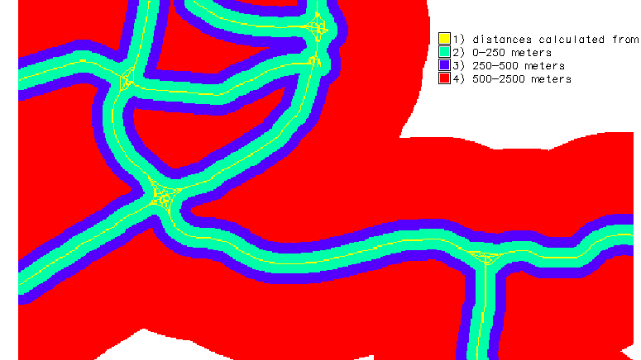
Raster map buffer: lines
Draws the requested distance rings around each cell with the given category: line buffer example

Slide 12
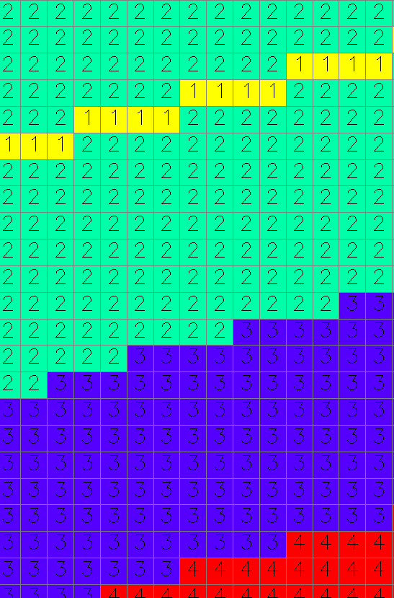
Raster map buffer: lines
Distances are measured from center of cell to center of cell – use multiples of cell size for buffer distance
highway
Cat 2: 0-250m
8x30=240m
for 30m raster
Cat 3: 250-500m
(8+9)x30=510m
We have buffers – now what?

Slide 13
Raster map buffer operations
Combine buffer operation with map algebra to solve zone of influence or proximity tasks
Example: find developed areas within 250m, 500m and 2500m distance from highways and classify them as high, moderate and low noise impact.
Given land use map land, with developed areas represented by category 1 and 2 and buffer map rbuff we find developed areas impacted by noise as
noise_impact=if(land==1 || land == 2 && rbuff, rbuff, null())
if ( a, b, c) means
if statement a is TRUE (the cell is developed land AND inside buffer)
do b (assign cell the value from the rbuff map)
if statement a is FALSE
do c (assign cell the null value)

Slide 14
Raster map buffer operations
Result is a map that shows developed areas with high, moderate and low noise impact that can be used to plan noise monitoring and addition of noise barriers
source
high
moderate
low

Slide 15
Raster map buffer operations
Are there any schools affected in high and moderate noise area? If yes, how many students?
How can we find how many people are affected ? Can we do an accurate estimate?
Given the school capacity raster map school_cap and buffer map rbuff we find schools impacted by noise as
schools_noise=if(school_cap && rbuff < 4, school_cap, null())
number of students affected
r.sum schools_noise
Note1: To create schools_cap map we convert vector point map to raster using capacity attribute for value and school name for label
Note2: if (a,b,c) here means:
if the cell in school_cap is TRUE (has any value except for null) AND cell value in rbuff is less than 4, assign the cell the value from the school_cap map, if the statement a is FALSE, assign null

Slide 16
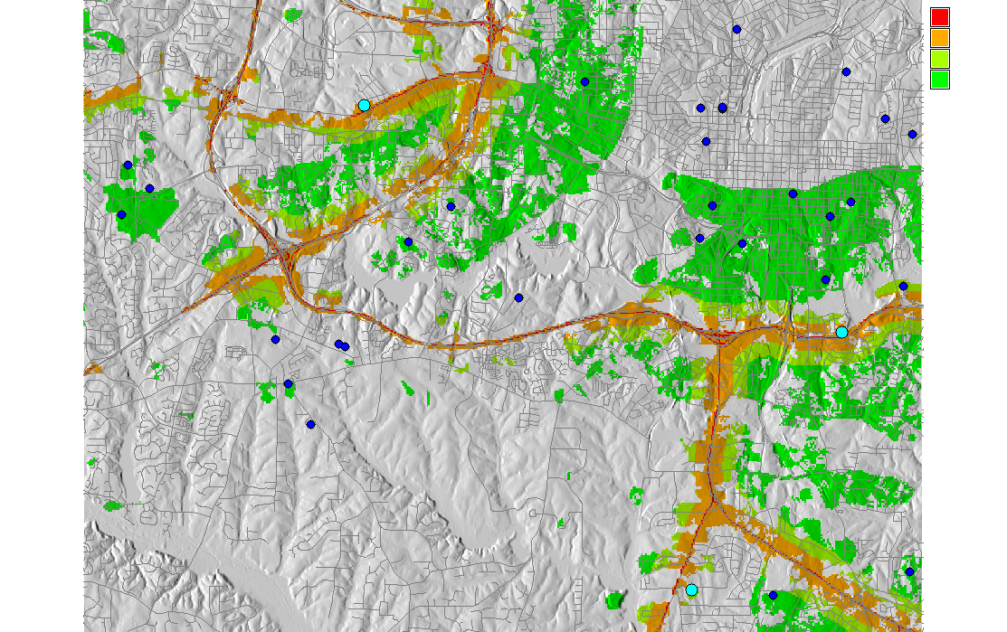
Raster map buffer operations
Location of schools affected by noise, number of students: 966
source
high
moderate
low
schools noise
high impact
moderate and less

Slide 17
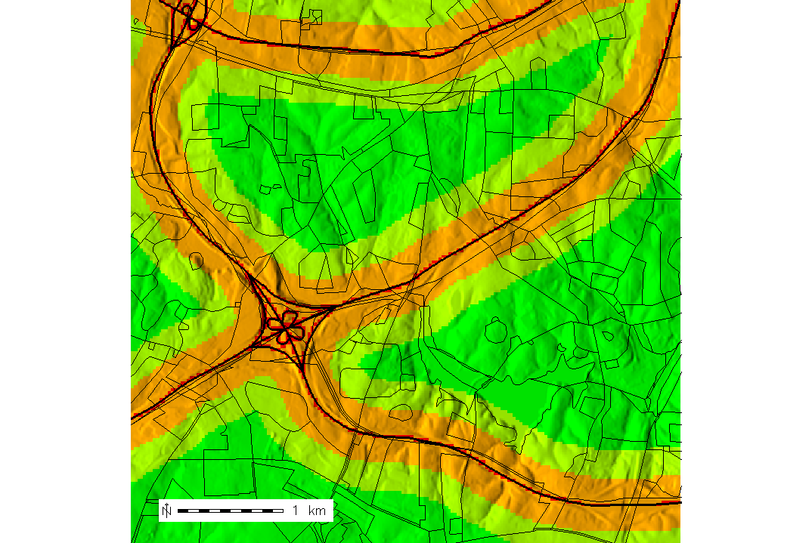
Raster map buffer operations
Overlay with census block: number of people affected?
701 people in the block
109 children
To estimate number of people in the high impact zone:
uniform distribution assumption
additional information about homes

Slide 18
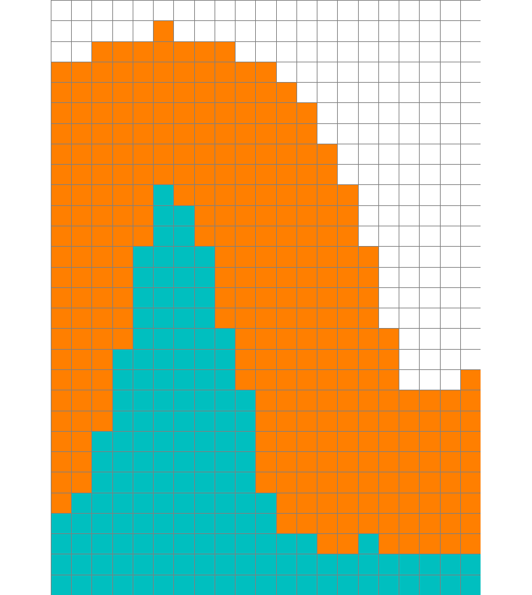
Raster map buffer: areas
Area Buffers:
Euclidean and Manhattan distance metrics

Slide 19
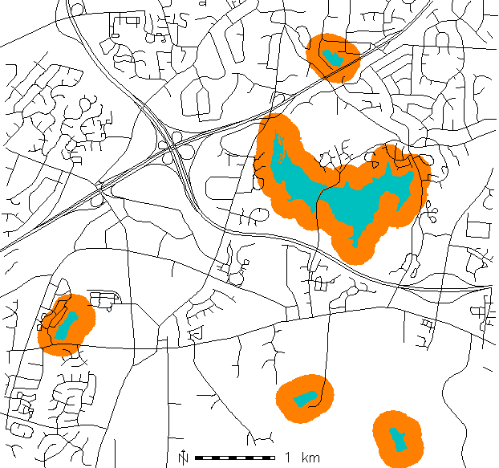
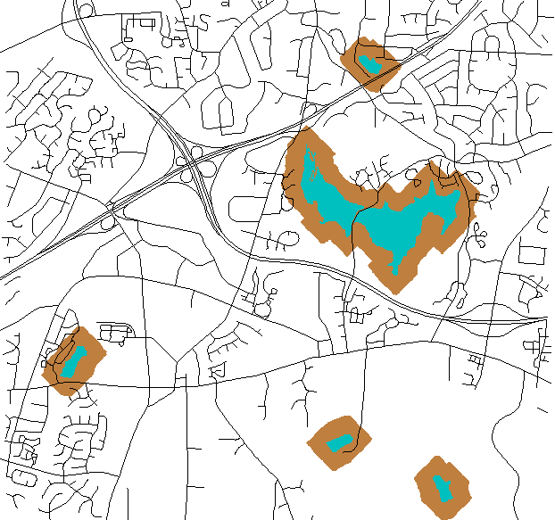
Raster map buffer areas
Area Buffers:
Find locations within walking distance from lakes
Euclidian and Manhattan distance metrics

Slide 20
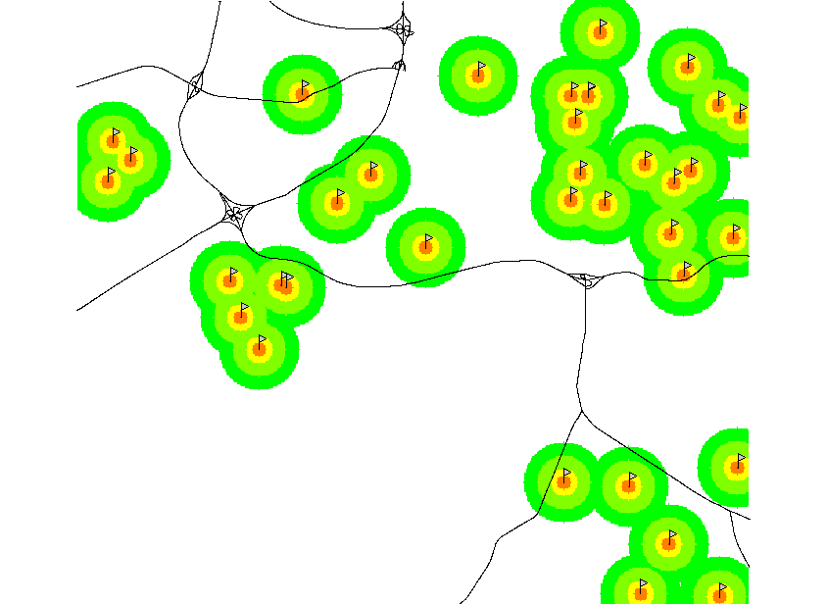
Raster map buffer: points
Point buffers:
Identify schools that do not have any vegetation within 900m distance
first create point buffers
1 school
2 150m
3 300m
4 600m
5 900m

Slide 21
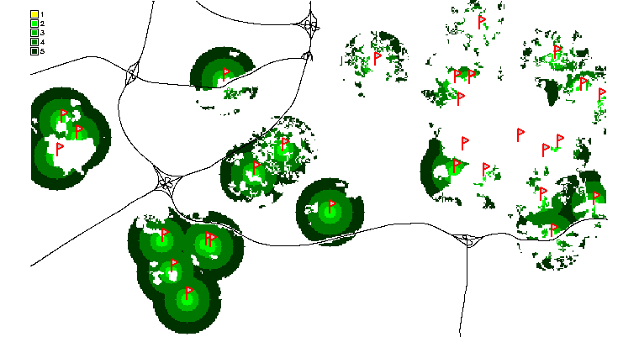
Raster map buffer operations
Point buffers:
overlay point buffers with land use using map algebra
1 school
2 150m
3 300m
4 600m
5 900m
1998
land cover

Slide 22
Cost surfaces
Cumulative (accumulated) cost surface:
raster representation of cumulative cost of reaching the target point(s) from any location in the given region.
Input cost map
value assigned to a cell represents cost of traversing that cell, e.g. time estimated from:
inverse of speed limit for driving,
slope and/or vegetation density for walking
Notes:
Intro - this has been already covered

Slide 23
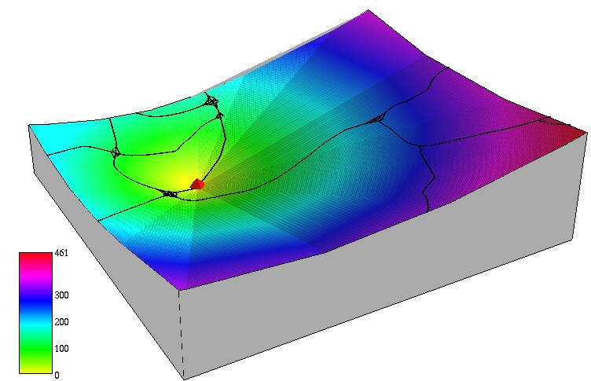
Cost surfaces: cost=1
If cost for each cell is 1: proximity surface
shortest path from each cell to the target point
Notes:
Intro - this has been already covered

Slide 24
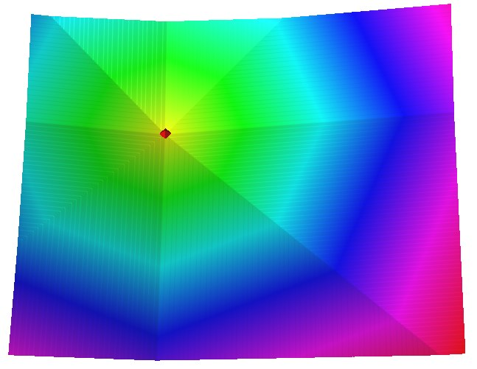
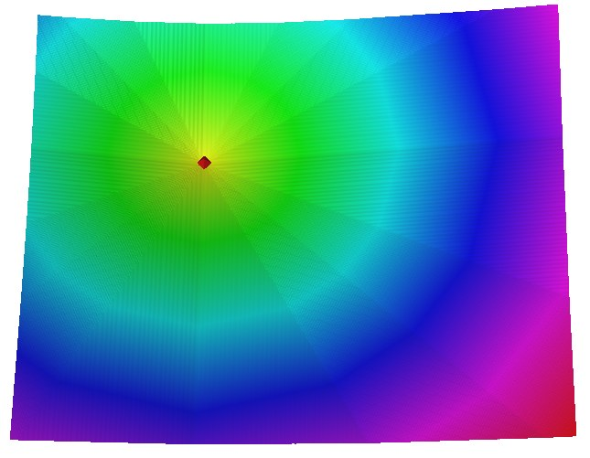
Cost surfaces: measuring distance
. K . . K .
. . . . . . . . .
K . X . X . X . K
. . . . . . . . .
. X . O . X .
. . . . . . . . .
K . X . X . X . K
. . . . . . . . .
. K . . K .
To measure the distance, traverse the region in:
standard 8 directions,
Knight 16 directions
Notes:
Intro - this has been already covered

Slide 25
Cost surfaces: cost map
if cost is spatially variable: define cost map by computing cost to traverse a cell
cost can be based on time, energy, etc.
Example: cost surface derived as minimum time t[s] needed to traverse a grid cell with resolution s[m]
t = s / v_{max}
where, v_{max} is speed limit map (convert [mi/hr] to [m/s])
Cost map is computed using map algebra.
Notes:
Intro - this has been already covered

Slide 26
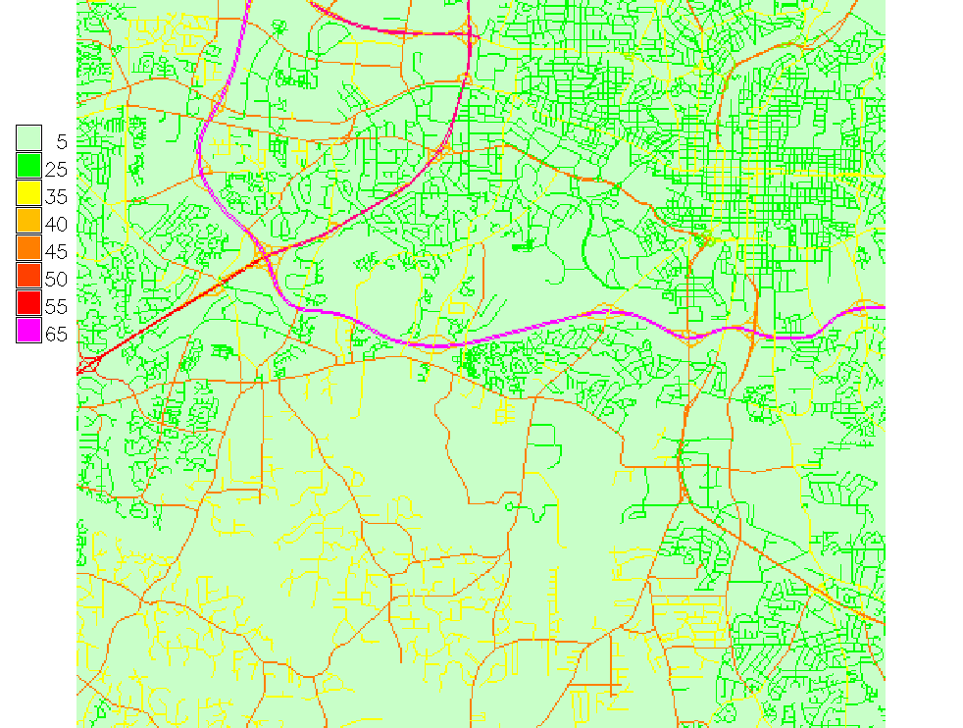
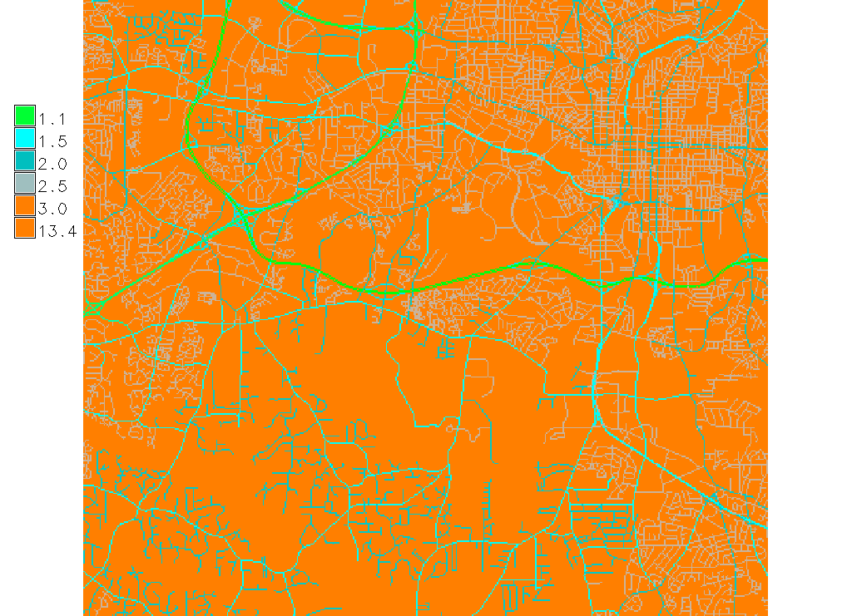
Cost surfaces: cost map
Deriving a cost map from speed limit, as time to traverse a 30m cell [seconds]
off-road cells are assigned to 5 mi/hr, for realistic travel time per cell
speed limit [mi/hr]
time to traverse a 30m cell [seconds]
Notes:
Intro - this has been already covered

Slide 27
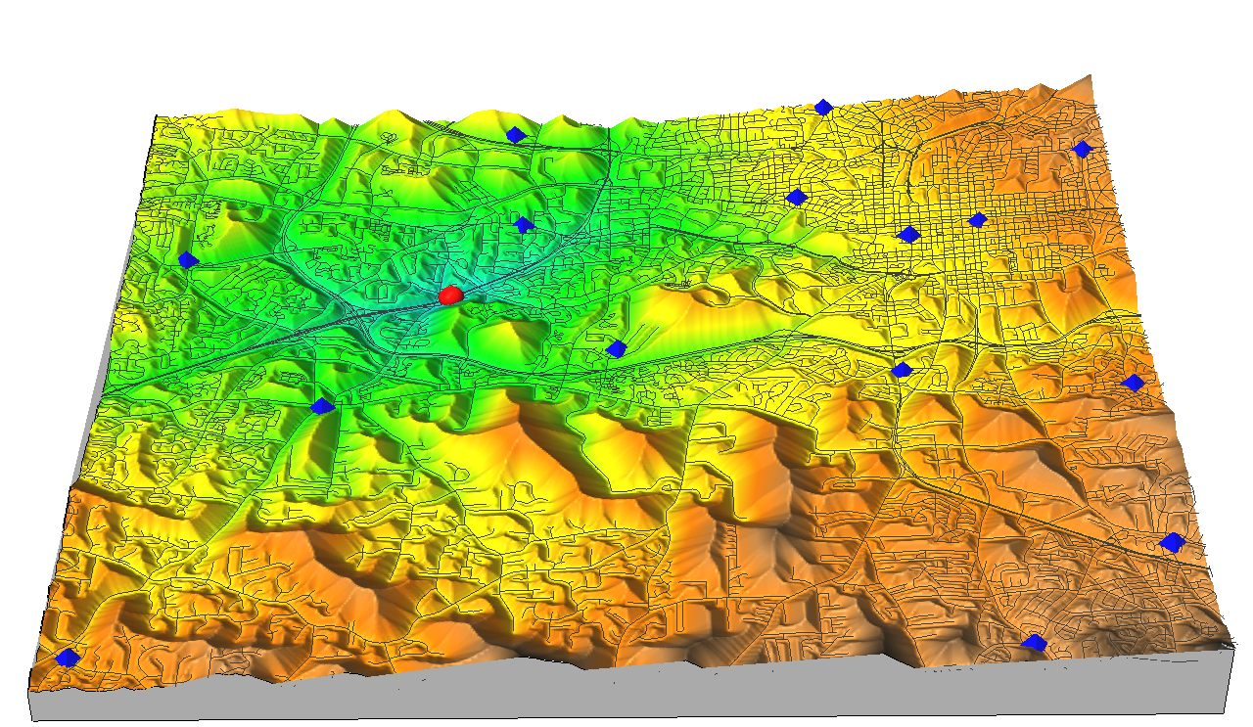
Cumulative cost surfaces
Cumulative cost surface: time to reach the point A,
the higher the hill the more time it takes to reach A
Application: locate the firestation that can reach the accident the fastest and identify the shortest path
accident
firestations
A
Notes:
Intro - this has been already covered

Slide 28
Least cost path
using the cumulative cost surface, find the least cost (fastest) path to the target point
least cost path (LCP) follows the steepest slope line, equivalent to flow routing with terrain replaced by cost surface
depending on algorithm used for flow routing depressions or flats in cost surface may lead to wrong results
save the directions used for creating the cumulative cost surface as back-link and compute LCP as tracked path
Notes:
Intro - this has been already covered

Slide 29
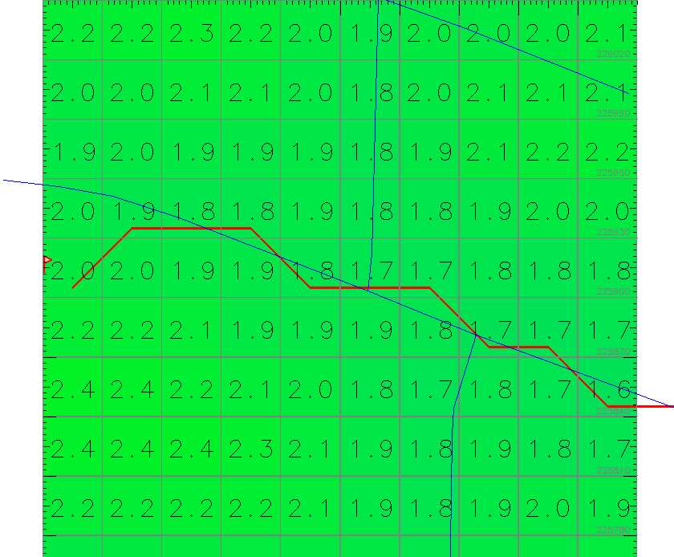
Least cost path
gradient line: similar to flow routing with terrain replaced by the cumulative cost surface
backlink: trace back the shortest path along cumulative cost surface gradient
roads
least cost path
Notes:
Intro - this has been already covered

Slide 30
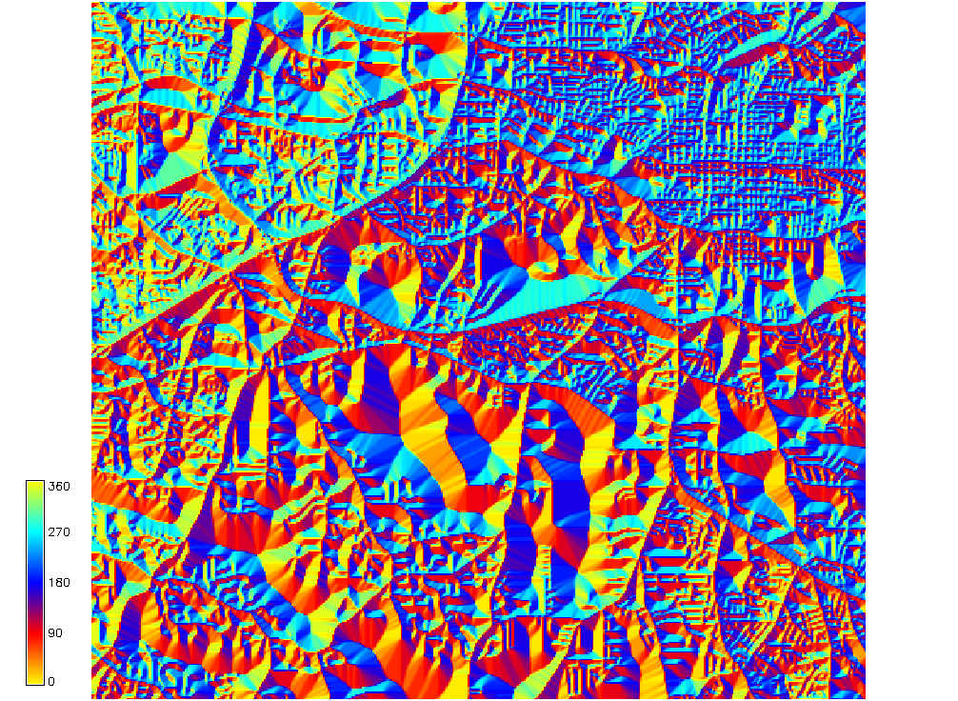
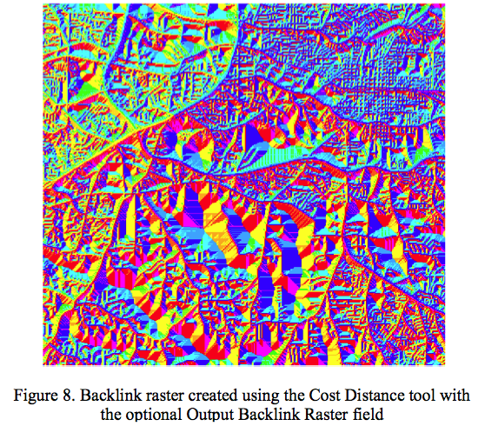
Least cost path: backlink raster
gradient direction map: direction of least cost path to the target from all grid cells = backlink map
Aspect map derived from
the cumulative cost cost surface
using r.slope.aspect, colored
consistently with Arc backlink output
0 yellow
90 red
180 blue
270 cyan
360 yellow
Figure from Amy Nau
Notes:
Intro - this has been already covered

Slide 31
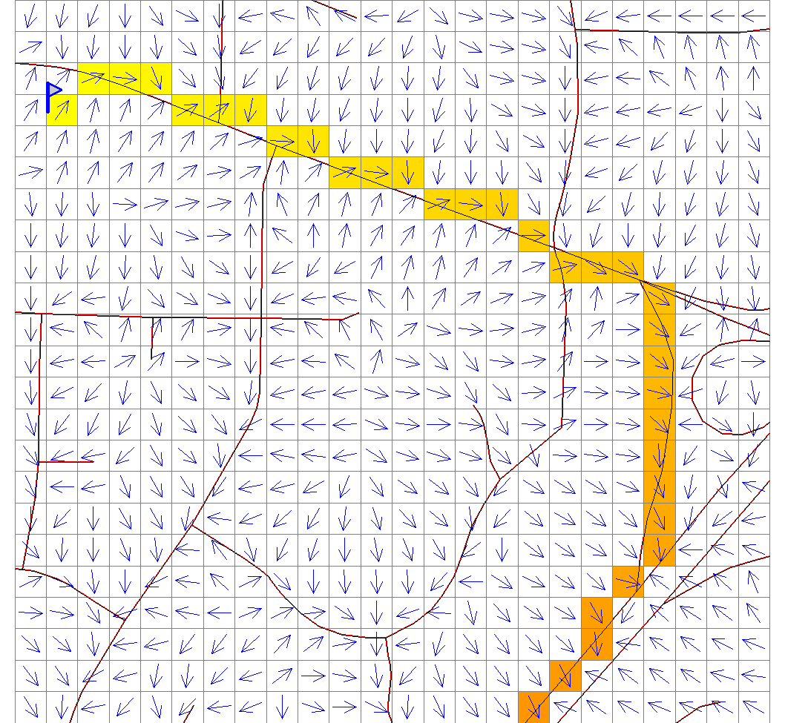
Least cost path: backlink raster
gradient direction map: direction of least cost path to the target from all grid cells = backlink map
Aspect map derived from
the cumulative cost cost surface
using r.slope.aspect, colored
consistently with Arc backlink output
0 yellow
90 red
180 blue
270 cyan
360 yellow
Notes:
Intro - this has been already covered

Slide 32
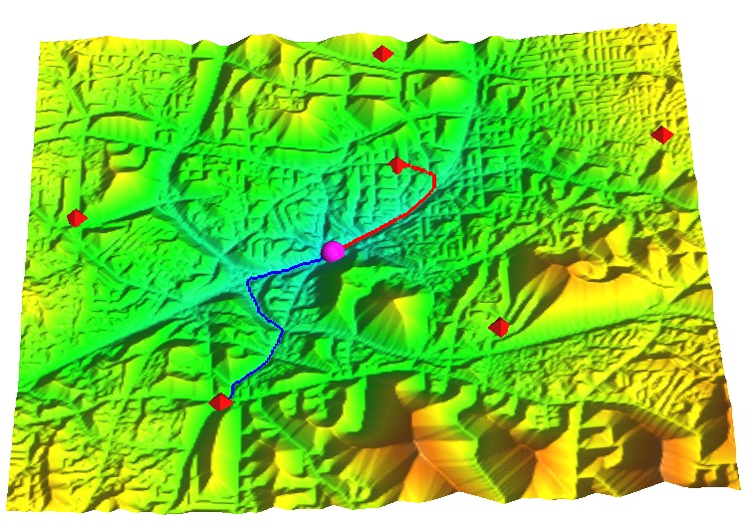
Least cost path
least cost path from two firestations (not shortest (Euclidean) distance in plane!)
wrong result if overpass is used as intersection
accident (target)
firestation (source)
least cost path
second LCP
Euclidean distance
overpass treated
as intersection
Notes:
Intro - this has been already covered

Slide 33
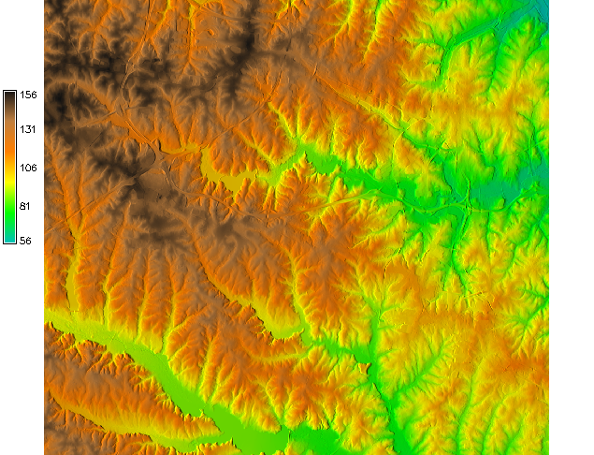
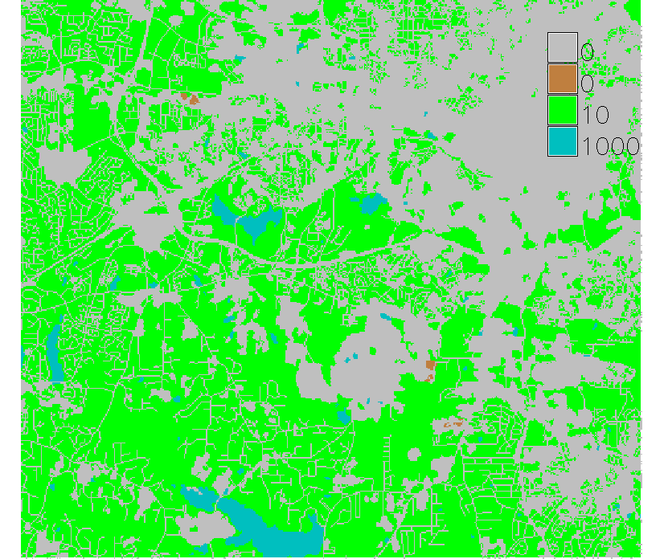
Cost surface and friction map
More complex cost map for walking combines elevation and friction map and differentiates between going upslope and downslope.
Inputs: Elevation - derive slope factor Friction is based on landuse

Slide 34
Cost surface and friction map
Example: Optimize search for lost person by mapping the distance that the person could have reached when walking from the given location in any direction
Friction is based on landuse:
low friction: developed areas, streets and roads
moderate friction: forest
extreme friction (barrier): lakes
Location where the person
was last seen

Slide 35
Cost surface for walking
t = a.ds + b.dh_{u} + c.dh_{md} + d.dh_{sd} + w.f
t [s] - time to traverse a cell
a,b,c,d [s/m] - cell distance and elevation difference weights, functions of inverse speed ~v⁻¹
ds [m] - distance across the cell
dh_{u}, dh_{md}, dh_{sd} [m] - elevation difference upslope, moderate downslope and steep downslope
w.f [s] - added time needed to traverse a cell due to friction, with f a friction map and w a weight
Walking upslope and steep downslope increase cost, moderate downslope decreases cost.
Default values for a,b,c,d are empirical coefficients, based on man walking effort at standard conditions.

Slide 36
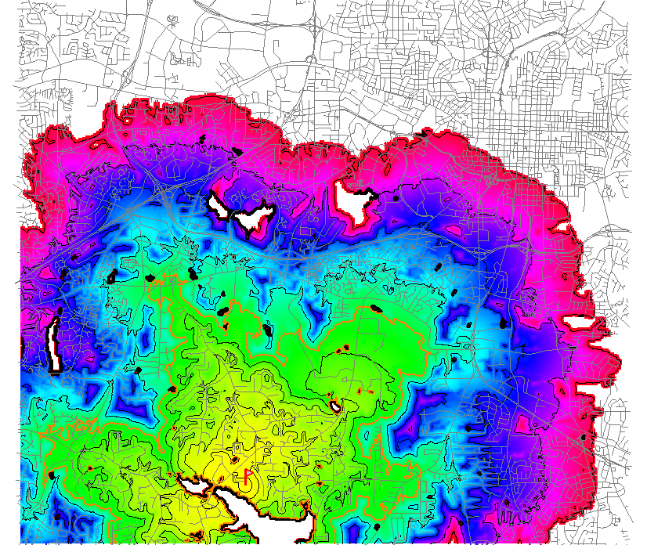
Cumulative cost surface
Map showing the time it will take walking person to get to each cell. Orange isochrone delineates search area for given time 1.5 hr
t[sec]
Notes:
Intro - this has been already covered

Slide 37
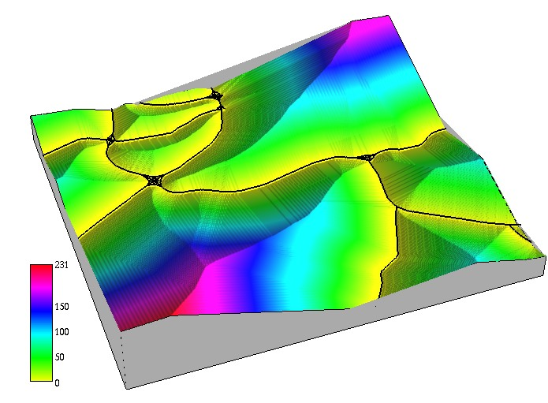
Cumulative cost surface from lines
Cumulative cost surface and least cost path can be performed for multiple targets including lines (treated at set of points)
If cost for each cell is 1, proximity surface
Example: Distance from major roads
Notes:
Intro - this has been already covered

Slide 38
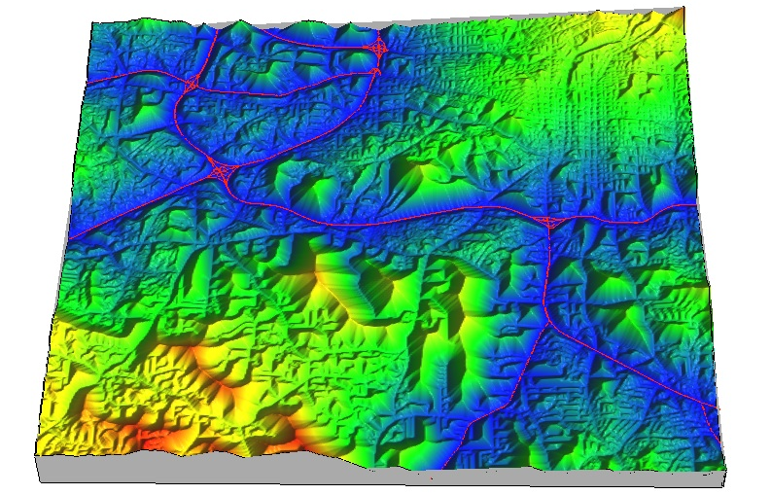
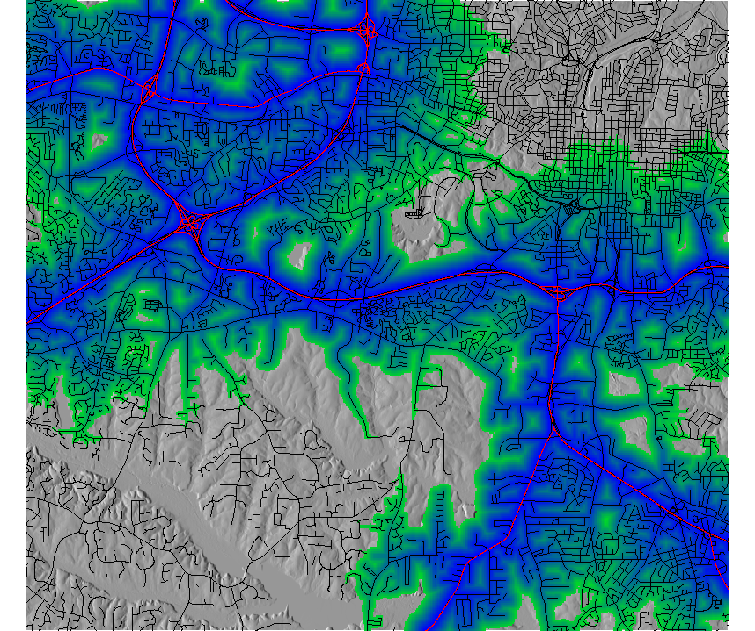
Cumulative cost surface from lines
If cost for each cell is based on inverse speed limit (minimum travel time), result is cumulative cost distance from major roads
For comparison,
cumulative
cost to point
areas within the cost distance
less than 3
Notes:
Intro - this has been already covered

Slide 39
Summary and references
measuring distance
http://en.wikipedia.org/wiki/Great_circle
buffers
Neteler ch. 5.4.2
cost surfaces, least cost path
Neteler ch. 5.4.3
deSmith, Goodchild, and Longley: Geospatial Analysis, http://www.spatialanalysisonline.com/
http://www.spatialanalysisonline.com/output/html/Accumulatedcostsurfacesandleastcostpaths.html
Berry, J.K. Beyond mapping III http://www.innovativegis.com/basis/MapAnalysis/Default.htm

